Slide 1
Podcast Plus: A Redux-Inspired Podcast App with Dynamic Themes for Android
Submitted by:
M Ahamed Yasik Sarvaththudeen
M Ahamed Mustafa
S Chandru
A Kamini
Rohan sharma

Slide 2
Description
A project that demonstrates the use of Android Jetpack Compose to build a UI for a podcast player app. The app allows users to choose , play and pause podcasts.

Slide 3
Required Depedencies
1. Android Essentials
AndroidX Libraries: Core libraries for backward compatibility, modern Android components, and utilities.
2. UI and Material Design
Material Components: Provides Material Design components and supports dynamic theming.
ConstraintLayout: For creating responsive and adaptable UI layouts.
3. Redux-Inspired State Management
Redux-Kotlin: Implements the Redux pattern for state management.
MVI (Model-View-Intent) Frameworks: Options like Orbit MVI or Mavericks help maintain unidirectional data flow, especially useful if using Jetpack Compose.
4. Dependency Injection
Hilt (Dagger): A DI library that simplifies dependency management and enables modularization.

Slide 4
5. Networking
Retrofit: For handling HTTP requests to fetch podcast data, episodes, etc.
OkHttp: A reliable HTTP client, often used with Retrofit for efficient network calls.
6. Coroutines and Asynchronous Programming
Kotlin Coroutines: For managing asynchronous tasks, especially for network requests and other background processing.
7. Local Data Storage
Room: A local database for offline storage, useful for caching episodes and user data.
DataStore: A lightweight data storage solution for settings, preferences, and UI themes.
8. Media Playback
ExoPlayer: A robust library for audio and video playback, ideal for handling podcast media.
9. Dynamic Themes and Theming Libraries
Dynamic Colors (Material You): Enables dynamic theming based on system settings, especially on Android 12 and newer.
10. Other Utilities
Timber: A logging library that simplifies and enhances debugging.

Slide 5
Program Code:
<?xml version="1.0" encoding="utf-8"?>
<manifest xmlns:android="http://schemas
.android.com/apk/res/android"
xmlns:tools="http://schemas.android.com/tools">
<application
android:allowBackup="true" android:dataExtractionRules="@xml/data_extraction_rules" android:fullBackupContent="@xml/backup_rules"
android:icon="@drawable/podcast_icon"
android:label="@string/app_name"
android:supportsRtl="true"
android:theme="@style/Theme.PodcastPlayer"
tools:targetApi="31">

Slide 6
<activity
android:name=".RegistrationActivity"
android:exported="false"
android:label="@string/title_activity_registration" android:theme="@style/Theme.PodcastPlayer" />
<activity
android:name=".MainActivity"
android:exported="false"
android:label="@string/title_activity_login" android:theme="@style/Theme.PodcastPlayer" />
<activity
android:name=".LoginActivity"
android:exported="true"
android:label="@string/app_name"
android:theme="@style/Theme.PodcastPlayer">
<intent-filter>
<action android:name="android.intent.action.MAIN" />

Slide 7
<category android:name="android.intent.category.LAUNCHER" />
</intent-filter>
</activity>
</application>
</manifest>
plugins {
id 'com.android.application'
id 'org.jetbrains.kotlin.android‘
}
android {
namespace 'com.example.podcastplayer'
compileSdk 33

Slide 8
defaultConfig {
applicationId "com.example.podcastplayer"
minSdk 21
targetSdk 33
versionCode 1
versionName "1.0“
testInstrumentationRunner “
androidx.test.runner.AndroidJUnitRunner"
vectorDrawables {
useSupportLibrary true
}
}
buildTypes {
release {
minifyEnabled false
proguardFiles getDefaultProguardFile('proguard-android-optimize.txt'), 'proguard-rules.pro'
}
}

Slide 9
compileOptions {
sourceCompatibility
JavaVersion.VERSION_1_8
targetCompatibility
JavaVersion.VERSION_1_8
}
kotlinOptions {
jvmTarget = '1.8'
}
buildFeatures {
compose true
}
composeOptions {
kotlinCompilerExtensionVersion '1.2.0'
}
packagingOptions {
resources {
excludes += '/META-INF/{AL2.0,LGPL2.1}'
} }}

Slide 10
dependencies {
implementation 'androidx.core:core-ktx:1.7.0'
implementation 'androidx.lifecycle:lifecycle-runtime-ktx:2.3.1'
implementation 'androidx.activity:activity-compose:1.3.1'
implementation "androidx.compose.ui:ui:$compose_ui_version"
implementation "androidx.compose.ui:ui-tooling-preview:
$compose_ui_version"
implementation 'androidx.compose.material:material:1.2.0'
testImplementation 'junit:junit:4.13.2'
androidTestImplementation 'androidx.test.ext:junit:1.1.5'
androidTestImplementation 'androidx.test.espresso:espresso-core:3.5.1'
androidTestImplementation "androidx.compose.ui:ui-test-junit4:
$compose_ui_version"
debugImplementation "androidx.compose.ui:ui-tooling:
$compose_ui_version"
debugImplementation "androidx.compose.ui:ui-test-manifest:
$compose_ui_version"
implementation 'androidx.room:room-common:2.5.0‘}

Slide 11
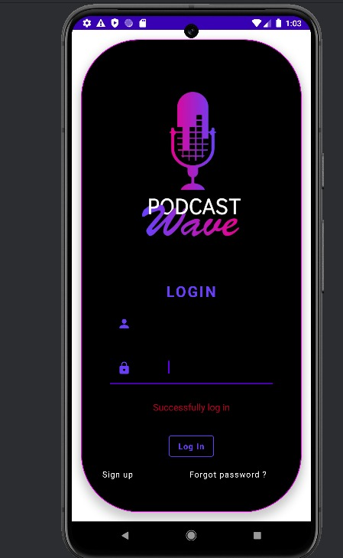
Output:

Slide 12
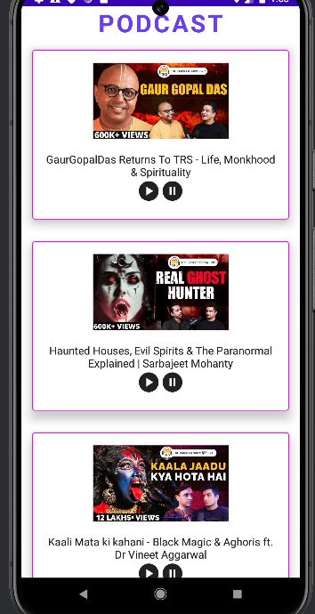

Slide 13
