Slide 1
Joining
Course Code: CSC 2108
Course Title: Introduction to Database
Dept. of Computer Science
Faculty of Science and Technology
Lecture No: | 13 | Semester:
Lecturer: | Nyme Ahmed [nyme.ahmed@aiub.edu]

Slide 2
Lecture Outline
After completing this lesson, you should be able to do the following:
  Write SELECT statements to access data from more than one table using equality and nonequality joins
  View data that generally does not meet a join condition by using outer joins
  Join a table to itself
Notes:
Lesson Aim
This lesson covers how to obtain data from more than one table, using the different methods available.

Slide 3
Obtaining Data from Multiple Tables
EMP
DEPT
EMPNO ENAME ... DEPTNO
------ ----- ... ------
7839 KING ... 10
7698 BLAKE ... 30
...
7934 MILLER ... 10
DEPTNO DNAME LOC
------ ---------- --------
10 ACCOUNTING NEW YORK
20 RESEARCH DALLAS
30 SALES CHICAGO
40 OPERATIONS BOSTON
EMPNO DEPTNO LOC
----- ------- --------
7839 10 NEW YORK
7698 30 CHICAGO
7782 10 NEW YORK
7566 20 DALLAS
7654 30 CHICAGO
7499 30 CHICAGO
...
14 rows selected.
Notes:
Data from Multiple Tables
Sometimes you need to use data from more than one table. In the slide example, the report displays data from two separate tables.
EMPNO exists in the EMP table.
DEPTNO exists in both the EMP and DEPT the tables.
LOC exists in the DEPT table.
To produce the report, you need to link EMP and DEPT tables and access data from both of them.
Class Management Note
In the slide, the DEPTNO column can come from either the EMP or the DEPT table.

Slide 4
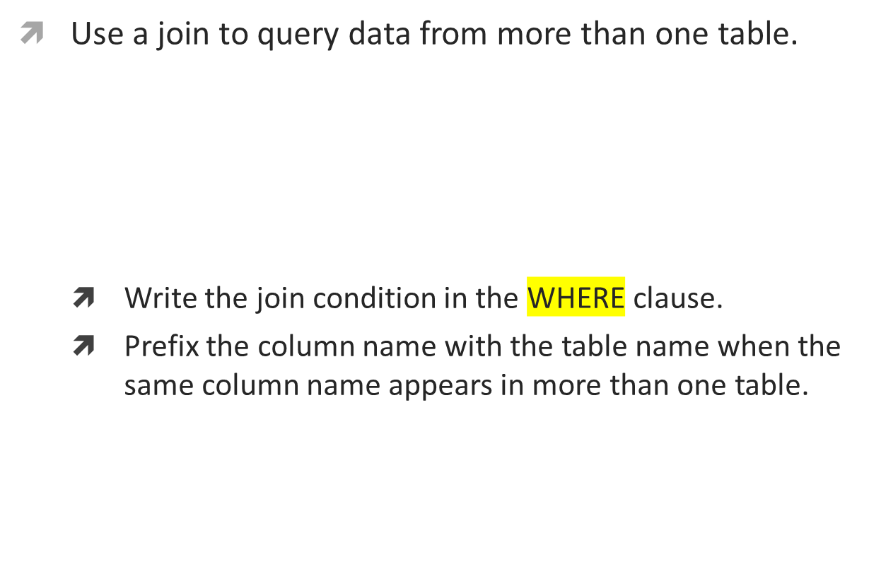
What Is a Join?
SELECT table1.column, table2.column
FROM table1, table2
WHERE table1.column1 = table2.column2;
Notes:
Defining Joins
When data from more than one table in the database is required, a join condition is used. Rows in one table can be joined to rows in another table according to common values existing in corresponding columns, that is, usually primary and foreign key columns.
To display data from two or more related tables, write a simple join condition in the WHERE clause. In the syntax:
table1.column denotes the table and column from which data is retrieved
table1.column1 = is the condition that joins (or relates) the tables together
table2.column2
Guidelines
When writing a SELECT statement that joins tables, precede the column name with the table name for clarity and to enhance database access.
If the same column name appears in more than one table, the column name must be prefixed with the table name.
To join n tables together, you need a minimum of (n-1) join conditions. Therefore, to join four tables, a minimum of three joins are required. This rule may not apply if your table has a concatenated primary key, in which case more than one column is required to uniquely identify each row.
For more information, see
Oracle Server SQL Reference Manual, Release 8, “SELECT.”

Slide 5
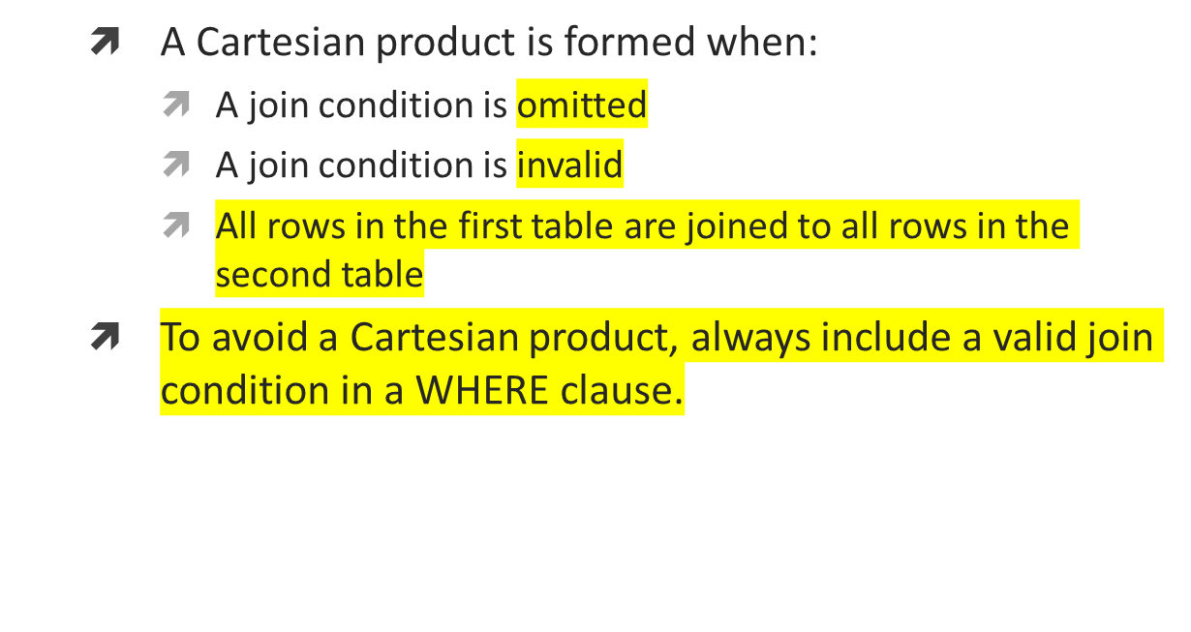
Cartesian Product
Notes:
Cartesian Product
When a join condition is invalid or omitted completely, the result is a Cartesian product in which all combinations of rows will be displayed. All rows in the first table are joined to all rows in the second table.
A Cartesian product tends to generate a large number of rows, and its result is rarely useful. You should always include a valid join condition in a WHERE clause, unless you have a specific need to combine all rows from all tables.

Slide 6
Generating a Cartesian Product
EMP (14 rows)
DEPT (4 rows)
EMPNO ENAME ... DEPTNO
------ ----- ... ------
7839 KING ... 10
7698 BLAKE ... 30
...
7934 MILLER ... 10
DEPTNO DNAME LOC
------ ---------- --------
10 ACCOUNTING NEW YORK
20 RESEARCH DALLAS
30 SALES CHICAGO
40 OPERATIONS BOSTON
ENAME DNAME
------ ----------
KING ACCOUNTING
BLAKE ACCOUNTING
...
KING RESEARCH
BLAKE RESEARCH
...
56 rows selected.
“Cartesian
product:
14*4=56 rows”
Notes:
Cartesian Product (continued)
A Cartesian product is generated if a join condition is omitted. The example on the slide displays employee name and department name from EMP and DEPT tables. Because no WHERE clause has been specified, all rows (14 rows) from the EMP table are joined with all rows (4 rows) in the DEPT table, thereby generating 56 rows in the output.
Class Management Note
Demo: l4cart.sql
Purpose: To illustrate executing a Cartesian product.
SQL> SELECT ename, dname
2 FROM emp, dept;
ENAME DNAME
---------- --------------
KING ACCOUNTING
BLAKE ACCOUNTING
...
KING RESEARCH
BLAKE RESEARCH
...
56 rows selected.

Slide 7




Types of Joins
Notes:
Types of Joins
There are two main types of join conditions:
Equijoins
Non-equijoins
Additional join methods include the following:
Outer joins
Self joins
Set operators
Note: Set operators are not covered in this course. They are covered in another SQL course.
Class Management Note
Do not get into details of all the types of joins. Explain each join one by one as is done in the following slides.

Slide 8
What Is an Equijoin?
EMP
DEPT
EMPNO ENAME DEPTNO
------ ------- -------
7839 KING 10
7698 BLAKE 30
7782 CLARK 10
7566 JONES 20
7654 MARTIN 30
7499 ALLEN 30
7844 TURNER 30
7900 JAMES 30
7521 WARD 30
7902 FORD 20
7369 SMITH 20
...
14 rows selected.
DEPTNO DNAME LOC
------- ---------- --------
10 ACCOUNTING NEW YORK
30 SALES CHICAGO
10 ACCOUNTING NEW YORK
20 RESEARCH DALLAS
30 SALES CHICAGO
30 SALES CHICAGO
30 SALES CHICAGO
30 SALES CHICAGO
30 SALES CHICAGO
20 RESEARCH DALLAS
20 RESEARCH DALLAS
...
14 rows selected.
Foreign key
Primary key
Notes:
Equijoins
To determine the name of an employee’s department, you compare the value in the DEPTNO column in the EMP table with the DEPTNO values in the DEPT table. The relationship between the EMP and DEPT tables is an equijoin—that is, values in the DEPTNO column on both tables must be equal. Frequently, this type of join involves primary and foreign key complements.
Note: Equijoins are also called simple joins or inner joins.
Class Management Note
Explain the use of decision matrix for simplifying writing joins. For example, if you want to display the name and department number of all the employees who are in the same department as Smith, you can start by making the following decision tree:
Now the SQL statement can be easily formulated by looking at the decision matrix. The first column gives the column list in the SELECT statement, the second column gives the tables for the FROM clause, and the third column gives the condition for the WHERE clause.

Slide 9
Retrieving Records with Equijoins
SQL> SELECT emp.empno, emp.ename, emp.deptno,
2 dept.deptno, dept.loc
3 FROM emp, dept
4 WHERE emp.deptno=dept.deptno;
EMPNO ENAME DEPTNO DEPTNO LOC
----- ------ ------ ------ ---------
7839 KING 10 10 NEW YORK
7698 BLAKE 30 30 CHICAGO
7782 CLARK 10 10 NEW YORK
7566 JONES 20 20 DALLAS
...
14 rows selected.
Notes:
Retrieving Records with Equijoins
In the slide example:
The SELECT clause specifies the column names to retrieve:
employee name, employee number, and department number, which are columns in the EMP table
department number, department name, and location, which are columns in the DEPT table
The FROM clause specifies the two tables that the database must access:
EMP table
DEPT table
The WHERE clause specifies how the tables are to be joined:
EMP.DEPTNO=DEPT.DEPTNO
Because the DEPTNO column is common to both tables, it must be prefixed by the table name to avoid ambiguity.

Slide 10
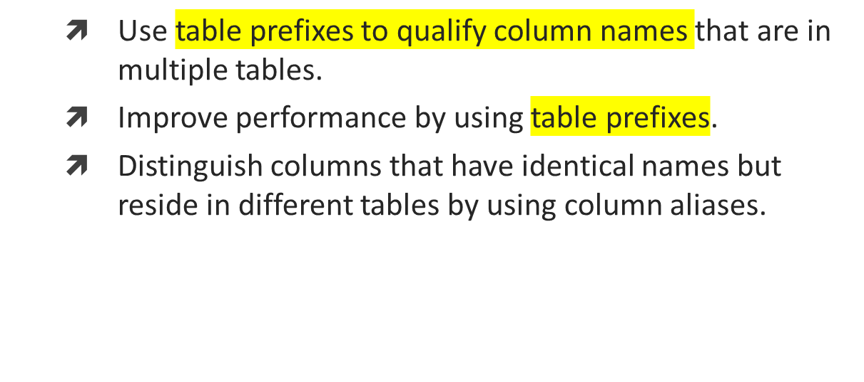
Qualifying Ambiguous Column Names
Notes:
Qualifying Ambiguous Column Names
You need to qualify the names of the columns in the WHERE clause with the table name to avoid ambiguity. Without the table prefixes, the DEPTNO column could be from either the DEPT table or the EMP table. It is necessary to add the table prefix to execute your query.
If there are no common column names between the two tables, there is no need to qualify the columns. However, you will gain improved performance by using the table prefix because you tell the Oracle Server exactly where to go to find columns.
The requirement to qualify ambiguous column names is also applicable to columns that may be ambiguous in other clauses, such as the SELECT clause or the ORDER BY clause.
Class Management Note
Demo: l4loc.sql
Purpose: To illustrate a SELECT clause with no aliases.

Slide 11
Additional Search Conditions
Using the AND Operator
EMP
DEPT
EMPNO ENAME DEPTNO
------ ------- -------
7839 KING 10
7698 BLAKE 30
7782 CLARK 10
7566 JONES 20
7654 MARTIN 30
7499 ALLEN 30
7844 TURNER 30
7900 JAMES 30
7521 WARD 30
7902 FORD 20
7369 SMITH 20
...
14 rows selected.
DEPTNO DNAME LOC
------ --------- --------
10 ACCOUNTING NEW YORK
30 SALES CHICAGO
10 ACCOUNTING NEW YORK
20 RESEARCH DALLAS
30 SALES CHICAGO
30 SALES CHICAGO
30 SALES CHICAGO
30 SALES CHICAGO
30 SALES CHICAGO
20 RESEARCH DALLAS
20 RESEARCH DALLAS
...
14 rows selected.
Notes:
Additional Search Conditions
In addition to the join, you may have criteria for your WHERE clause. For example, to display employee King’s employee number, name, department number, and department location, you need an additional condition in the WHERE clause.
SQL> SELECT empno, ename, emp.deptno, loc
2 FROM emp, dept
3 WHERE emp.deptno = dept.deptno
4 AND INITCAP(ename) = 'King';
EMPNO ENAME DEPTNO LOC
--------- ---------- --------- -------------
7839 KING 10 NEW YORK

Slide 12
Using Table Aliases
Simplify queries by using table aliases.
SQL> SELECT emp.empno, emp.ename, emp.deptno,
2 dept.deptno, dept.loc
3 FROM emp, dept
4 WHERE emp.deptno=dept.deptno;
SQL> SELECT e.empno, e.ename, e.deptno,
2 d.deptno, d.loc
3 FROM emp e, dept d
4 WHERE e.deptno=d.deptno;
Notes:
Table Aliases
Qualifying column names with table names can be very time consuming, particularly if table names are lengthy. You can use table aliases instead of table names. Just as a column alias gives a column another name, a table alias gives a table another name. Table aliases help to keep SQL code smaller, therefore using less memory.
Notice how table aliases are identified in the FROM clause in the example. The table name is specified in full, followed by a space and then the table alias. The EMP table has been given an alias of E, whereas the DEPT table has an alias of D.
Guidelines
Table aliases can be up to 30 characters in length, but the shorter they are the better.
If a table alias is used for a particular table name in the FROM clause, then that table alias must be substituted for the table name throughout the SELECT statement.
Table aliases should be meaningful.
The table alias is valid only for the current SELECT statement.

Slide 13
Joining More Than Two Tables
CUSTOMER
ORD
NAME CUSTID
----------- ------
JOCKSPORTS 100
TKB SPORT SHOP 101
VOLLYRITE 102
JUST TENNIS 103
K+T SPORTS 105
SHAPE UP 106
WOMENS SPORTS 107
... ...
9 rows selected.
CUSTID ORDID
------- -------
101 610
102 611
104 612
106 601
102 602
106 604
106 605
...
21 rows selected.
ITEM
ORDID ITEMID
------ -------
610 3
611 1
612 1
601 1
602 1
...
64 rows selected.
Notes:
Additional Search Conditions
Sometimes you may need to join more than two tables. For example, to display the name, the orders placed, the item numbers, the total for each item, and the total for each order for customer TKB SPORT SHOP, you will have to join the CUSTOMER, ORD, and ITEM tables.
SQL> SELECT c.name, o.ordid, i.itemid, i.itemtot, o.total
2 FROM customer c, ord o, item i
3 WHERE c.custid = o.custid
4 AND o.ordid = i.ordid
5 AND c.name = 'TKB SPORT SHOP';
NAME ORDID ITEMID ITEMTOT TOTAL
------------ --------- --------- --------- ---------
TKB SPORT SHOP 610 3 58 101.4
TKB SPORT SHOP 610 1 35 101.4
TKB SPORT SHOP 610 2 8.4 101.4

Slide 14
Non-Equijoins
EMP
SALGRADE
EMPNO ENAME SAL
------ ------- ------
7839 KING 5000
7698 BLAKE 2850
7782 CLARK 2450
7566 JONES 2975
7654 MARTIN 1250
7499 ALLEN 1600
7844 TURNER 1500
7900 JAMES 950
...
14 rows selected.
GRADE LOSAL HISAL
----- ----- ------
1 700 1200
2 1201 1400
3 1401 2000
4 2001 3000
5 3001 9999
“salary in the EMP
table is between
low salary and high
salary in the SALGRADE
table”
Notes:
Non-Equijoins
The relationship between the EMP table and the SALGRADE table is a non-equijoin, meaning that no column in the EMP table corresponds directly to a column in the SALGRADE table. The relationship between the two tables is that the SAL column in the EMP table is between the LOSAL and HISAL column of the SALGRADE table. The relationship is obtained using an operator other than equal (=).

Slide 15
Retrieving Records with Non-Equijoins
SQL> SELECT e.ename, e.sal, s.grade
2 FROM emp e, salgrade s
3 WHERE e.sal
4 BETWEEN s.losal AND s.hisal;
ENAME SAL GRADE
---------- --------- ---------
JAMES 950 1
SMITH 800 1
ADAMS 1100 1
...
14 rows selected.
Notes:
Non-Equijoins (continued)
The slide example creates a non-equijoin to evaluate an employee’s salary grade. The salary must be between any pair of the low and high salary ranges.
It is important to note that all employees appear exactly once when this query is executed. No employee is repeated in the list. There are two reasons for this:
None of the rows in the salary grade table contain grades that overlap. That is, the salary value for an employee can only lie between the low salary and high salary values of one of the rows in the salary grade table.
All of the employees’ salaries lie within the limits provided by the salary grade table. That is, no employee earns less than the lowest value contained in the LOSAL column or more than the highest value contained in the HISAL column.
Note: Other operators such as <= and >= could be used, but BETWEEN is the simplest. Remember to specify the low value first and the high value last when using BETWEEN. Table aliases have been specified for performance reasons, not because of possible ambiguity.

Slide 16
Books
Modern Database Management (Sixth Edition) by Fred R. McFadden, Jeffrey A. Hoffer, Mary B. Prescott
Database System Concepts (Fifth Edition) by Henry F. Korth, S. Sudarshan, A. Silberschatz
Oracle-database-10g-sql-fundamentals-1-student-guide-volume-1
SQL and Relational Theory: How to Write Accurate SQL Code by C.J. Date
Database Systems: A Practical Approach to Design, Implementation and Management (4th Edition) by Thomas M. Connolly, Carolyn E. Begg
Fundamentals of Database Systems, 5th Edition by RamezElmasri, Shamkant B. Navathe
Database Design and Relational Theory: Normal Forms and All That Jazz by C. J. Date
An Introduction to Database Systems 8th Edition, by C.J. Date

Slide 17
References
https://www.db-book.com/db6/slide-dir/index.html
https://docs.oracle.com/en/database/oracle/oracle-database/20/sqlrf/SQL-Standards.html#GUID-BCCCFF75-D2A4-43AD-8CAF-C3C97D92AC63
https://www.slideshare.net/HaaMeemMohiyuddin1/data-knowledge-and-information
https://www.slideshare.net/tabinhasan/from-data-to-wisdom
https://www.slideshare.net/thinnaphat.bo/

