Slide 1
Joining Continued
Course Code: CSC 2108
Course Title: Introduction to Database
Dept. of Computer Science
Faculty of Science and Technology
Lecture No: | 14 | Semester:
Lecturer: | Nyme Ahmed [nyme.ahmed@aiub.edu]

Slide 2
Lecture Outline
After completing this lesson, you should be able to do the following:
  Write SELECT statements to access data from more than one table using equality and nonequality joins
  View data that generally does not meet a join condition by using outer joins
  Join a table to itself
Notes:
Lesson Aim
This lesson covers how to obtain data from more than one table, using the different methods available.

Slide 3
Outer Joins
EMP
DEPT
ENAME DEPTNO
----- ------
KING 10
BLAKE 30
CLARK 10
JONES 20
...
DEPTNO DNAME
------ ----------
10 ACCOUNTING
30 SALES
10 ACCOUNTING
20 RESEARCH
...
40 OPERATIONS
No employee in the
OPERATIONS department
Notes:
Returning Records with No Direct Match with Outer Joins
If a row does not satisfy a join condition, the row will not appear in the query result. For example, in the equijoin condition of EMP and DEPT tables, department OPERATIONS does not appear because no one works in that department.
SQL> SELECT e.ename, e.deptno, d.dname
2 FROM emp e, dept d
3 WHERE e.deptno = d.deptno;
ENAME DEPTNO DNAME
---------- --------- -------------
KING 10 ACCOUNTING
BLAKE 30 SALES
CLARK 10 ACCOUNTING
JONES 20 RESEARCH
...
ALLEN 30 SALES
TURNER 30 SALES
JAMES 30 SALES
...
14 rows selected.

Slide 4
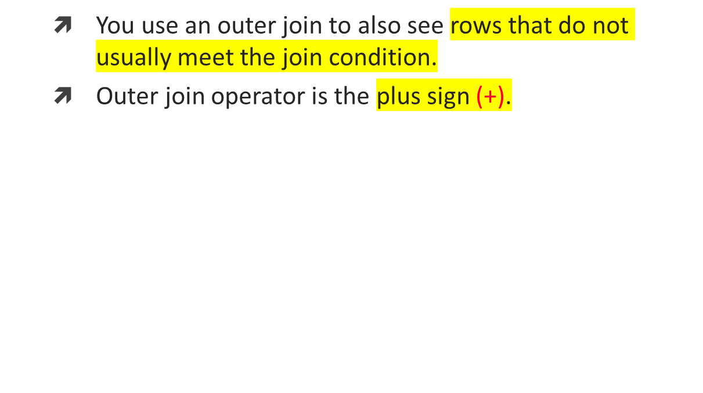
Outer Joins
SELECT table1.column, table2.column
FROM table1, table2
WHERE table1.column(+) = table2.column;
SELECT table1.column, table2.column
FROM table1, table2
WHERE table1.column = table2.column(+);
Notes:
Returning Records with No Direct Match with Outer Joins
The missing row(s) can be returned if an outer join operator is used in the join condition. The operator is a plus sign enclosed in parentheses (+), and it is placed on the “side” of the join that is deficient in information. This operator has the effect of creating one or more null rows, to which one or more rows from the nondeficient table can be joined.
In the syntax:
table1.column = is the condition that joins (or relates) the tables together.
table2.column (+) is the outer join symbol, which can be placed on either side of the
WHERE clause condition, but not on both sides (Place the outer
join symbol following the name of the column in the table without the matching rows.)
Class Management Note
Demo: l4ejoin.sql
Purpose: To illustrate an equijoin leading to an outer join.

Slide 5
Using Outer Joins
SQL> SELECT e.ename, d.deptno, d.dname
2 FROM emp e, dept d
3 WHERE e.deptno(+) = d.deptno
4 ORDER BY e.deptno;
ENAME DEPTNO DNAME
---------- --------- -------------
KING 10 ACCOUNTING
CLARK 10 ACCOUNTING
...
40 OPERATIONS
15 rows selected.
Notes:
Returning Records with No Direct Match with Outer Joins (continued)
The slide example displays numbers and names for all the departments. The OPERATIONS department, which does not have any employees, is also displayed.
Outer Join Restrictions
The outer join operator can appear on only one side of the expression—the side that has information missing. It returns those rows from one table that have no direct match in the other table.
A condition involving an outer join cannot use the IN operator or be linked to another condition by the OR operator.
Class Management Note
Demo: l4ojoin.sql
Purpose: To illustrate an outer join.

Slide 6
Self Joins
EMP (WORKER)
EMP (MANAGER)
EMPNO ENAME MGR
----- ------ ----
7839 KING
7698 BLAKE 7839
7782 CLARK 7839
7566 JONES 7839
7654 MARTIN 7698
7499 ALLEN 7698
EMPNO ENAME
----- --------
7839 KING
7839 KING
7839 KING
7698 BLAKE
7698 BLAKE
“MGR in the WORKER table is equal to EMPNO in the MANAGER table”
Notes:
Joining a Table to Itself
Sometimes you need to join a table to itself. To find the name of each employee’s manager, you need to join the EMP table to itself, or perform a self join. For example, to find the name of Blake’s manager, you need to:
Find Blake in the EMP table by looking at the ENAME column.
Find the manager number for Blake by looking at the MGR column. Blake’s manager number is 7839.
Find the name of the manager with EMPNO 7839 by looking at the ENAME column. King’s employee number is 7839, so King is Blake’s manager.
In this process, you look in the table twice. The first time you look in the table to find Blake in the ENAME column and MGR value of 7839. The second time you look in the EMPNO column to find 7839 and the ENAME column to find King.
Class Management Note
Show the data from the EMP table and point out how each manager is also an employee.

Slide 7
Joining a Table to Itself
SQL> SELECT worker.ename||' works for '||manager.ename
2 FROM emp worker, emp manager
3 WHERE worker.mgr = manager.empno;
WORKER.ENAME||'WORKSFOR'||MANAG
-------------------------------
BLAKE works for KING
CLARK works for KING
JONES works for KING
MARTIN works for BLAKE
...
13 rows selected.
Notes:
Joining a Table to Itself (continued)
The slide example joins the EMP table to itself. To simulate two tables in the FROM clause, there are two aliases, namely WORKER and MANAGER, for the same table, EMP.
In this example, the WHERE clause contains the join that means “where a worker’s manager number matches the employee number for the manager.”
Class Management Note
Point out the following to the students:
The column heading in the result of the query on the slide seems meaningless. A meaningful column alias should have been used instead.
There are only 13 rows in the output, but there are 14 rows in the EMP table. This occurs because employee King, who is the president, does not have a manager.

Slide 8




Summary
Notes:
Summary
There are multiple ways to join tables. The common thread, though, is that you want to link them through a condition in the WHERE clause. The method you choose will be based on the required result and the data structures that you are using.
Types of Joins
Equijoin
Non-equijoin
Outer join
Self join
Cartesian Products
Omission of the WHERE clause will result in a Cartesian product, in which all combinations of rows will be displayed.
Table Aliases
Table aliases speed up database access.
Table aliases can help to keep SQL code smaller, therefore conserving memory.
SELECT table1.column, table2.column
FROM table1, table2
WHERE table1.column1 = table2.column2;

Slide 9
Books
Modern Database Management (Sixth Edition) by Fred R. McFadden, Jeffrey A. Hoffer, Mary B. Prescott
Database System Concepts (Fifth Edition) by Henry F. Korth, S. Sudarshan, A. Silberschatz
Oracle-database-10g-sql-fundamentals-1-student-guide-volume-1
SQL and Relational Theory: How to Write Accurate SQL Code by C.J. Date
Database Systems: A Practical Approach to Design, Implementation and Management (4th Edition) by Thomas M. Connolly, Carolyn E. Begg
Fundamentals of Database Systems, 5th Edition by RamezElmasri, Shamkant B. Navathe
Database Design and Relational Theory: Normal Forms and All That Jazz by C. J. Date
An Introduction to Database Systems 8th Edition, by C.J. Date

Slide 10
References
https://www.db-book.com/db6/slide-dir/index.html
https://docs.oracle.com/en/database/oracle/oracle-database/20/sqlrf/SQL-Standards.html#GUID-BCCCFF75-D2A4-43AD-8CAF-C3C97D92AC63
https://www.slideshare.net/HaaMeemMohiyuddin1/data-knowledge-and-information
https://www.slideshare.net/tabinhasan/from-data-to-wisdom
https://www.slideshare.net/thinnaphat.bo/

