Slide 1
Creating Views
Course Code: CSC 2108
Course Title: Introduction to Database
Dept. of Computer Science
Faculty of Science and Technology
Lecture No: | 15 | Semester:
Lecturer: | Nyme Ahmed [nyme.ahmed@aiub.edu]

Slide 2
Lecture Outline
After completing this lesson, you should be able to do the following:
  Describe a view
  Create a view
  Retrieve data through a view
  Alter the definition of a view
  Insert, update, and delete data through
  a view
  Drop a view
Notes:
Lesson Aim
In this lesson, you will learn to create and use views. You will also learn to query the relevant data dictionary object to retrieve information about views.

Slide 3
Database Objects
Object
Table
View
Sequence
Index
Synonym
Description
Basic unit of storage; composed of rows
and columns
Logically represents subsets of data from
one or more tables
Generates primary key values
Improves the performance of some queries
Alternative name for an object

Slide 4
What Is a View?
EMP Table
EMPNO ENAME JOB MGR HIREDATE SAL COMM DEPTNO
----- -------- --------- ---- --------- ------ ----- -------
7839 KING PRESIDENT 17-NOV-81 5000 10
7782 CLARK MANAGER 7839 09-JUN-81 1500 300 10
7934 MILLER CLERK 7782 23-JAN-82 1300 10
7566 JONES MANAGER 7839 02-APR-81 2975 20
7788 SCOTT ANALYST 7566 09-DEC-82 3000 20
7876 ADAMS CLERK 7788 12-JAN-83 1100 20
7369 SMITH CLERK 7902 17-DEC-80 800 20
7902 FORD ANALYST 7566 03-DEC-81 3000 20
7698 BLAKE MANAGER 7839 01-MAY-81 2850 30
7654 MARTIN SALESMAN 7698 28-SEP-81 1250 1400 30
7499 ALLEN SALESMAN 7698 20-FEB-81 1600 300 30
7844 TURNER SALESMAN 7698 08-SEP-81 1500 0 30
7900 JAMES CLERK 7698 03-DEC-81 950 30
7521 WARD SALESMAN 7698 22-FEB-81 1250 500 30
EMPNO ENAME JOB MGR HIREDATE SAL COMM DEPTNO
----- ------- --------- ----- --------- ----- ----- -------
7839 KING PRESIDENT 17-NOV-81 5000 10
7698 BLAKE MANAGER 7839 01-MAY-81 2850 30
7782 CLARK MANAGER 7839 09-JUN-81 2450 10
7566 JONES MANAGER 7839 02-APR-81 2975 20
7654 MARTIN SALESMAN 7698 28-SEP-81 1250 1400 30
7499 ALLEN SALESMAN 7698 20-FEB-81 1600 300 30
7844 TURNER SALESMAN 7698 08-SEP-81 1500 0 30
7900 JAMES CLERK 7698 03-DEC-81 950 30
7521 WARD SALESMAN 7698 22-FEB-81 1250 500 30
7902 FORD ANALYST 7566 03-DEC-81 3000 20
7369 SMITH CLERK 7902 17-DEC-80 800 20
7788 SCOTT ANALYST 7566 09-DEC-82 3000 20
7876 ADAMS CLERK 7788 12-JAN-83 1100 20
7934 MILLER CLERK 7782 23-JAN-82 1300 10
EMPVU10 View
EMPNO ENAME JOB
------ -------- -----------
7839 KING PRESIDENT
7782 CLARK MANAGER
7934 MILLER CLERK
Notes:
What Is a View?
You can present logical subsets or combinations of data by creating views of tables. A view is a logical table based on a table or another view. A view contains no data of its own but is like a window through which data from tables can be viewed or changed. The tables on which a view is based are called base tables. The view is stored as a SELECT statement in the data dictionary.

Slide 5
Why Use Views?
  To restrict database access
  To make complex queries easy
  To allow data independence
  To present different views of the same data
Notes:
Advantages of Views
Views restrict access to the database because the view can display a selective portion of the database.
Views allow users to make simple queries to retrieve the results from complicated queries. For example, views allow users to query information from multiple tables without knowing how to write a join statement.
Views provide data independence for ad hoc users and application programs. One view can be used to retrieve data from several tables.
Views provide groups of users access to data according to their particular criteria.
For more information, see
Oracle Server SQL Reference, Release 8, “CREATE VIEW.”

Slide 6
Simple Views and Complex Views
Feature Simple Views Complex Views
Number of tables One One or more
Contain functions No Yes
Contain groups of data No Yes
DML through view Yes Not always
Notes:
Simple Views Versus Complex Views
There are two classifications for views: simple and complex. The basic difference is related to the DML (insert, update, and delete) operations.
A simple view is one that:
Derives data from only one table
Contains no functions or groups of data
Can perform DML through the view
A complex view is the one that:
Derives data from many tables
Contains functions or groups of data
Does not always allow DML through the view

Slide 7
Creating a View
  You embed a subquery within the CREATE VIEW statement.
  The subquery can contain complex SELECT syntax.
CREATE [OR REPLACE] [FORCE|NOFORCE] VIEW view
[(alias[, alias]...)]
AS subquery
[WITH CHECK OPTION [CONSTRAINT constraint]]
[WITH READ ONLY]
Notes:
Creating a View
You can create a view by embedding a subquery within the CREATE VIEW statement.
In the syntax:
OR REPLACE re-creates the view if it already exists
FORCE creates the view regardless of whether or not the base tables exist
NOFORCE creates the view only if the base tables exist (This is the default.)
view is the name of the view
alias specifies names for the expressions selected by the view’s query (The number of aliases must match the number of expressions selected by the view.)
subquery is a complete SELECT statement (You can use aliases for the columns in the SELECT list.)
WITH CHECK OPTION specifies that only rows accessible to the view can be inserted or updated
constraint is the name assigned to the CHECK OPTION constraint
WITH READ ONLY ensures that no DML operations can be performed on this view

Slide 8
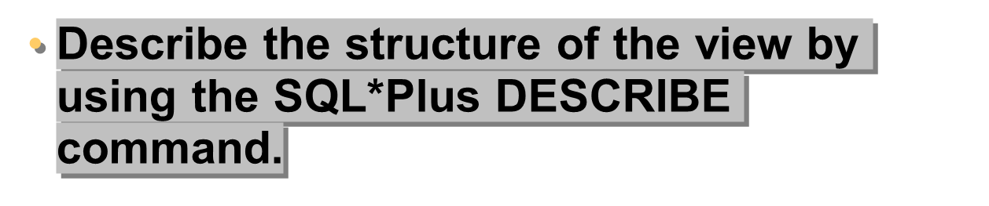
Creating a View
  Create a view, EMPVU10, that contains details of employees in department 10.
SQL> CREATE VIEW empvu10
2 AS SELECT empno, ename, job
3 FROM emp
4 WHERE deptno = 10;
View created.
SQL> DESCRIBE empvu10
Notes:
Creating a View (continued)
The example on the slide creates a view that contains the employee number, name, and job title for all the employees in department 10.
You can display the structure of the view by using the SQL*Plus DESCRIBE command.
Name Null? Type
------------------------------- -------- ------------
EMPNO NOT NULL NUMBER(4)
ENAME VARCHAR2(10)
JOB VARCHAR2(9)
Guidelines for creating a view:
The subquery that defines a view can contain complex SELECT syntax, including joins, groups, and subqueries.
The subquery that defines the view cannot contain an ORDER BY clause. The ORDER BY clause is specified when you retrieve data from the view.
If you do not specify a constraint name for a view created with the CHECK OPTION, the system will assign a default name in the format SYS_Cn.
You can use the OR REPLACE option to change the definition of the view without dropping and re-creating it or regranting object privileges previously granted on it.

Slide 9
Creating a View
  Create a view by using column aliases in the subquery.
  Select the columns from this view by the given alias names.
SQL> CREATE VIEW salvu30
2 AS SELECT empno EMPLOYEE_NUMBER, ename NAME,
3 sal SALARY
4 FROM emp
5 WHERE deptno = 30;
View created.
Notes:
Creating a View (continued)
You can control the column names by including column aliases within the subquery.
The example on the slide creates a view containing the employee number (empno) with the alias EMPLOYEE_NUMBER, name (ename) with the alias NAME, and salary (sal) with the alias SALARY for department 30.
Alternatively, you can control the column names by including column aliases in the CREATE VIEW clause.

Slide 10
Retrieving Data from a View
SQL> SELECT *
2 FROM salvu30;
EMPLOYEE_NUMBER NAME SALARY
--------------- ---------- ---------
7698 BLAKE 2850
7654 MARTIN 1250
7499 ALLEN 1600
7844 TURNER 1500
7900 JAMES 950
7521 WARD 1250
6 rows selected.
Notes:
Retrieving Data from a View
You can retrieve data from a view as you would from any table. You can either display the contents of the entire view or just view specific rows and columns.

Slide 11
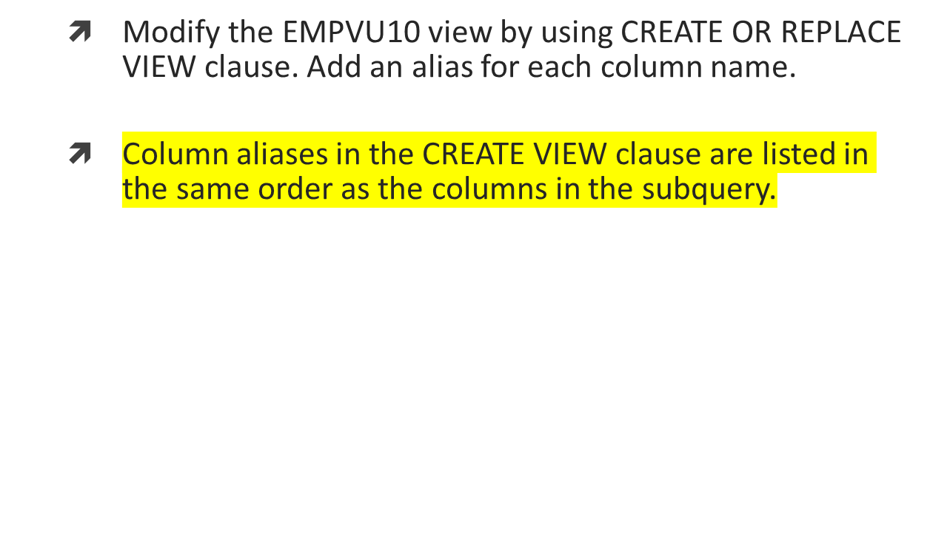
Modifying a View
SQL> CREATE OR REPLACE VIEW empvu10
2 (employee_number, employee_name, job_title)
3 AS SELECT empno, ename, job
4 FROM emp
5 WHERE deptno = 10;
View created.
Notes:
Modifying a View
The OR REPLACE option allows a view to be created even if one exists with this name already, thus replacing the old version of the view for its owner. This means that the view can be altered without dropping, re-creating, and regranting object privileges.
Note: When assigning column aliases in the CREATE VIEW clause, remember that the aliases are listed in the same order as the columns in the subquery.
Class Management Note
The OR REPLACE option started with Oracle7. With earlier versions of Oracle, if the view needed to be changed, it had to be dropped and re-created.
Demo: l12emp.sql
Purpose: To illustrate creating a view using aliases.

Slide 12
Creating a Complex View
Create a complex view that contains group functions to display values from two tables.
SQL> CREATE VIEW dept_sum_vu
2 (name, minsal, maxsal, avgsal)
3 AS SELECT d.dname, MIN(e.sal), MAX(e.sal),
4 AVG(e.sal)
5 FROM emp e, dept d
6 WHERE e.deptno = d.deptno
7 GROUP BY d.dname;
View created.
Notes:
Creating a Complex View
The example on the slide creates a complex view of the department names, minimum salary, maximum salary, and average salary by the department. Note that alternative names have been specified for the view. This is a requirement if any column of the view is derived from a function or an expression.
You can view the structure of the view by using the SQL*Plus DESCRIBE command. Display the contents of the view by issuing a SELECT statement.
SQL> SELECT *
2 FROM dept_sum_vu;
NAME MINSAL MAXSAL AVGSAL
-------------- --------- --------- ---------
ACCOUNTING 1300 5000 2916.6667
RESEARCH 800 3000 2175
SALES 950 2850 1566.6667

Slide 13
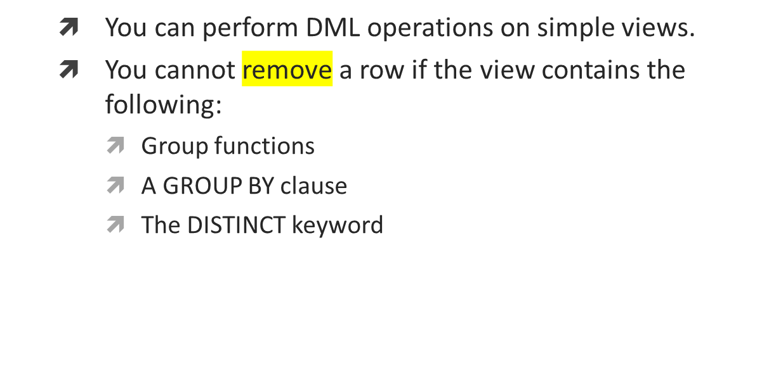
Rules for Performing DML Operations on a View
Notes:
Performing DML Operations on a View
You can perform DML operations on data through a view if those operations follow certain rules.
You can remove a row from a view unless it contains any of the following:
Group functions
A GROUP BY clause
The DISTINCT keyword

Slide 14
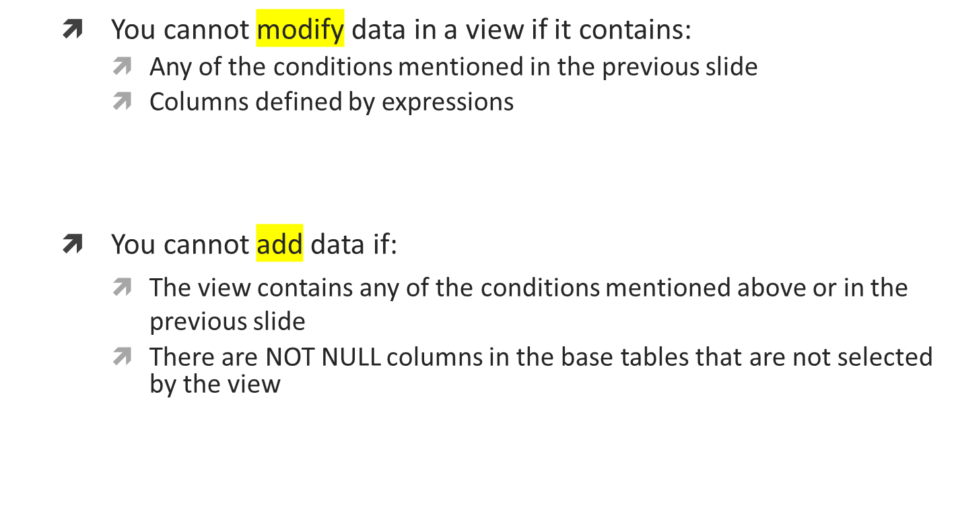
Rules for Performing DML Operations on a View
Notes:
Performing DML Operations on a View (continued)
You can modify data in a view unless it contains any of the conditions mentioned in the previous slide and any of the following:
Columns defined by expressions—for example, SALARY * 12
The ROWNUM pseudocolumn
You can add data through a view unless it contains any of the above and there are NOT NULL columns, without a default value, in the base table that are not selected by the view. All required values must be present in the view. Remember that you are adding values directly into the underlying table through the view.
For more information, see
0racle8 Server SQL Reference, Release 8, “CREATE VIEW.”
Class Management Note
Oracle7.3 and Oracle8 allow you, with some restrictions, to modify views that involve joins. The restrictions for DML operations described above also apply to join views. Any UPDATE, INSERT, or DELETE statement on a join view can modify only one underlying base table. If at least one column in the subquery join has a unique index, then it may be possible to modify one base table in a join view. You can query USER_UPDATABLE_COLUMNS to see whether the columns in a join view are updatable.
(For Page 12-16)
If the user does not supply a constraint name, the system assigns a name in the form SYS_Cn, where n is an integer that makes the constraint name unique within the system.
Demo: l12vu1.sql, l12vu2.sql
Purpose: To illustrate creating views with and without the CHECK OPTION.

Slide 15
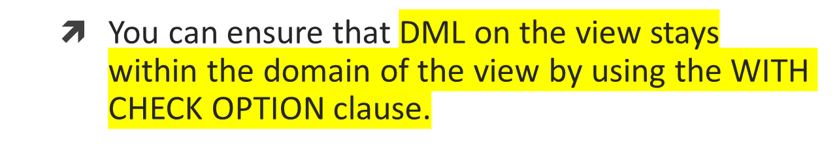
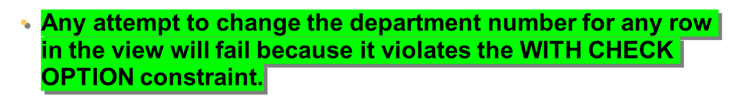
Using the WITH CHECK OPTION Clause
SQL> CREATE OR REPLACE VIEW empvu20
2 AS SELECT *
3 FROM emp
4 WHERE deptno = 20
5 WITH CHECK OPTION CONSTRAINT empvu20_ck;
View created.
Notes:
Using the WITH CHECK OPTION Clause
It is possible to perform referential integrity checks through views. You can also enforce constraints at the database level. The view can be used to protect data integrity, but the use is very limited.
The WITH CHECK OPTION clause specifies that INSERTS and UPDATES performed through the view are not allowed to create rows that the view cannot select, and therefore it allows integrity constraints and data validation checks to be enforced on data being inserted or updated.
If there is an attempt to perform DML operations on rows that the view has not selected, an error is displayed, with the constraint name if that has been specified.
SQL> UPDATE empvu20
2 SET deptno = 10
3 WHERE empno = 7788;
update empvu20
*
ERROR at line 1:
ORA-01402: view WITH CHECK OPTION where-clause violation
Note: No rows are updated because if the department number were to change to 10, the view would no longer be able to see that employee. Therefore, with the WITH CHECK OPTION clause, the view can see only department 20 employees and does not allow the department number for those employees to be changed through the view.

Slide 16
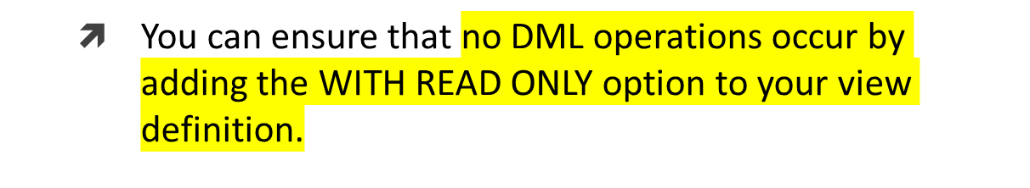
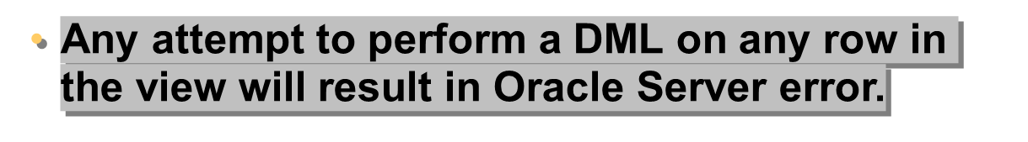
Denying DML Operations
SQL> CREATE OR REPLACE VIEW empvu10
2 (employee_number, employee_name, job_title)
3 AS SELECT empno, ename, job
4 FROM emp
5 WHERE deptno = 10
6 WITH READ ONLY;
View created.
Notes:
SQL> DELETE FROM empvu10
2 WHERE employee_number = 7782;
DELETE FROM empvu10
*
ERROR at line 1:
ORA-01752:Cannot delete from view without exactly one key-preserved
table
Denying DML Operations
You can ensure that no DML operations occur on your view by creating it with the WITH READ ONLY option. The example on the slide modifies the EMPVU10 view to prevent any DML operations on the view.
Any attempts to remove a row from the view will result in an error.
Any attempts to insert a row or modify a row using the view will result in Oracle Server error -01733: virtual column not allowed here.

Slide 17
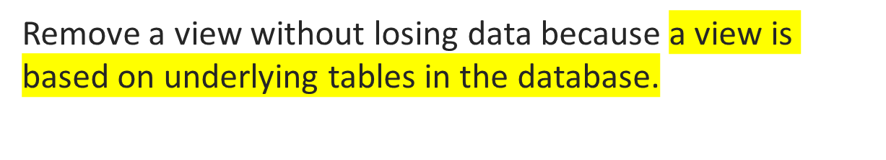
Removing a View
DROP VIEW view;
SQL> DROP VIEW empvu10;
View dropped.
Notes:
Removing a View
You use the DROP VIEW statement to remove a view. The statement removes the view definition from the database. Dropping views has no effect on the tables on which the view was based. Views or other applications based on deleted views become invalid. Only the creator or a user with the DROP ANY VIEW privilege can remove a view.
In the syntax:
view is the name of the view

Slide 18
Summary
  A view is derived from data in other tables or other views.
  A view provides the following advantages:
    Restricts database access
    Simplifies queries
    Provides data independence
    Allows multiple views of the same data
    Can be dropped without removing the underlying data
Notes:
What Is a View?
A view is based on a table or another view and acts as a window through which data on tables can be viewed or changed. A view does not contain data. The definition of the view is stored in the data dictionary. You can see the definition of the view in the USER_VIEWS data dictionary table.
Advantages of Views
Restrict database access
Simplify queries
Provide data independence
Allow multiple views of the same data
Remove views without affecting the underlying data
View Options
Can be a simple view based on one table
Can be a complex view based on more than one table or can contain groups or functions
Can be replaced if one of the same name exists
Contain a check constraint
Can be read-only

Slide 19
Books
Modern Database Management (Sixth Edition) by Fred R. McFadden, Jeffrey A. Hoffer, Mary B. Prescott
Database System Concepts (Fifth Edition) by Henry F. Korth, S. Sudarshan, A. Silberschatz
Oracle-database-10g-sql-fundamentals-1-student-guide-volume-1
SQL and Relational Theory: How to Write Accurate SQL Code by C.J. Date
Database Systems: A Practical Approach to Design, Implementation and Management (4th Edition) by Thomas M. Connolly, Carolyn E. Begg
Fundamentals of Database Systems, 5th Edition by RamezElmasri, Shamkant B. Navathe
Database Design and Relational Theory: Normal Forms and All That Jazz by C. J. Date
An Introduction to Database Systems 8th Edition, by C.J. Date

Slide 20
References
https://www.db-book.com/db6/slide-dir/index.html
https://docs.oracle.com/en/database/oracle/oracle-database/20/sqlrf/SQL-Standards.html#GUID-BCCCFF75-D2A4-43AD-8CAF-C3C97D92AC63
https://www.slideshare.net/HaaMeemMohiyuddin1/data-knowledge-and-information
https://www.slideshare.net/tabinhasan/from-data-to-wisdom
https://www.slideshare.net/thinnaphat.bo/

