Slide 1

Python Basics
By Ahammad Shawki

Slide 2

Object Oriented Programming in Python
By Ahammad Shawki

Slide 3
Command Line Fundamentals
By Ahammad Shawki

Slide 4

Standard Libraries of Python
By Ahammad Shawki

Slide 5
Data Structures and Algorithms in Python
By Ahammad Shawki

Slide 6
Playing With Pandas
By Ahammad Shawki

Slide 7
NumPy Journey
By Ahammad Shawki

Slide 8
Matplotlib Tutorials
By Ahammad Shawki

Slide 9
Fun Coding
By Ahammad Shawki

Slide 10
Idempotence
Permutation
Interpreter
Combination
API
GUI
Programming Terms
Memoization
Regex
By Ahammad Shawki
Dynamic Programming
Operator
Dry
Low-Level
Front-End
Iterators and Iterables
Bottom Up

Slide 11


Slide 12
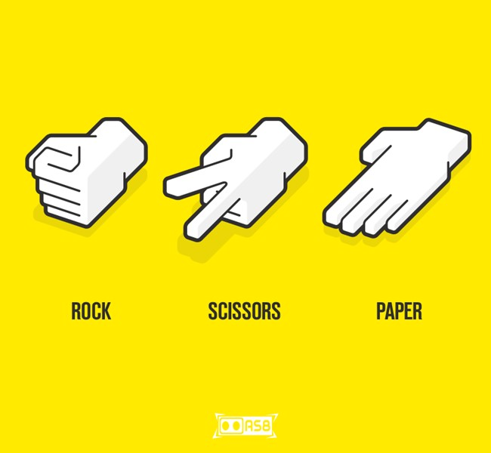

Slide 13
