Slide 1
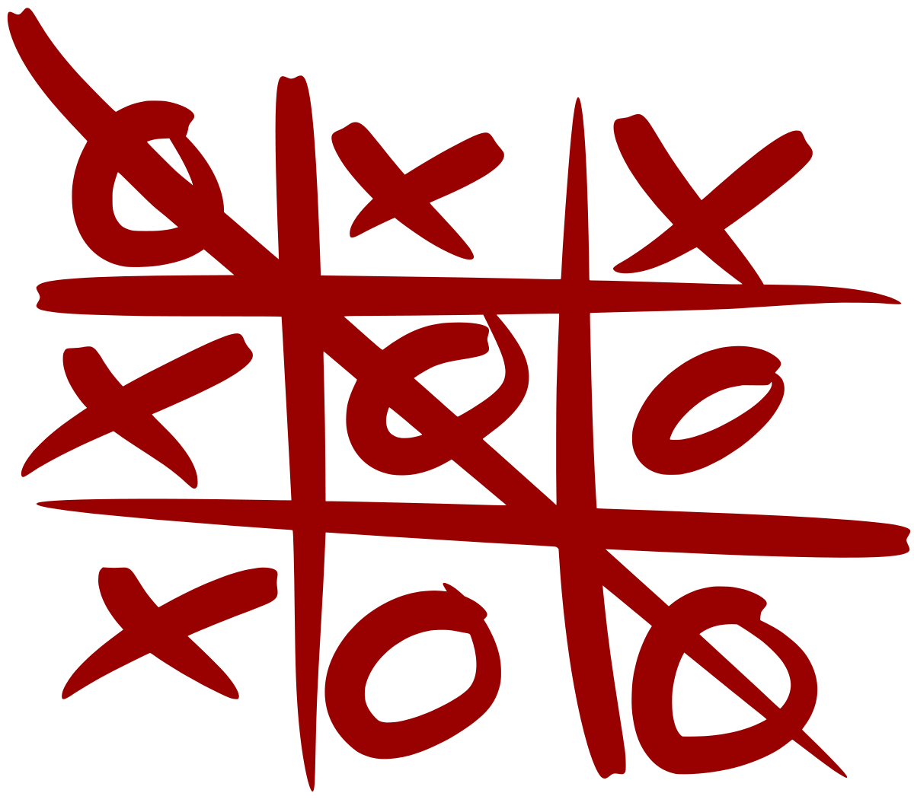
TIC
TAC
TURTLE

