Slide 1
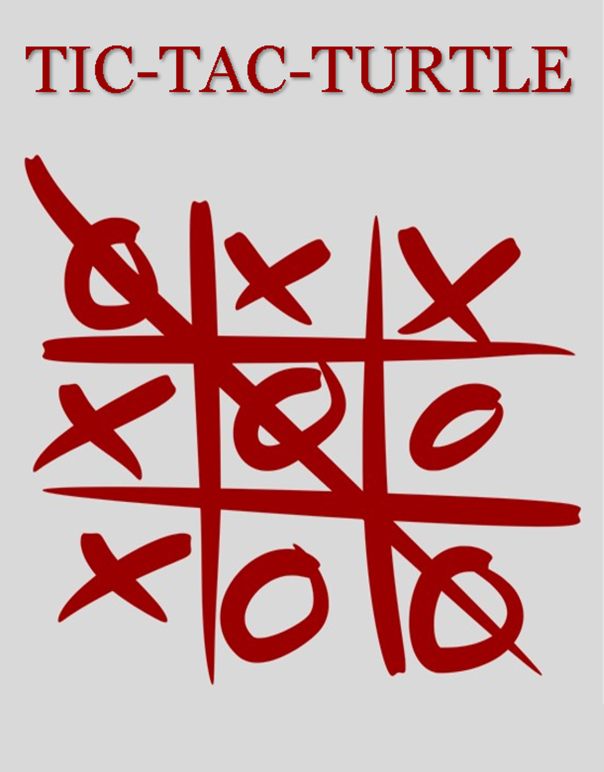



Slide 2
REMATCH?

Slide 3
THANKS FOR PLAYING
TIC-TAC-TURTLE.
-AHAMMAD SHAWKI

Slide 4
SPECIAL CREDIT GOES TO
ARKO CHOWDHURY
FOR
INITIAL ALGORITHMS

Slide 5


Slide 6


