Slide 1
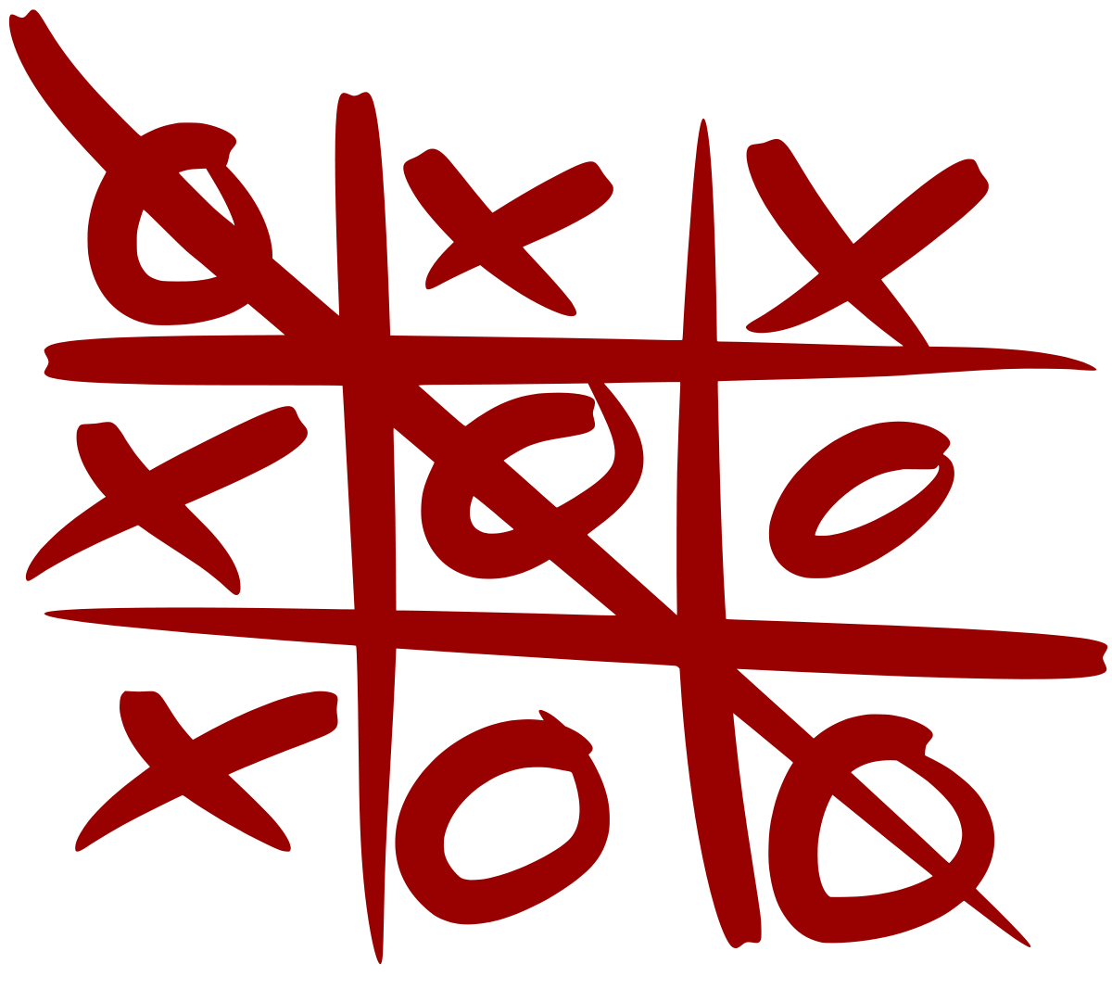
TICK
TAC
TURTLE

