Slide 1
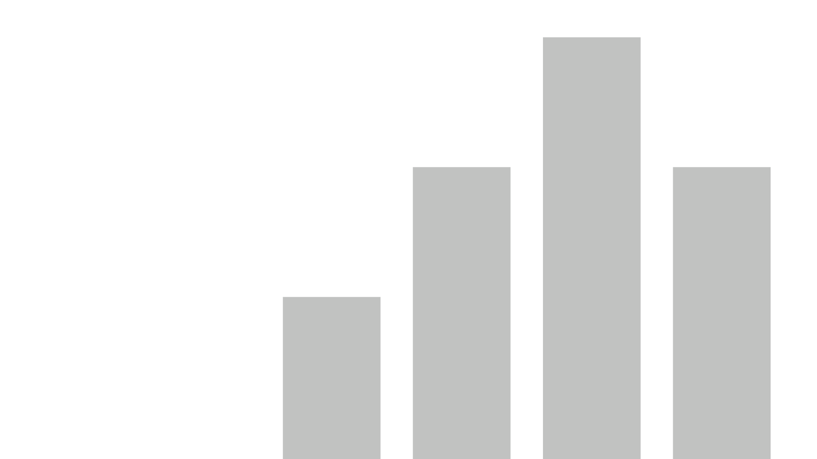


DATA PROFESSIONALS: SURVEY INSIGHTS
View in Power BI
By:
Abdulrahman Hamzat

Slide 2
TABLE OF CONTENT
Background
Project Description
List of Key Insights
Key Insights
Summary and Conclusion
Dashboard

Slide 3
BACKGROUND
The dataset used for this project is a survey of various data professionals created by AlexTheAnalyst. The survey, conducted in 2022, had 630 anonymous participants from around the globe. The dataset provides information on the participants’ current roles, current salaries, industries, favorite programming languages, genders, level of happiness with salaries, work-life balance, and more.

Slide 4
PROJECT DESCRIPTION
To better understand variations among the listed data professions, such as, popularity, salary, programming language, etc.
This will help to discover underlying trends based on the submitted responses.

Slide 5
LIST OF KEY INSIGHTS
Average salary by current job title.
Happiness with work-life balance and salary.
Most favorite programming language.
Career switch.
Count of current job titles.

Slide 6
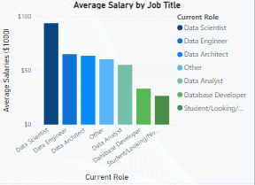
KEY INSIGHTS Average Salary By Current Job Title
Data scientists have the highest average salary of $93.78. $65.09 for the Data Engineers, and $55.30 for the Data analysts.

Slide 7
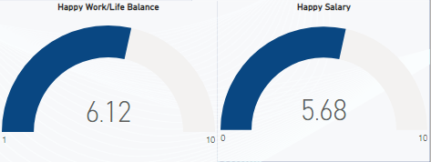
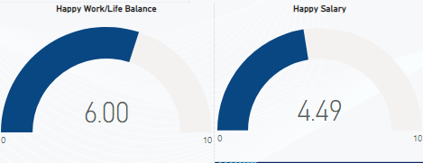
KEY INSIGHTS Happiness With Work-Life Balance And Salary
Data Scientists
Data Analysts
Both group of professionals have above average satisfaction with work-life balance. However, the data analysts have a below average score unlike the data scientists for salary satisfaction.

Slide 8
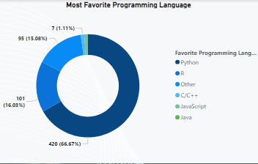
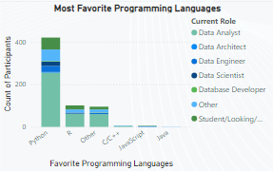
KEY INSIGHTS Most Favorite Programming Language
About 67% of participants chose Python as their favorite programming language while 16% chose R. Both are commonly used in all the data professions.

Slide 9
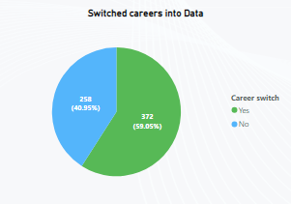
KEY INSIGHTS Career Switch
The majority of participants switched careers into various data professions.

Slide 10
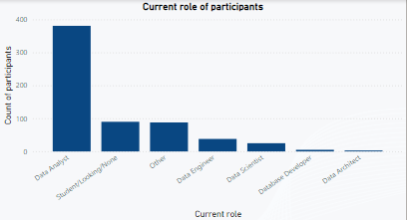
KEY INSIGHTS Count of Current Job Titles
381 Data Analysts; 38 Data Engineers; 25 Data Scientists; 5 Database Developers; and 3 Data Architects

Slide 11
SUMMARY AND CONCLUSION
The majority of survey participants are data analysts, and while they report a good work-life balance, their salary satisfaction is notably lower compared to data scientists. Python and R are widely used across all data professions, with Python emerging as the most popular, favored by 67% of respondents.
Data-related professions are becoming increasingly popular, with many respondents having transitioned into these careers.

Slide 12
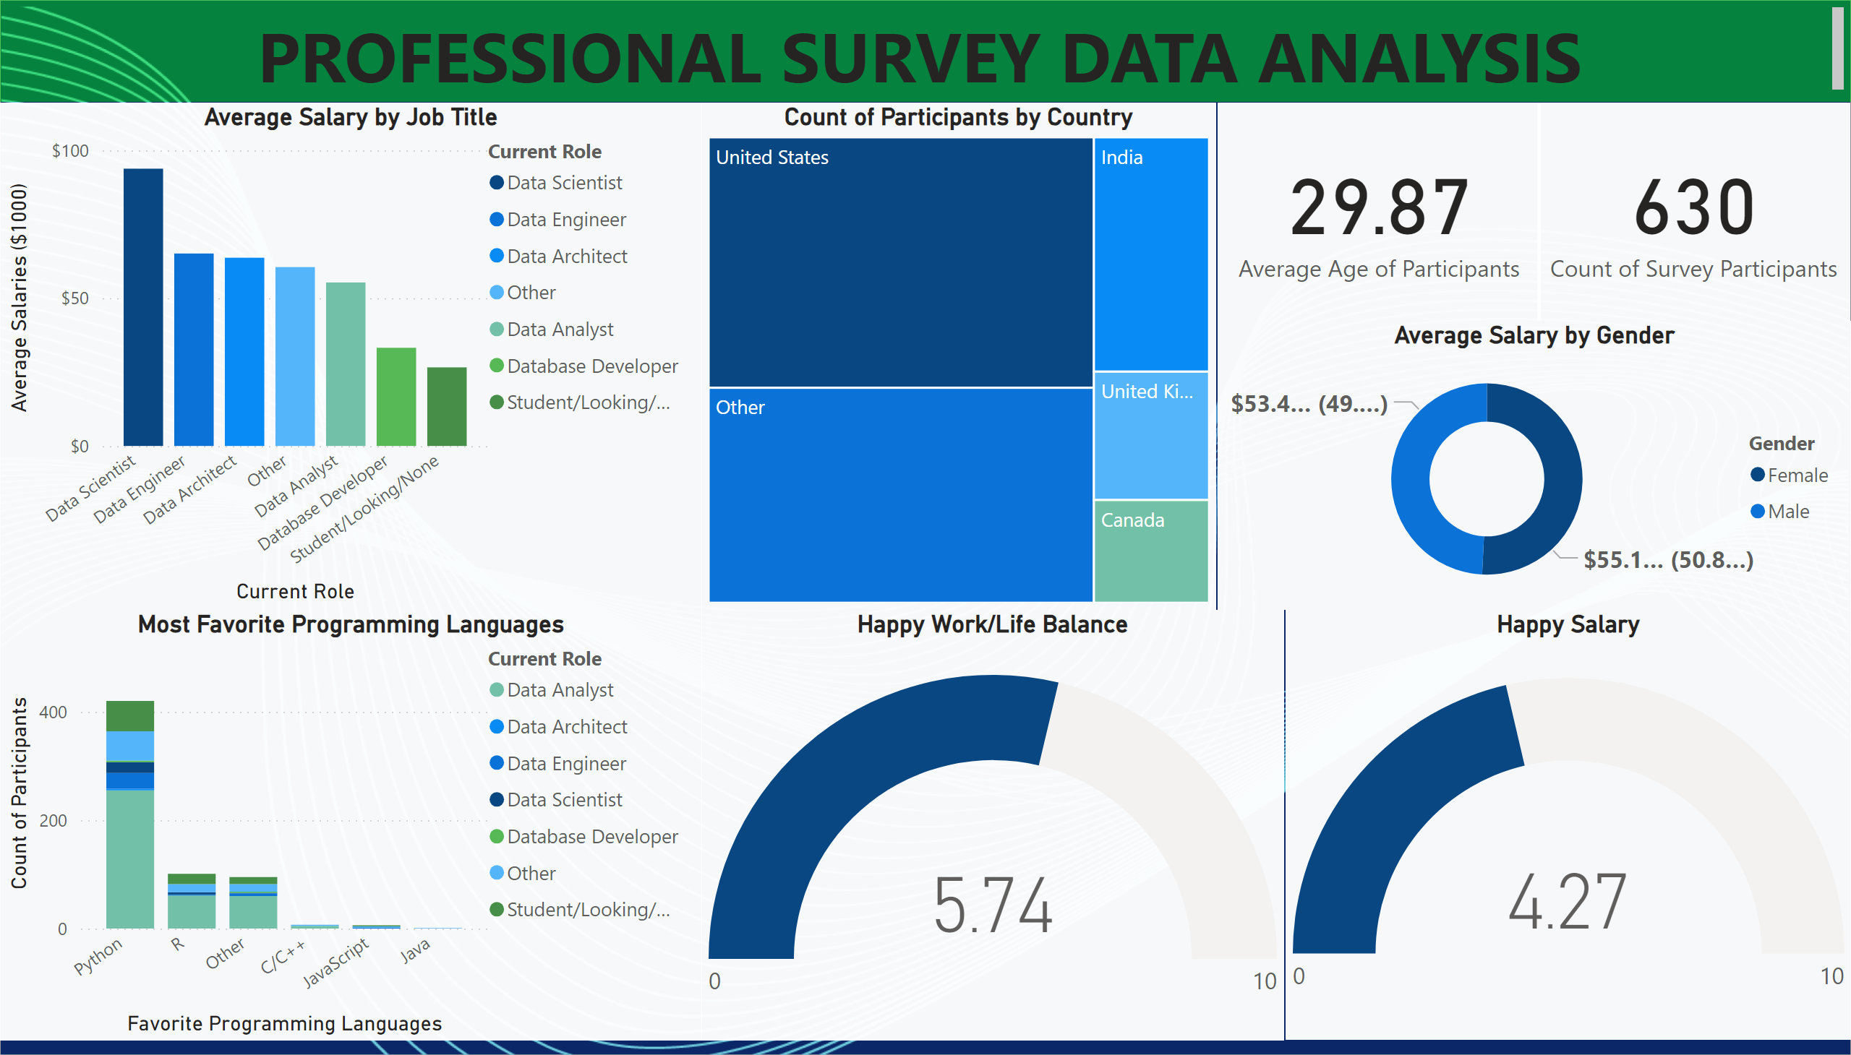
Page 1
Notes:
textbox
No alt text provided
card
No alt text provided
card
No alt text provided
Average Salary by Job Title
No alt text provided
Most Favorite Programming Languages
No alt text provided
Count of Participants by Country
No alt text provided
Happy Work/Life Balance
No alt text provided
Happy Salary
No alt text provided
Average Salary by Gender
No alt text provided

Slide 13


