Slide 1

LEXICAL ANALYZER
NOEL ROYCHOUDHURY ( 110809022)
AHANA ROYCHOUDHURY (110809023)
MST. AYESHA SULTANA (110809024)

Slide 2

Role of lexical analyzer
Specification of tokens
Recognition of tokens
Lexical analyzer generator
Finite automata
Design of lexical analyzer generator

Slide 3

Token
The source code
To semantic
analyser
Lexical Analyser
Parser
Find_Next_Token
Symbol
table

Slide 4

Simplicity of design
Improving compiler efficiency
Enhancing compiler portability

Slide 5

Tokens
Patterns
Lexemes

Slide 6

A token is a string of characters, categorized according to the rules as a symbol (e.g., IDENTIFIER, NUMBER, COMMA)
A pattern is a description of the form that the lexemes of a token may take
A lexeme is a sequence of characters in the source program that matches the pattern for a token

Slide 7

In theory of compilation regular expressions are used to formalize the specification of tokens
Regular expressions are means for specifying regular languages
Example:
    Letter_(letter_ | digit)*
Each regular expression is a pattern specifying the form of strings

Slide 8

1. program → suru [list_stat] shesh .
2. list_stat → list_stat | stat | €
3. stat → declaration | expression-stmt | selection-stmt | iteration-stmt
4. declaration → var-declaration
5. var-declaration → type-specifier var-decl-list
6. var-decl-list → var-decl-list , var-decl-id | var-decl-id
7. var-decl-id → letter ( letter | digit )*
8. type-specifier → shonkha | borno
9. expression-stmt → expression
10. selection-stmt → jodi ( expression ) statement | jodi [ expression] statement othoba statement
11. iteration-stmt → koro [statement ] jokhn [ expression ]
12. expression→var = expression | simple-expression
13. var → letter ( letter | digit )*
14. simple-expression → simple-expression rel-expression | rel-expression

Slide 9

15. rel-expression → add-expression relop add-expression | add-expression
16. relop → <= | < | > | >= | ==
17. add-expression → add-expression addop term | term
18. addop → + | − | * | /
19. term → var | constant
20. constant → number
21. number → digit | digit digit *
22 .digit → 0 | 1 | 2 | . . . | 9 |
23. letter → a | b | c | d | ……..| z |

Slide 10

suru
[
shonkha b1 = 4 , sum = 0 .
jodi [ b1 == 4 ]
sum = b1 + 4 .
othoba
sum = b1 .
koro
[
sum = b1 + 1 .
]
jokhn [ sum <= b1]
]
shesh .

Slide 11

TOKEN | INFORMAL DESCRIPTION | SAMPLE LEXEMES
Delimiters Operators Identifiers Constant | Various symbols Arithmetic and logical ops Letter followed by letters or number Any numeric constant without fractional part | . , [ ] whitespace >,<,=,<=,==,>=,+, - , / , * num , b1 , sum 789 , 70 , 56

Slide 12

keyword→ suru | shesh | lekho | poro| koro | jokhn | jodi |othoba|shonkha |borno
identifier→ letter ( letter | digit )*
letter → a | b | c | d | .........| z|
digit → 0 | 1 | 2 | 3 | 4 |5 | 6 | 7 | 8 | 9
number → digit | digit digit *
relop → <= | < | > | >= | ==
arithop → + | − | * | /
delim → blank | tab | newline | . | [ | ] | ,

Slide 13

Regular expressions = specification
Finite automata = implementation
A finite automaton consists of
  An input alphabet
  A set of states S
  A start state n
  A set of accepting states F S
  A set of transitions state T S
*
Notes:
*

Slide 14

Transition
s₁ ª s₂
Is read
  In state s₁ on input “a” go to state s₂
If end of input
  If in accepting state => accept, othewise => reject
If no transition possible => reject
*
Notes:
*

Slide 15
A state
The start state
An accepting state
a
A transition
*
Notes:
*

Slide 16

Deterministic Finite Automata (DFA)
  One transition per input per state
  No Epsilon-transitions
Nondeterministic Finite Automata (NFA)
  Can have multiple transitions for one input in a given state
  Can have Epsilon-transitions
*
Notes:
*

Slide 17

NFAs and DFAs recognize the same set of languages (regular languages)
DFAs are easier to implement
  There are no choices to consider
*
Notes:
*

Slide 18

High-level sketch
NFA
Regular
expressions
DFA
Lexical
Specification
Table-driven
Implementation of DFA
*
Notes:
*

Slide 19

[a-z][A-Z] / [0-9]
start
[a-z] / [A-Z]
0
1
ID
[0-9]
[1-9]
3
NUMBER
0
4
0
ZERO

Slide 20

start
=
=
0
1
2
ASSGN
EQU
<
=
3
4
LEQ
LT
>
5
NEQ
>
6
=
7
GT
GEQ

Slide 21

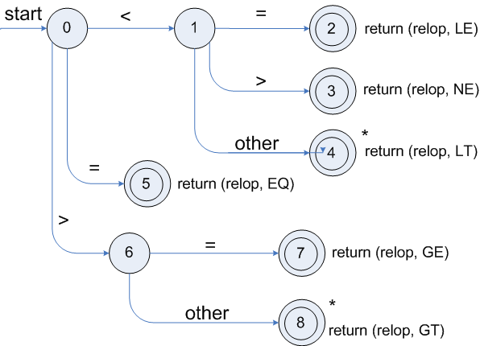

Slide 22
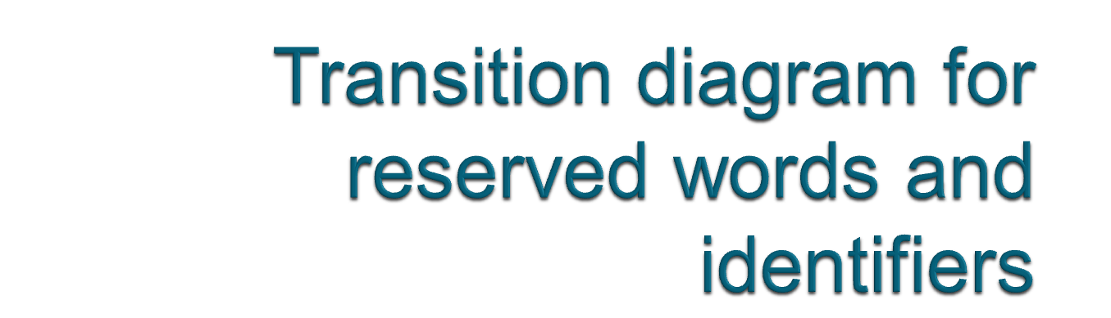
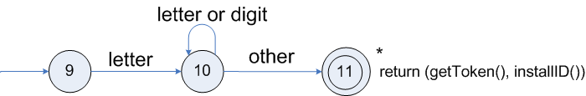
Transition diagram for reserved words and identifiers

Slide 23

TOKEN getRelop()
{
TOKEN retToken = new (RELOP)
while (1) { /* repeat character processing until a
return or failure occurs */
switch(state) {
case 0: c= nextchar();
if (c == ‘<‘) state = 1;
else if (c == ‘=‘) state = 5;
else if (c == ‘>’) state = 6;
else fail(); /* lexeme is not a relop */
break;
case 1: …
…
case 8: retract();
retToken.attribute = GT;
return(retToken);
}
}

Slide 24

suru
[
shonkha b1 = 4 , p1 , sum = 0 .
jodi [ b1 == 4 ]
p1 = b1.
othoba
p1 = b1 + 4 .
koro
[
sum = sum + p1 .
p1 = p1 - 1 .
]
jokhn [ p1 <= 0 ]
]
shesh .

Slide 25

************* : LEXICAL ANALYSIS : **************
KEYWORD : { suru }
SYMBOL : { [ }
KEYWORD : { shonkha }
IDENTIFIER : { b1 }
ASSIGNMENT OPERATOR : { = }
CONSTANT : { 4 }
SYMBOL : { ,}
IDENTIFIER : { sum }
CONSTANT : { 0 }
SYMBOL : { . }
KEYWORD : { jodi }
SYMBOL : { [ }
IDENTIFIER : { b1 }
RELATIONAL OPERATOR : { == }
CONSTANT : { 4 }

Slide 26

SYMBOL : { ] }
IDENTIFIER : { p1 }
ASSIGNMENT OPERATOR : { = }
IDENTIFIER : { b1 }
KEYWORD : { othoba }
IDENTIFIER : { p1 }
ASSIGNMENT OPERATOR : { = }
IDENTIFIER : { b1 }
ARITHMETIC OPERATOR : { + }
CONSTANT : { 4 }
SYMBOL : { . }
KEYWORD : { koro }
SYMBOL : { [ }
IDENTIFIER : { sum }
ASSIGNMENT OPERATOR : { = }
IDENTIFIER : { sum }
ARITHMETIC OPERATOR : { + }
IDENTIFIER : { p1 }
SYMBOL : { . }
IDENTIFIER : { p1 }
ASSIGNMENT OPERATOR : { = }
IDENTIFIER : { p1 }

Slide 27
ARITHMETIC OPERATOR : { - }
CONSTANT : { 1 }
SYMBOL : { . }
SYMBOL : { ] }
KEYWORD : { jokhn }
SYMBOL : { [ }
IDENTIFIER : { p1 }
RELATIONAL OPERATOR : { >= }
CONSTANT : { 0 }
SYMBOL : { ] }
SYMBOL : { ] }
KEYWORD : { shesh }
SYMBOL : { . }
*******************************************************
NUMBER OF KEYWORDS => 7
NUMBER OF IDENTIFIERS => 14
NUMBER OF OPERATORS => 11
NUMBER OF SYMBOLS => 17
*******************************************************

Slide 28

The limitations in our project is that we have only included a few keywords(suru,shesh,koro,jokhn,jodi,othoba,lekho,poro,borno,shonkha).But we could not include the library functions for lekho and poro. Moreover we are unable to assign the character type identifiers.
Therefore more no of key words can be added and altogether a new language can be evolved by including more keywords and implementing library functions.

Slide 29

Alfred V. Aho, Ravi Sethi & Jeffrey. D. Ullman, “Compilers Principles, Techniques Tools"
Allen holab,”Compiler in C”
http://en.wikipedia.org/wiki/Lexical_analysis

Slide 30
THANK YOU!!!

