Slide 1
Advanced Digital Library
A digital library management system to perform CRUD operations on student details and book details, and issue and return book by valid admin user
Technologies Used: Java Swing, MySQL, JDBC connector
Developed & Documented by Ahana Basu 16-07-2023

Slide 2
OBJECTIVE
Log In/Sign Up to the application
To fetch details from back-end MySQL tables and perform CRUD (Create, Read, Update, Delete) operations on them.
Tables/Components:
Users – stores details of all the admins/librarians/staffs who signs up to the application.
Student Details – stores academic details of all the students registered.
Book Details – keeps track of all the books (names, authors etc) and their respective availabilities, so that when any book gets out of stock, immediate indent can be done.
Issued Book Details – stores information of all the books issued along with the student issued to, status of issue (pending/returned) and issue date and due date.
To show details of issued books as and required, given a range of date or all the records.
Log Out of application when necessary actions performed.

Slide 3
functions
Sign Up
Log In
Manage Books
ADD
UPDATE
DELETE
Manage Students
ADD
UPDATE
DELETE
Issue Book
Display Student and Book details Alongside
Check validity and book availability
Return Book
Don’t accept if already returned or not issued at all
View All Issued Books Record (pending and returned)
View only issued books (pending)
View Defaulters List (who has not returned within due date)
Log Out

Slide 4
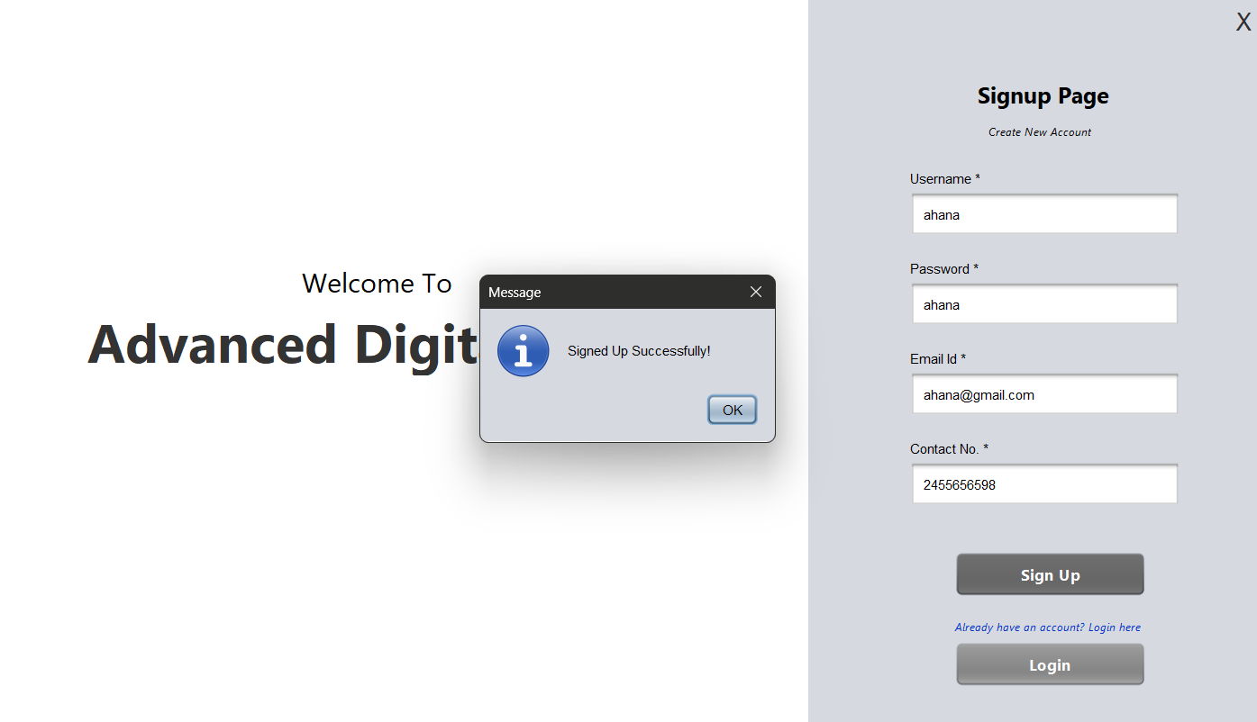
SIGN UP - successful
Click cross button to close the window
Clicking “OK” will redirect the page to login page
If you already have an account with us, please login
To create new account, enter valid mandatory personal details, success message will pop after successful sign up.

Slide 5
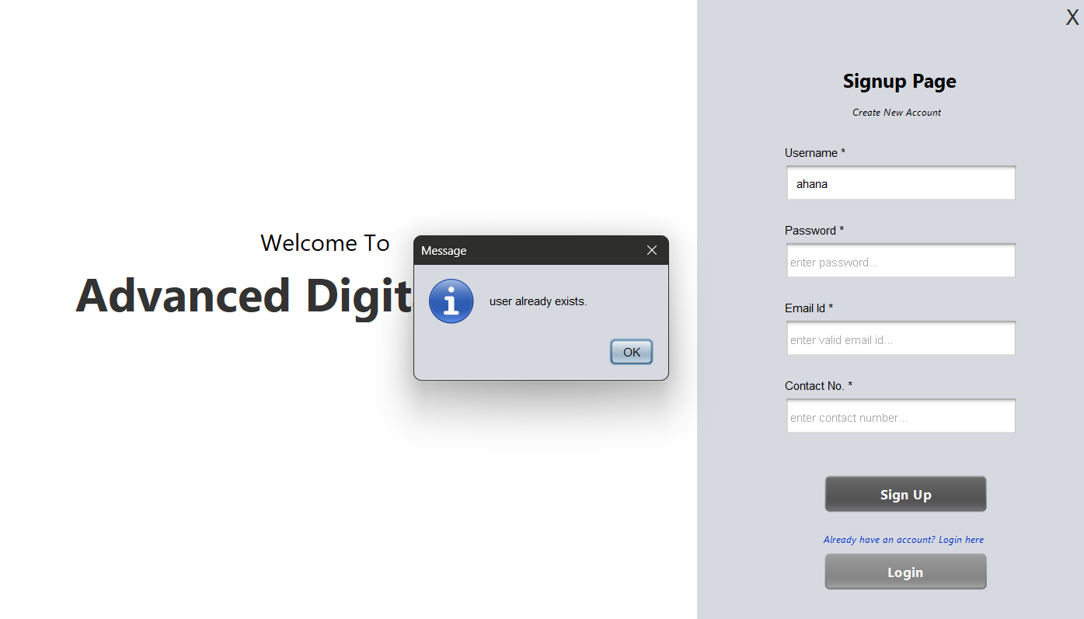
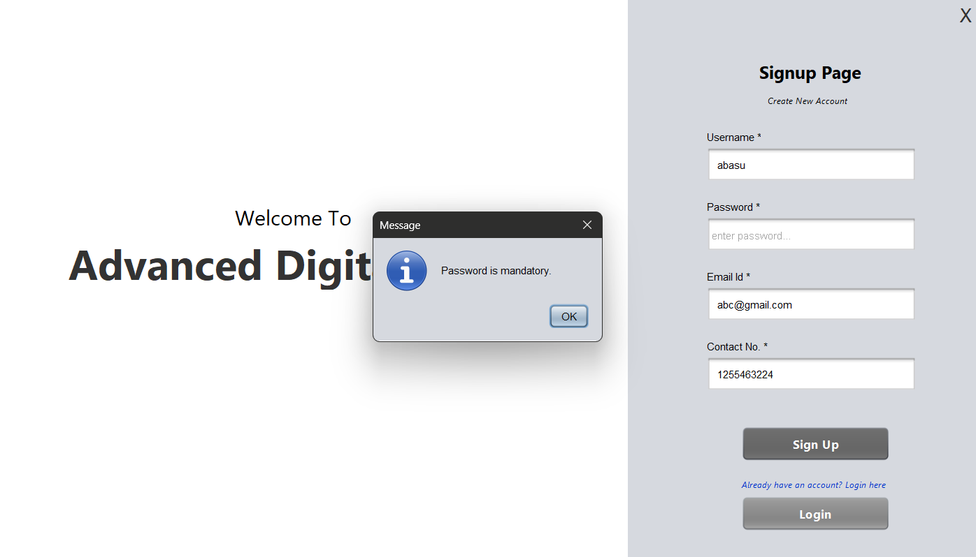
SIGN UP - failure
“ahana” username already used to sign up before
CONDITION 2
When all the fields are not filled, error shows as all fields are mandatory to be recorded.
CONDITION 1
When you try to sign up with already existing username. Pop up generated saying “user already exists”.
In that case, head over to login with your already existing credentials.
“password” field is left empty, which is a mandatory field.

Slide 6
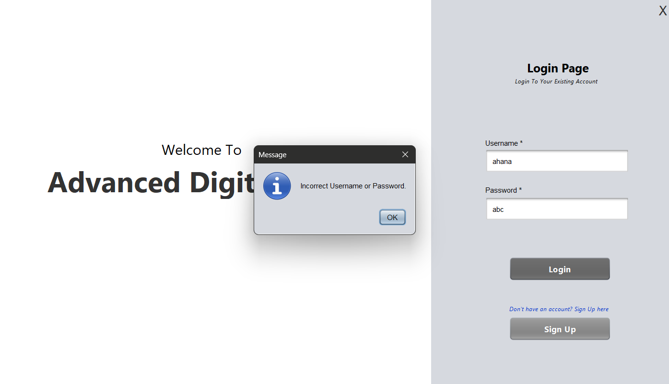
LOG IN - failure
Wrong password entered
Click “OK” and rewrite the correct login credentials to successfully LOGIN

Slide 7
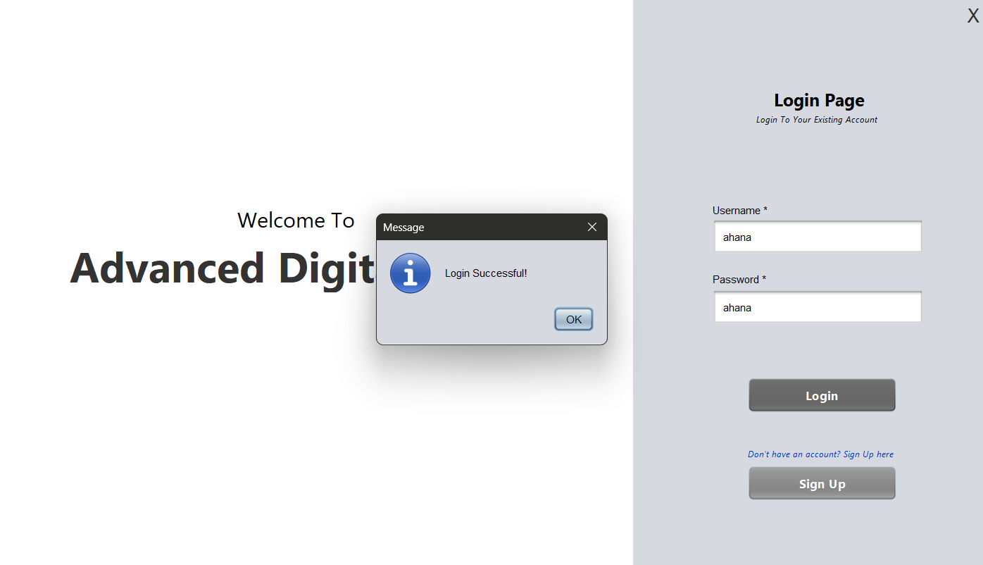
LOG IN - successful
Click “OK” to redirect to home page
Only when right login credentials are entered, success message pops up

Slide 8
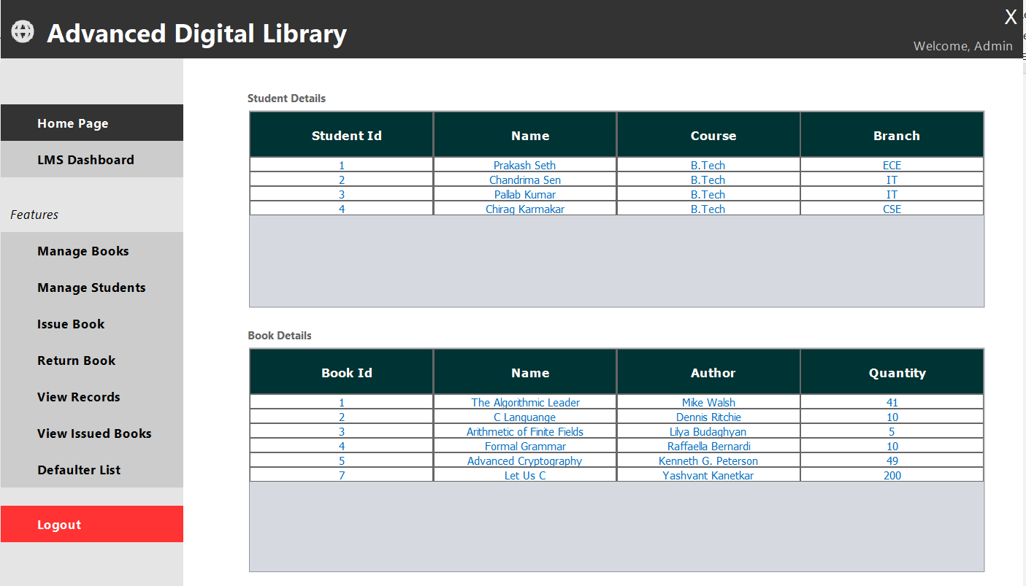
HOME PAGE
CRUD operations on books present in library
Details of all students registered
CRUD operations on registered students
Issue a valid/available book to a registered student
Return issued book which is pending
View all records of issued books (returned or pending)
Details of all books in library
View all records of pending issued book
View students who did not return within due date
Log Out of account

Slide 9
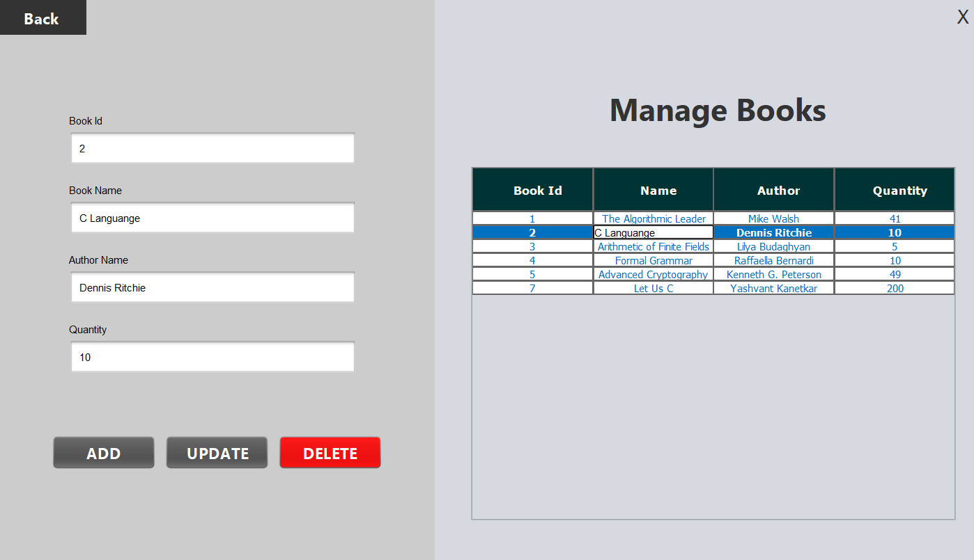
Back to HOME PAGE
MANAGE BOOKS – CRUD
List of all books
Enter valid book details
To add a new book to the library stock
Update book details of already existing book
delete deprecated books from stock

Slide 10
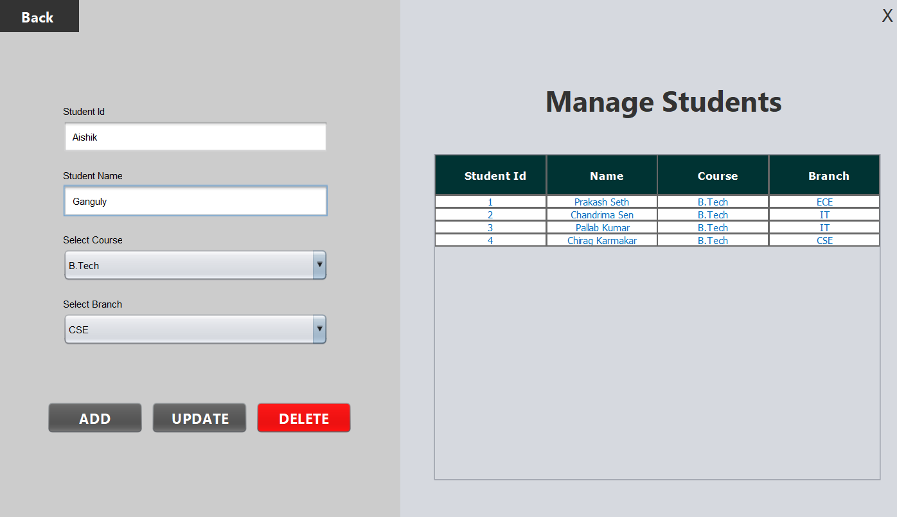
Back to HOME PAGE
MANAGE STUDENTS – CRUD
List of all students
Enter/select valid student details
Add/register new students to log
Update student details
delete student from register

Slide 11
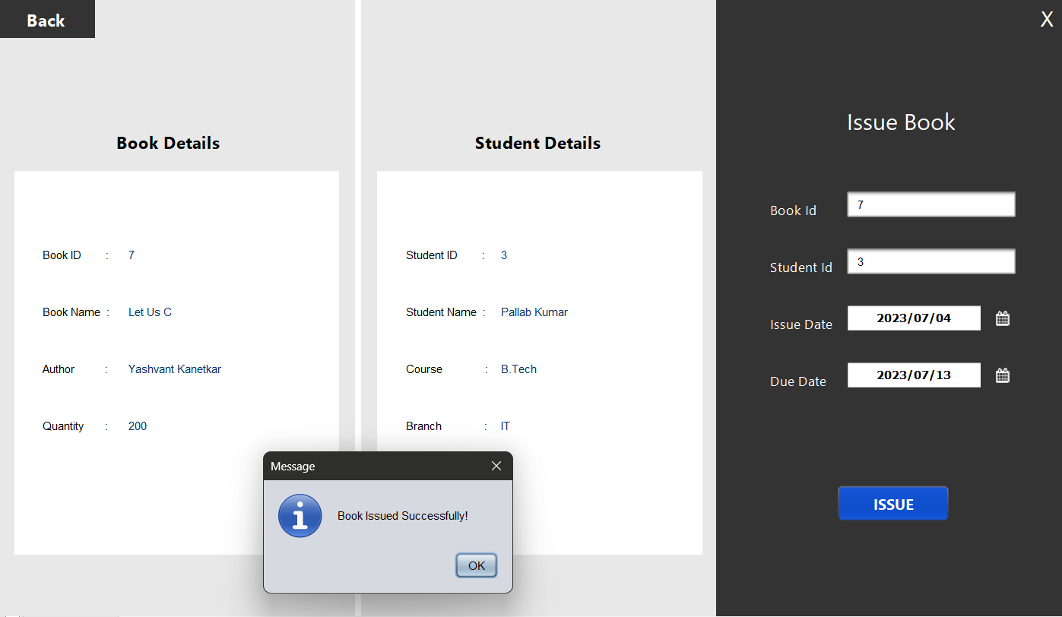
Back to HOME PAGE
ISSUE BOOK
Details of book to be issued
Select dates
Pop up message for successful issue
Details of student to whom the book is being issued

Slide 12
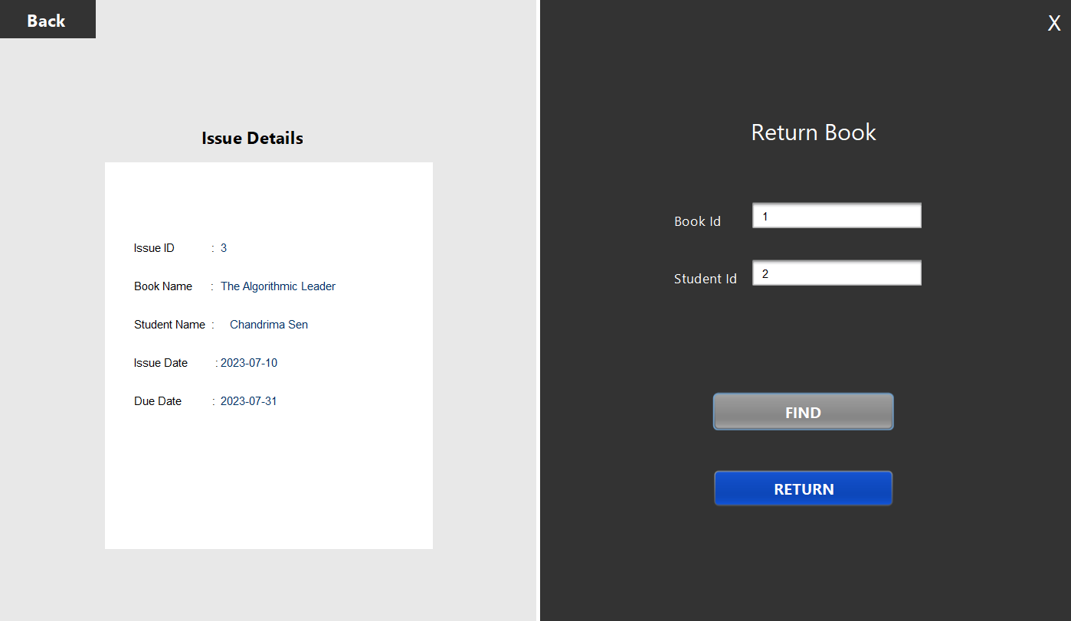
Back to HOME PAGE
Back to HOME PAGE
RETURN BOOK
Enter book is and respective student id
Issue details against entered Book Id and Student Id in right panel
Search if the mentioned book is issued to the student
Click “Return” is the book is issued and pending

Slide 13
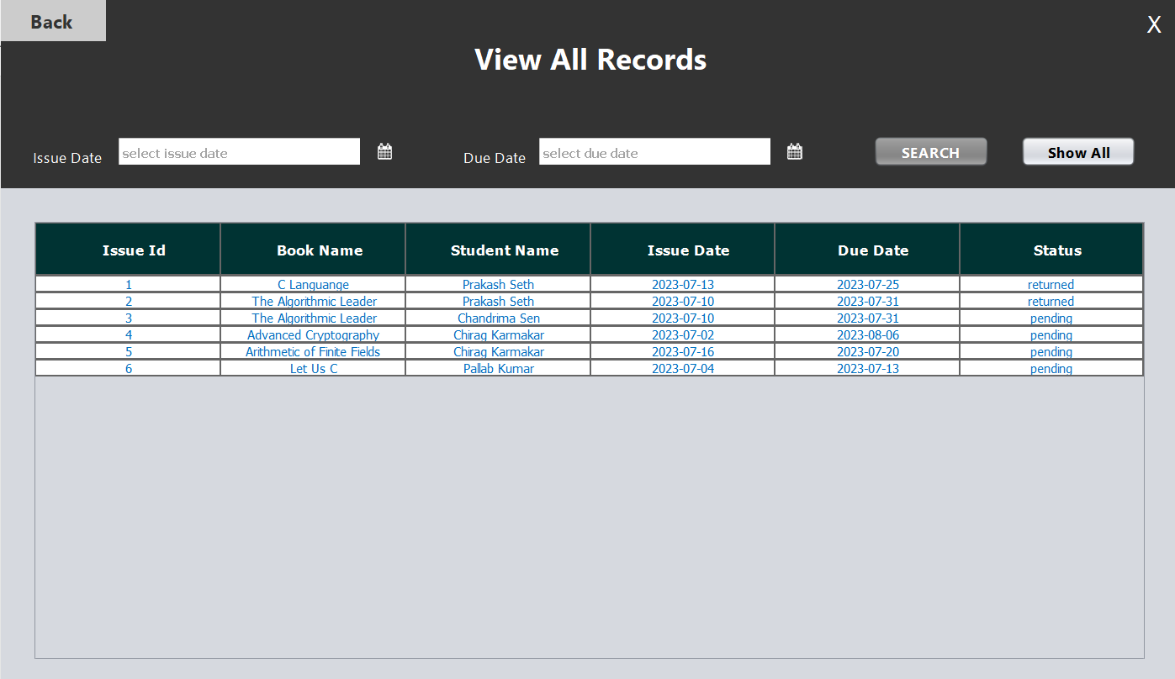
Back to HOME PAGE
View All Records – both pending and returned issues
Click “SEARCH” after selecting issue date and due date
To view all records when no range of date mentioned

Slide 14
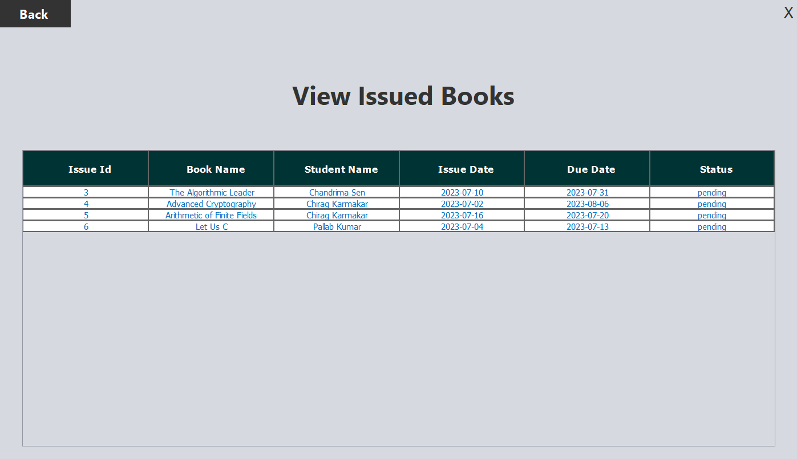
Back to HOME PAGE
View All Records – only pending
List of books which are issued and pending

Slide 15
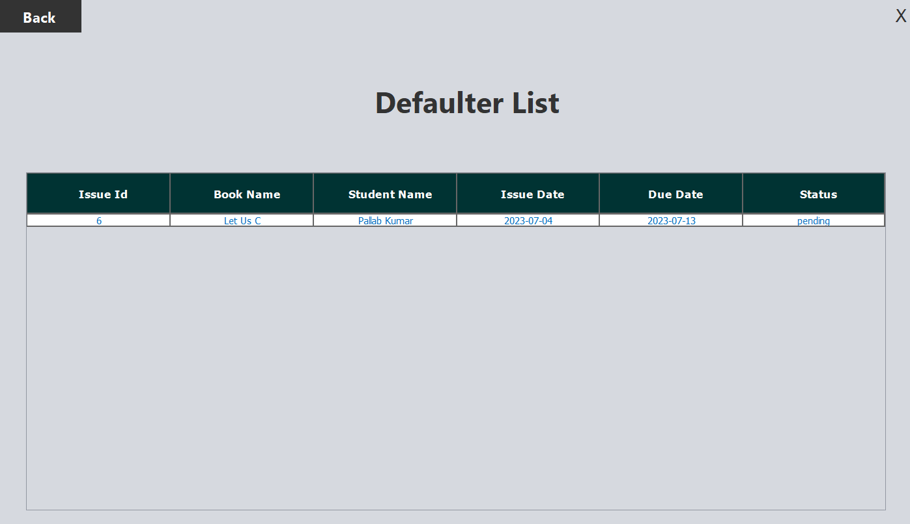
Back to HOME PAGE
Defaulter List
List of students who did not return within due date

