Slide 1
6.4 Consider an expression grammar as it would be written for a predictive parser with left recursion removed:
exp->term exp’
exp’->+ term exp’ | -term exp’ | ε
term->factor term’
term’-> * factor term’ | ε
factor ->(exp) | number
Write an attribute grammar for the value of an expression given by this grammar

Slide 2
Simple arithmetic expression grammar
exp → exp addop term∣term
addop → +|-
term → term mulop factor ∣ factor
mulop →*
factor →(exp) ∣ number
After removal of the left recursion
exp → term exp’
exp’→ addop term exp’∣ε
addop → +|-
term → factor term’
term’ → mulop factor term’∣ε
mulop →*
factor →(exp) ∣ number

Slide 3
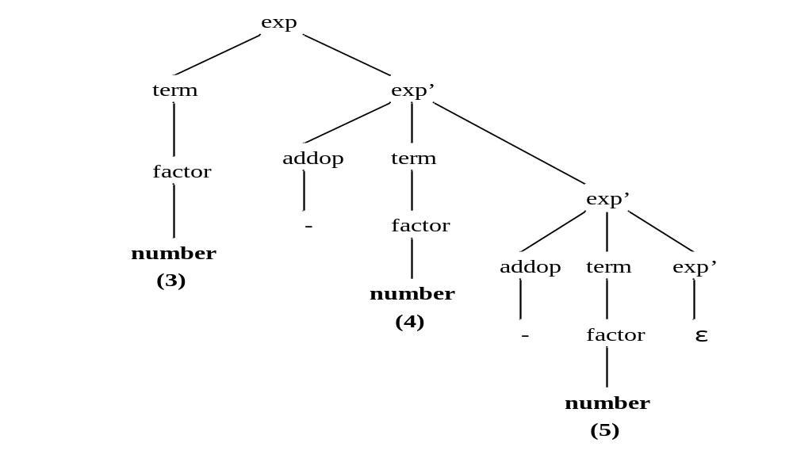
    exp → term exp’
    exp’→ addop term exp’∣ε
    addop → + -
    term → factor term’
    term’ → mulop factor term’∣ε
    mulop →*
    factor →(exp) ∣ number
The parse tree for the expression 3-4-5

Slide 4
Solution
Grammar rule | Semantic Rules
exp->term exp’ | exp.val=term.val+exp’.val
exp’₁->+term exp’₂ | exp1’.val=0+term.val+exp2’.val (or exp1’.val=exp2’.val+term.val)
exp’₁->-term exp’₂ | exp1’.val=0-term.val+exp2’.val (or exp1’.val=exp2’.val-term.val)
exp’->ε | exp’.val=0
term->factor term’ | term.val=factor.val*term’.val

Slide 5
term’₁->*factor term’₂ | term1’.val=factor.val*term2’.val
term’->ε | term’.val=1
factor->(exp) | factor.val=exp.val
factor->mumber | factor.val=number.val

Slide 6
Other solution
Rewrite the grammar
exp->term exp’
exp’->+ term exp’ | -term exp’ | ε
term->factor term’
term’-> * factor term’ | ε
factor ->(exp) | number
Into
exp->exp+term | exp-term | term
term->term * factor | factor
factor->(exp) | number
This solution is wrong

