Slide 1
Review
袁华：hyuan@scut.edu.cn
School of Computer Science & Engineering ,SCUT
Communication & Computer Network key-Lab of GD

Slide 2
Final grade
Final Grade：70% Examination +30%
Exam. Range：Courseware, homework, exercise and example, Experiment report, teaching material, etc.
Bring calculator please
Simulation EXAM：http://202.38.193.234/jsjwl/
Problem style
  Make a single choice(40%)
  Compute，analyze，simply answer(60%)

Slide 3
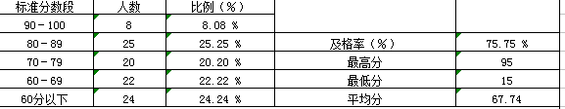
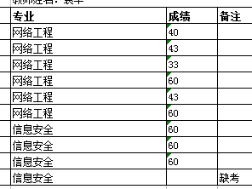
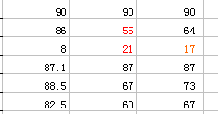
2011网工&信安（99人）

Slide 4
Chapter 1 Introduction
What is computer network?
Network category
  LAN/MAN/WAN/Internet
Reference model
  TCP/IP(DoD) reference model and function of each layer
  OSI reference model and function of each layer
Some concepts
  Encapsulation/de-encapsulation/
  peer to peer(virtual communication)/Each PDU’s name
  standards

Slide 5
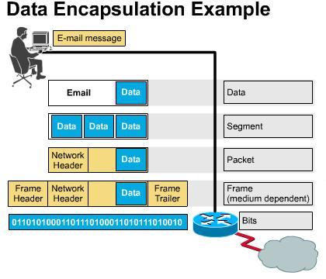
Encapsulation

Slide 6
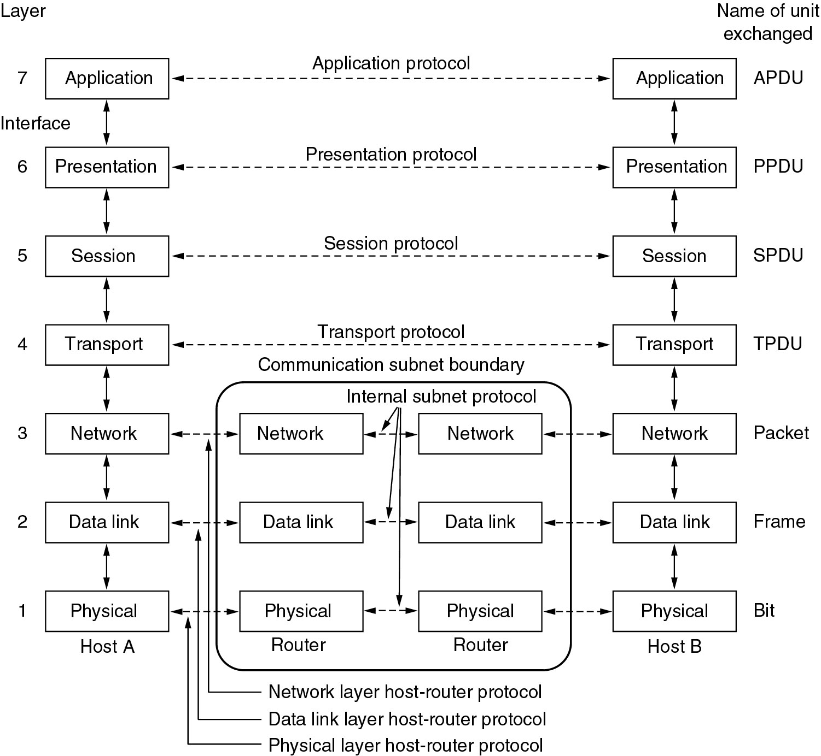

Virtual Communication（Peer to Peer）

Slide 7
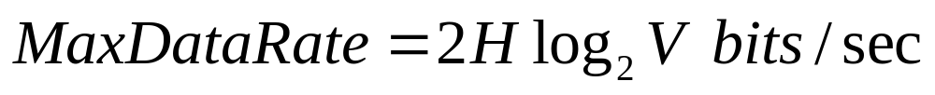
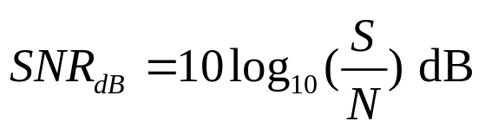

Chapter 2 Physical Layer
Understand Fourier Analysis
Nyquist theorem
Shannon theory

Slide 8
Chapter 2 Physical Layer(cont’d)
Transmission media
  Twisted Pair
    UTP
    STP
  Coaxial Cable
  Fiber Optics
Equipment of physical layer
  Repeater and hub (main functions)

Slide 9
Chapter 2 Physical Layer(cont’d)
Understand wireless transmission
Understand communication satellite
Understand Public Switched Telephone Networks (PSTN，three parts)
Understand modem
  Amplitude modulation(AM)
  Frequency modulation(FM)
  Quadrature Phrase shift keying (QPSK)

Slide 10
Chapter 2 Physical Layer(cont’d)
Understand codec
Master trunk multiplex technology
  Frequency Division Multiplexing
  Time Division Multiplexing
  Wavelength Division Multiplexing
Understand T1 and E1
  PCM
  T1 in NA and Japan, E1 everywhere else

Slide 11
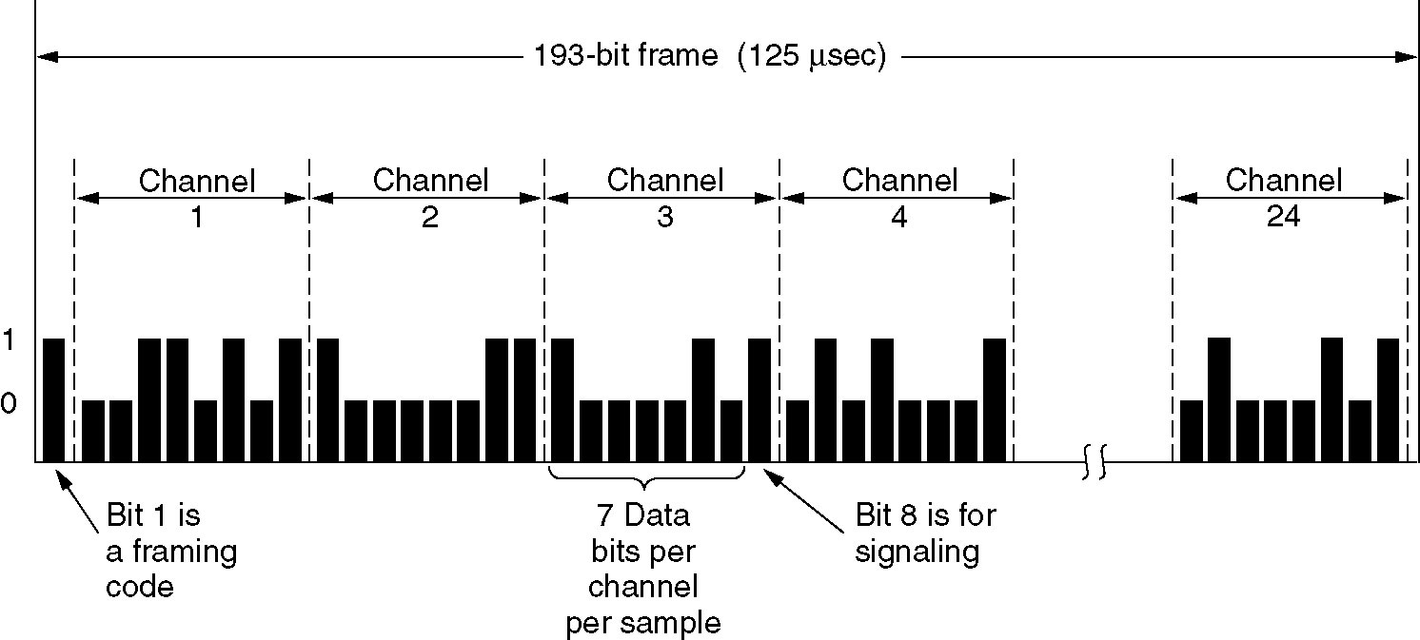
Time Division Multiplexing
The T1 carrier (1.544 Mbps).

Slide 12
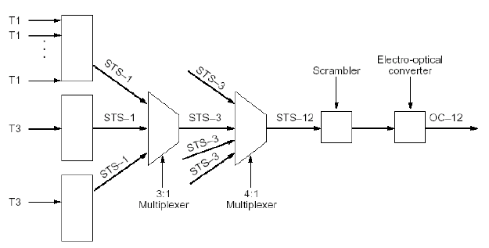
Relations

Slide 13

波特率和比特率
波特率：每秒钟信号变化的次数
信元
比特率与波特率的关系
其中：C：比特率； B：波特率； n：调制电平数或线路的状态数，为2的整数倍。

Slide 14
Digital Modulation and Multiplexing
Modulation schemes send bits as signals.
  Baseband Transmission（基带传输）：directly convert bits into a signal.
  Passband Transmission（通带传输） ：the signal occupies a band of frequencies around the frequency of the carrier signal
multiplexing schemes share a channel among users.（ P145 ）

Slide 15
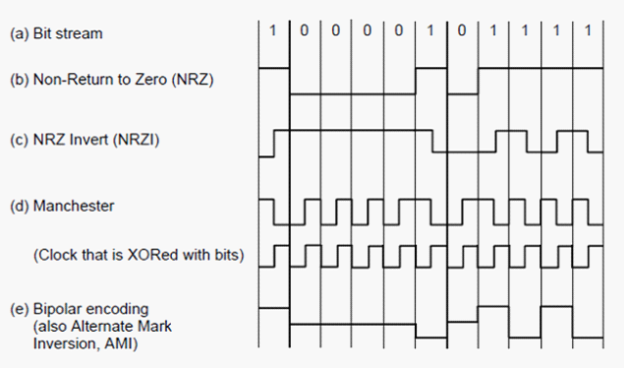
Baseband Transmission
Line codes （线路编码）send symbols that represent one or more bits

Slide 16
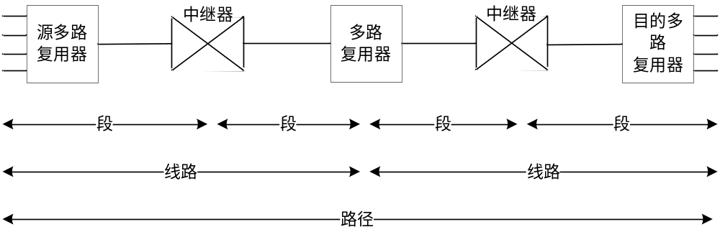
Chapter 2 Physical Layer(cont’d)
Understand SONET/SDH
  SONET frame
  Section overload + line overload + path overload+ SPE
  OC-3/OC-3c

Slide 17
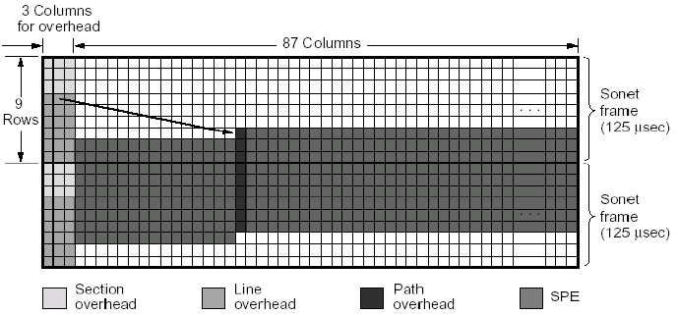
SONET frame

Slide 18
Chapter 2 Physical Layer(cont’d)
Master circuit-switching ,message switching and packet switching
Learn mobile-phone system
  Code division multiple Access (CDMA)
  For example

Slide 19
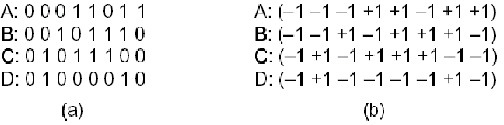
实例之各站时间片序列

Slide 20
复用
发送时的复用，如B 、C 站均发送1，则得：
(-1 -1 +1 -1 +1 +1 +1 -1)
+(-1 +1 -1 +1 +1 +1 -1 -1)
= (-2 0 0 0 +2 +2 0 -2 )

Slide 21
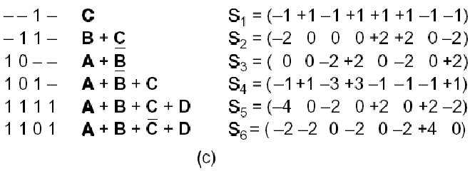
实例之复用——线形相加
其中“-”表示该站未发送。
复用信号

Slide 22
解复用原理——接收还原
运用内积规则
如收到复用后的S，欲还原C，只需求S 。 C即可。
例：S = Ā+ B + C
S 。C =( Ā+ B + C ) 。C
= Ā。C + B 。C + C 。 C
= 0 + 0 + 1 = 1

Slide 23
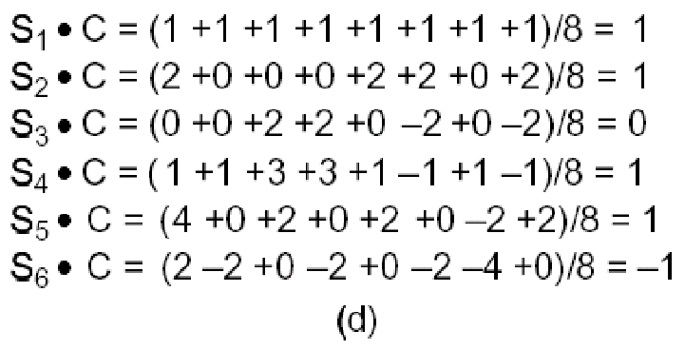
实例之解复用——接收还原
表示发送了1
表示没有发送
表示发送了0

Slide 24
Chapter 3 data link layer
Understand main functions of data link layer
Master framing
  Character count(字符计数法)
  Flag bytes with byte stuffing(带字符填充的首尾界符法)
  Starting and ending flags, with bit stuffing(带位填充的首尾标志法)
  Physical layer coding violations(物理层编码违例法)

Slide 25
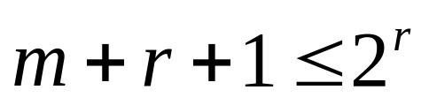
Chapter 3 data link layer(cont’d)
Master error detection and correction
  Haimming distance (definition)
  Error correction: hamming code
    Correct one bit error:
  Error detection:CRC
The error-detecting and error-correcting properties of a code depend on its Hamming distance.
  In order to detect d errors, we need a distance of d+1.
  In order to correct d errors, we need a distance of 2d+1

Slide 26
海明码(纠一位错)
每一个码字从左到右编号，最左边为第1位
校验位和数据位
  凡编号为2的乘幂的位是校验位，如1、2、4、8、16、……。
  其余是数据位，如3、5、6、7、9、……。
每一个校验位设定根据：包括自己在内的一些位的集合的奇偶值(奇数或偶数)。

Slide 27
如何决定每个数据位的校验位
将某一位数据位的编号展开成2的乘幂的和，那末每一项所对应的位即为该数据位的校验位。
  如： 11 = 1 + 2 + 8
29 = 1 + 4 + 8 + 16
  校验位1的检验集合为所有奇数位。
  校验位2的检验集合：2、3、6、7、10、11、…
  校验位4的检验集合：4、5、6、7、……
  校验位8的检验集合：8、9、10、11、……

Slide 28
校验位的计算(m=7,r=4)
 | B1 | B2 | B3 | B4 | B5 | B6 | B7 | B8 | B9 | B10 | B11
 | P1 | P2 | D1 | P3 | D2 | D3 | D4 | P4 | D5 | D6 | D7
1=2⁰ | √ |  | √ |  | √ |  | √ |  | √ |  | √
2=2¹ |  | √ | √ |  |  | √ | √ |  |  | √ | √
4=2² |  |  |  | √ | √ | √ | √
8=2³ |  |  |  |  |  |  |  | √ | √ | √ | √

Slide 29
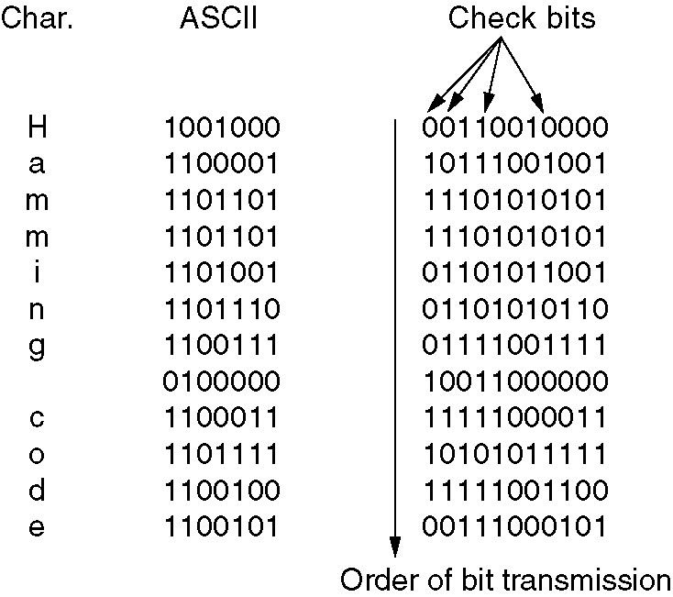

海明码实例（1/3）
如何确定校验位？
7位
数据位
本例使用偶校验even

Slide 30
海明码实例之校验位计算（2/3）
 | B1 | B2 | B3 | B4 | B5 | B6 | B7 | B8 | B9 | B10 | B11
 | P1 | P2 | D1 | P3 | D2 | D3 | D4 | P4 | D5 | D6 | D7
信息码 | - | - | 1 | - | 0 | 0 | 1 | - | 0 | 0 | 0
检验位 | 0 | 0 | - | 1 | - | - | - | 0 | - | - | -
海明码 | 0 | 0 | 1 | 1 | 0 | 0 | 1 | 0 | 0 | 0 | 0
使用偶校验，一个校验集合里的1的个数是偶数

Slide 31
海明码实例之检验位计算（3/3）
 | B1 | B2 | B3 | B4 | B5 | B6 | B7 | B8 | B9 | B10 | B11
 | P1 | P2 | D1 | P3 | D2 | D3 | D4 | P4 | D5 | D6 | D7
信息码 | - | - | 1 | - | 1 | 0 | 0 | - | 0 | 0 | 1
检验位 | 1 | 0 | - | 1 | - | - | - | 1 | - | - | -
海明码 | 1 | 0 | 1 | 1 | 1 | 0 | 0 | 1 | 0 | 0 | 1

Slide 32
接收纠错实例
例如接收到码字为00111000100，校验各校验位：
  第一位：00111000100，校验集合有3个1
  第二位：00111000100，校验集合有1个1
  第四位：00111000100，校验集合有2个1
  第八位：00111000100，校验集合有1个1
累加出错位编号：1+2+8=11
可计算得其第11位出错，将该位由0改为1，即纠正得到正确结果: 00111000101
counter
1
3
3
11

Slide 33
Question
Hamming code generation
  original data: 10101111， m = 8
  Use even-parity Hamming code
  What is the hamming code for it?
  Reference key： 101001001111

Slide 34
CRC
The basic idea of the CRC method:
  The sender and receiver agree upon a generator polynomial, G(x), in advance.
  The sender appends a checksum to the end of the frame in such a way that the polynomial represented by the checksummed frame is divisible by G(x).
  When the receiver gets the frame, it tries dividing it by the same G(x). If there is a remainder, there must have been an error and a retransmission will be requested.

Slide 35
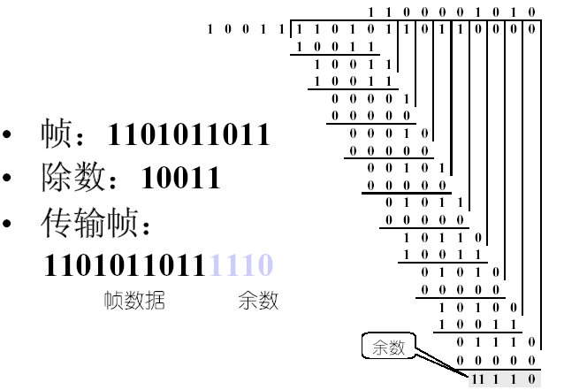
CRC码计算举例

Slide 36
Question
CRC code generation
  Question 1
    G(x)=x³+x²+1
    1111 → ?
    1100 → ?
  Question 2
    ① 0000000 ② 0001100 ③ 0010111
    ④ 1000110 ⑤ 1001111 ⑥ 1010001
    Which code is wrong?
Answer:
1111 → 1111111
1100 → 1100101

Slide 37
Chapter 3 data link layer(cont’d)
Master 6 dll’s basic protocol
  Utopia
  Stop and wait
  PAR (positive acknowledgement with retransmission ) or ARQ (automatic repeat request)
  One-bit sliding window
  Go back n
  Selective repeat
Master sliding widow
Master ARQ(PAR)
Master piggingbak

Slide 38
Chapter 3 data link layer(cont’d)
Learn some dll protocol
  HDLC
  PPP
    PAP/CHAP

Slide 39
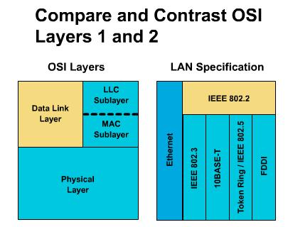
Chapter 4 the medium access control sublayer
Main function
  The MAC sublayer is especially important in LANs, many of which use a multiaccess channel as the basis for communication.
  Broadcast channels are sometimes referred to as multiaccess channels or random access channels
The Channel Allocation
  Static Channel Allocation
  Dynamic Channel Allocation

Slide 40
Chapter 4 MAC sublayer(cont’d)
Multiple Access Protocols
  ALOHA
    Pure ALOHA P280
    Slotted ALOHA P282
  Carrier Sense Multiple Access Protocols
    1-persistent CSMA P284
    nonpersistent CSMA
    p-persistent CSMA
    CSMA/CD (CSMA with Collision Detection)(“先听后发、边发边听”)
  Learn Collision-Free Protocols
    A Bit-Map Protocol
    Binary Countdown
  Learn Limited-Contention Protocols
    The Adaptive Tree Walk Protocol

Slide 41
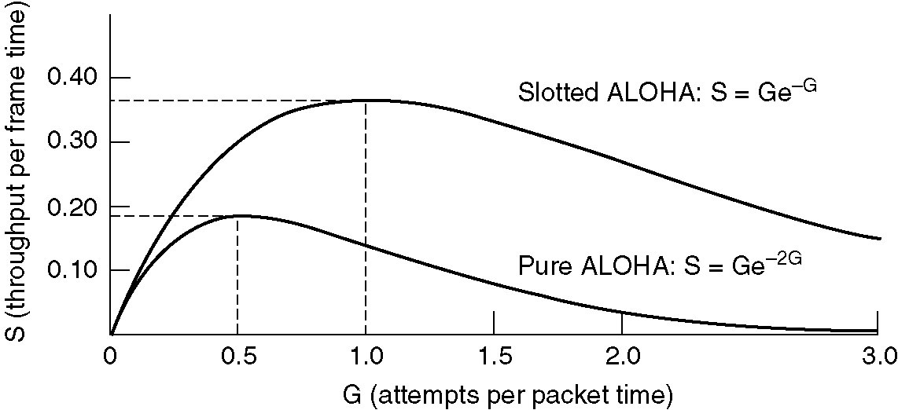
The relation between S and G
1/e = 37%
1/2e = 18%

Slide 42
Chapter 4 MAC sublayer(cont’d)
Ethernet P298
  Ethernet Cabling
  Ethernet frame formats P300
    DIX
    IEEE 802.3

Slide 43
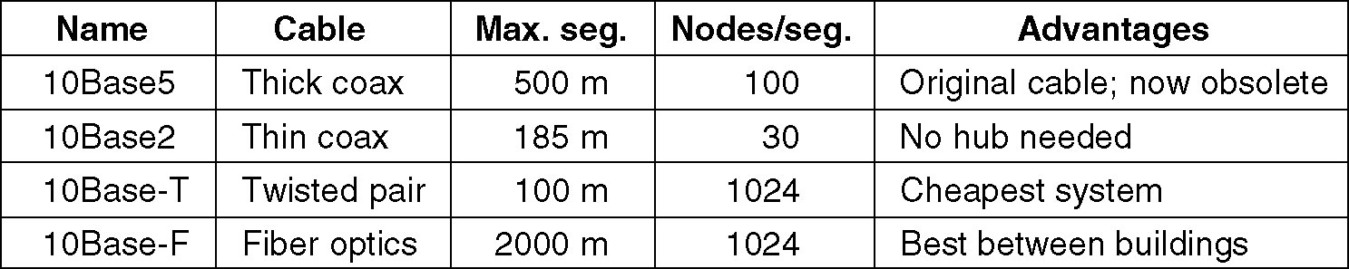
Ethernet Cabling
The most common kinds of Ethernet cabling.
10Base2（IEEE 802.3a）
  –10：传输带宽
  –Base：基带传输
  –2（或5）：同轴电缆传输的长度
10Base-TX（IEEE 802.3X）
  –T：铜制非屏蔽双绞线
  –F：表示光缆

Slide 44
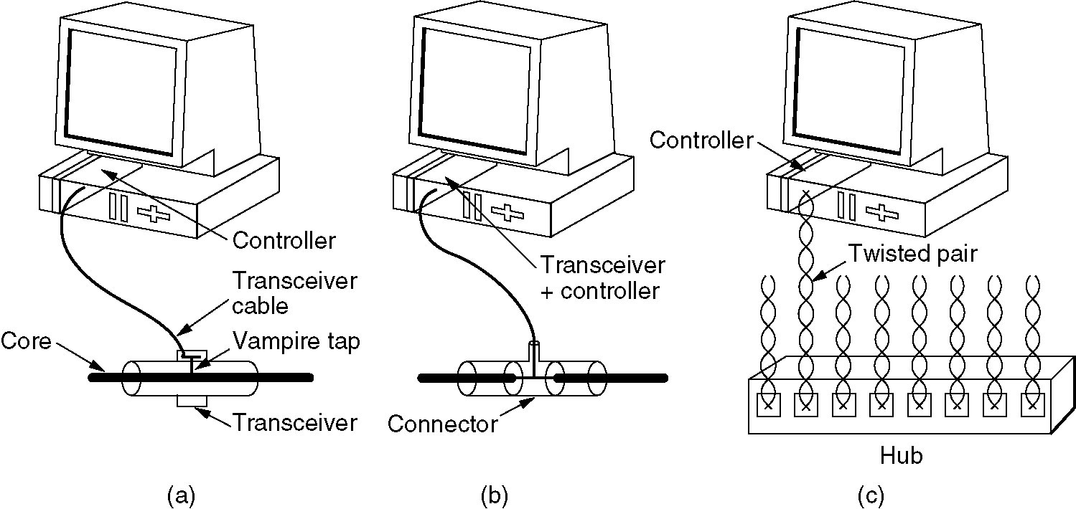
Ethernet Cabling (cont’d)
Three kinds of Ethernet cabling.
(a) 10Base5, (b) 10Base2, (c) 10Base-T.

Slide 45
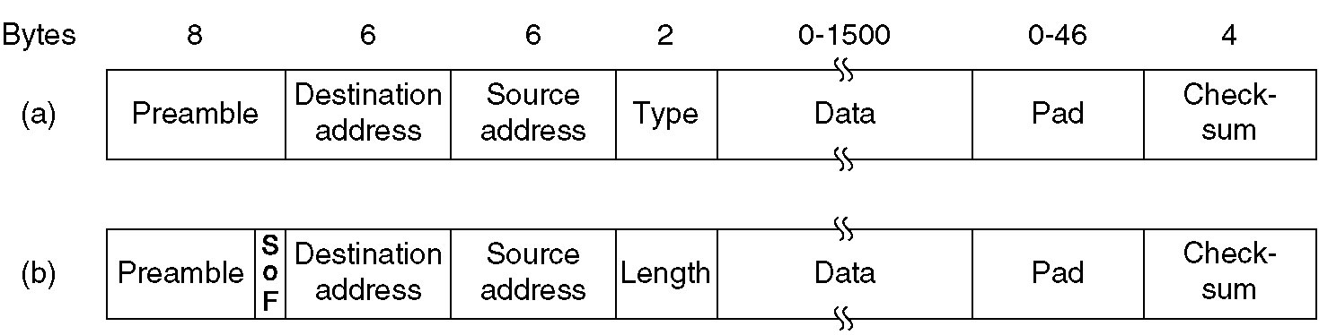
Frame format
DIX Ethernet,
IEEE 802.3

Slide 46
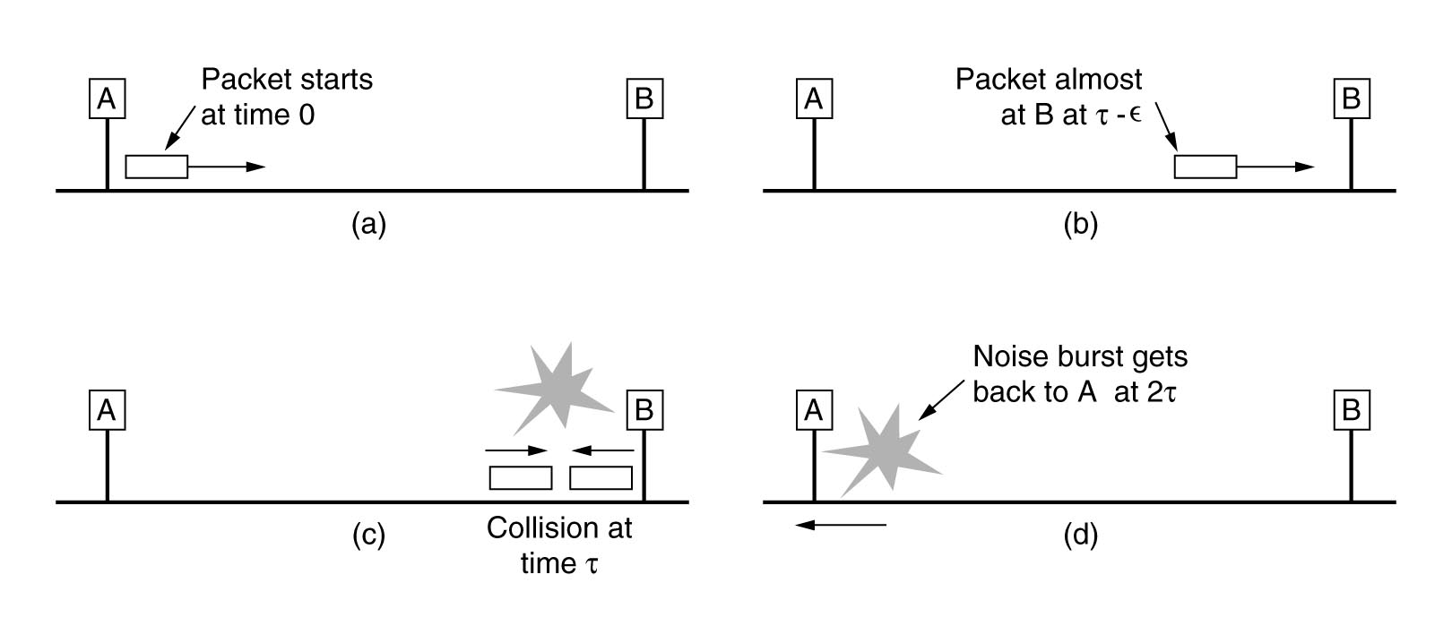
Why length≥ 64 Byte? P277
CSMA/CD require
  Sending time the frame need ≥ 2τ
Ethernet（802.3），10Mbps LAN
  Time slot：2τ = 51.2μs
  The shortest frame：10Mbps× 2τ/8 = 64 Byte
    或者：（51200/100ns）/8=64Byte

Slide 47
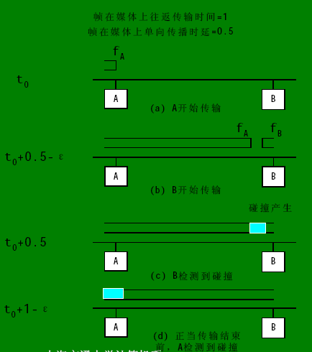
Collision window(冲突窗口)
发生冲突时间的上限，即发送站发出帧后能检测到碰撞的最长时间，数值上等于最远两站传播时间的两倍，即2τ

Slide 48
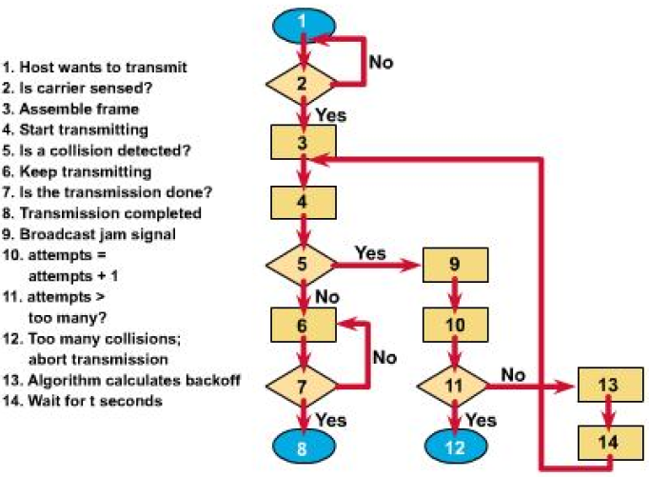
CSMA/CD
先听后发
边发边听

Slide 49
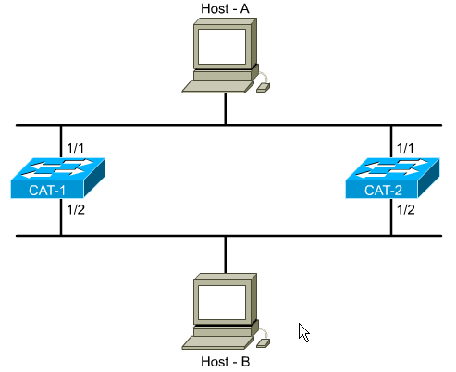
Chapter 4 MAC sublayer(cont’d)
Learn STP
Learn VLAN P360
Master the work principle of bridge and switch
leran two switch-method
  Cut through (free fragment)
  Store and forward

Slide 50
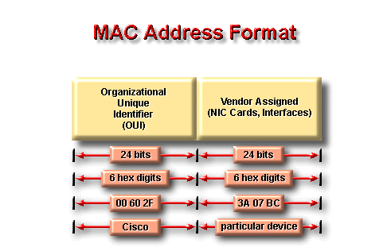
The MAC address

Slide 51
交换的工作原理
flooding --当目的地址未知或为广播地址时，桥发送帧到除源端口之外的每个端口
learning --通过读取每个帧的源地址和对应源端口来学习连在网段上的每个设备的地址
forwarding --对于已学到的目的地址，桥将直接发送帧到对应的目的设备所在端口
filtering --如果目的地址和源地址在同一端口，桥将丢掉帧

Slide 52
Chapter 5 network layer
Routing Protocol
  IGP
    DV:RIP
    LS:OSPF
  BGP
Routed Protocol
  IPv4
  IPv6
Other

Slide 53
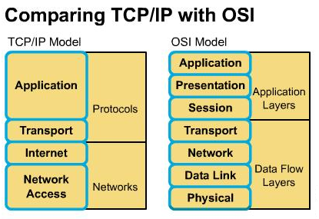
Main object of the chapter5
How packets transport from source to destination?
How to select a path?
  Routing protocol, Router
  Routed protocol: IPv4,IPv6
  Other

Slide 54
Routing algorithm
Routing algorithm
  Static routing algorithm
    Dijkstra
    flooding
  Dynamic routing algorithm
    DV
    LS
Learn Dijkstra algorithm

Slide 55
Master DV
Principle of DV-algorithm
  A typical example: RIP
Problem of DV
  How to settle it
An exercise

Slide 56
Master OSPF
Link state algorithm
  Five steps
  Problems and their resolution
OSPF
  Five message types
  DR selection
  OSPF operation process(status)
BGP

Slide 57
Learn other routing algorithm
Multi-level routing
broadcast routing
Multicast routing
mobile routing
adhoc routing
……

Slide 58
Congestion control
Congestion control
Traffic shaping
  Leaky bucket
  Token bucket
Internetworking

Slide 59
Routed protocol
Internet protocol
  Packet
  IP address
Other protocol
  ARP（principle，ARP table）
  DHCP
  RARP
  ICMP（ping，trcert）
  CIDR（supernet）

Slide 60
IPv4
Main function of router
  How to process arrived packet？
  How to look up？
Learn IP
  IP packet format
  IP address and it’s classification
Reserved IPv4 address
  legal
Subnet and subnetting

Slide 61
An exercise (1/2)
设某路由器建立的路由表的部分表项如下表所示：
如果该路由器收到IP分组的目的IP地址分别为：
  （1）128.96.39.129 （2）128.96.39.12
  （3）128.96.40.152 （4）192.4.153.129
  （5）192.4.153.21
那么，这些分组将选择哪个网关传递？并分析说明选择原因和过程。

Slide 62
Other protocol and technology
The idea of CIDR
The principle of NAT/PAT
ICMP and it’s application
Principle Address resolution protocol
  ARP
  RARP
Learn assignment of IP address (RARP\Boot\pDHCP)

Slide 63
Sup. :IPv6
Advantage of IPv6
IPv6
  IPv6 address
    local link address, FE80
    How to produce EUI_64
  IPv6 packet format

Slide 64
Sup.: Router operation
Router’s component
  RAM
  NVRAM
  Flah M
  ROM
How to start router?
Basic operation
  Hostname/password/interface
  Show command
  operation mode
  command ：ip route，ip add，router，network

Slide 65
Chapter 6 transport layer
UDP (segment)
TCP (segment)
Measures to provide reliable data transmit (transmission policy)
  Positive acknowledgement and retransmit
  Window (sliding widow)
  nagle and clark
  Congestion control (slow start)
Learn timmer (retransmission/persistence/keep alive)
Comparation

Slide 66
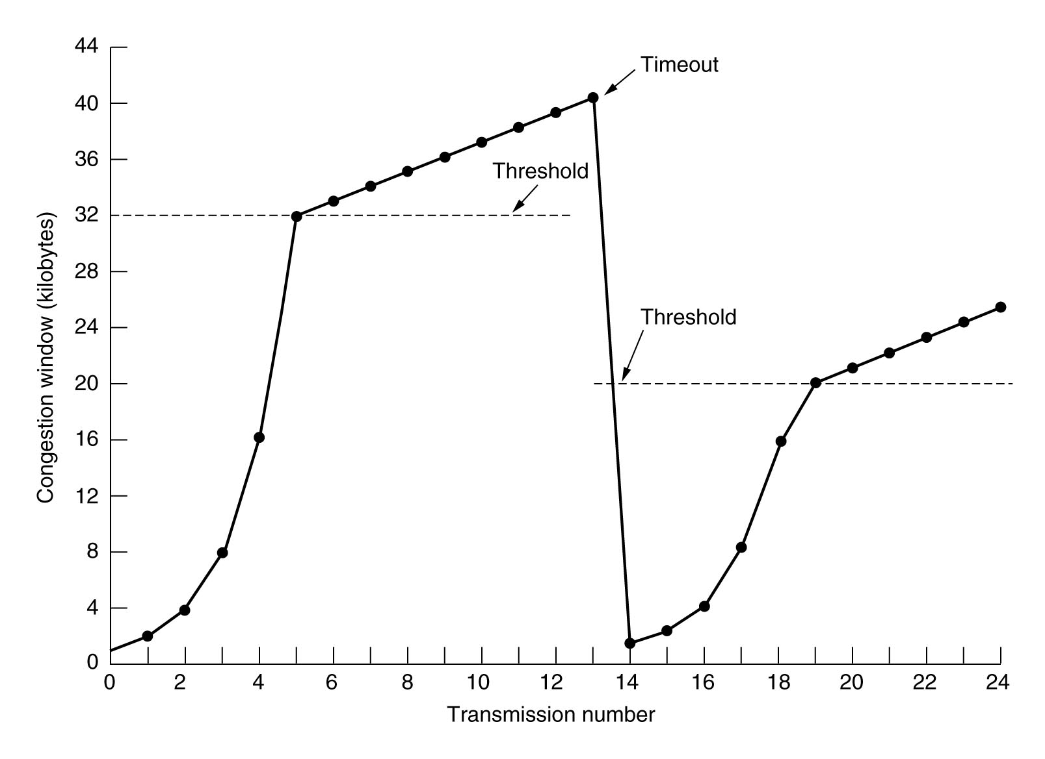
An Example of the Internet Congestion Algorithm
Constant？

Slide 67
Chapter 7 application layer
Function of application layer
Master DNS
Application
  E-mail
  www
  ftp/telnet
  Multimedia
CDN/P2P: Chord

Slide 68

No Pain, NO Gain!
No Pain NO Gain！

Slide 69

Many thanks to
Every student
Assistant teacher
Materials from internet

