Slide 1
Problems and their solutions
袁华：hyuan@scut.edu.cn
School of Computer Science & Engineering ,SCUT
Communication & Computer Network key-Lab of GD

Slide 2
Try to explain encapsulation and decapsulation.
Encapsulation：is top-down process happened in the sender .In each layer,encapsulation add the specialized tail and head information to the application data.
  Its process: information->data->segment->packet->frame->bit
  The information is encapsulated to form the data ,then the data is transported to the transport layer and encapsulated as the segments, the segments are encapsulated to the packets in NL, in the packets, there is the IP information. Then the packets is sent to the data link layer and become the frame which has the MAC address, finally the frame is transformed into bits in PL.
De-Encapsulation:
  De-Encapsulation is a down-top process happened in the receiver.The process is opposite to the encapsulation .It begins in the physical layer and then the bits transform to frames, frames is de-encapsulated to the packets, the packets is de-encapsulation to the segments, the segments transform to the data and finally the data is de-encapsulated to information.

Slide 3
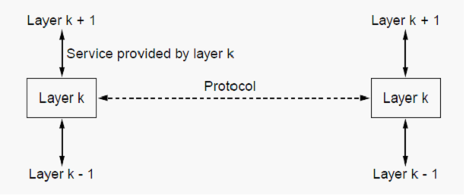
Suppose there is a change in the
service (set of operations) provided by layer k. How does this impact services at layers k-1 and k+1?
The K+1 layer Will be affected, because the services are provided by the lower to upper layer, such as k layer provided services to k+1 layer，and k layer’s service is provided by the k-1 layer.

Slide 4
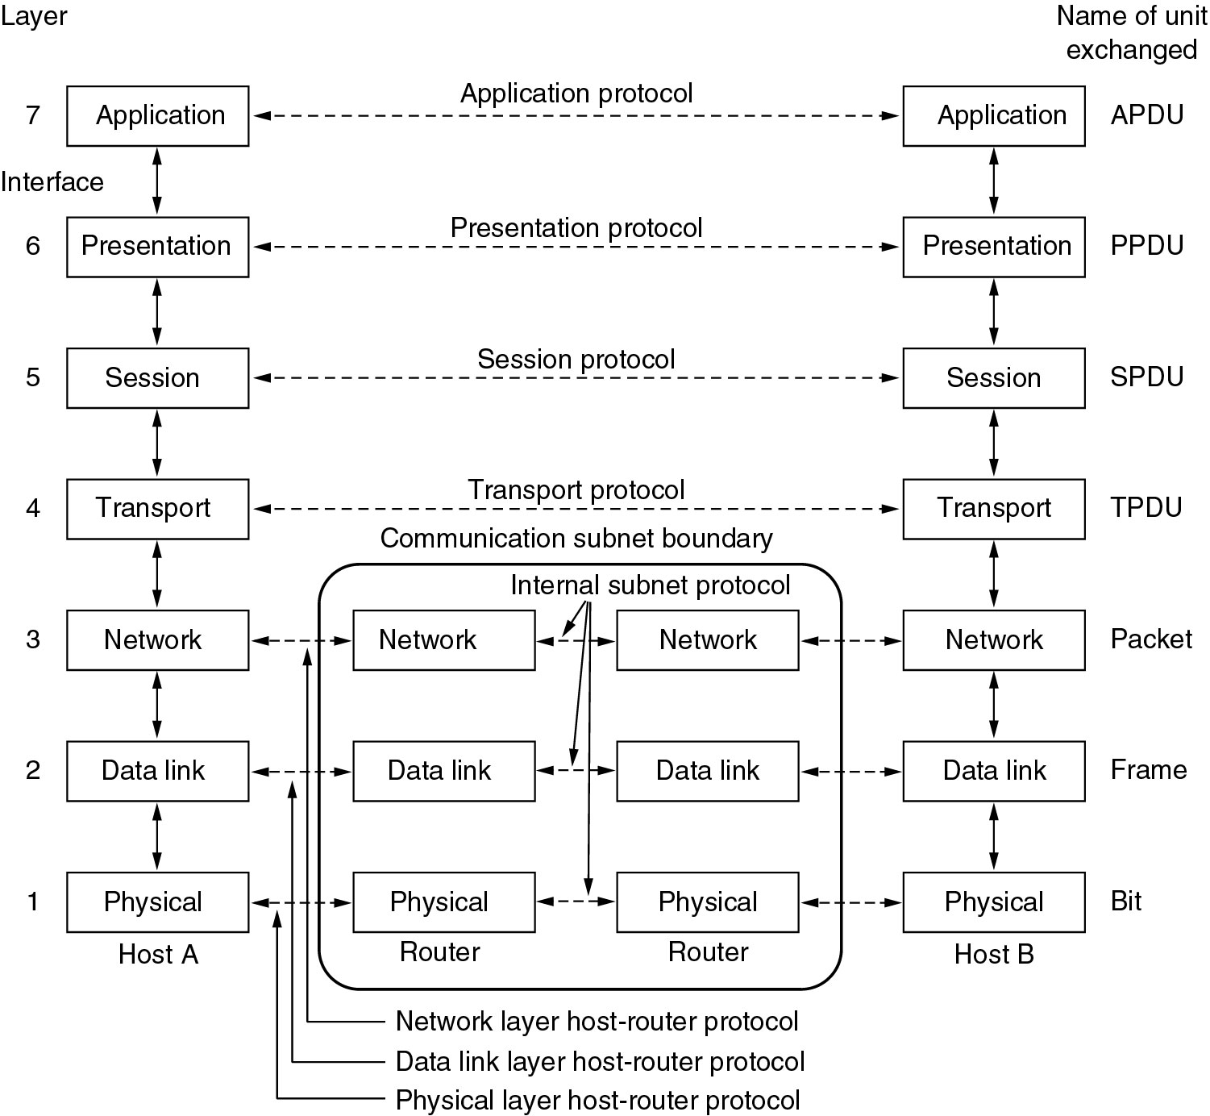
Try to explain peer-to-peer communication (virtual communication)
The entities comprising the corresponding layers on different machines are called peers. It is peers that communicate by using the protocol to talk to each other. It seems that some layer can communicate with the same layer in other sides, which means there is a “real” channel between these correspoding peers. In the layered model, in reality, no data are directly transferred from layer n on one machine to layer n on another machine. Instead, each layer passes data and control information to the layer immediately below it, until the lowest layer is reached. Below layer 1 is the physical medium through which actual communication occurs.

Slide 5
A noiseless 8-kHz channel is sampled every 1 msec. What is the maximum data rate?
  Solution：
  According to: Maximum data rate=: 2B log2 V bits/sec
  Assume: log2 V=4
  the maximum data rate =2Hlog2 V b/s=2*8k*4=64kbps

Slide 6
If a binary signal is sent over a 3-kHz channel whose signal-to-noise ratio is 20 dB,what is the maximum achievable data rate?
  Solution: According to Shannon’s theorem:the maximum data rate= B log2 (1 + S/N)
  According to : 10lgS/N = 20 dB So:S/N =100
  log2 101≈6.658
  So: the maximum data rate = B log2 (1 + S/N)≈3k*6.658=19.98Kbps

Slide 7
What is the maximum bit rate achievable in a V.32standard modem if the baud rate is2400 and no error correction is used?
  Solution:
  according to C=B*log2V
  no error correction is used, So: C=2400* log232 =12000bps

Slide 8
What's the function of repeater(中继器) and hub(集线器)?
  Answer：
  De-noise and amplify the signal
  Can extend the network’s range
  As a hub, can be the center of the star-topology

Slide 9
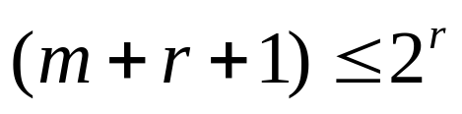
An 8-bit byte with binary value 10101111 is to be encoded using an even-parity Hamming code. What is the binary value after encoding?
  According to ，m=8 ➔ r=4
  P1=B1⊕B3⊕B5⊕B7⊕B9⊕B11 =∑(0,1,0,0,1,1)=1
  P2=B2⊕B3⊕B6⊕B7⊕B10⊕B11=∑(0,1,1,0,1,1)=0
  P3=B4⊕B5⊕B6⊕B7 ⊕B12 =∑(0,0,1,0,1)=0
  P4=B8⊕B9⊕B10⊕B11⊕B12 =∑(0,1,1,1,1)=0
  So, Hamming code is: 101001001111

Slide 10
A switch designed for use with fast Ethernet has a backplane that can move 10 Gbps. How many frames/sec can it handle in the worst case?
  Solution：
  In the worst case, every frame will be transmitted using the shortest length, that’s 64byte.
  Suppose it can handle x frames/s.
  64B×8bit/frame×x frame/s=10Gbps
  x=10×10**9/512=19531250(frame)

Slide 11
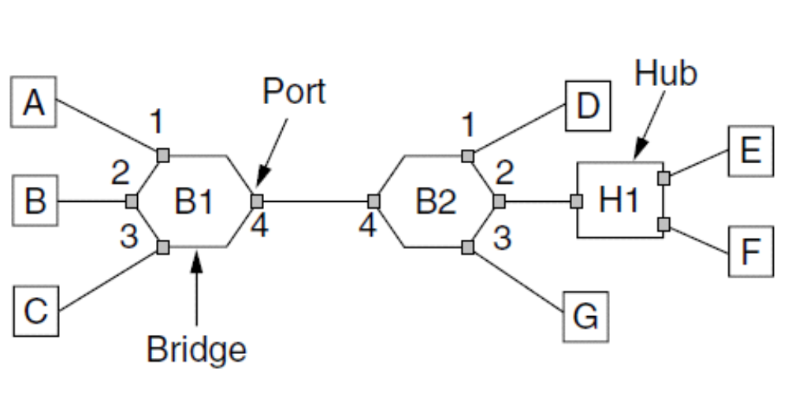
Suppose the hash tables in the two bridges are empty. List all ports on which a packet will be forwarded for the following sequence of data transmissions:
(a) A sends a packet to C.
(b) E sends a packet to F.
(c) F sends a packet to E.
(d) G sends a packet to E.
(e) D sends a packet to A.
(f) B sends a packet to F.

Slide 12
Suppose that instead of using 16 bits for the network part of a class B address originally, 20 bits had been used. How many class B networks would there have been?
  Solution:
  20 bits had been used for the network part of a class B address，but there are 2 bits is fixed，so there are only 2**18 class B networks
  the number of networks would have been 2**18 or 262,144. However, all 0s and all 1s are special, so only 262,142 are available.

Slide 13
On a router A, run the following command lines:
ip route 193.46.64.0 255.255.252.0 S0
ip route 0.0.0.0 0.0.0.0 S1
(1) Please explain what the above lines do. (2 marks)
(2) For the flowing destination IPs, please explain what the router will do. (3 marks)
193.46.65.10; 193.46.67.14; 193.46.40.7
  Solution:
  (1) Static routing; Default routing
  (2)S0; S0; S1

Slide 14
If a research lab was given a C-like IP address 125.66.86.0, we want to create 29 subnets on the network.
(1) Please write sunbnetting method, and what the subnet mask? (4 marks)
(2) How many IPs can be allocated to PCs in each subnet? (3 marks)
(3) Please write down the legal IP address with maximum subnet-id and minimum host-id. (3 marks)
Solution:
（1）255.255.255.248
（2）8-2=6
（3）125.66.86.241 (11110 001)

Slide 15
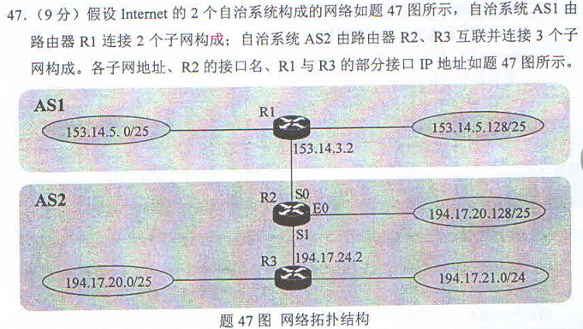
2013考研真题

Slide 16
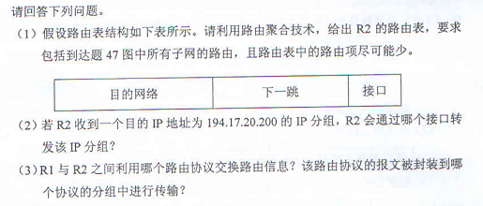
2013考研真题（续）

Slide 17
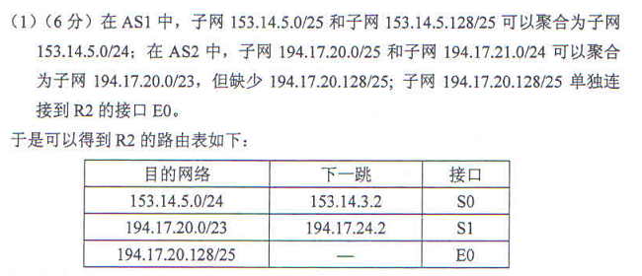
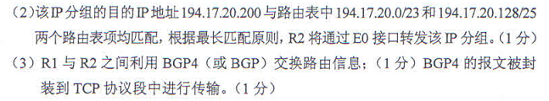
参考答案

Slide 18

Many thanks to
Every student
Assistant teacher
Materials from internet

