Slide 1
Extremely Low Bit Neural Network: Squeeze the Last Bit Out with ADMM(AAAI2018)
胡超杰
2018.10.19

Slide 2
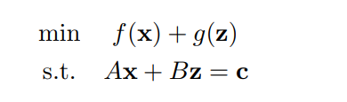
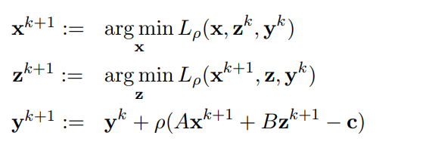
ADMM
拉格朗日乘子
二次惩罚项

Slide 3


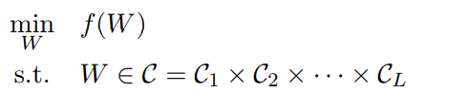

The objective function
$$α$$

Slide 4
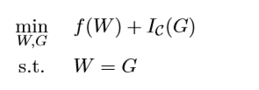

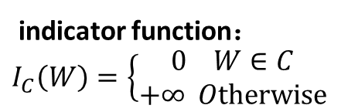
The objective function
indicator function：
$I_{C}\left(W\right)=\left\{\begin{aligned}0 W∈C \\ +∞ Otherwise\end{aligned}\right.$

Slide 5


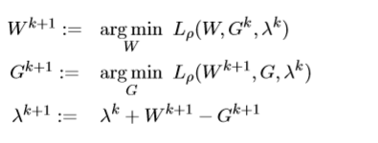
The objective function

Slide 6




Proximal step

Slide 7



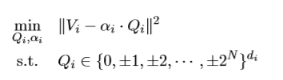

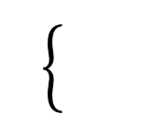
Proximal step

Slide 8
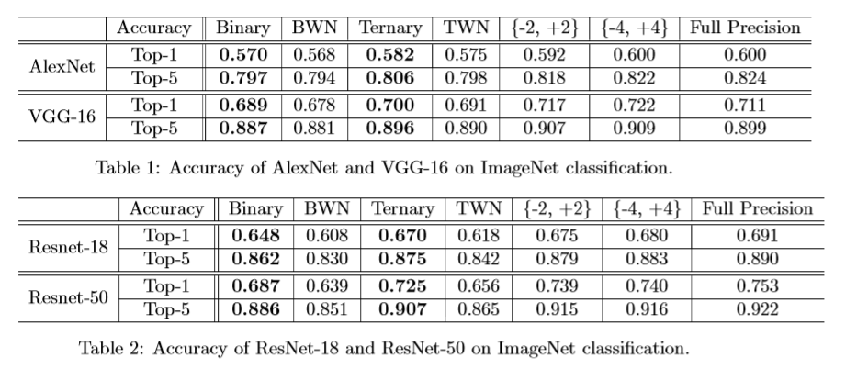
Experiments

Slide 9
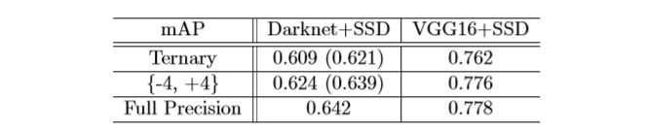
Experiments

Slide 10
Thanks！

