Slide 1
Federated Learning
胡超杰
2018.11.09

Slide 2
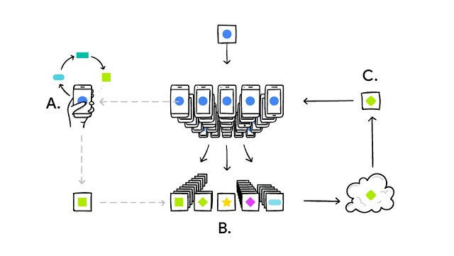
Federated Learning
1、手机端根据本地信息更新模型
2、在wifi、充电、无操作状态下上传模型更新
3、云端模型更新

Slide 3
Federated Learning
存在的问题：
1、移动端高延迟、低吞吐、间歇性训练。
2、移动端设备之间数据往往不是独立同分布
3、移动端设备之间数据量不平衡
4、通信成本
Federated Averaging

Slide 4
Communication-Efﬁcient Learning of Deep Networks from Decentralized Data
AISTATS 2017

Slide 5
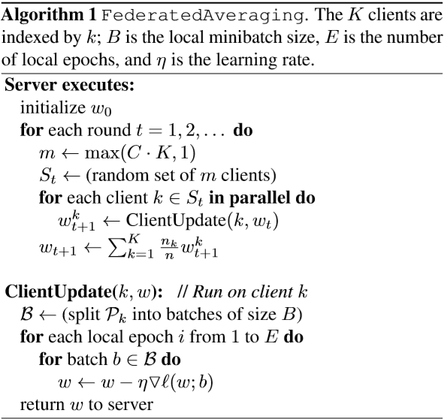
No-IID
Federated Averaging
分布式节点内部根据本地数据进行训练
云端定期从K个节点中随机抽取m个节点的更新信息
云端权重更新就是分布式节点对应权重的加权和

Slide 6
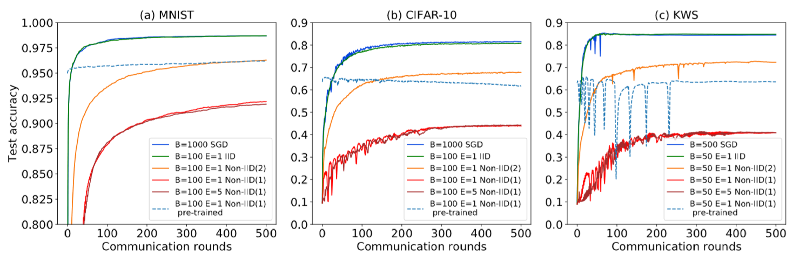
Experimental Results

Slide 7
Federated Learning with Non-IID Data
https://arxiv.org/abs/1806.00582

Slide 8
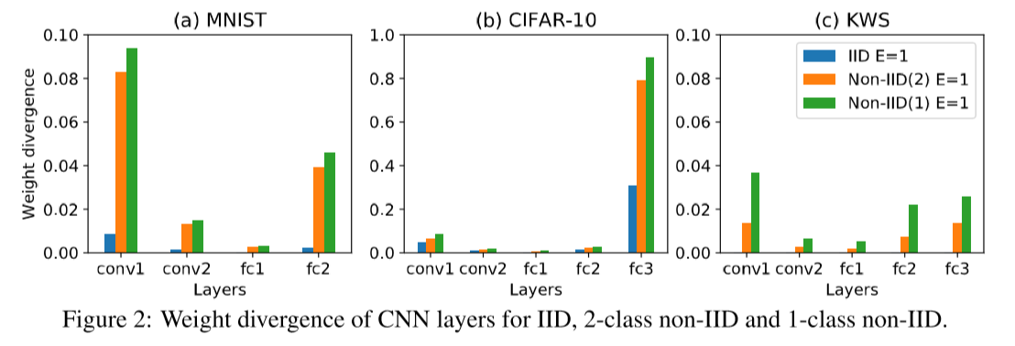
Weight Divergence due to Non-IID Data

Slide 9
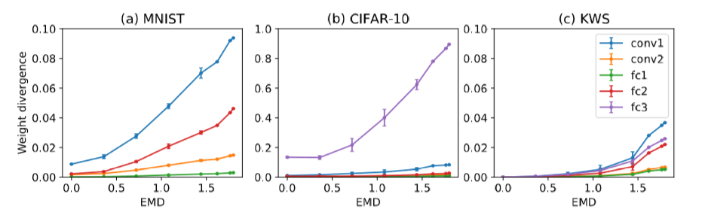
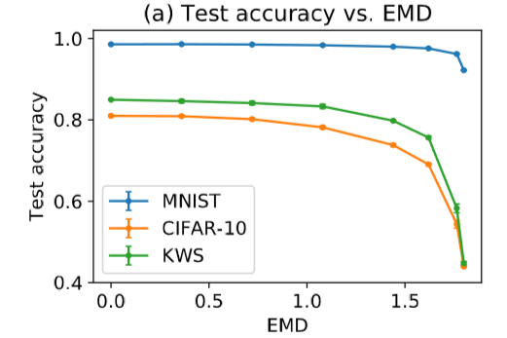
Weight Divergence due to Non-IID Data
EMD：不同数据集之间距离的度量指标，分布差异越大EMD值越大

Slide 10
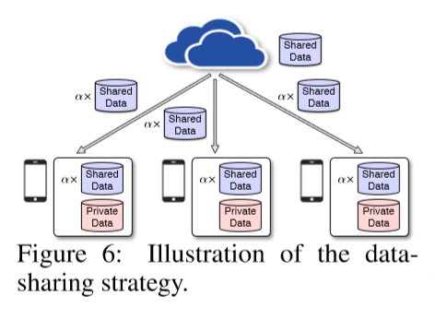
Proposed Solution
we can distribute a small subset of global data containing a uniform distribution over classes from the cloud to the clients

Slide 11
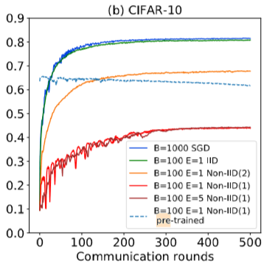
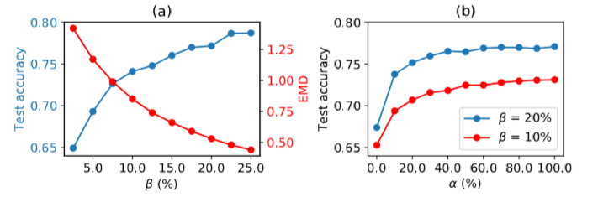

Experimental Results
With sharing data
Without sharing data
G:sharing data
D:total data from clients

Slide 12
Thanks!

