Slide 1
LARGE SCALE DISTRIBUTED NEURAL NETWORK TRAINING THROUGH ONLINE DISTILLATION(ICLR2018)
胡超杰
2018.11.02

Slide 2
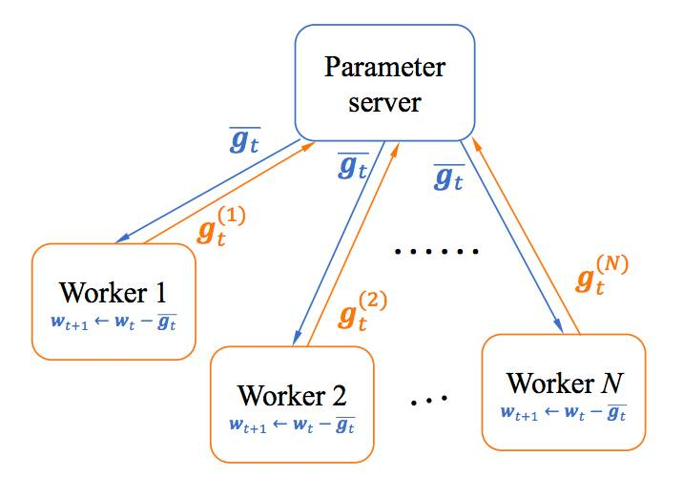
分布式训练
adding workers does not further improve training time

Slide 3
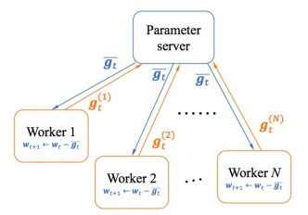
分布式训练
use extra machines to train another copy of the model and create an ensemble to improve accuracy
....
increases the cost at test time

Slide 4
分布式训练
Group 1
Group 2
Group M
....
M*N machines
distillation
N machines

Slide 5
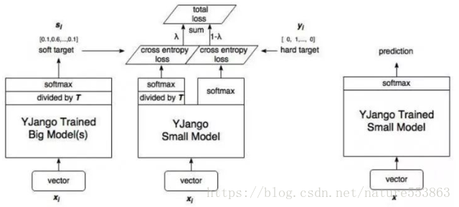
知识蒸馏
教师网络预测输出除以T再做softmax，获得软化的概况分布，避免放大错误分类的概率，引入不必要的噪声

Slide 6
分布式训练
人工决定什么时候停止集成网络的训练什么时候开始蒸馏
蒸馏过程中网络通信成本较高
蒸馏过程中多个分布式节点同步运行稳定性不易保证

Slide 7
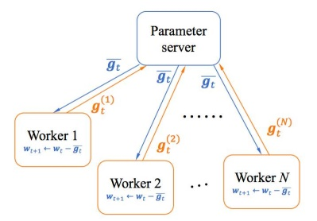
CODISTILLATION
参数服务器
下载其他节点
参数副本
上传参数副本
........

Slide 8
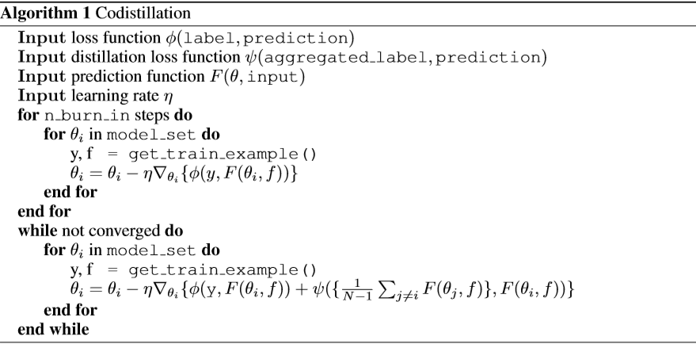
CODISTILLATION
1. Each worker trains an independent version of the model on a locally available subset of the training data.
2. Occasionally, workers checkpoint their parameters.
3. Once this happens, other workers can load the freshest available checkpoints into memory and perform codistillation.

Slide 9
Thanks！

