Slide 1
Distributed k-Means and k-Median Clustering on General Topologies (NIPS 2013)
刘敏仟
2018.11.18

Slide 2
介绍
分布式聚类：在任意一个图中，数据分布在图的节点上，通信被限制在图的边上。
论文中通过建立一个点的小集合来代表整个数据集，来减少在平凡图中的通信。

Slide 3
Coreset
A coreset is a set of weighted points whose cost approximates the cost of the original data for any set of k centers. Set P is a weighted data set with a weighting function w.

Slide 4
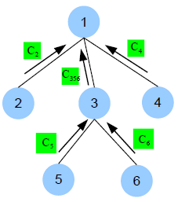
Each node computes a coreset on the weighted pointset for its own data and its subtrees’ coresets.（另一论文）

Slide 5
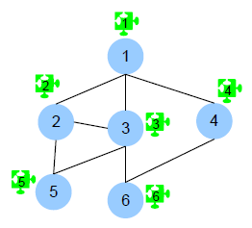
Local constant approximation solutions are computed, and the costs of these solutions are used to coordinate the construction of a local portion on each node.

Slide 6
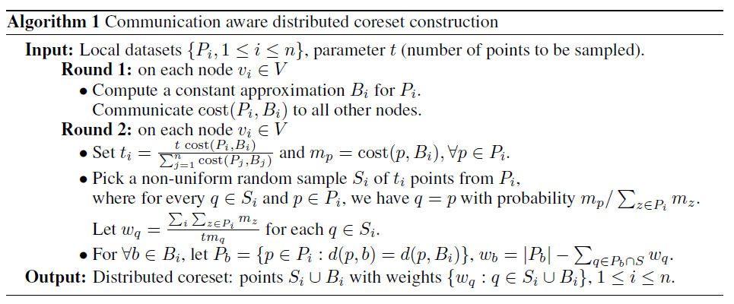
算法
They use P_{b} to represent the set of points which have b as their closest center in the local approximation solution.

Slide 7
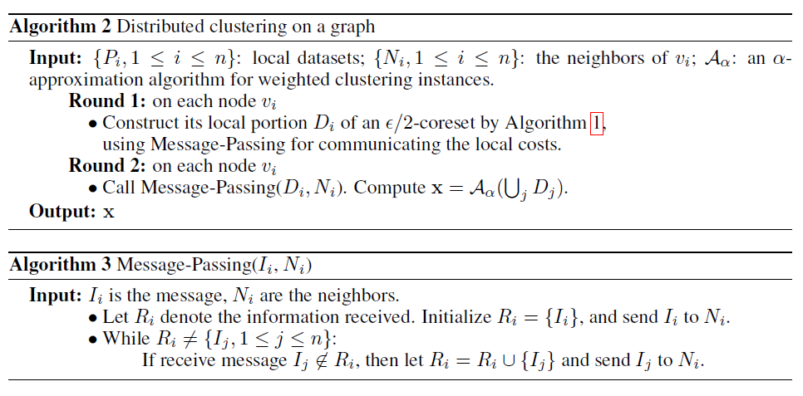

Slide 8
实验数据
数据集：YearPredictionMSD (515345 points in R⁹⁰; k = 50)
数据分配方法：uniform, similarity-base, weighted, degree-based
该论文与论文Q. Zhang, J. Liu, and W. Wang. Approximate clustering on distributed data streams. In Proceedings of the IEEE International Conference on Data Engineering, 2008. 提出的COMBINE算法进行了对比

Slide 9
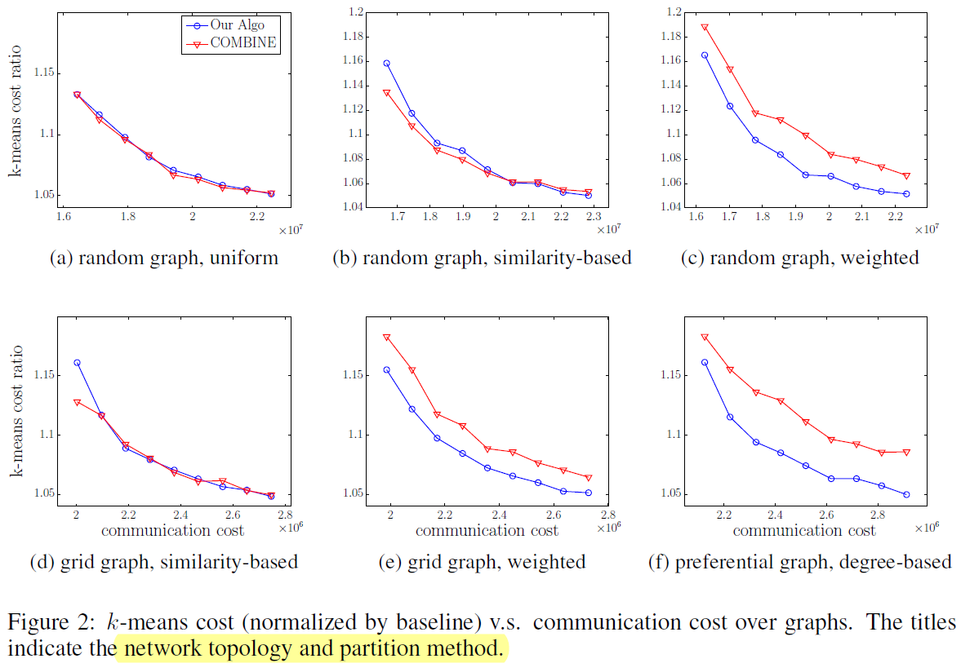

Slide 10
