Slide 1
Perceive Where to Focus: Learning Visibility-aware Part-level Features
for Partial Person Re-identification
Yifan Sun, Qin Xu, Yali Li, Chi Zhang, Yikang Li, Shengjin Wang, Jian Sun
CVPR 19
Reference: https://arxiv.org/pdf/1904.00537v1.pdf
Intelligent Information Fusion Research Group

Slide 2
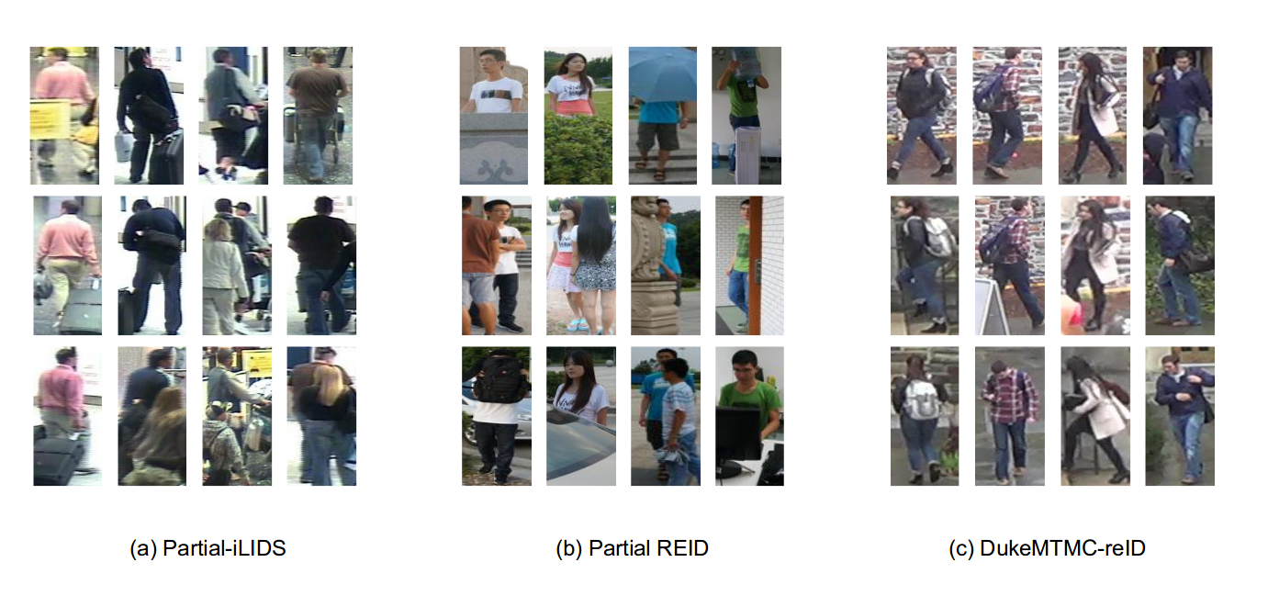
Dataset
局部行人重识别
完整行人重识别
引言
1.

Slide 3
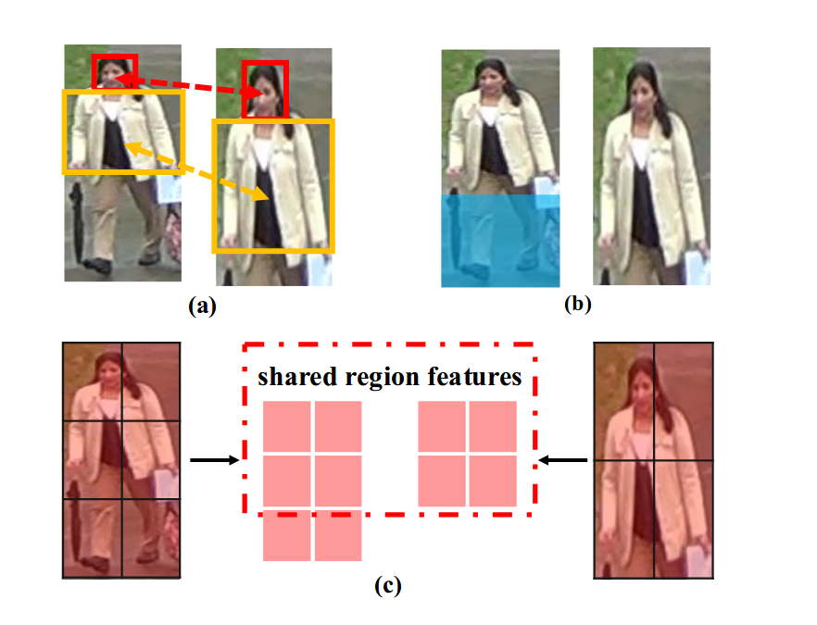
Challenges and Ideas
(a) Misalignment
(b) Extra distracting noises
(c) Ideas
Learning part features
Perceive visible parts
focusing on shared parts
引言
2.

Slide 4
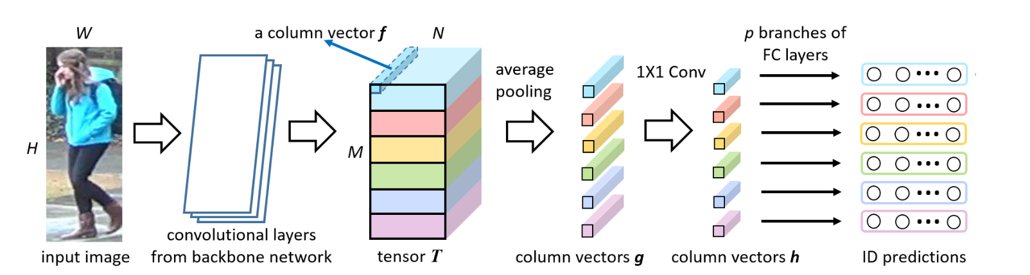
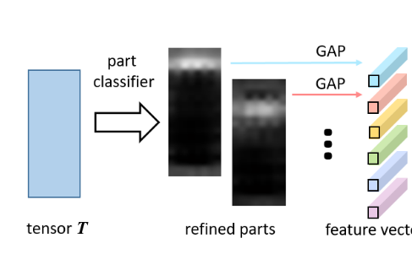
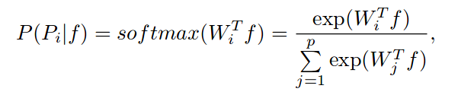

PCB + RPP
Reference: Yifan Sun, Beyond Part Models: Person Retrieval with Refined Part Pooling
引言
3.

Slide 5
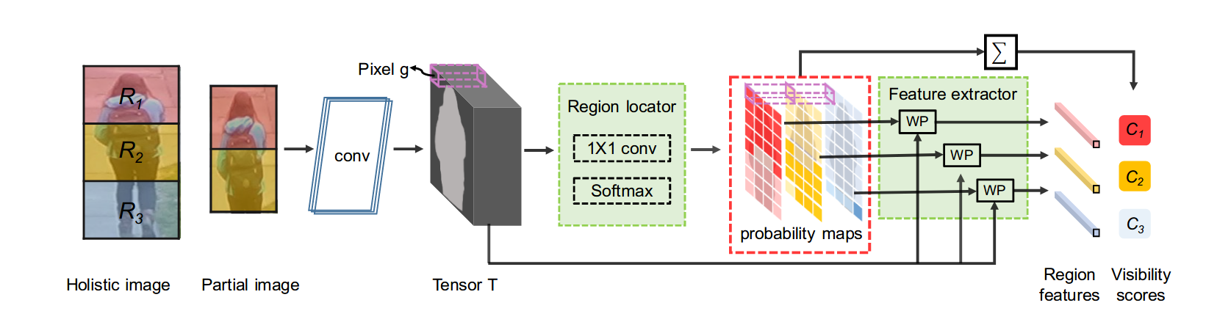
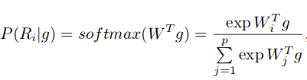


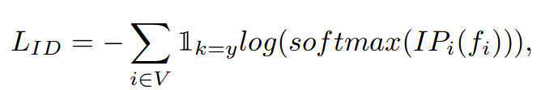
VPM(Visibility-aware Part Model)
对完整行人图像预定义p（图中p为3）个区域
切除局部区域后，resize到一定大小，输入CNN得到tensor T，再经过一个Attention得到每个pixel属于p个区域的概率（probability maps），概率与T相乘再池化可得区域特征
只有可见区域才算分类loss，只有共享区域才算度量loss。
VPM
4.

Slide 6
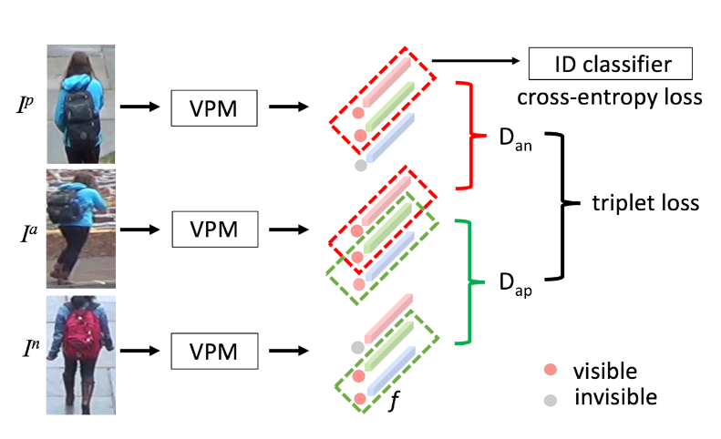
VPM Traning
只有可见区域才算分类loss，只有共享区域才算度量loss
VPM
5.

Slide 7
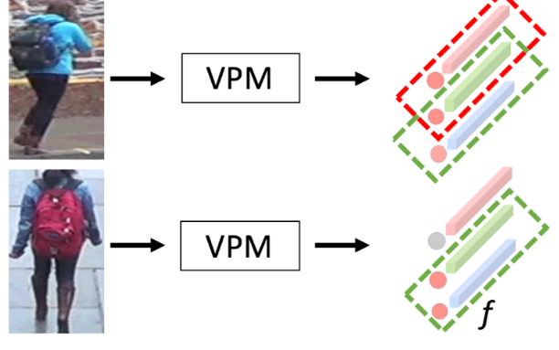
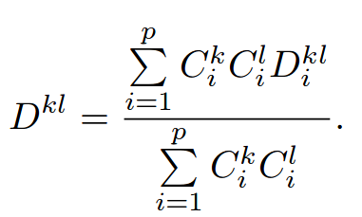
Employing VPM
分数一大一小，那么这个区域距离影响就小。之后再做归一化
VPM
6.

Slide 8
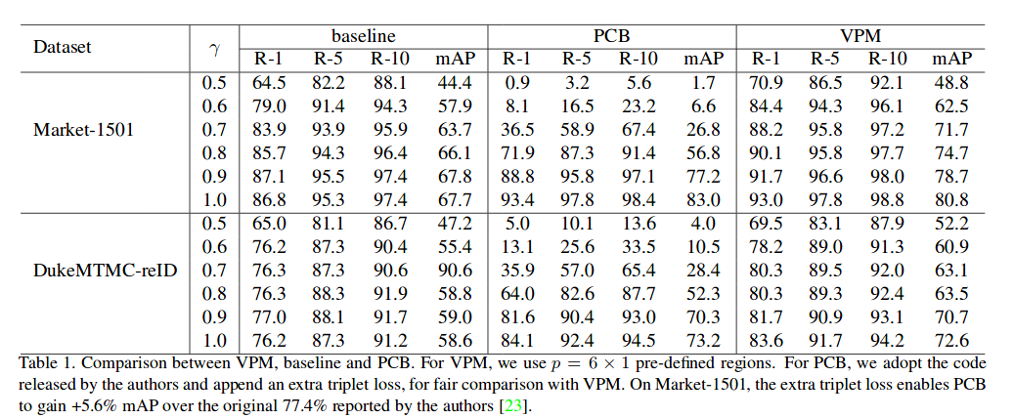
Experiments
Experiments
7.

Slide 9
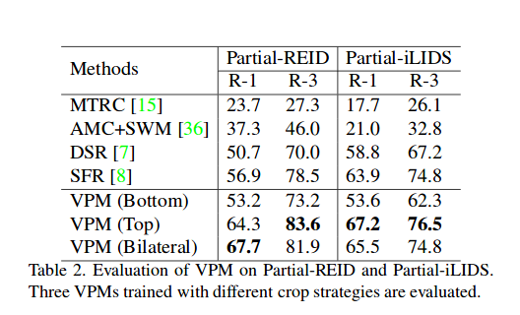
Experiments
Experiments
8.

Slide 10
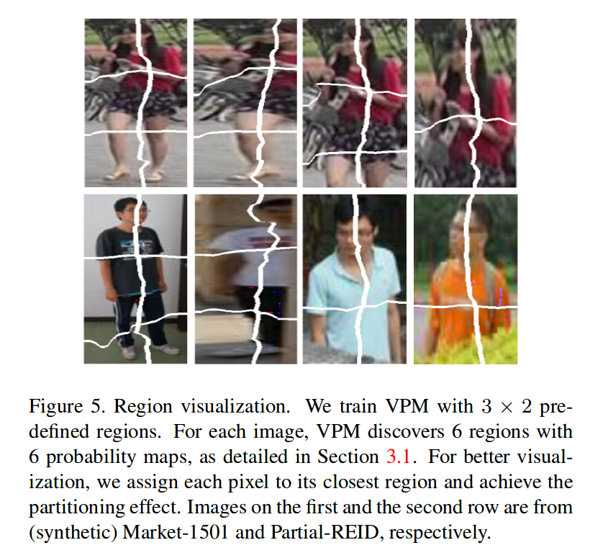
Experiments
Experiments
9.

Slide 11
THANK YOU！

