Slide 1

关键点检测中的多源异构
陈伟航 Tencent AI Lab

Slide 2
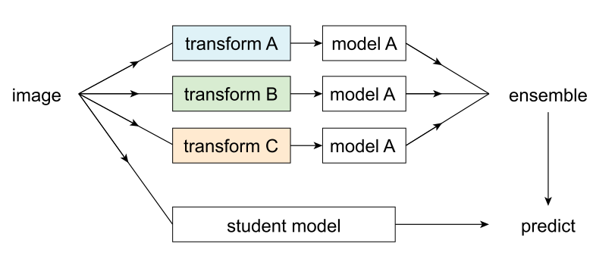
Data distillation
﻿In data distillation, ensembled predictions from a single model applied to multiple transformations of an unlabeled image are used as automatically annotated data for training a student model.

Slide 3
Multi Scale Selective Fusion for Pose Estimation

Slide 4
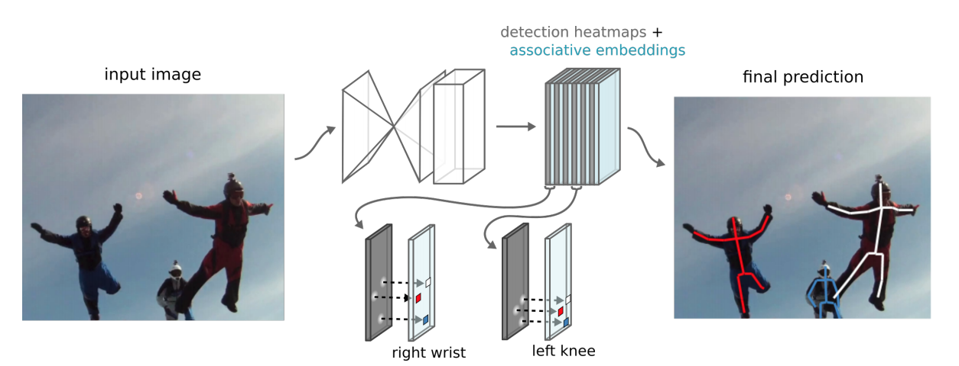
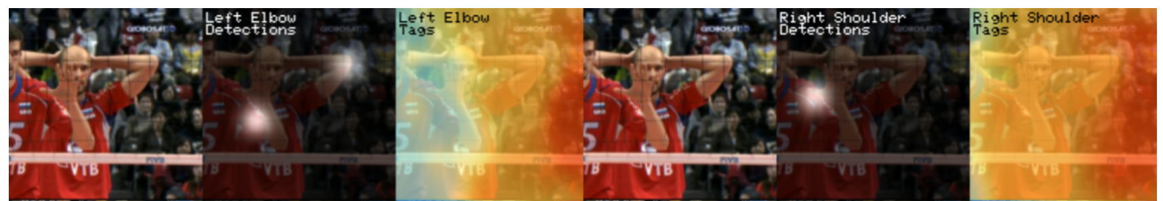
Associate Embedding Pose Estimation

Slide 5
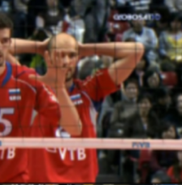
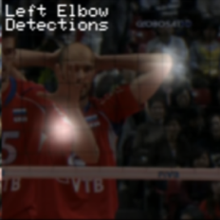
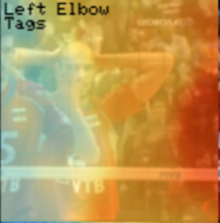
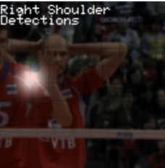
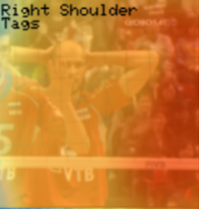
Multi Scale Fusion
Mean
Concat

Slide 6
Motivation
Scale | AP | APM | APL | APXL | APXXL
384 | 0.531 | 0.317 | 0.58 | 0.664 | 0.746
512 | 0.607 | 0.458 | 0.654 | 0.708 | 0.749
640 | 0.636 | 0.531 | 0.677 | 0.708 | 0.73
768 | 0.63 | 0.555 | 0.677 | 0.694 | 0.68
896 | 0.59 | 0.561 | 0.649 | 0.634 | 0.573
960 | 0.562 | 0.554 | 0.622 | 0.61 | 0.517
1024 | 0.532 | 0.542 | 0.609 | 0.561 | 0.462
Mv7 | 0.688 | 0.618 | 0.709 | 0.725 | 0.759
同个模型接收不同scale的输入，对不同size的目标识别准确率不同。

Slide 7
Multi Scale Fusion
Person size
Select
Mean
Select
Concat
Person size

Slide 8
Vote Select
每个Scale分别输出heatmap和tag，group得到keypoint对应的person
用keypoint的覆盖范围作为bbox，估算person size
根据图中的person size，对不同的scale投票，小的person对大的scale投票，大的person对小的scale投票，投票策略可以有多种选择
选择得票最高的三个scale进行fusion
Scale | AP | APM | APL | APXL | APXXL
Mv7 | 0.688 | 0.618 | 0.709 | 0.725 | 0.759
Vote select | 0.681 | 0.598 | 0.703 | 0.723 | 0.767
Mean & Vote | 0.69 | 0.615 | 0.708 | 0.726 | 0.771

Slide 9
Multi Scale Attention Fusion
FT
ATT
x
+
ATT
x
FT

Slide 10
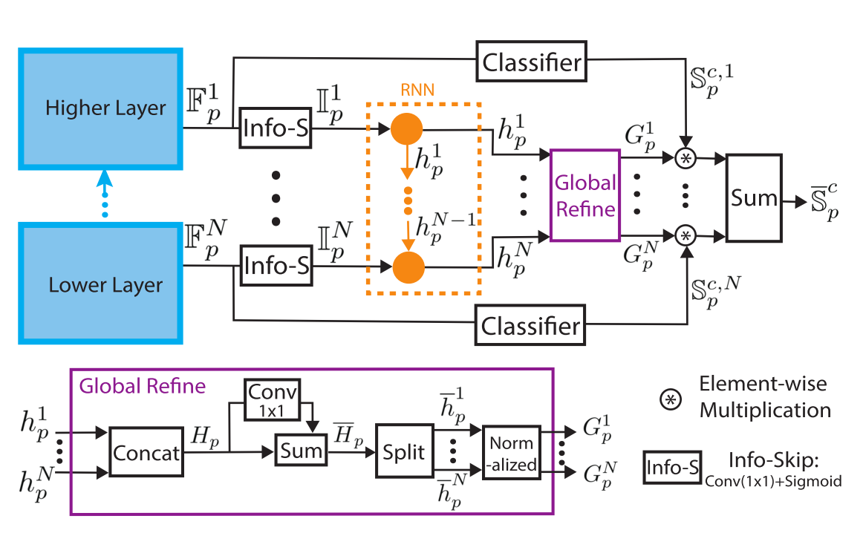
Multi scale feature fusion
Alibaba AI Lab CVPR2018

Slide 11
展望
Data distillation for auto labeling.
Key point and visual feature for person reid.
From two-stage model to one-stage model.
Scale selection for multi scale problems.
Graph search for person re-id.
Fixed Point Quantization on Raspberry.

Slide 12
Thank You

