Slide 1
EANet & DSAP
梁天保

Slide 2
Densely Semantically Aligned Person Re-Identification
CVPR 2019
Zhizheng Zhang, Cuiling Lan, Wenjun Zeng, Zhibo Chen
University of Science and Technology of China, Microsoft Research Asia
Contributions:
propose making use of dense semantic alignment for person Re-ID, addressing the misalignment challenges. The first one to make use of fine grained semantics to address the misalignment problems for effective person re-ID.
DSAG removes the dependency on the performance of the dense semantics estimator during interference, making the inference model more computationally efficient and robust to dense semantics estimation errors
http://openaccess.thecvf.com/content_CVPR_2019/papers/Zhang_Densely_Semantically_Aligned_Person_Re-Identification_CVPR_2019_paper.pdf

Slide 3
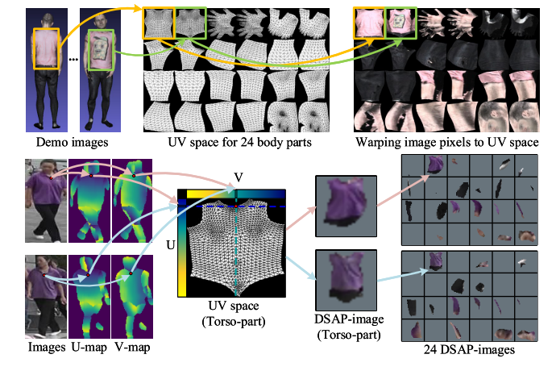
Densely Semantically Aligned Person Re-Identification
---- uv space
http://openaccess.thecvf.com/content_CVPR_2019/papers/Zhang_Densely_Semantically_Aligned_Person_Re-Identification_CVPR_2019_paper.pdf

Slide 4
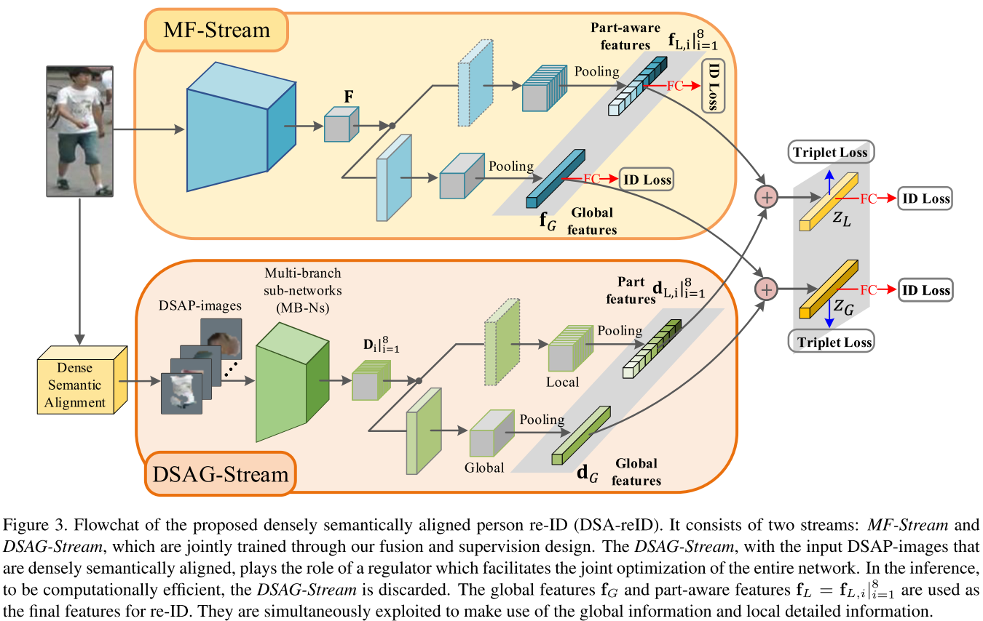
Densely Semantically Aligned Person Re-Identification
---- Method Overview
http://openaccess.thecvf.com/content_CVPR_2019/papers/Zhang_Densely_Semantically_Aligned_Person_Re-Identification_CVPR_2019_paper.pdf

Slide 5
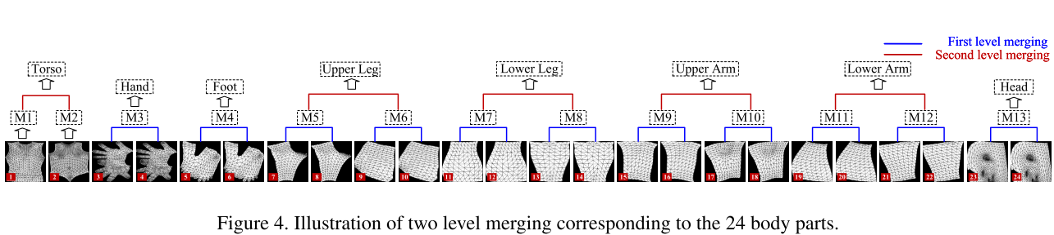
Densely Semantically Aligned Person Re-Identification
---- Method Overview
http://openaccess.thecvf.com/content_CVPR_2019/papers/Zhang_Densely_Semantically_Aligned_Person_Re-Identification_CVPR_2019_paper.pdf

Slide 6
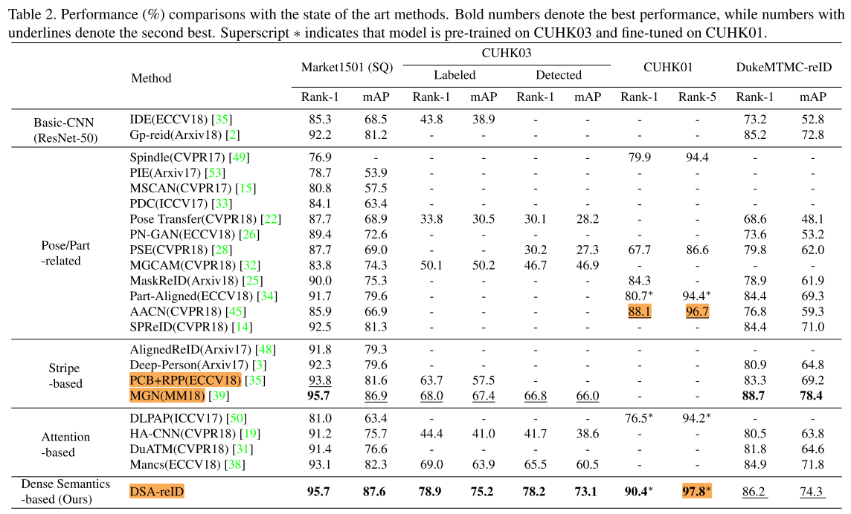
Densely Semantically Aligned Person Re-Identification
---- Experiment
http://openaccess.thecvf.com/content_CVPR_2019/papers/Zhang_Densely_Semantically_Aligned_Person_Re-Identification_CVPR_2019_paper.pdf

Slide 7
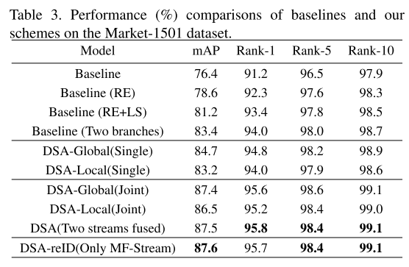
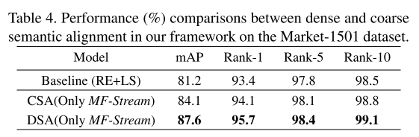
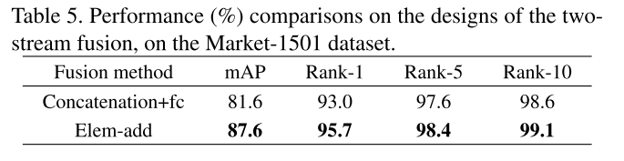
Densely Semantically Aligned Person Re-Identification
---- Experiment
CSA : coarsely semantically aligned, cropping images into 24 parts
DSA-Global/Local(Single): denotes the design with only the global/local branch in our two stream framework for both training and inferencing.
DSA-Global/Local(Joint): train with two branch and test with Global/Local features
http://openaccess.thecvf.com/content_CVPR_2019/papers/Zhang_Densely_Semantically_Aligned_Person_Re-Identification_CVPR_2019_paper.pdf

Slide 8
EANet: Enhancing Alignment for Cross-Domain Person Re-identification
arXiv 2018.12.29
Houjing Huang, Wenjie Yang, Xiaotang Chen, Xin Zhao, Kaiqi Huang, Jinbin Lin, Guan Huang, Dalong Du
CRISE & CASIA ,Horizon Robotics
Contributions:
address cross-domain ReID and make contributions for both model generalization and adaptation;
propose Part Aligned Pooling (PAP) that brings significant improvement for cross-domain testing.
design a Part Segmentation (PS) constraint over ReID feature to enhance alignment and improve model generalization.
https://arxiv.org/abs/1812.11369

Slide 9
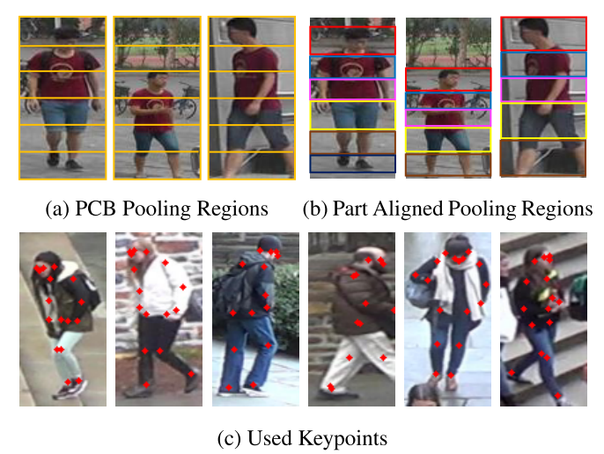
EANet: Enhancing Alignment for Cross-Domain Person Re-identification
--------Motivations
https://arxiv.org/abs/1812.11369

Slide 10
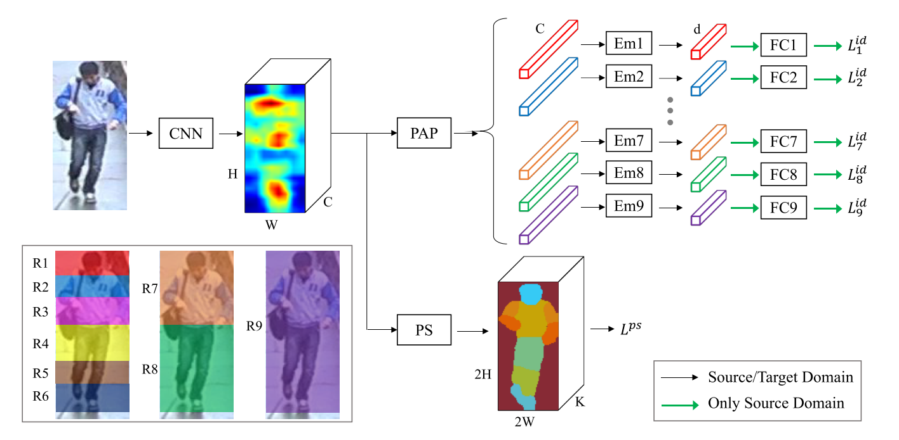
EANet: Enhancing Alignment for Cross-Domain Person Re-identification
--------Method OverView
https://arxiv.org/abs/1812.11369

Slide 11
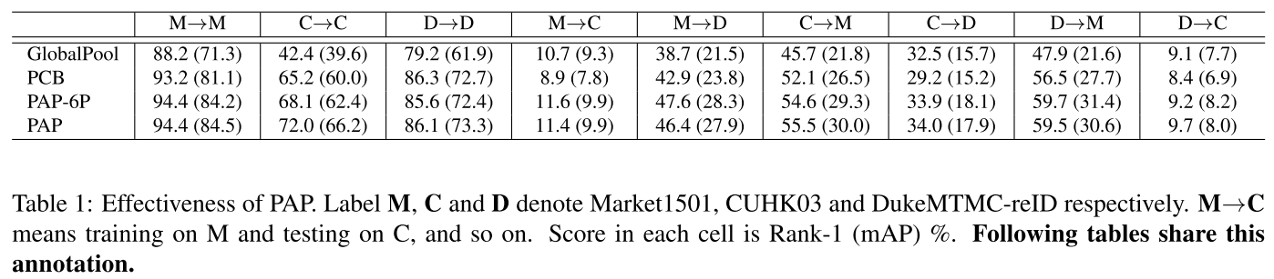
EANet: Enhancing Alignment for Cross-Domain Person Re-identification
---- Effectiveness of PAP
https://arxiv.org/abs/1812.11369

Slide 12
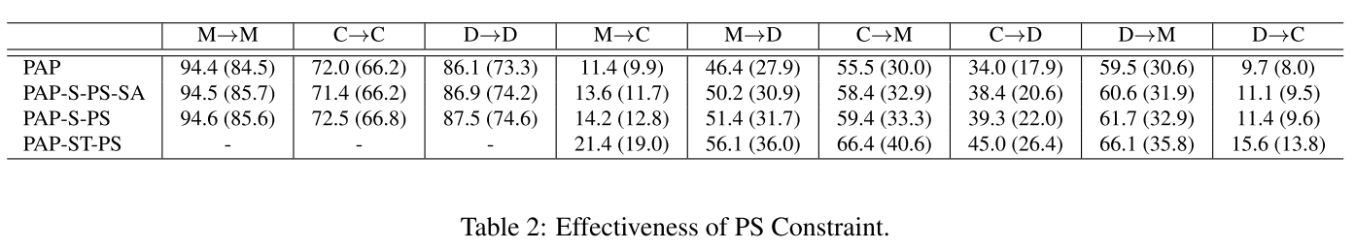
EANet: Enhancing Alignment for Cross-Domain Person Re-identification
---- Effectiveness of PS
PAP ：Traing on Source Domain with PAP component and directly test on Target Domain
PAP-S-PS : Traing on Source Domain with PAP and PS component and directly test on Target Domain
PAP-ST-PS : Train on Source Domain with PAP , PS loss and Target Domain with PS loss,then directly test on Target Domain
PAP-S-PS-SA : averaging over all pixel losses when calculating PS loss while PAP-S-PS calculating PS loss by averaging over each part pixel losses to avoid the loss dominating by large part
https://arxiv.org/abs/1812.11369

Slide 13
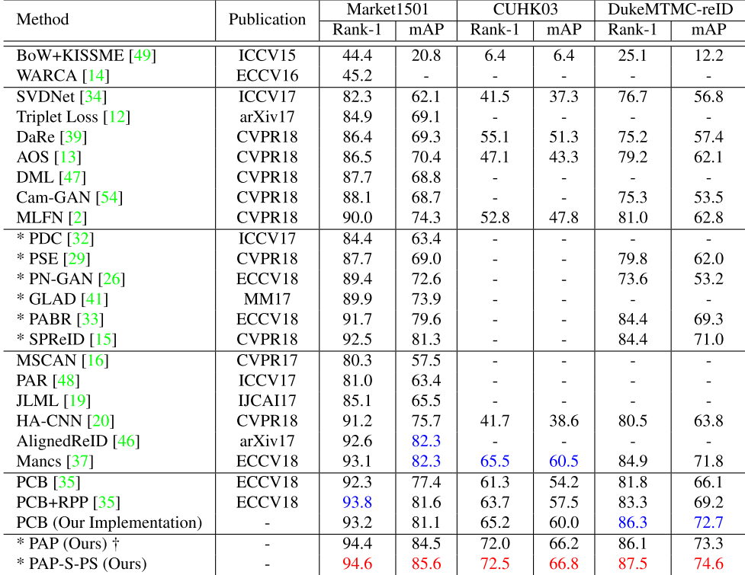
EANet: Enhancing Alignment for Cross-Domain Person Re-identification
---- Single Domain Comparison with SOTA
https://arxiv.org/abs/1812.11369

Slide 14
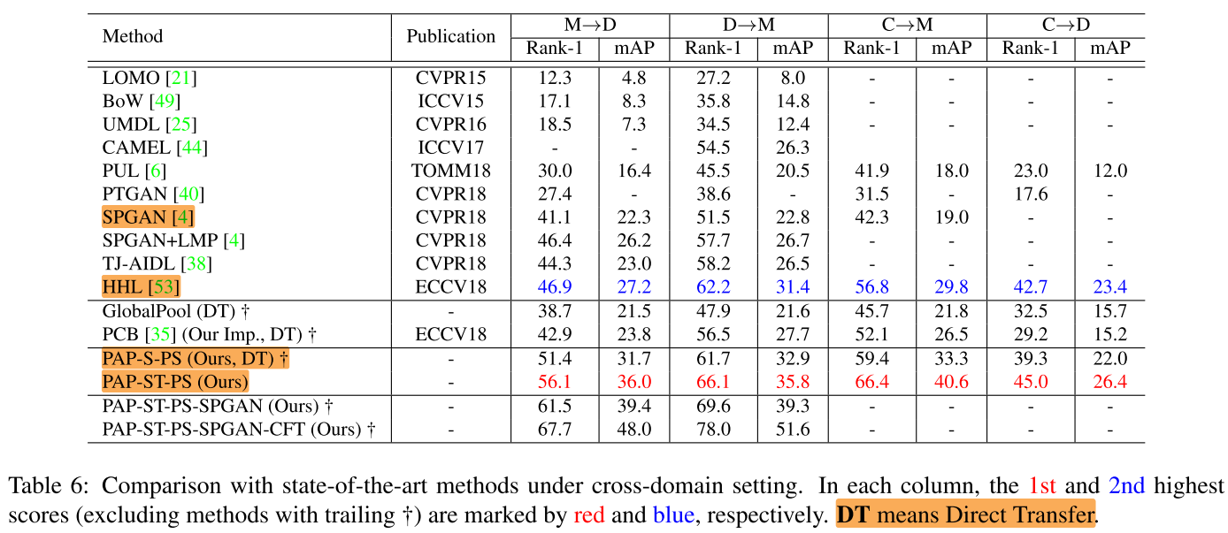
EANet: Enhancing Alignment for Cross-Domain Person Re-identification
Cross-Domain Comparison with SOTA
https://arxiv.org/abs/1812.11369

Slide 15
Thanks

