Slide 1
A Coarse-to-fine Pyramidal Model for Person Re-identification via Multi-Loss Dynamic Training
CVPR 2019
Feng Zheng, Xing Sun,
Xinyang Jiang, Xiaowei Guo,
Zongqiao Yu, Feiyue Huang
YouTu Lab, Tencent
梁天保
https://arxiv.org/abs/1811.11459

Slide 2
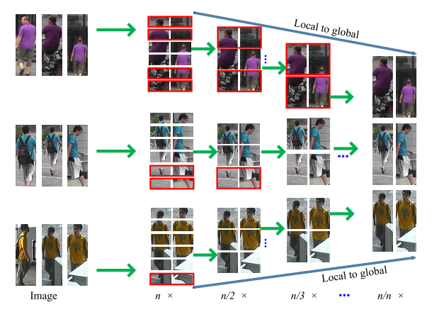
Abstract
https://arxiv.org/abs/1810.12193

Slide 3
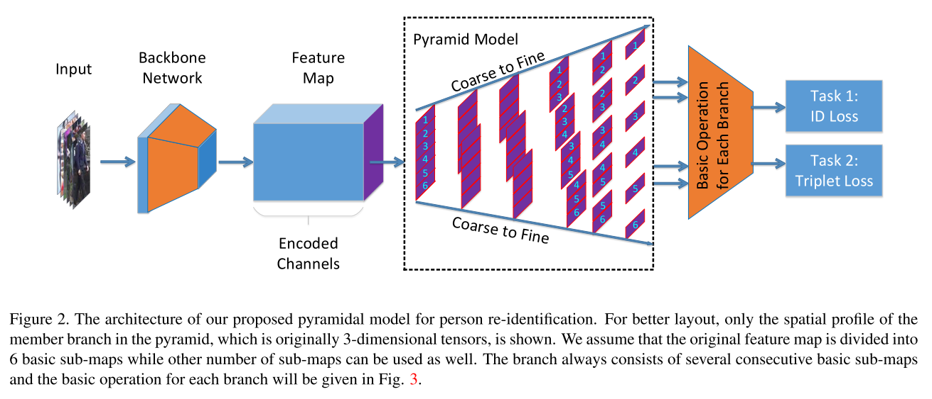
Abstract
https://arxiv.org/abs/1810.12193

Slide 4
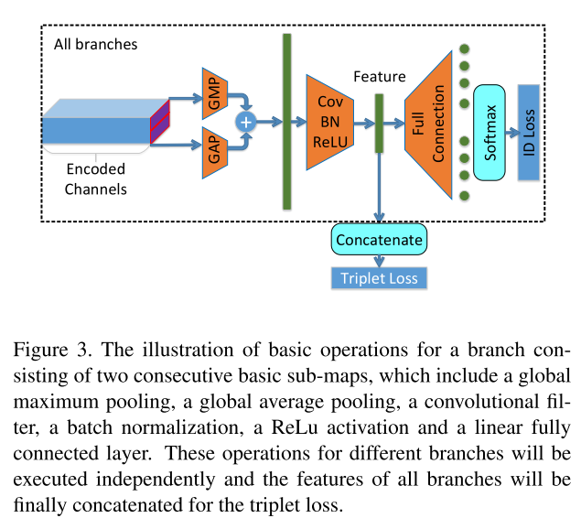
Abstract
https://arxiv.org/abs/1810.12193

Slide 5
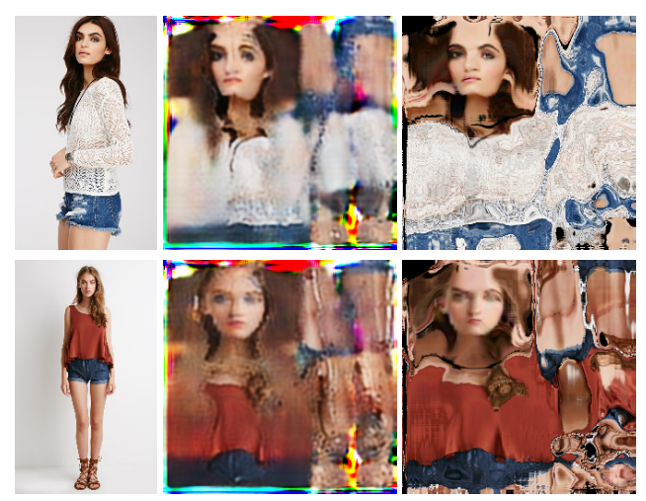
Abstract
https://arxiv.org/abs/1811.11459

Slide 6
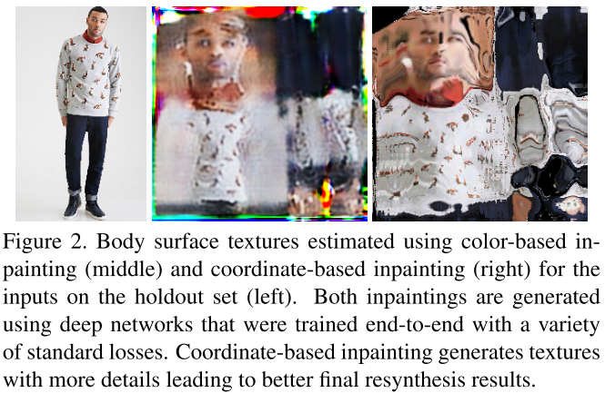
Abstract
https://arxiv.org/abs/1811.11459

Slide 7
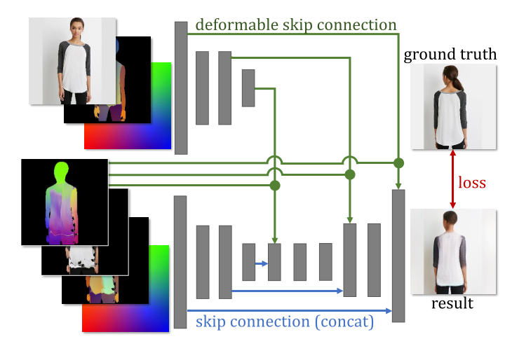
Abstract
https://arxiv.org/abs/1811.11459

Slide 8
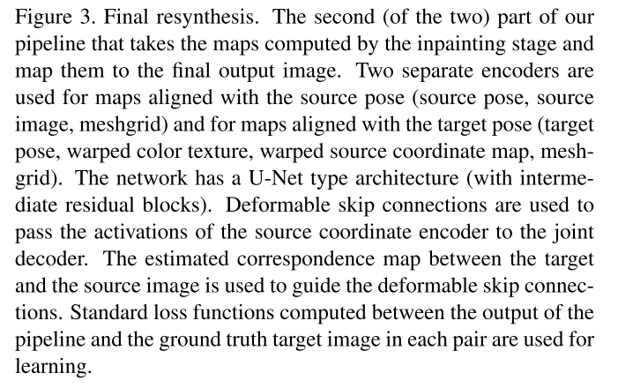
Abstract
https://arxiv.org/abs/1811.11459

Slide 9
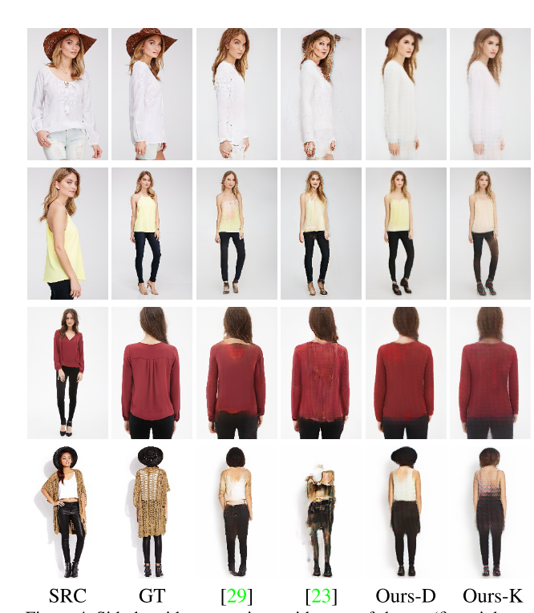
Abstract
https://arxiv.org/abs/1811.11459

Slide 10
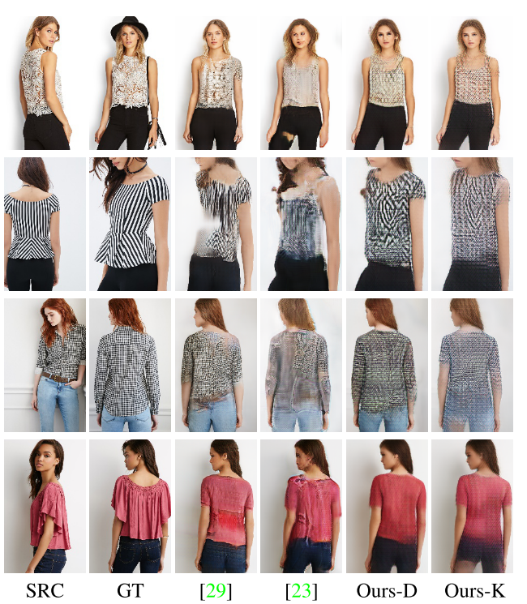
Abstract
https://arxiv.org/abs/1811.11459

Slide 11
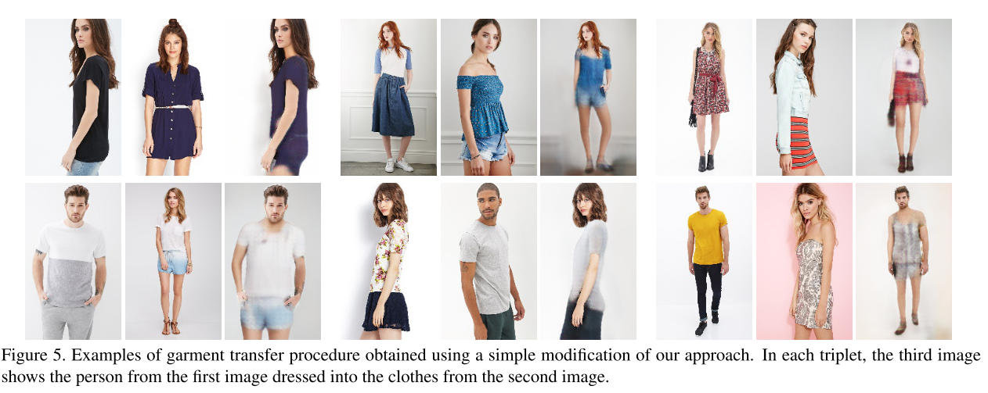
Abstract
https://arxiv.org/abs/1811.11459

Slide 12
Thanks
https://arxiv.org/abs/1811.11459

