Slide 1
Mask R-CNN
CVPR 2018
Kaiming He
Georgia Gkioxari
Piotr Dollar
Ross Girshick
Facebook AI Research(FAIR)
梁天保
https://arxiv.org/abs/1703.06870

Slide 2
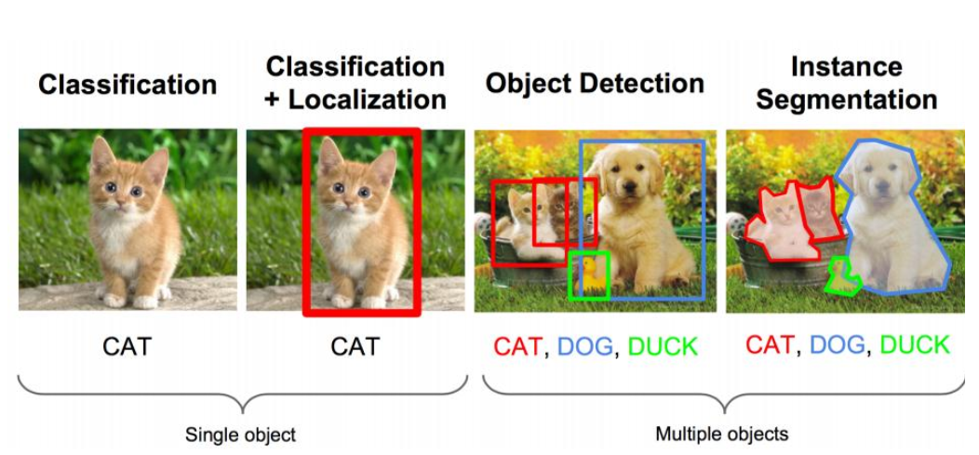
Task
https://arxiv.org/abs/1703.06870

Slide 3

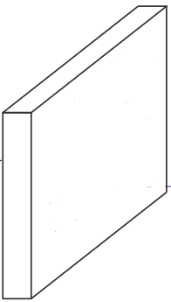
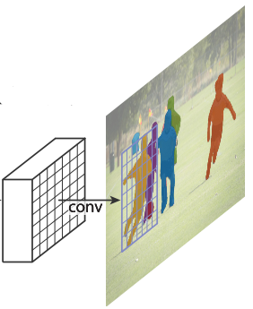
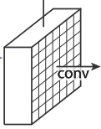
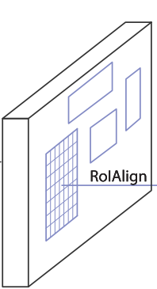
OverView
class
RPN
ROI Pooling
box
feature map
conv
mask
ROI Align
https://arxiv.org/abs/1703.06870

Slide 4
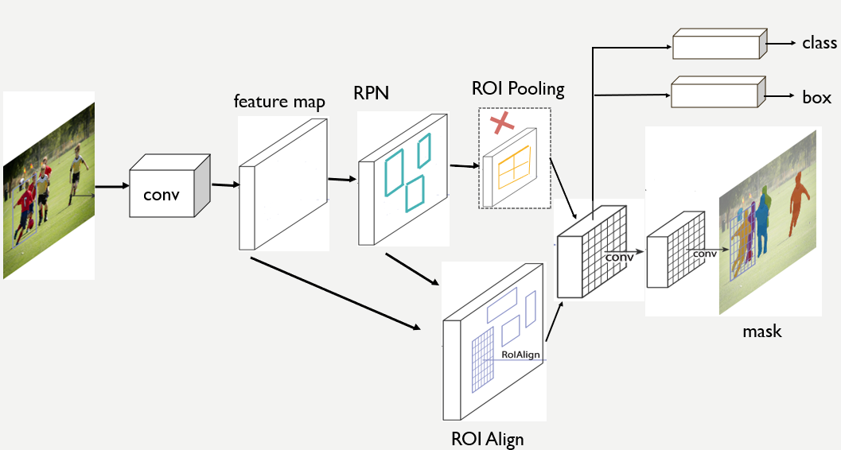
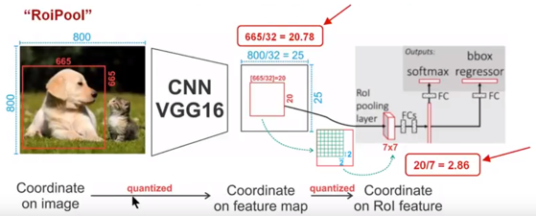
Roi Pooling
https://arxiv.org/abs/1703.06870

Slide 5
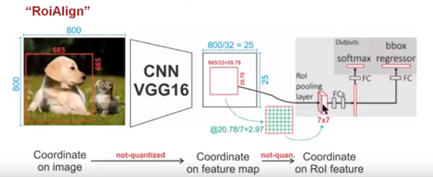
RoiAlign
https://arxiv.org/abs/1703.06870

Slide 6
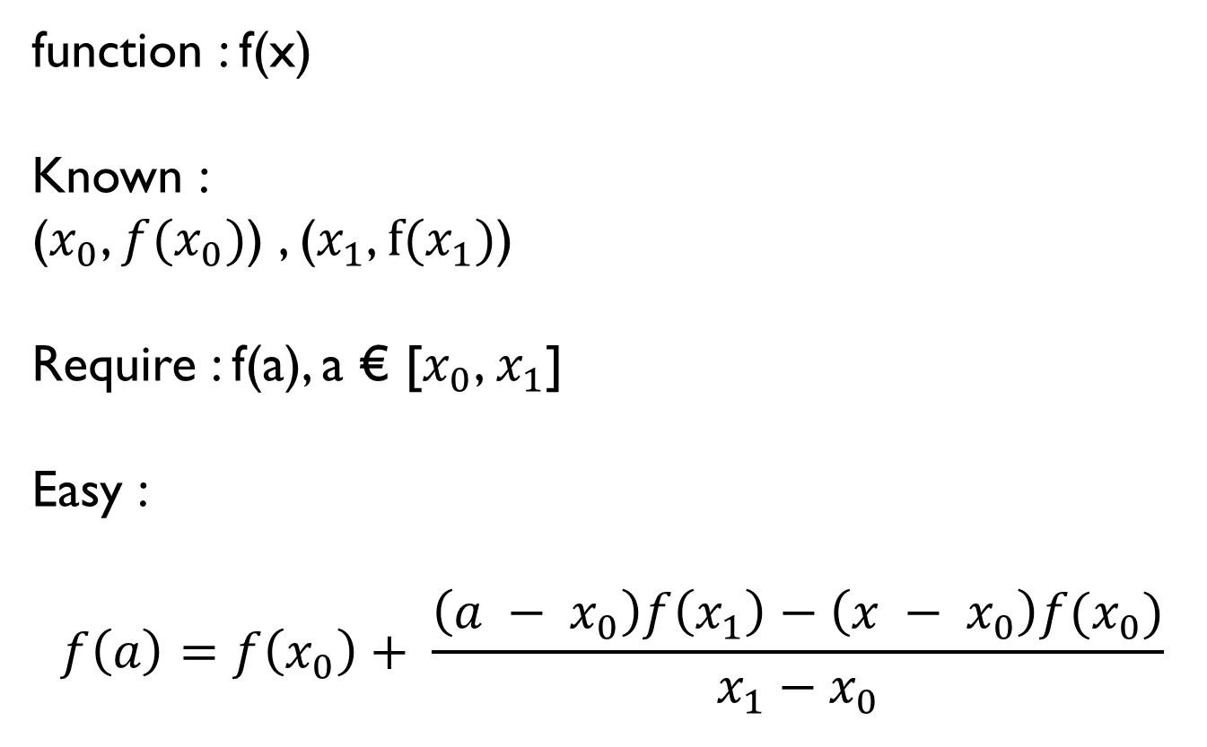
Linear Interpolation
function : f(x)
Known :
($x_{0}$, ${f(x}_{0})$) , ($x_{1}$, $f(x_{1})$)
Require : f(a), a € [$x_{0}$, $x_{1}$]
Easy :
$$f\left(a\right)=f\left(x_{0}\right)+ \frac{\left(a − x_{0}\right)f\left(x_{1}\right)−\left(x − x_{0}\right)f(x_{0})}{x_{1}−x_{0}}$$
https://arxiv.org/abs/1703.06870

Slide 7
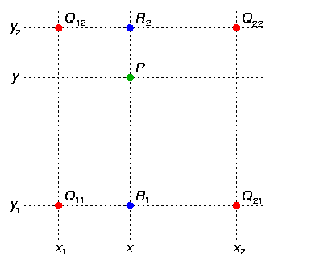
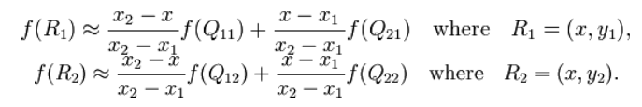

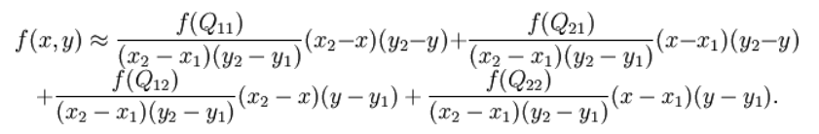
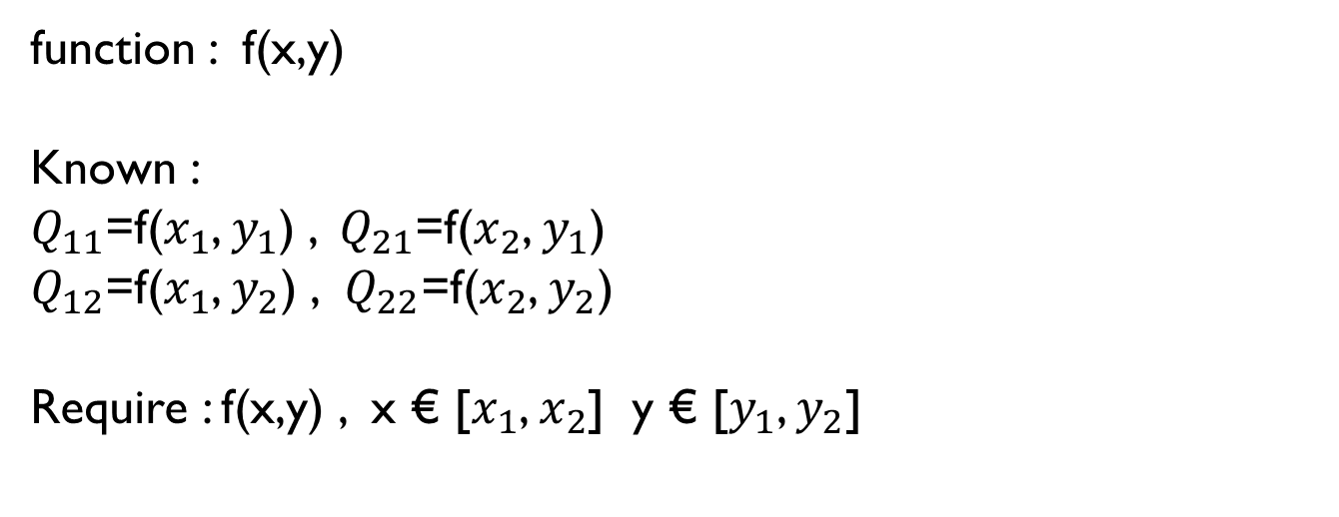
Bilinear Interpolation
function : f(x,y)
Known :
$Q_{11}$=f($x_{1}$, $y_{1}$) , $Q_{21}$=f($x_{2}$, $y_{1}$)
$Q_{12}$=f($x_{1}$, $y_{2}$) , $Q_{22}$=f($x_{2}$, $y_{2}$)
Require : f(x,y) , x € [$x_{1}$, $x_{2}$] y € [$y_{1}$, $y_{2}$]
https://arxiv.org/abs/1703.06870

Slide 8
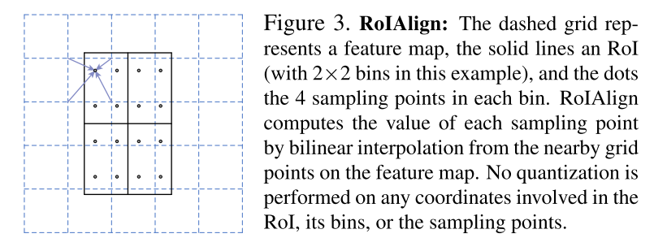
Roi Align
https://arxiv.org/abs/1703.06870

Slide 9
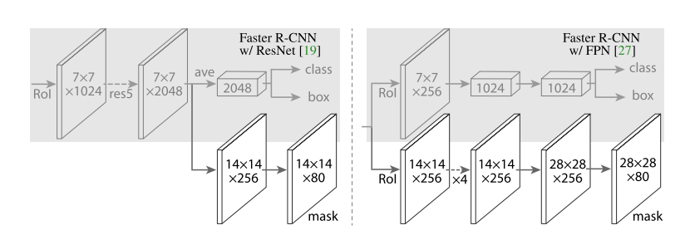
Lmask
https://arxiv.org/abs/1703.06870

Slide 10
Thanks
https://arxiv.org/abs/1703.06870

