Slide 1
Methodologies for Cross-Domain Data Fusion: An Overview
Yu Zheng, Senior Member

Slide 2
Abstract
How to unlock the power of knowledge from multiple disparate (but potentially connected) datasets is paramount (重要的)in big data research, essentially distinguishing big data from traditional data mining tasks.
Summarizes the data fusion methodologies, classifying them into three categories:
1. Stage-based
2. Feature level-based
3. Semantic meaning-based data fusion methods

Slide 3
1.1 Introduction
When addressing a problem, we usually need to harness(治理) multiple disparate datasets . For example, to improve urban planning :
1. the structure of a road network
2. traffic volume
3. points of interests (POIs) and populations in a city.
However, the data from different domains consists of multiple modalities, each of which has a different representation, distribution, scale and density.
1. Image: pixel
2. POIs : spatial points 3. Air quality : a geo-tagged time series

Slide 4
1.2 Methods
Stage-based fusion methods : Use different datasets at different stages of a data mining task.
Feature level-based methods: Learns a new representation of the original features extracted from different datasets by using deep neural networks (DNN) . The new feature representation will then be fed into a model for classification or prediction.
The third category blends data based on their semantic meanings, which can be further classified into four groups.

Slide 5
Semantic meaning-based data fusion methods
Multi-view(多视点) learning-based :This group of methods treats different datasets as different views on an object or an event. Different features are fed into different models. The results are later merged together or mutually reinforce each other.
Similarity-based : This group of methods leverages the underlying correlation (or similarity) between different objects to fuse different datasets.
Probabilistic dependency-based : This group models the probabilistic causality (or dependency) between different datasets using a graphic representation
Transfer learning-based methods : This group of methods transfers the knowledge from a source domain to another target domain, dealing with the data sparsity problems in the target domain.

Slide 6
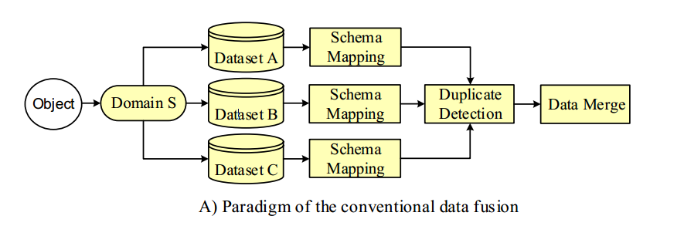
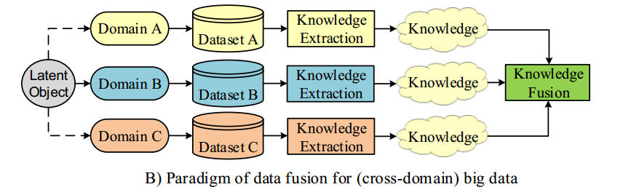
2.1Relation to Traditional Data Integration

Slide 7
2.2Relation to Heterogeneous Information Network
A heterogeneous(不同成分的) information network consists of nodes and relations of different types. For example, a bibliographic information network consists of authors, conferences and papers as different types of nodes.
Heterogeneous information networks can be constructed in almost any domain, such as social networks, ecommerce, and online movie databases. However, it only links the object in a single domain rather than data across different domains.
Consequently , algorithms proposed for mining heterogeneous information networks cannot be applied to cross-domain data fusion directly.

Slide 8
Stage-based Data Fusion

Slide 9
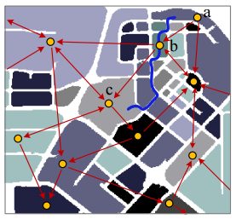
Road network and taxi trajectories
partition a city into regions
map the GPS trajectories of taxicabs onto the regions to formulate a region graph
each node is a region
edge denotes aggregation of commutes between two regions

Slide 10
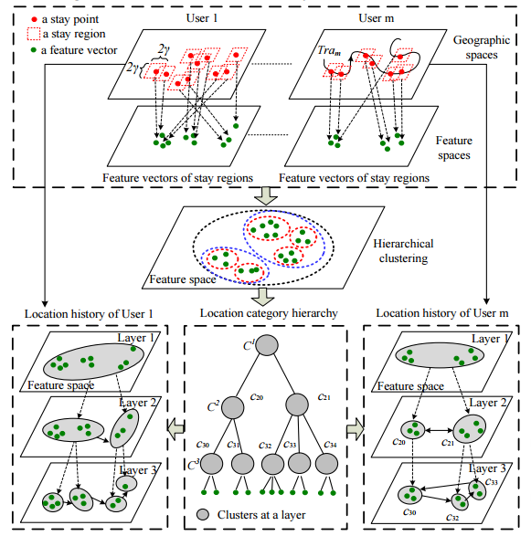
Users’ trajectories and POIs

Slide 11
GPS trajectories and Social Media
first detect a traffic anomaly based on GPS trajectories of vehicles and road network data
retrieve the relevant social media that people have posted at the locations when the anomaly was happening

Slide 12
Feature base Data Fusion

Slide 13
直接做法
平等对待各种模态的数据的特征
将各种特征连接后放到一个向量里
用这个向量做聚类和分类
实际上不同模态的数据有不同的形式
不同模态之间有非线性的关联
好模型的标准：
Feature能保留不同模态概念上的相似性
多模态中的数据缺失不影响feature的构建
Feature能恢复另一个模态的数据

Slide 14
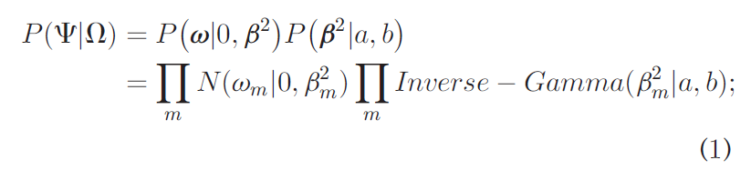
高级做法
对目标函数做稀疏的正则化来处理冗余问题
每个权重参数 w 的方差 β² 服从一个优先分布（这里用了逆高斯分布），让冗余w接近0
可以用ML的方法来优化这个稀疏的正则项
这种稀疏的正则项不像L1正则项那么强

Slide 15
DNN
以前的DNN用BP训练
层数多的时候，BP效果不好
新的方法：autoencoder 和 RBM
当前在图像识别上，神经网络构建的特征比人工构建的好

Slide 16
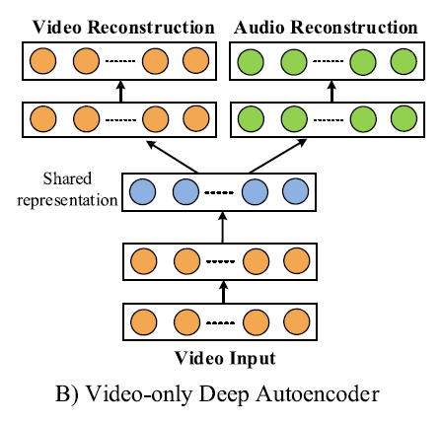
Autoencoder提取中间特征
自动编码器的目标是尽可能复现输入
中间的结果则是输入数据的另一种抽象表达，也就是特征
多模态输入的话，中间结果就是多模态的特征
效果：
用其他模态的数据提高某个模态的学习效果
在多模态的特征之间共享联系

Slide 17
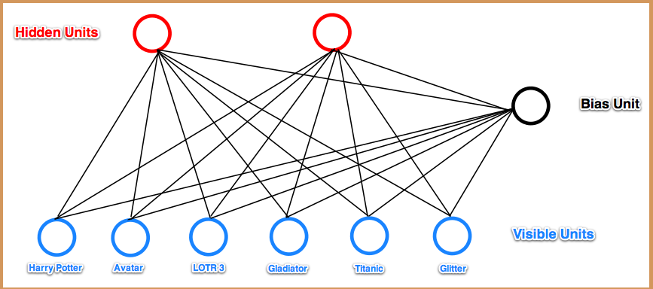


RBM（Restricted Boltzmann Machine）
输入层为visible, hidden为特征
连边表示两层之间的关联，用能量E表示
给定输入，计算hidden取0或1的概率
取概率大的结果为输出

Slide 18
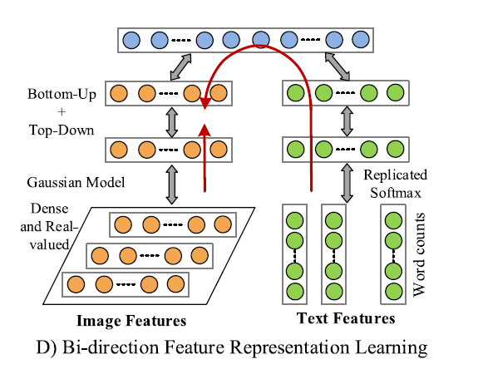

Slide 19
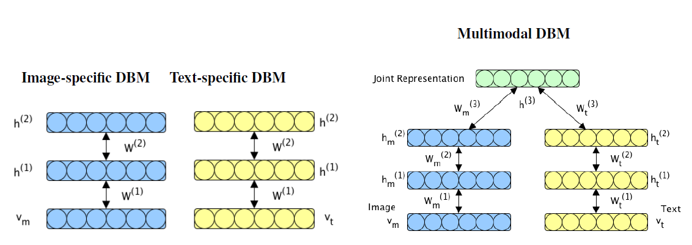
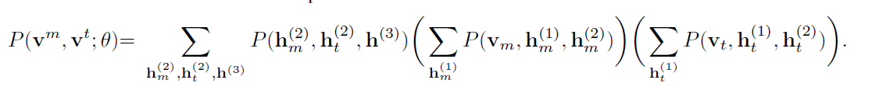
RBM for data fusion
关键在于学习不同模态输入数据的一个联合概率分布

Slide 20
DBM(NN)的缺点
依赖调参
难以解释

Slide 21
Methodologies for Cross-Domain Data Fusion: An Overview
SEMANTIC MEANING-BASED DATA FUSION
Xintong Wang @ South China University of Technology Nov. 25, 2016

Slide 22
Semantic Meaning-Based Data Fusion
Feature-based data fusion method:
Regard a feature solely as a real-valued number or a categorical value.
Semantic meaning-based methods:
Understand the insight of each dataset and relations between features across different datasets.
Interpretable and meaningful.
Xintong Wang @ South China University of Technology Nov. 25, 2016

Slide 23
Outlines:
Multi-View Based Data Fusion
Co-Training
Multi-Kernel Learning
Subspace Learning
Similarity-Based Data Fusion
Probabilistic Dependency-Based Fusion
Transfer Learning-Based Data Fusion
Xintong Wang @ South China University of Technology Nov. 25, 2016

Slide 24

Multi-View Based Data Fusion:
Identify a person:
Face, Fingerprint, Signature…
Image Representation:
Color, Texture features…
Latent consensus, Complementary…
Describe an object comprehensively and accurately.
Xintong Wang @ South China University of Technology Nov. 25, 2016

Slide 25
Outlines:
Multi-View Based Data Fusion
Co-Training
Multi-Kernel Learning
Subspace Learning
Similarity-Based Data Fusion
Probabilistic Dependency-Based Fusion
Transfer Learning-Based Data Fusion
Xintong Wang @ South China University of Technology Nov. 25, 2016

Slide 26
Co-Training:
Co-Training method partitions each example into TWO distinct view making THREE assumptions:
Sufficiency, Compatibility, Conditional independence
Xintong Wang @ South China University of Technology Nov. 25, 2016
Notes:
F1分类器的结果F2也要用来学习，因此必须满足条件独立性

Slide 27
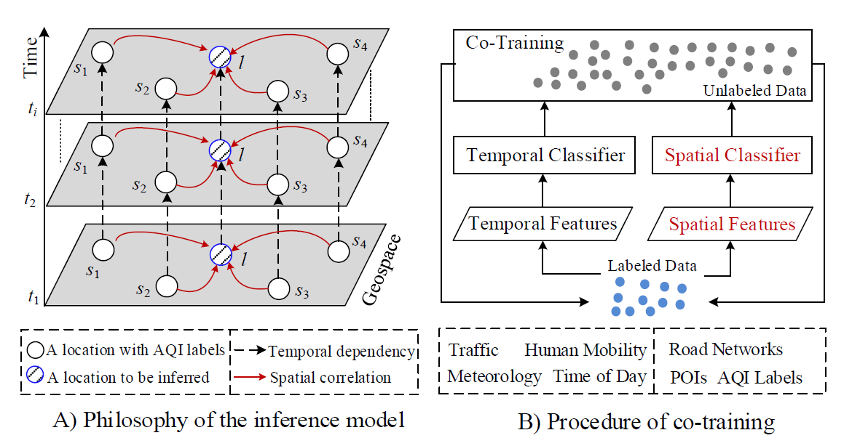
Co-Training:
Example: Infer the fine-grained air quality throughout a city based on five datasets:
Air quality, Meteorological data, Traffic, POIs, Road Network.
Temporal dependency and spatial correlation formulate two distinct views.
Xintong Wang @ South China University of Technology Nov. 25, 2016

Slide 28
Co-Training:
Example: Infer the fine-grained air quality (Cont.)
Spatial Classifier: ANN (spatial-related features)
Temporal Classifier: CRF (temporal-related features)
Infer an instance:
Maximizes the production of the results from the two classifiers.
Xintong Wang @ South China University of Technology Nov. 25, 2016

Slide 29
Outlines:
Multi-View Based Data Fusion
Co-Training
Multi-Kernel Learning
Subspace Learning
Similarity-Based Data Fusion
Probabilistic Dependency-Based Fusion
Transfer Learning-Based Data Fusion
Xintong Wang @ South China University of Technology Nov. 25, 2016

Slide 30
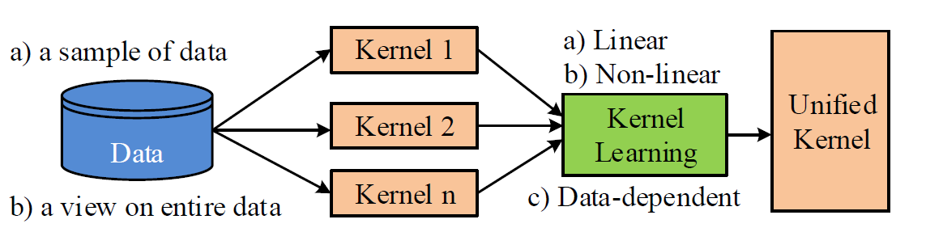
Multi-Kernel Learning:
Multi-Kernel Learning (MKL) refers to a set of ML methods that uses a predefined set of kernels and learns an optimal linear or non-linear combination of kernel as part of the algorithm.
Kernel, a hypothesis on the data: classifier, regression…
Xintong Wang @ South China University of Technology Nov. 25, 2016

Slide 31
Multi-Kernel Learning:
Multi-Kernel Learning (Conts) : Two uses of MKL
A learning method picks the best kernel, or uses a combination of these kernels.
i.e. linear, polynomial and Gaussian kernel used in SVM.
Train different kernel using inputs coming from different representations:
Combining kernels: intermediate combination (NOT early or late)
Xintong Wang @ South China University of Technology Nov. 25, 2016

Slide 32
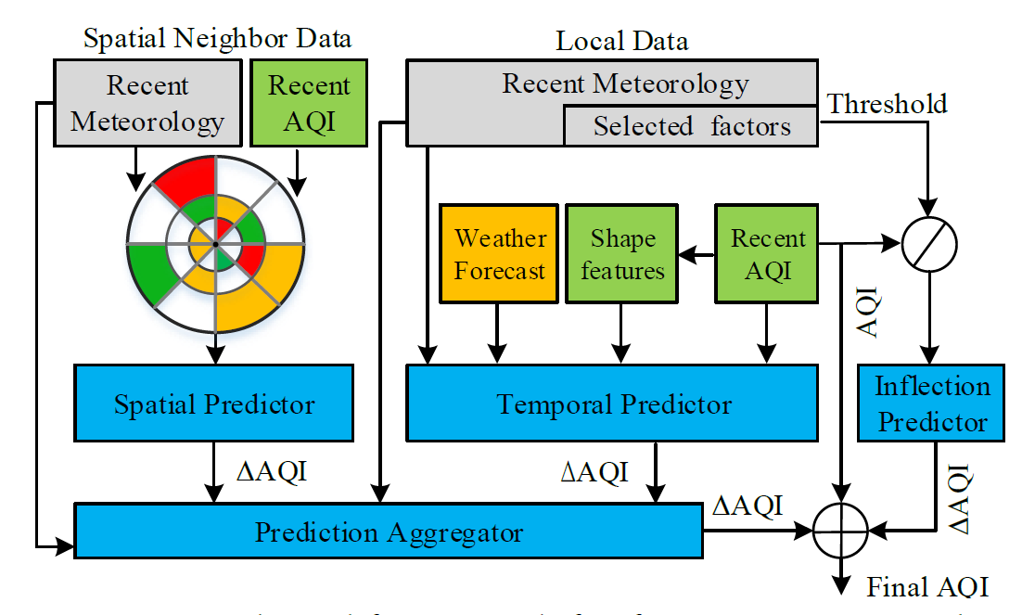
Multi-Kernel Learning:
Example: Forecast the air quality for the next 48 hours of a location
Two kernels: Spatial Predictor and Temporal Predictor
A kernel learning module: Prediction Aggregator
MKL-based framework outperforms a single kernel-based model:
From the feature space’s perspective:
From the model’s perspective:
From the parameter learning’s perspective:
Xintong Wang @ South China University of Technology Nov. 25, 2016

Slide 33
Outlines:
Multi-View Based Data Fusion
Co-Training
Multi-Kernel Learning
Subspace Learning
Similarity-Based Data Fusion
Probabilistic Dependency-Based Fusion
Transfer Learning-Based Data Fusion
Xintong Wang @ South China University of Technology Nov. 25, 2016

Slide 34
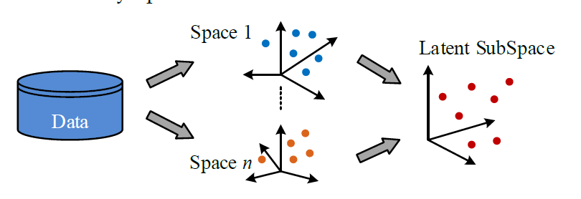
Subspace Learning:
Subspace Learning-based method aim to obtain a latent subspace shared by multiple views:
Input views are generated from this latent subspace.
With the subspace, we can perform tasks: classification, clustering…
Dimensional Reduction.
Xintong Wang @ South China University of Technology Nov. 25, 2016

Slide 35
Subspace Learning:
Subspace Learning-based method: From PCA to CCA
PCA is widely used to exploit the subspace for single-view data.
CCA is a multi-view version of PCA: Subspace is linear.
KCCA, Fisher discriminant analysis, Lawrence process, Statistical framework…
Xintong Wang @ South China University of Technology Nov. 25, 2016

Slide 36
Similarity base Data Fusion

Slide 37
数据融合中的两个任务
补缺
寻找关联
相似性高的数据可以相互补充
相似性高的数据之间的关联更大

Slide 38
Coupled Matrix Factorization
协同过滤
矩阵分解 X= U · V
X：sparse
U V: dense
寻找中间模态数据使得X能够分解成U和V
中间模态数据可以是另一种模态的数据，比如X是Location -> Activity, U是location -> POI, V是POI -> Activity
Video -> Wifi -> People

Slide 39
Manifold alignment
相似度高的数据可以相互补充
相似度的计算：
单个数据集中，两个数据的相似度：比如两个空间点的距离
不同数据集中，两个数据的相似度：分别计算相似度然后组合在一块
预测某个时间某个地点的噪声
(t, s) -> n，组成一个三维空间，由于数据采集问题，这个空间非常稀疏
分解 t -> check in, s -> poi, s -> road network, n -> 311 data

Slide 40
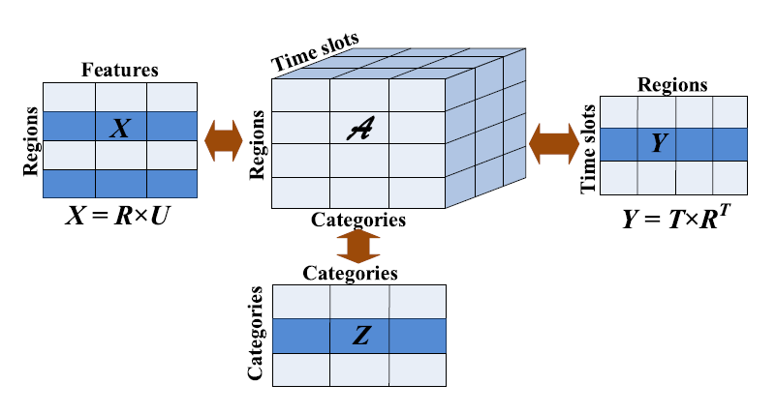
分解 t -> check in, s -> poi, s -> road network, n -> 311 data
A中有非0的点，求这些点中与缺失点相似度最高的点，用相似度最高的点的n填充到缺失的地方

Slide 41
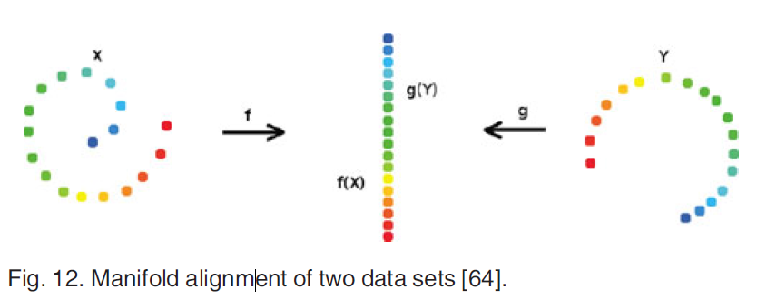


相似度计算

Slide 42
Application
自动化调参 多模态
视频 WiFi 人物
轨迹点补全

Slide 43
5. SEMANTIC MEANING-BASED DATA FUSION
5.3 Probabilistic Dependency-Based Fusion
5.4. Transfer Learning-Based Data Fusion

Slide 44
5.3 Probabilistic Dependency-Based Fusion
Bridge the gap between datasets by probabilistic dependency
Emphasize interaction
Variables(features extracted from different datasets)
--->nodes
Probabilistic dependency(between variables)
---->edge
Graphical model contain hidden variables to be inferred

Slide 45
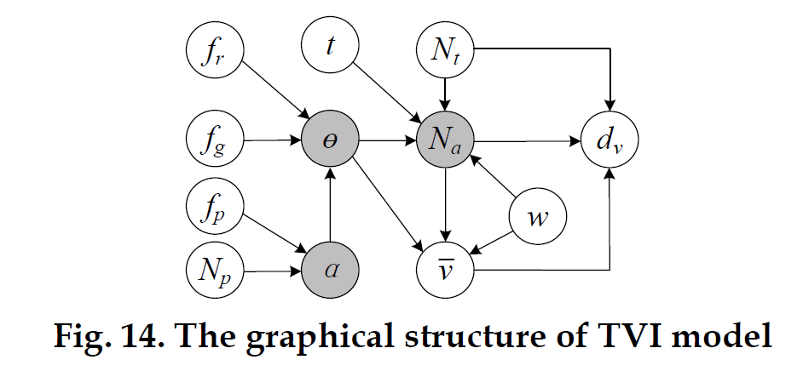
5.3 Probabilistic Dependency-Based Fusion example 13 TVI(traffic volume inference

Slide 46
5.3 Probabilistic Dependency-Based Fusion example 13 TVI(traffic volume inference
Traffic volume on each road lane Na influenced by 1. weather w, 2. time of day t, 3. type of road Θ, 4. the volume of observed sample vehicles Nt

Slide 47
5.3 Probabilistic Dependency-Based Fusion example 13 TVI(traffic volume inference
Road’s Θ is determined by 1. road network features fr, 2. global position feature fg, 3. surrounding POIs α(influenced by fp and number of POIs)
Expectation and Maximization algorithms to learn parameters in unsupervised manner

Slide 48
5.4 Transfer Learning-Based Data Fusion
Transfer between the same type of datasets
Transfer learning among multiple datasets

Slide 49
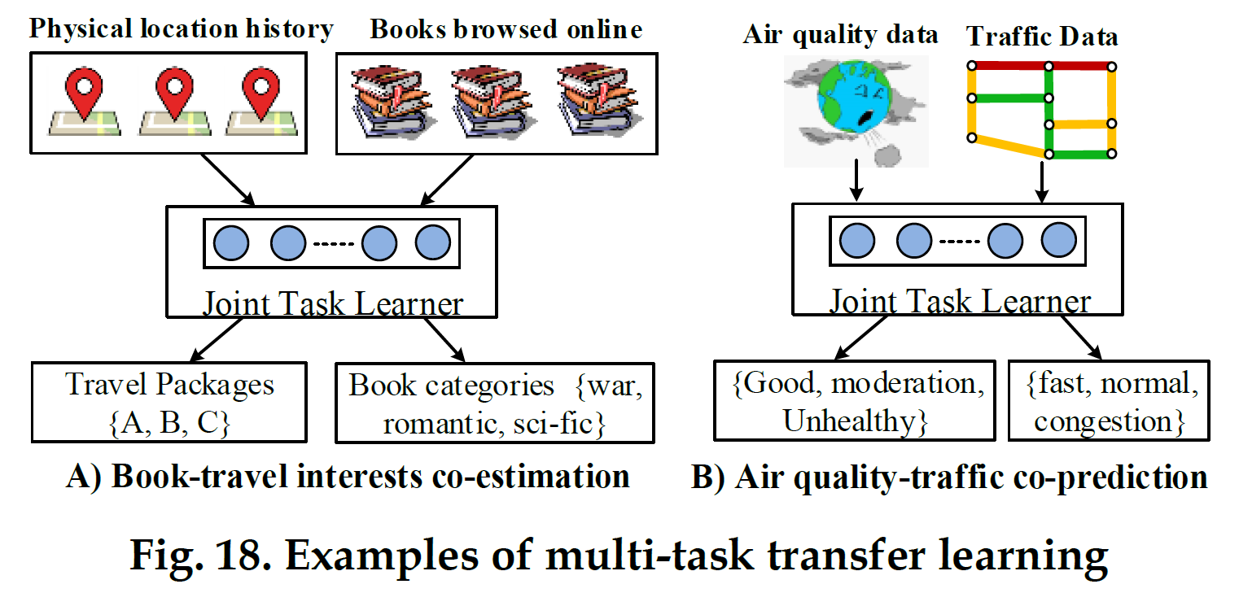
5.4.1 Transfer between the same type of datasets

Slide 50
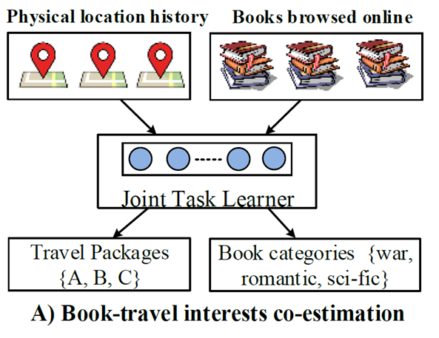
5.4.1 Transfer between the same type of datasets
Task 1 infer an individual’s interests in different travel packages in terms o f her location history
Task 2 estimate user’s interests in different book styles based on the books has browsed
MTL framework ,share representation of a user’s general interests

Slide 51
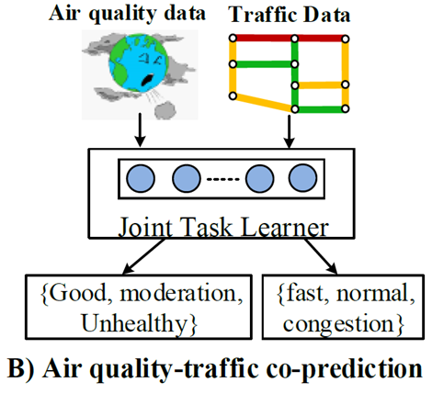
5.4.1 Transfer between the same type of datasets
Task co-predict the air quality and traffic condition at near future simultaneously
MTL framework ,share representation of two datasets

Slide 52
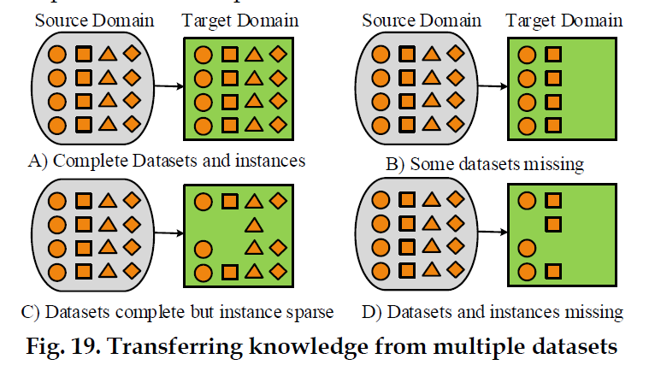
5.4.2 Transfer learning among multiple datasets

Slide 53
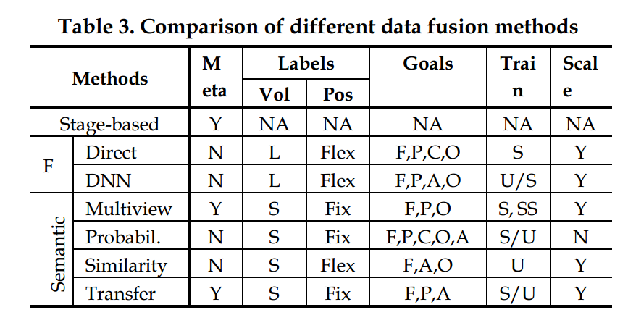
6. DISCUSSION
Meta ：Indicates if a method can incorporate other approaches as a meta method.
Vol ：amount of Training Data.
Pos ： Whether there are some object instances that can constantly generate labeled data.
Goal: Filling Missing Values (of a sparse dataset)
Predict Future Causality Inference Object Profiling(性能分析) Anomaly(异常) Detection
5.Train: Supervised (S), unsupervised (U) and semi -supervised (SS) learning .
6.Scale(扩展):It is not easy for probabilistic dependency-based approaches to scale up (N) . With respect to the similarity-based data fusion methods, when a matrix becomes very large,which can be operated in parallel ,can be employed to expedite decomposition (Y)

