Slide 1
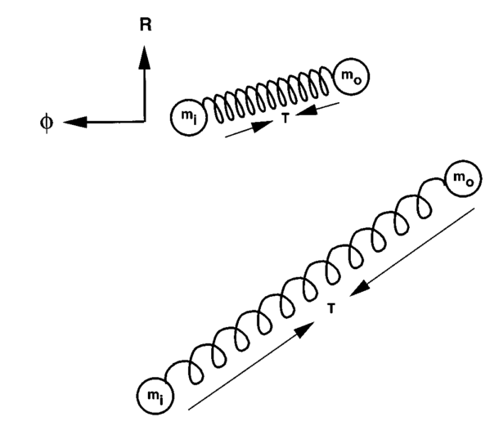
T
Restoring Force

