Slide 1
PranavX Labs | AI/ML Internship | 15-Day Research Project
AI Confidence Drift Detection
Using Machine Learning
A study of whether changes in a model’s confidence, tracked across repeated predictions, can help identify unreliable predictions.
Prepared by Pranav
github.com/ahansardar/ai-confidence-drift

Slide 2
PROJECT OVERVIEW
Confidence is not the same as correctness
A model that reports 96% confidence can still be wrong. This project treats confidence as something to test, not something to trust automatically. In practice I saw three recurring issues:
1. Confident, and wrong
A model can stay highly confident while producing an incorrect prediction, with no internal warning sign.
2. Unstable across inputs
Confidence can swing across similar or repeated predictions, for reasons unrelated to correctness.
3. Drift with difficulty
As a problem gets harder, confidence usually drops. Does that always mean accuracy drops too? I tested this instead of assuming it.
AI Confidence Drift Detection · Pranav · PranavX Labs AI/ML Internship
2 / 14

Slide 3
RESEARCH QUESTION
Research question and hypothesis
“Can machine learning detect meaningful changes in an AI model’s confidence, and can those changes be used to identify predictions that are likely unreliable?”
Hypothesis
Statistical features built from a confidence sequence (moving average, volatility, consecutive drops) predict unreliable predictions better than raw confidence alone, and far better than no confidence signal at all.
Tested experimentally, not assumed. Part of it held up, part of it did not (see slides 9 and 11).
AI Confidence Drift Detection · Pranav · PranavX Labs AI/ML Internship
3 / 14

Slide 4
DATASET
Task and dataset
Binary text classification: alt.atheism vs. soc.religion.christian
Source: scikit-learn’s official 20 Newsgroups mirror (fetch_20newsgroups), public and documented
Chosen because the two categories share overlapping vocabulary, so predictions are not trivially easy
Headers, footers and quoted text stripped from every post to avoid metadata leakage
Ground truth is the newsgroup each post was actually published to
Total documents | 1,754
Train / test split | 1,315 / 439 (stratified)
Class balance | 44.4% / 55.6%
AI Confidence Drift Detection · Pranav · PranavX Labs AI/ML Internship
4 / 14

Slide 5
METHODOLOGY
How the pipeline works
1.
Train the base classifier
TF-IDF + Logistic Regression on the text classification task
2.
Generate confidence sequences
Re-classify each test document at 6 increasing corruption levels
3.
Engineer drift features
Moving average, volatility, deltas, consecutive drops, margin
4.
Train the confidence drift detector
A second model predicting whether a prediction is unreliable
5.
Evaluate
Calibration, high-confidence errors, and a controlled A/B/C comparison
AI Confidence Drift Detection · Pranav · PranavX Labs AI/ML Internship
5 / 14

Slide 6
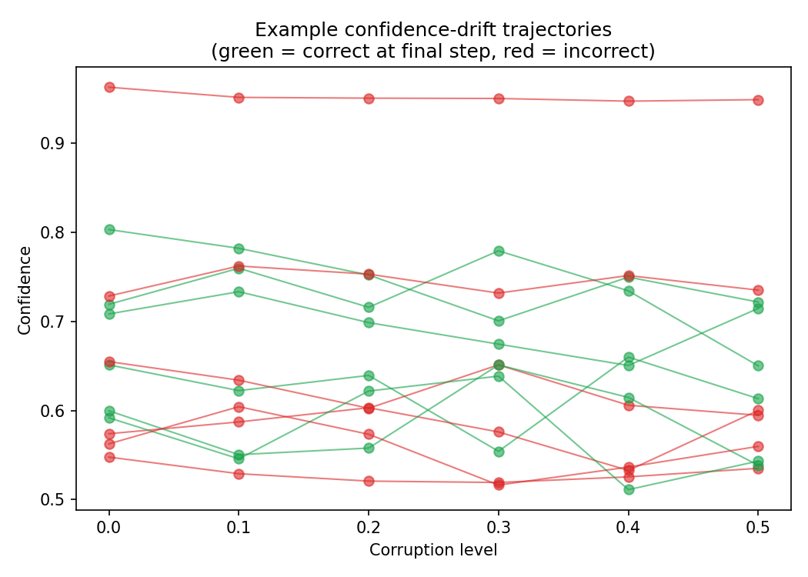
CONFIDENCE-DRIFT SIMULATION
Where the confidence sequences come from
The dataset has no naturally repeated predictions, so I corrupt each test document at 6 levels (0% up to 50% of words removed and shuffled) and re-classify it each time. Every confidence value is a real model output, none are fabricated.
Step | doc_00750 (stayed confident, stayed wrong) | doc_01280 (dropped sharply, stayed correct)
0 | 0.963 | 0.889
1 | 0.952 | 0.771
2 | 0.951 | 0.778
3 | 0.951 | 0.682
4 | 0.948 | 0.842
5 | 0.949 | 0.651
Net drift alone turned out to be a weak signal for error, see slide 9.
Figure 1. Confidence trajectories for 12 test documents under increasing corruption. Green ends correct, red ends incorrect.
AI Confidence Drift Detection · Pranav · PranavX Labs AI/ML Internship
6 / 14

Slide 7
FEATURE ENGINEERING
Features I engineered
13 features in total. I did not assume they would all be useful, that is what the experiments on slide 11 test.
Group | Features
Point in time | confidence, prediction_margin, historical_accuracy_for_class
Change | confidence_diff, confidence_pct_change, rate_of_change
Trend / history | moving_avg_confidence, moving_std_confidence, rolling_std_confidence, confidence_range_so_far
Pattern | consecutive_decreases, step, corruption_level
AI Confidence Drift Detection · Pranav · PranavX Labs AI/ML Internship
7 / 14

Slide 8
CONFIDENCE VS. ACTUAL CORRECTNESS
Does higher confidence mean higher accuracy?
Confidence range | n | Accuracy
40-60% | 156 | 63.5%
60-80% | 223 | 90.1%
80-100% | 60 | 93.3%
Accuracy rises with confidence, so confidence carries real signal. But the relationship is not perfectly clean, see calibration next.
Figure 2. Accuracy by confidence bin, step-0 test predictions.
AI Confidence Drift Detection · Pranav · PranavX Labs AI/ML Internship
8 / 14

Slide 9
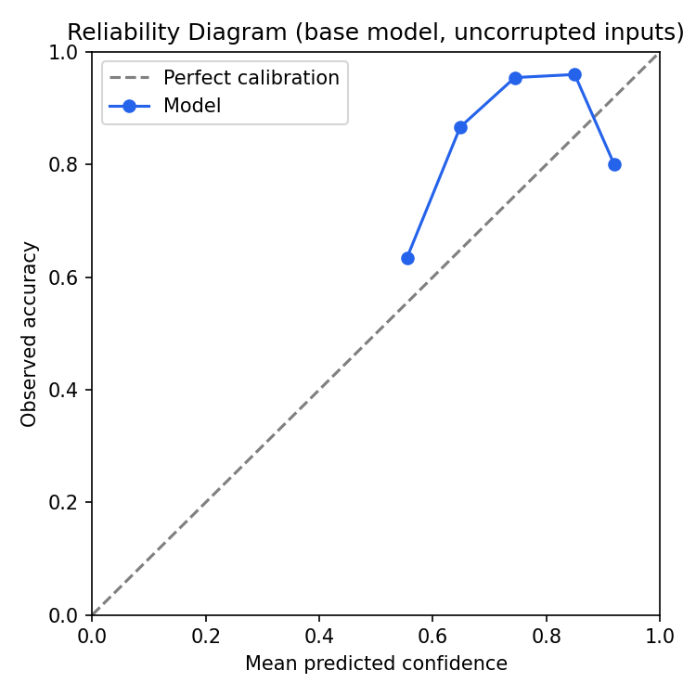
CALIBRATION ANALYSIS
Confidence is not perfectly calibrated
Expected Calibration Error: 0.153
Brier score: 0.125
The model is a bit under-confident in the 0.6-0.9 range, its accuracy there is higher than its stated confidence.
The top bin (0.9-1.0, only 10 samples) has lower accuracy (80%) than the bin below it (96%). Likely small-sample noise, but a fair reminder that very high confidence is not a guarantee.
This is exactly why I built a separate detector rather than trusting raw confidence on its own (slide 11).
Figure 3. Reliability diagram, step-0 test predictions.
AI Confidence Drift Detection · Pranav · PranavX Labs AI/ML Internship
9 / 14

Slide 10
HIGH-CONFIDENCE ERROR ANALYSIS
When the model is confident, and wrong
100 of 439 step-0 predictions (22.8%) were high confidence, 75% or above.
6 of those 100 (6.0%) were still wrong.
One case: the model was 96.3% confident and completely wrong (doc_00750).
All 6 high-confidence errors went the same direction: true label alt.atheism, predicted soc.religion.christian. My guess is that these posts quote Christian scripture while arguing against it, and a TF-IDF/bigram model cannot tell that apart from someone writing as a believer. A reasonable explanation from what I can see, not something I have proven.
AI Confidence Drift Detection · Pranav · PranavX Labs AI/ML Internship
10 / 14

Slide 11
EXPERIMENTS A / B / C
Does confidence drift actually help?
Same document-level train/test split throughout. Task: predict whether a prediction is unreliable.
Experiment | Features | F1 | ROC-AUC
A | none (step, corruption level only) | 0.253 | 0.508
B | single-point confidence | 0.443 | 0.741
C | full confidence-drift features | 0.483 | 0.787
+0.230
F1 improvement, A to C
+0.279
ROC-AUC improvement, A to C
Real, measured improvement. F1 of 0.48 still is not great in absolute terms though, this is a meaningful step, not a solved problem.
Logistic Regression results shown; Random Forest and Gradient Boosting gave comparable F1 (0.47-0.49) on the C feature set.
AI Confidence Drift Detection · Pranav · PranavX Labs AI/ML Internship
11 / 14

Slide 12
RESULTS SUMMARY
What I found
Confidence carries real signal on average: accuracy rises from 63.5% to 93.3% across confidence bins.
But it is not perfectly calibrated: ECE of 0.153, and 6% of high-confidence predictions are still wrong.
Net confidence drift alone is a weak predictor of error (correlation of about 0.04). I tested this assumption instead of taking it for granted, and it did not hold.
The shape of the drift sequence does help: volatility, moving stats and consecutive drops lifted unreliable-prediction detection from F1 0.25 to 0.48, and ROC-AUC 0.51 to 0.79.
AI Confidence Drift Detection · Pranav · PranavX Labs AI/ML Internship
12 / 14

Slide 13
LIMITATIONS & FUTURE SCOPE
Limitations and what I would try next
Limitations
What I would try next
Sequences are simulated through text corruption, not naturally repeated real-world queries.
Dataset is modest in size (439 test documents), some bins have very few samples.
Only two classes were studied, and only one base model architecture.
Detector F1 of about 0.48 means it still misses or mislabels a fair number of predictions.
Try a different base model, like a neural text classifier, and see if drift features still help.
Use genuinely repeated real-world queries instead of synthetic corruption, if such data becomes available.
Try calibration techniques like temperature scaling and check whether that changes what the drift features add.
Extend to multi-class classification with richer margin and entropy features.
AI Confidence Drift Detection · Pranav · PranavX Labs AI/ML Internship
13 / 14

Slide 14
CONCLUSION
Confidence drift is useful, if you look at its shape
Confidence lines up with correctness on average, but it is not something to trust blindly. 6% of high-confidence predictions were still wrong, and net drift barely predicted error on its own (correlation of about 0.04). A detector trained on the shape of the confidence sequence, its volatility, moving statistics, and consecutive drops, gave a real, measured improvement: F1 went from 0.25 to 0.48, ROC-AUC from 0.51 to 0.79.
So my answer to the research question is yes, with a condition I tested rather than assumed: confidence drift is useful when you look at its statistical shape, not just whether it went up or down. There is still real room to improve the detector, which I think is an honest place to end this project.
Code, data, models, figures and the full research report:
github.com/ahansardar/ai-confidence-drift
Thank you.

