Slide 1
Software Defined Radio Receiver
Part 1

Slide 2
Part_1
Receiver parameters
Anti-image BPF
Demodulation and carrier recovery
Interpolation and clock recovery

Slide 3
Receiver Parameters
After choosing and loading signal r, define message and receiver parameters.
SRRC length
SRRC roll-off factor (beta)
Symbol period (t_T)
Intermediate frequency (f_if)
Sampling frequency (fs)

Slide 4
Receiver Parameters
Preamble string
Up-sampling ratio (M= fs*t_T)

Slide 5
Sub-Nyquist demodulation
fs is less than the Nyquist criteria.
i.e. fs < (f_if+BW/2)
fs is a sub-Nyquist frequency
Signal image closest to base band shall be recovered.

Slide 6
Anti-image BPF
To remove channel image interferers and signal unwanted copies we apply a BPF around f0 with BW a little greater than singal BW.

Slide 7
Carrier recovery
In order to recover the signal correctly, LO at the receiver has to generate exactly the same carrier signal.
In practice it’s not possible to have two identical oscillators, as there will be a small phase and frequency offsets.
That causes distortion to the signal we want to recover

Slide 8
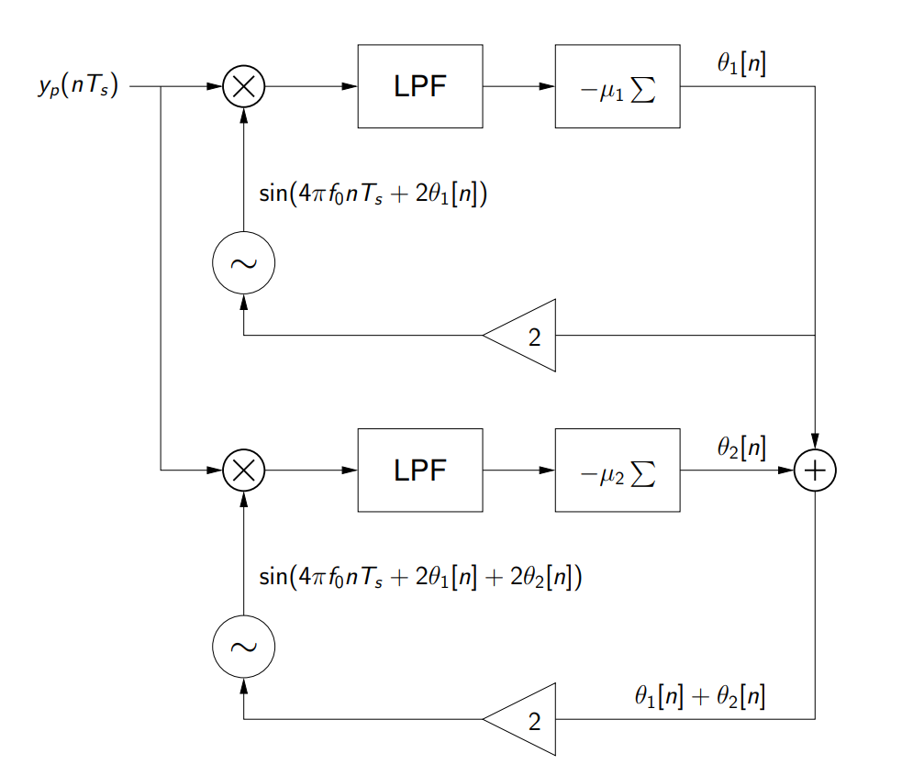
Carrier recovery
Adaptive electronic components or software algorithms are used to trace the carrier.
We have use dual PLL adaptive algorithm in order to estimate the carrier

Slide 9
Carrier recovery
Before passing the signal through the PLL it need some pre-processing, namely squaring then passing it to a BPF.
When squaring the signal its bandwidth/ center frequency doubles and hence if fs<2*(2*f0), the squared signal will be distorted.
For this reason, under that condition, the signal is upsampled by a factor of 2.

Slide 10
Demodulation
Signal is mixed with the estimated carrier then passed to a LPF.

Slide 11
Clock recovery
When signal travels through channel it experience distortion, in addition to sampler period accuracy, which make it hard to locate the exact samples/ peaks that we would like to keep after down sampling.
This could be considered as problem of finding one parameter, the time-offset (τ).
We try to find optimal value for tau by minimizing error function using steepest descend algorithm.

Slide 12
Clock Recovery
Objective function: moving average of squared decision error, i.e. cluster variance.
Jcv(τ)= avg{(Q(x[k]) – x[k])^2}
Q: quntization funtion
Steepest descent of DD clock recovery algorithm
τ[k+t] = τ[k] – µ* Jcv(τ[k])’
τ[k+1] = tau [k]+ µ/δ *(Q(x[k])−x[k]) (x (kT/M + τ[k]+δ )−x(kT/M +τ [k]−δ )
µ: step size, δ: small positive value represents time derivative dt.

Slide 13
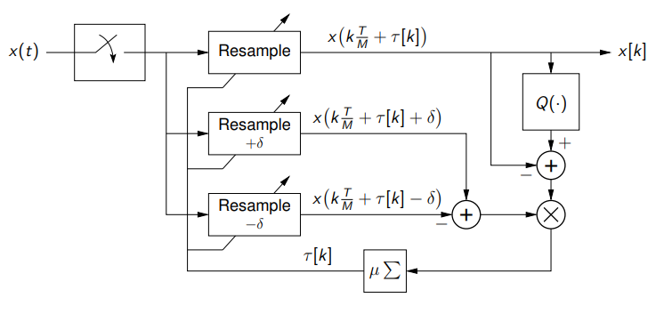
Clock Recovery
Bloc Diagram

