Slide 1
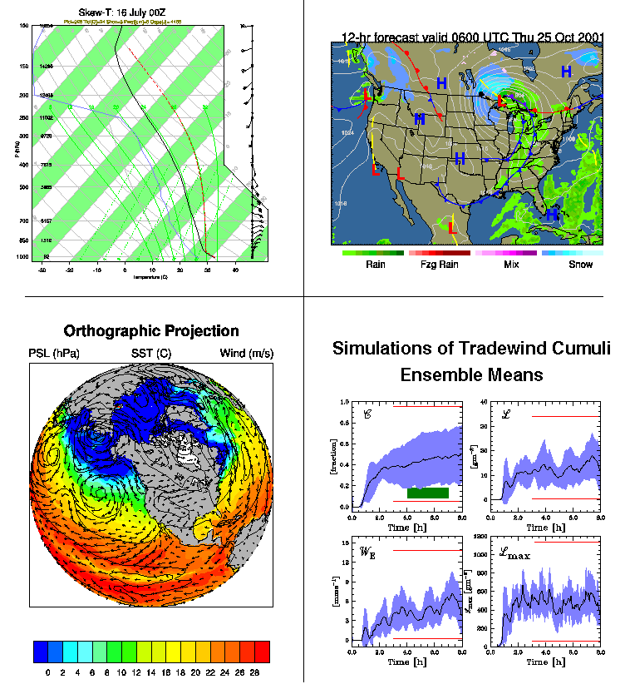

Introduction
Dennis Shea
NCAR is sponsored by the National Science Foundation

Slide 2
Workshop Overview
Objective
  comfortable with NCL; minimize learning curve
    workshop will not make you an expert
  access, process and visualize data
Labs important: you must invest the time
  “osmosis” method of learning does not work

Slide 3
NCL Support
Documentation and Examples
  http://www.ncl.ucar.edu/
    numerous downloadable examples to get you going
  downloadable reference manuals [pdf], FAQ
    http://www.ncl.ucar.edu/Document/Manuals/language_man.pdf
ncl-talk@ucar.edu
users must subscribe
http://www.ncl.ucar.edu/Support/ncl_talk.shtml

Slide 4
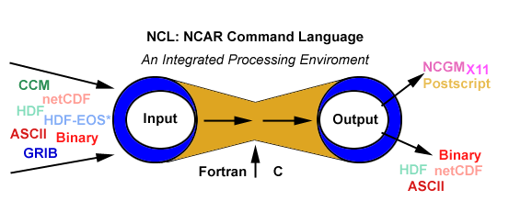
Integrated data processing environment
NCL Overview
pdf, png
Shape
Vis5D
freeware: supported, public domain
portable: linux/unix, windows (cygwin), MacOS
general purpose: unique capabilities
excellent 2D graphics (limited 3D)
parallel: IO, computation (beta version Nov. 2012)

Slide 5
Introduction: Key Points
NCL execution: scripts via unix command line
  unix prompt> ncl test ncl
NCL variable model ⬅➔ netCDF variable model
basic syntax to access/create the variable model
  = , :=, @ , ! , &, $
Printing
  Still the best for debugging; (NCL no built-in debugger)

Slide 6
Executing NCL: Interactive (1 of 3)
Interactive Mode (Command line)
  ncl [options][command-line-arguments] <return>
    ncl> enter commands
    ncl> quit <return>
  can save (record) interactive commands
    ncl> record “file_name”
    ncl> …. enter commands …
    ncl> stop record
Interactive environment
  use for simple testing
  can use ‘up/down arrow’ to recall previous lines
  not as ‘friendly’ as (say) IDL, Matlab, ferret
    not good at error recovery

Slide 7
Running NCL: Batch (2 of 3)
Recommended
Batch Mode [ .ncl suffix is optional]
  ncl [options][arguments] script.ncl
        ncl < script.ncl [also acceptable]
  ncl [options][arguments] script.ncl >&! out
  ncl [options][arguments] script.ncl >&! out &
    appending "&" means put in background
    note: the >&! & are csh and tcsh syntax
NCL built for larger processing tasks
  better accomplished via a script (recommended)
    use editor (vi, nedit, emacs, ..) to open/modify
    enter/delete statements
    run the script

Slide 8
Running NCL: predefined options (3 of 3)
ncl –hnxV [predfined options are preceded by dash]
may be used for interactive or batch mode
informational
  ncl –h [display predefined options and usage and exit]
  ncl –V [print the NCL version and exit]
action
  ncl –x [echo statements as encountered (debug)]
  ncl –n [don't enumerate dimensions of values in print() ]
multiple predefined options
  ncl –nx [ not ncl –n –x ]

Slide 9
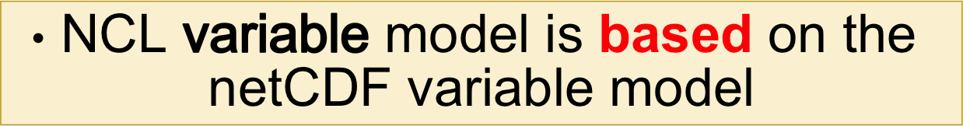
netCDF / NCL Relationship
NCL makes GRIB, HDF, HDF-EOS look like netCDF files

Slide 10
netCDF Conventions
Convention: set of accepted rules for file contents
  make data comparison easier
  facilitate automatic use of viewing (eg: ncview)
COARDS (1995; frozen)
  Cooperative Ocean/Atmosphere Research Data Service
  http://ferret.wrc.noaa.gov/noaa_coop/coop_cdf_profile.html
CF (2005/2006; continues to evolve)
  Climate and Forecast Metadata Convention (1.0 -> 1.6)
  generalize and extend the COARDS convention

Slide 11
Parts of netCDF file
ncdump –h foo.nc (or ncl_filedump foo.nc)
DIMENSION SIZES & NAMES
dimensions:
lat = 64
lon = 128
time = 12
VARIABLES:
Names , Types, Attributes, Coordinate Variables
variables:
float lat(lat)
lat:long_name = "latitude"
lat:units = "degrees_north"
float lon(lon)
lon:long_name = "longitude"
lon:units = "degrees_east"
double time(time)
time:long_name = "time"
time:units = ”hours_since …"
float T(time, lat, lon)
T:long_name = “Temperature”
T:units = “degC"
T:missing_value = 1.e+20f
T:_FillValue = 1.e+20f
time=UNLIMITED (12 currently)
FILE ATTRIBUTES
global attributes:
title = “Temp: 1999”
source = “NCAR”
Conventions = ”CF-1.0”
exercise:
ncl_filedump FOO.nc | less
ncl_filedump FOO.grb | less

Slide 12
NCL/netCDF Variable Semantics
double T(time, lat, lon)
T: long_name = “Temperature”
T: units = “degC"
T: _FillValue = 1.e+20f
variable type – double (float, int, short,..)
variable name – T
named dimensions – time, lat, lon
attributes – long_name, units, _FillValue
float prr(time, y, x)
prr:_FillValue = -9999.f ; CF
prr:missing_value = -9999.f ; COARDS
prr:long_name = "Liquid Precipitation" ; CF, COARDS
prr:grid_mapping = "Lambert_Conformal" ;
prr:units = "kg m-2 s-1" ; CF, COARDS
prr:height = "surface" ;
prr:coordinates = "lon lat" ; CF

Slide 13
netCDF/NCL variable
array [could be of length 1 (scalar)]
(may) have additional information
4.35 4.39 0.27 -3.35 -6.90
4.36 4.66 3.77 -1.66 4.06
9.73 -5.84 0.89 8.46 10.39
17 3.68 5.08 0.14 -5.63
-0.63 -4.12 -2.51 1.76 -1.43
-4.29 0.07 5.85 0.87 8.65
x
name: x
type: float [real]
shape: 2-dimensions
size: 6 (rows) x 5 (columns)
values: x(2,3) = 8.46 [row major, 0-based indexing]
long_name: “Temperature”
units: “degC”
named dimensions: x(time,lat)
lat: (/ -60, -30 ,0, 30, 60 /)
time: (/2000, 2001, 2002, 2003, 2004, 2005, 2006 /)
Meta data

Slide 14
Detailed Look netCDF Variable (NCL)
ncl <return> ; interactive mode
ncl 0 > f = addfile ("UV300.nc", "r") ; open file (nc, grb, hdf, hdfeos)
ncl 1 > u = f->U ; import STRUCTURE
ncl 2 > printVarSummary (u) ; overview of variable
Variable: u
Type: float
Total Size: 65536 bytes
16384 values
Number of Dimensions: 3
Dimensions and Sizes: [time|2] x [lat | 64] x [lon | 128]
Coordinates:
time: [ 1 .. 7 ]
lat: [ -87.8638 .. 87.8638 ]
lon: [ 0 .. 357.185]
Number of Attributes: 5
_FillValue : 1e36 [CF ]
units : m/s [COARDS, CF]
long_name : Zonal Wind [COARDS, CF]
short_name : U
missing_value : 1e36 [COARDS; CF-1.6 ]
Classic netCDF
Variable Model
NCL
syntax/funcs
query
use
modify
add
any aspect of
data object

Slide 15
netCDF [NCL] Variable model
X
f = addfile(“foo.nc”,”r”) ; grb/hdf
x = f⁻>X
Scalar or Array
NCL reads the scalar/array, attributes, and coordinate variables as one object (structure)
attributes
long_name
_FillValue
units
add_offset
scale_factor
etc.
X
accessed via @
accessed via &
values
attributes
coord var
coordinates
Scalar or Array
long_name
_FillValue
units
add_offset
scale_factor
etc.
time
lev
lat
lon
etc.
time
lev
lat
lon
etc.

Slide 16
load "$NCARG_ROOT/lib/ncarg/nclscripts/csm/gsn_code.ncl"
load "$NCARG_ROOT/lib/ncarg/nclscripts/csm/gsn_csm.ncl"
f = addfile("erai_1989-2009.mon.msl_psl.nc","r") ; open file [hdf,grib]
p = f->SLP ; (time,lat,lon)
; ( 252,121,240)
printVarSummary(p) ; netCDF variable model
wks = gsn_open_wks("ps","parvis_1") ; open a PS file
plot = gsn_csm_contour_map(wks,p(0,:,:),False) ; default plot
; uses attributes, coordinates
Graphics Libraries
p
NetCDF [NCL] Variable model
p = f->SLP
NCL reads
  data values (scalar or array)
  attributes @
  coordinate variables &
as a single data object.
accessed via @
accessed via &
values
attributes
coords
scalar
or
array
_FillValue
long_name
missing_value
units
etc.
time
latitude
longitude
etc

Slide 17
p
NetCDF [NCL] Variable model
p = f->SLP
NCL reads
  data values
  attributes
  coordinate arrays
as a single data object.
accessed via @
accessed via &
values
attributes
coords
scalar
or
array
_FillValue
long_name
missing_value
units
etc.
time
latitude
longitude
etc
Variable: p
Type: float
Total Size: 29272320 bytes
7318080 values
Number of Dimensions: 3
Dimensions and sizes: [time | 252] x [latitude | 121] x [longitude | 240]
Coordinates:
time: [780168..963504]
latitude: [90..-90]
longitude: [ 0..358.5]
Number Of Attributes: 4
_FillValue : 1e+20
units : hPa
long_name : Mean sea level pressure
missing_value : 1e+20
“printVarSummary(p)” output

Slide 18
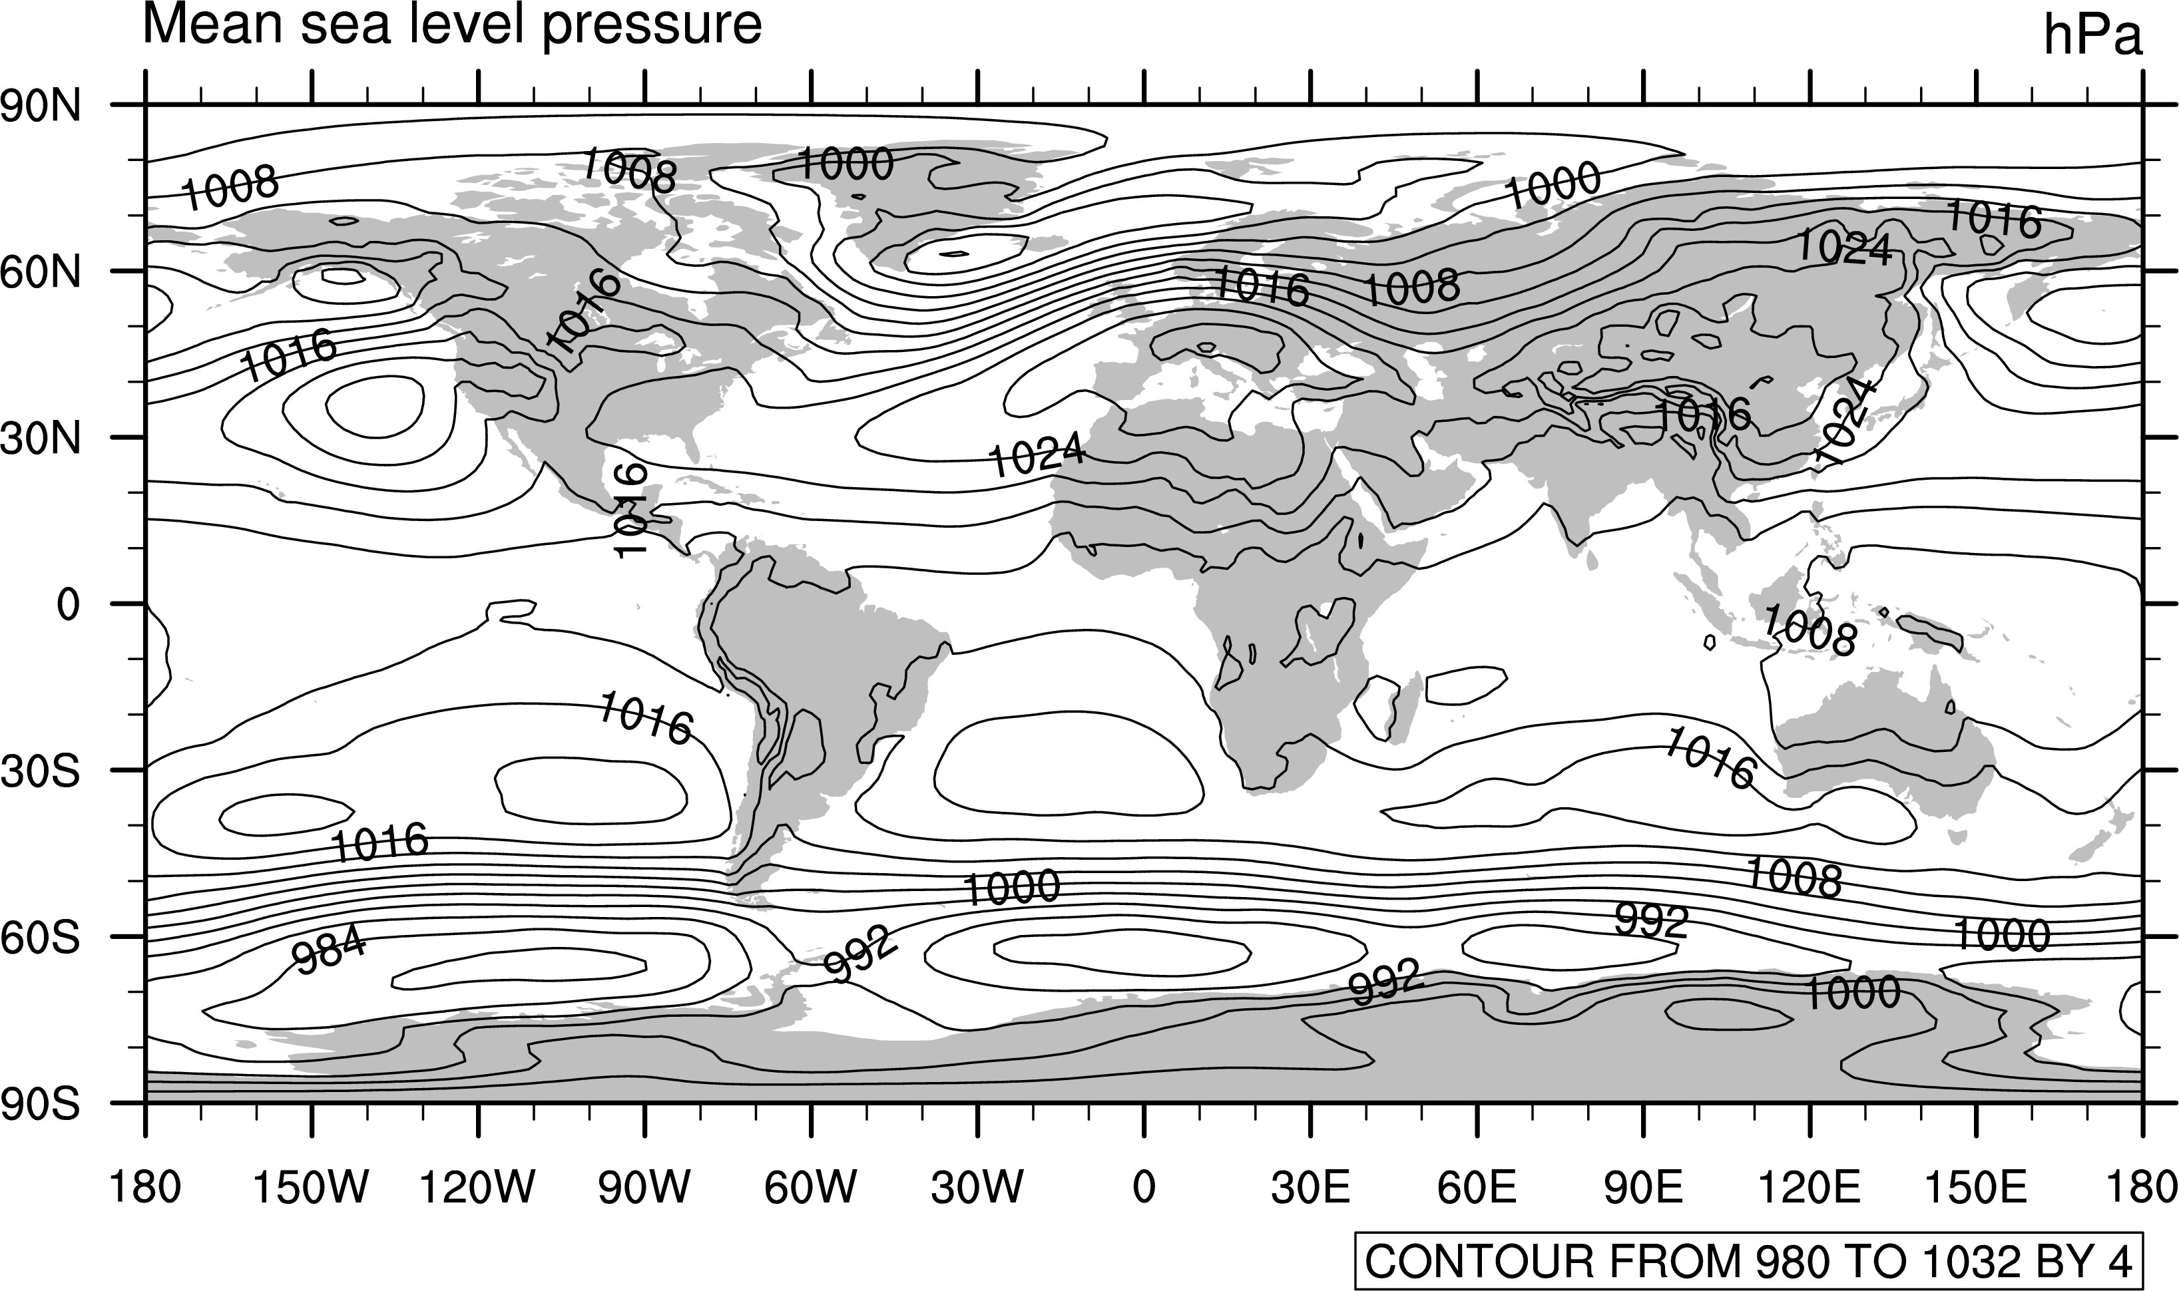
load "$NCARG_ROOT/lib/ncarg/nclscripts/csm/gsn_code.ncl"
load "$NCARG_ROOT/lib/ncarg/nclscripts/csm/gsn_csm.ncl"
f = addfile("erai_1989-2009.mon.msl_psl.nc","r") ; open file [hdf,grib]
p = f->SLP ; (time,lat,lon)
; ( 252,121,240)
printVarSummary(p) ; netCDF variable model
wks = gsn_open_wks("ps","parvis_1") ; open a PS file
plot = gsn_csm_contour_map(wks,p(0,:,:),False) ; default B&W plot

Slide 19

Language
Basics

Slide 20
NCL Syntax Characters (subset)
= - assignment
:= - reassignment (v6.1.2)
; - comment [can appear anywhere; text to right ; ignored]
-> - use to (im/ex)port variables via addfile(s) function(s)
@ - access/create attributes
! - access/create named dimension
& - access/create coordinate variable
{…} - coordinate subscripting
$...$ - enclose strings when (im/ex)port variables via addfile(s)
(/../) - array construction (variable); remove meta data
[/../] - list construction;
[:] - all elements of a list
: - array syntax
| - separator for named dimensions
\ - continue character [statement to span multiple lines]
:: - syntax for external shared objects (eg, fortran/C)

Slide 21
Data Types
numeric (classic netCDF3)
double (64 bit)
float (32 bit)
long (64 bit; signed +/-)
integer (32 bit; signed +/-)
short (16 bit; signed +/-)
byte ( 8 bit, signed +/-)
complex NOT supported
non-numeric
string
character
graphic
file
logical
list
enumeric (netCDF4; HDF5)
int64 (64 bit; signed +/-)
uint64 (64 bit; unsigned )
uint (32 bit; unsigned )
ulong (32 bit; unsigned )
ushort (16 bit; unsigned )
ubyte ( 8 bit, unsigned)
snumeric
[numeric , enumeric]

Slide 22
Simple Variable Creation
  a_int = 1
  a_float = 2.0 ; 0.00002 , 2e-5
  a_double = 3.2d ; 0.0032d , 3.2d-3
  a_string = "a”
  a_logical = True [False] ; note capital T/F
array constructor characters (/…/)
  a_integer = (/1, 2, 3/) ; ispan(1,3,1)
  a_float = (/2.0, 5 , 8.0/) ; fspan(2,8,3)
  a_double = (/12 , 2d0 , 3.2 /) ; (/12,2 ,3.2 /)*1d0
  a_string = (/"abcd", "e", "Hello, World”/)
  a_logical = (/True, False, True/)
  a_2darray = (/ (/1,2,3/), (/4,5,6/), (/7,8,9/) /)
http://www.ncl.ucar.edu/Document/Manuals/Ref_Manual/NclDataTypes.shtml#BasicNumericTypes

Slide 23
Variable Creation and Deletion
  a = 2.0
  pi = 4.0*atan(1.0)
  s = (/ “Melbourne”, “Sydney”, “Toulouse”, “Boulder” /)
  r = f->precip ; (time,lat,lon)
  R = random_normal(20,7, (/N,M/) ) ; R(N,M)
  q = new ( (/ntim, klev, nlat, mlon/), “double” )
; free memory; Generally, do not need to do this
; delete each variable individually
  delete(a)
  delete(pi)
  delete(s)
  delete(r)
  delete(R)
; delete multiple variables in one line
delete( [/ a, pi, s, r, R, q /] ) ; [/…/] list syntax

Slide 24
Conversion between data types
NCL is a ‘strongly typed’ language
  constraints on mixing data types
coercion
  implicit conversion of one type to another
automatic coercion when no info is lost
  let i be integer and x be float or double
  fortran: x=i and i=x
  NCL: x=i and i=toint(x)
many functions to perform conversions

Slide 25
Variable Reassignment
NCL = will not allow the following
  k = (/ 1, 3, 4, 9 /) ; 1d array, type integer
  … later in code …
  k = (/17.5, 21.4/) ; different size and type
Two approaches
  Up to version 6.1.1, 2 steps required
    delete(k) ; delete existing variable
    k = (/17.5, 21.4/) ; new assignment
  version 6.1.2
    k := (/17.5, 21.4/) ; delete previous variable
    ; and reassign ‘k’
NCL := will not allow the following
  x = x(::4,:,:) ; same variable

Slide 26
Meta Data
information associated with variable or file
  attributes: @ (numeric, text)
  named dimensions: ! (text)
  coordinates: & (numeric)
@, !, & can be used to create/assign, retrieve
most frequently, meta data is read from files

Slide 27
Attributes [ @ ]
info associated with a variable or file
  attributes can be any data type except file or list
  scalar, multi dimensional array (string, numeric)
assign/access with @ character
  T = (/ 10, 25, 39 /)
  T@units = “degC”
  T@long_name = “Temperature”
  T@wgts = (/ 0.25, 0.5, 0.25 /)
  T@x2d = (/ (/1,2,3/), (/4,5,6/), (/7,8,9/) /)
  T@_FillValue = -999
  title = T@long_name
attribute functions [isatt, getfilevaratts]
  if (isatt(T,"units")) then .... end if
  atts = getfilevaratts (fin, "T")
  delete an attribute: delete(T@wgts)

Slide 28
_FillValue attribute
Unidata & NCL reserved attribute; CF compliant
netCDF Operators [NCO] & CDO: _FillValue attribute
ncview: recognizes missing_value attribute (COARDS)
  best to create netCDF files with both
NCL functions recognize _FillValue
  most functions will ignore for computations (eg, “avg”)
  use built-in function “ismissing” to check for _FillValue
  if (any (ismissing(T) )) then … end if
    NOTE: if (any(T.eq.T@_FillValue)) will not work
NCL: best to not use zero as a _FillValue
  OK except when contouring [random bug]

Slide 29
Arrays and Dimension Numbering
row major
  left dimension varies slowest; right dim varies fastest
  dimension numbering left to right [0,1,..]
subscripts
  0-based [ entire range for N index values: 0,N-1 ]
Consider T(:,:,:) ➔T (0,1,2)
left dimension is 0 : varies slowest
middle dimension is 1
right dimension is 2 : varies fastest
Different language/tool ordering:
  NCL/C/C++ : 0-based; left (slowest) - right (fastest)
  fortran, Matlab, R: 1-based; left (fastest) - right(slowest)
  IDL : 0-based; left (fastest) - right(slowest)

Slide 30
NCL – Fortran/Matlab Array Indexing
ncl: x(N,M) => value <= x(M,N) : fortran M=3, N=2
    x(0,0) => 7.23 <= x(1,1)
    x(0,1) => -12.5 <= x(2,1)
    x(0,2) => 0.3 <= x(3,1)
    switch to next index
    x(1,0) => -431.2 <= x(1,2)
    x(1,1) => 323.1 <= x(2,2)
    x(1,2) => -234.6 <= x(3,2)

Slide 31
NCL (netCDF): Named Dimensions [!]
may be “named”: x(time,level,lat,lon)
dimensions are named on netCDF files
  alternative way to reference subscripts
assigned with ! character {let T(:,:,:) -> T(0,1,2)}
  T!0 = "time" ; leftmost [slowest varying] dim
  T!1 = "lat“
  T!2 = "lon" ; rightmost [fastest varying] dim
dim names may be renamed, retrieved
  T!1 = ”latitude" … dName = T!2
delete can eliminate: delete (T!2)
named dimensions used to reshape
  T(lat|:, lon|:, time|:)

Slide 32
Create, Assign Coordinate Variables [&]
create 1D array
  time = (/ 1980, 1981, 1982 /)
  time@units = “yyyy”
  lon = ispan(0, 355, 5)
  lon@units = “degrees_E”
assign dimension name [same as variable name]
  time!0 = “time”
  lon!0 = “lon”
let x(:,:) … dimension numbers x(0,1)
name dimensions
  x!0 = “time” … x!1 = “lon”
assign coordinate variables to x
  x&time = time … x&lon = lon

Slide 33
netCDF/NCL: Coordinate Variable (CV)
CV: Coordinate Variable ( Unidata definition )
  one dimensional variable in which dimension name is the same as the variable name
  must be monotonically increasing or decreasing
Examples of CV
  lat(lat), longitude(longitude), plevel(plevel), time(time)
CV allow ‘natural’ coordinates via {…} syntax
  Q(time,plevel,lat,longitude)
    CV: Q(:, {925:400}, {-20:60}, {130:280} )
    Index: Q(:, 3:10, 24:40, 42:75)
The following is not a coordinate variable:
float xlat(nlat, mlon) ; two-dimensions
xlat:units = "degrees_north”
It is an array that contains coordinate information.
Requires use of standard integer index values

Slide 34
Meta Data Syntax Review:
Access/Change/Create/Delete
@ attribute
  u@long_name = "U"
  lonName = u@long_name
! named dimensions
  u!0 = "TIME"
  tName = u!0
& coordinate variable
  u&lat = (/ -90., -85, .... , 85., 90. /)
  latitude = u&lat
$ substitute string
  x = fin->$variable(n)$ … x = fin->$"T: p"$

Slide 35
netCDF [NCL] Variable model
X
f = addfile(“foo.nc”, “r”) ; grb/hdf
x = f⁻>X
Scalar or Array
NCL reads the scalar/array, attributes, and coordinate variables as an object
attributes
long_name
_FillValue
units
add_offset
scale_factor
etc.
X
accessed via @
accessed via &
values
attributes
coord var
coordinates
Scalar or Array
long_name
_FillValue
units
add_offset
scale_factor
etc.
time
lev
lat
lon
etc.
time
lev
lat
lon
etc.

Slide 36
Variable Subscripting (1 of 3)
Standard Array Subscripting (Indexing)
ranges: start/end and [optional] stride
index values separated by :
omitting start/end index implies default begin/end
Consider T(time,lat,lon)
T ➔ entire array [ don't use T(:,:,:) ]
T(0,:,::5) ➔ 1st time index, all lat, every 5th lon
T(:3, ::-1, :50) ➔ 1st 4 time indices, reverse, 1st 51 lon
T(7:12,45,10:20) ➔ 6 time indices, 46th value of lat, 10-20 indices of lon
Good programming: Use variables not hard wired #
T(tstrt:tlast, : , ln1:ln2 ) ➔ time index tstrt:tlast, all lat :,
longitude index values ln1:ln2

Slide 37
Variable Subscripting (2 of 3)
Coordinate Variable Subscripting
only applies to coordinate variables (1D, mono)
same rules apply for ranges, strides, defaults
use curly brackets {…}
standard and coordinate subs can be mixed
[if no reorder]
T(2:7,{-30:30},:) ➔ six times, all lon, lat -30° to +30° (inclusive)
T(0,{-20},{-180:35:3}) ➔ 1st time, lat nearest -20°, every 3rd lon between -180° and 35°
T(::12,{latS:latN},:) ➔ all times/lon, lat latS to latN (inclusive)
T(8,{latS},{lonL:lonR:3})➔ 9th time, lat nearest latS, every 3rd lon between latL and lonR

Slide 38
Variable Subscripting (3 of 3)
Named Dimensions
only used for dimension reordering
indicated by |
dim names must be used for each subscript
named/coordinate subscripting can be mixed
Consider T(time,lat,lon)
t = T(lat|:, lon|:, time|:) ➔ makes t(lat,lon,time)
t = T(time|:,{lon|90:120},{lat|-20:20}) ➔ all times,
90-120° lon, -20-20° lat

Slide 39
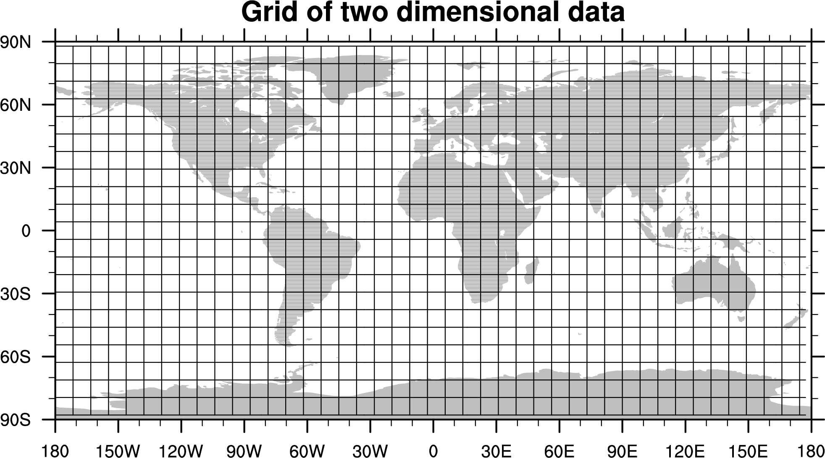
Subscripting: Index, CV
Standard:
T(9:13,1:8)
Coordinate:
T({-10:20},{-170:-110})
Latitude coordinate variable (1D)
Combined:
T({-10:20}, 1:8)
Longitude coordinate variable (1D)

Slide 40
“printing”
printVarSummary
  gives gross overview of a variable
print
  includes same info as printVarSummary
  prints each value
write_matrix
  print to standard out or a file
  format control of numerical output
  can write to file also

Slide 41
printVarSummary
Print overview of variable contents
  type
  dimension information
  coordinate information (if present)
  attributes (if present)
printVarSummary (u)
Variable: u
Type: double
Total Size: 1179648 bytes
147456 values
Number of Dimensions: 4
Dimensions / Sizes: [time | 1] x [lev | 18] x [lat | 64] x [lon | 128]
Coordinates:
time: [4046..4046]
lev: [4.809 .. 992.5282]
lat: [-87.86379 .. 87.86379]
lon: [ 0. 0 .. 357.1875]
Number of Attributes: 2
long_name: zonal wind component
units: m/s

Slide 42
print (1 of 3)
Prints out all variable information including
  All meta data, values
  T(lat,lon): print (T)
Variable: T
Type: float
Total Size: 32768 bytes
8192 values
Number of Dimensions: 2
Dimensions / Sizes: [lat | 64] x [lon | 128]
Coordinates:
lat: [-87.86379 .. 87.86379]
lon: [ 0. 0 .. 357.1875]
Number of Attributes: 2
long_name: Temperature
units: degC
(0,0) -31.7
(0,1) -31.4
(0,2) -32.3
(0,3) -33.4
(0,4) -31.3 etc. [entire T array will be printed]

Slide 43
print (2 of 3)
can be used to print a subset of array
  meta data, values
  T(lat,lon): print( T(:,103) ) or print( T(:,{110}) )
Variable: T (subsection)
Type: float
Total Size: 256 bytes
64 values
Number of Dimensions: 1
Dimensions / Sizes: [lat | 64]
Coordinates:
lat: [-87.86379 .. 87.86379]
Number of Attributes: 3
long_name: Temperature
units: degC
lon: 109.6875 [ added ]
(0) -40.7
(1) -33.0
-25.1
-20.0
(4) -15.3 etc.

Slide 44
print (3 of 3)
print with embedded strings
  no meta data
  print ( ”T: min="+min(T)+" max="+max(T) )
(0) T: min=-53.8125 max=25.9736
sprintf and sprinti provide formatting
  often used in graphic labels
  print ( "min(T) = "+ sprintf("%5.2f ", min(T)) )
(0) min(T) = -53.81
sprinti can left fill with zeros (ex: let n=3)
  fnam = "h" + sprinti ("%0.5i", n) + ".nc"
  print("file name = "+fnam)
(0) file name = h00003.nc

Slide 45
write_matrix(x[*][*], fmt, opt)
pretty-print 2D array (table) to standard out
  integer, float, double
  user format control (fmt)
  T(N,M), N=7, M=5: write_matrix (T, “5f7.2”, False)
4.35 4.39 0.27 -3.35 -6.90
4.36 4.66 3.77 -1.66 4.06
9.73 -5.84 0.89 8.46 10.39
4.91 4.59 -3.09 7.55 4.56 17 3.68 5.08 0.14 -5.63
-0.63 -4.12 -2.51 1.76 -1.43
-4.29 0.07 5.85 0.87 8.65
can also create an ASCII file
opt = True
opt@fout = “foo.ascii” ; file name
write_matrix (T, “5f7.2”, opt)

Slide 46
Debugging, Error Messages, Help
NCL does not have a built-in debugger
  use print /printVarSummary ; examine output!
    nmsg = num( ismissing(x) ) ; count # _FillValue
    print(“x: min=“+min(x) +” max=“+max(x) )
Error messages; Warning or Fatal
  Look at the message; often describe problem/issue
    eg: Fatal: left and right side have different sizes
      printVarSummary of variables before Fatal
Help: question(s): ncl-talk@ucar.edu
- include enough info to facilitate answering
- do *not* attach large files (> 1.5 Mb)
    - they will be rejected, use ftp/web
- do *not* 'dump' a messy script to ncl-talk
- Our time is valuable too!

