Slide 1
Silent Majority: Predicting Political Allegiance from Facebook Page Likes
By Adam hare

Slide 2
Motive
Systematic failures at predicting outcome of Brexit vote and 2016 US Presidential Election
Absence of many friends from PolitEcho due to their method of scoring
Interest in what information ostensibly apolitical pages may actually reveal
Similar work done by major companies:
Facebook itself
Cambridge Analytica (maybe not as well as they’d like you to think)
Possibly soon the US border patrol

Slide 3
Reducing the data
Pages with the same name but different Facebook ids were combined
Many page likes were unique among the group:
219 friends, 29,216 pages, 16,543 unique -> no filter 215 friends, 16,696 pages, 4,023 unique -> filter out only one 211 friends, 13,068 pages, 2,209 unique -> filter two or fewer 210 friends, 10,803 pages, 1,454 unique -> filter three or fewer 207 friends, 9,107 pages, 1,030 unique -> filter out four or fewer 206 friends, 7,687 pages, 746 unique -> filter out five or fewer 203 friends, 6,583 pages, 562 unique -> filter out six or fewer 203 friends, 5,701 pages, 436 unique -> filter out seven or fewer 203 friends, 4,909 pages, 337 unique -> filter out eight or fewer 203 friends, 4,297 pages, 269 unique -> filter out nine or fewer 203 friends, 3,837 pages, 223 unique -> filter out ten or fewer
To eliminate rare pages, any page that had two or fewer likes in the dataset was removed. This was chosen as a compromise between preserving all data and eliminating possibly useful information.

Slide 4
The Methods (overview)
With the data gathered, it was formatted into a table with pages for the columns and friend ids for the rows. If a friend X liked a page Y, the table at row X and column Y would have an entry equal to 1. All other entries are zero.
The next step was to apply collaborative filtering before feeding the data to a neural network.
The collaborative filtering model is a modified version of the code presented in Worksheet 2.
The neural net is implemented in Keras, with one dense hidden layer.

Slide 5
Collaborative Filtering
Collaborative filtering attempts to generate missing data by decomposing a matrix into two matrices whose product approximates the original matrix.
In this case, 0’s represent unknown or missing data because not liking a page does not necessarily express preference either way.
Because the only options for the data are 0 and 1, the preference variable is the same as the confidence variable.
The current method has no way of gathering additional data on confidence. A possible expansion would be to get a metric of a user’s interactions with a given page. Then, more interactions would lead to a higher confidence.
To test for convergence, the sum of all of the entries of X were compared to the sum of all the entries of the previous X (and the same for Y). If the difference was less than a threshold (0.00075) for each matrix for five consecutive iterations, the process was determined to have converged. The idea was to roughly ensure that the number of iterations did not prevent the process from finishing.

Slide 6
Collaborative Filtering: The Hyper-parameters
The collaborative filtering algorithm used has two hyper-parameters: the number of factors (f) and regularization coefficient (reg).
The hyper-parameters were tested for f as integer powers of two on [2, 256] and reg as integer powers of 10 on [10⁻⁵, 10⁵].
Higher values for f were tried but would not have finished computing in time
To analyze which values of the hyper-parameters performed best, a scoring mechanism was used:
Compare the original data and the filtered data:
If the original data is a 0, do nothing.
If the original data is a 1 and the filtered data exceeds one, do nothing.
If the original data is a 1 and the filtered data is less than 1, add the difference to the error term.
This is an adaptation of Least Absolute Deviation, which was a method suggested in the literature.
Also calculate the number of friends who have a minimum preference of 0.5 or greater.
This favors results that have a larger spread of preferences, specifically some values which express no or little preference for a page.

Slide 7
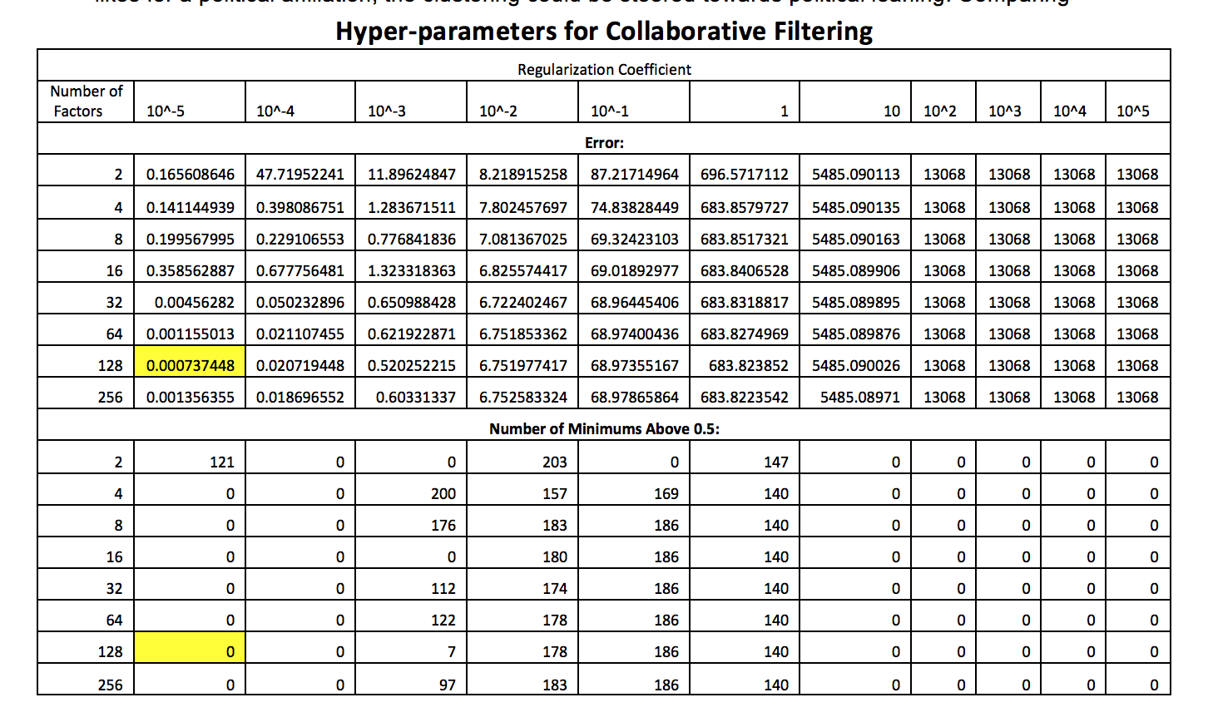
Collaborative Filtering: Hyper-parameter Results

Slide 8
Neural network
A neural net was chosen because they are particularly suited for finding complex and non-obvious relations in the data.
For instance, perhaps one page is most closely associated with liberal friends, while when it is paired with another page, it tends to indicate a conservative background. A neural net would be able to account for this whereas a method like Naïve Bayes may not.
The drawback is that neural nets are rather opaque and so it would be difficult to figure out how individual pages contribute to the eventual decision.
Using a neural net requires labeled data (unlike an unsupervised method of learning)
This was done by hand by looking at individual profiles. If political preference was stated explicitly, that was chosen. Otherwise, an attempt was made to classify the individual based on page likes, posts, and personal knowledge.
This is the biggest stumbling block to scaling this project or using more data. The roughly 200 friends were manageable to label, but it would be infeasible for larger datasets.

Slide 9
Neural Network: The Layers
The neural network architecture chosen has three layers: the input layer, the hidden layer, and the output layer.
The input layer consists of the data (with or without collaborative filtering).
The hidden layer is fully-connected (dense) and represents an intermediate stage. It takes weighted values from the input layer and a bias term and uses a sigmoid activation function (see next slide).
The output layer takes the output from the hidden layer, applies the soft max function, and returns a pair of values. The first is the probability the friend is of the first class (conservative) and the second the probability the friend is of the second class (liberal).
This scheme employs “one-hot” encoding for the labels.
Only one hidden layer was used because it is sufficient to approximate any decision boundary.¹ Additional layers would increase complexity and further risk over-fitting with little benefit.
Notes:
1. From page 130 of Bishop, Christopher M. Neural Networks for Pattern Recognition. Oxford; Clarendon Press: Oxford University Press, 1996. Print.

Slide 10
Neural Network: The Hidden Layer & Hyper-Parameters
The hidden layer uses a sigmoid activation function. This provides perfect entropy when points are on the dividing boundary and has a convenient derivative, making gradient calculations easier. It also introduces non-linearity into the model.
The hidden layer takes two hyper-parameters: the number of nodes in the layer (n) and the regularization coefficient.
As for collaborative filtering, the values tested for n are integer powers of two on [2, 1024] and reg are integer powers of 10 on [10⁻⁵, 10⁵].
The accuracy of each pair was chosen by setting aside a random 10% of the training data, training on the rest, then evaluating the accuracy on set aside data.

Slide 11
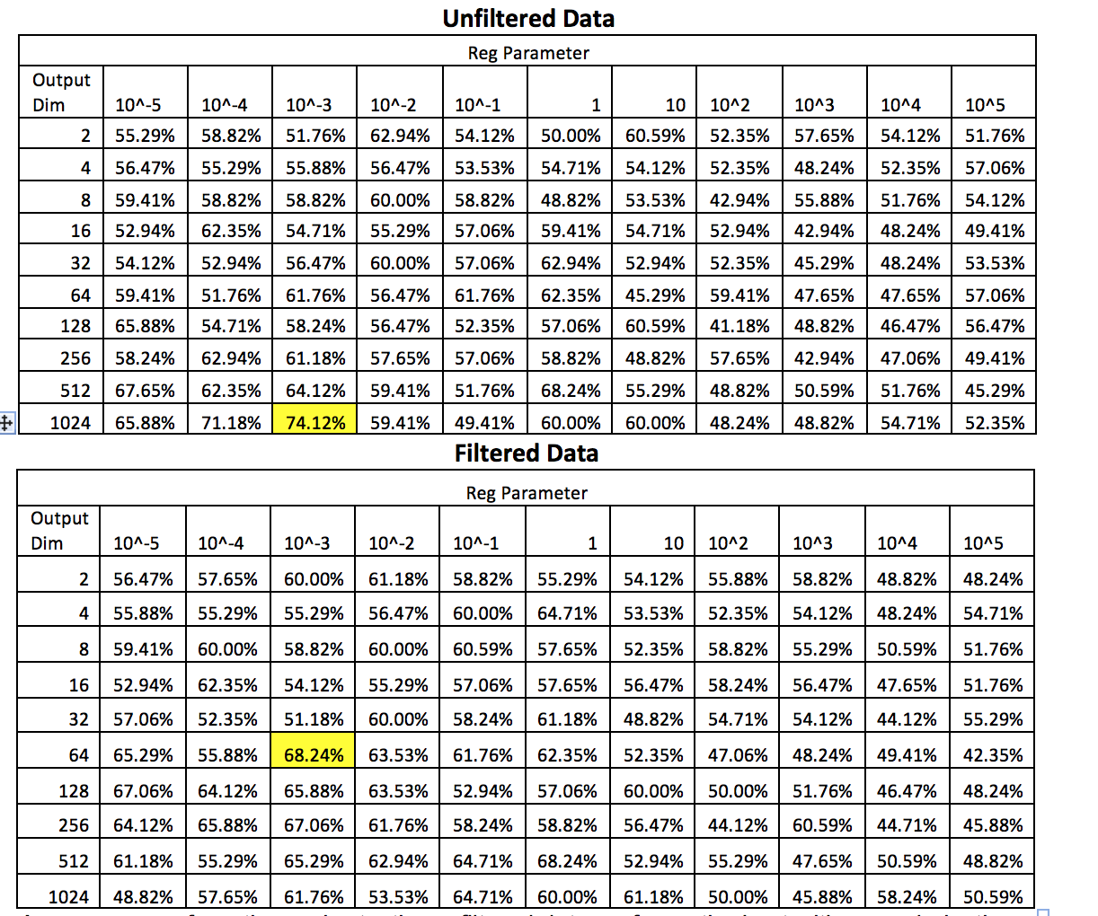
Neural Network: Hyper-Parameter results

Slide 12
Testing
To test how well the model performs the model using the chosen hyper-parameters was trained on the entire training set, with 15% set aside for testing.
This process was performed on both the unfiltered original and data passed through collaborative filtering.
The process was repeated 300 times, each time with a random shuffling of the data, with the mean and standard deviation values for each relevant section reported in the confusion matrix.

Slide 13
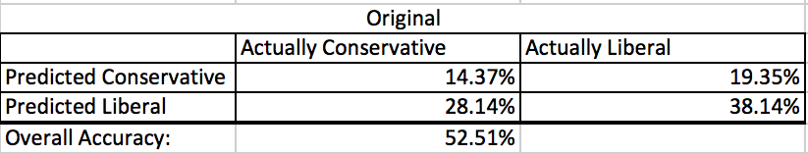
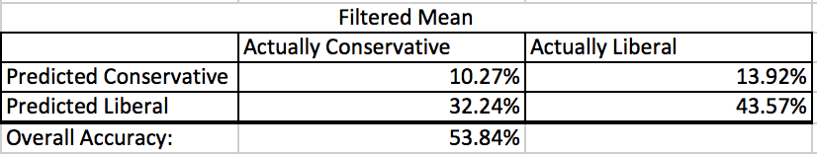
Testing Results:

Slide 14
Conclusion
Neither method performs significantly better than random.
The filtered method appears to do slightly better because it tends to predict more liberals overall.
These results do not compare favorably to the best scores when attempting to fit hyper-parameters.
It seems likely that there was a problem fitting the hyper-parameters or only cross-validating 10 times was susceptible to outliers.
Biggest contributor likely lack of data

Slide 15
Future work: Existing Model
More data
Ideally from both sides of the spectrum
More political affiliations
i.e. Centrist, Independent, Libertarian, Green, etc.
Place in spectrum rather than binary label
Would require a much larger dataset
Automatic data labeling when possible
Use self-identified information in profiles
Use Facebook’s ad classification for the profile
Analyze posts in addition to pages
Someone may not have political likes, but could like still post politically or like/share political posts
Evaluation on which pages to use for analysis
Eliminate old, irrelevant, or uninteresting pages
Continue to tweak hyper-parameters

Slide 16
Future Work: Other Models
Try unsupervised learning, possibly seeded clustering
May not cluster based on political affiliation
Could use mutual friends/page likes as a starting point/accuracy measure
Try Naïve Bayes Classification
Different methods for dealing with missing data
Nearest neighbors methods of collaborative filtering

