Slide 1
LABMENTIX | CYBERSECURITY TRAINING PROGRAM
Caesar & Vigenère
Cipher Tool
Classical cryptography, broken by statistics
PLAINTEXT
Aharnish Dhaw Kumar
Batch: 15 August 2026
Trainer: Ganesh Kuche
15-Day Hands-On Project
Submitted 22/09/2026
T
R
A
I
N
E
R
SHIFT +11
E
C
L
T
Y
P
C
Notes:
Introduce the project: a Python tool with CLI and Tkinter GUI that encrypts, decrypts and automatically breaks Caesar and Vigenère ciphers using statistics.

Slide 2







OVERVIEW
Project at a Glance
PROJECT TITLE
STUDENT
Caesar and Vigenere Cipher Tool
Aharnish Dhaw Kumar
THREE ATTACK TECHNIQUES
Chi-squared
BATCH / COHORT
TRAINER
scoring for Caesar shifts
15 August 2026
Ganesh Kuche
Kasiski
DOMAIN
DIFFICULTY
examination for key length
Cryptography
Advanced
Index of Coincidence
SUBMISSION DATE
DELIVERABLES
to confirm key length
22/09/2026
CLI tool, Tkinter GUI, README
Caesar & Vigenère Cipher Tool | Aharnish Dhaw Kumar
2 / 14

Slide 3
ABSTRACT & PROBLEM STATEMENT
Why Classical Ciphers Fail
The problem
What this project does
Substitution ciphers do not hide the statistical structure of a language. Letters in natural text appear with predictable frequencies, so an attacker can recover the message and key without authorization.
A custom Python cipher tool with a graphical interface for Caesar and Vigenère ciphers
Automated cracking using chi-squared scoring, Kasiski examination and Index of Coincidence
Shows how patterns expose plaintext with no prior knowledge of the key
e
t
q
z
These are the weaknesses that modern standards like AES are engineered to eliminate.
common
common
rare
rare
Caesar & Vigenère Cipher Tool | Aharnish Dhaw Kumar
3 / 14
Notes:
Frequency patterns survive both Caesar and Vigenère encryption. That is the central weakness the project demonstrates.

Slide 4




GOALS
Project Objectives
Build the tool
Crack Caesar automatically
Design a command-line and graphical tool for Caesar and Vigenère encryption, decryption and analysis.
Implement chi-squared frequency analysis to find the shift of a Caesar cipher.
Detect Vigenère key length
Test and document
Integrate Kasiski examination and Index of Coincidence calculations.
Test across various ciphertexts and record performance observations.
Caesar & Vigenère Cipher Tool | Aharnish Dhaw Kumar
4 / 14

Slide 5



SETUP
Tools & Environment
Tool | Version | Purpose
Python 3 | 3.10+ | Core logic and cryptographic implementation
Tkinter | Standard library | Graphical user interface layer
VS Code / Terminal | Native OS | Development, testing and script execution
Git / Markdown | Latest | Versioning and documentation
cipher_gui.py
Tkinter interface, presentation layer only
GUI imports the core logic
cipher_tool.py
Cipher algorithms, frequency statistics and CLI
README.md
Usage instructions and theory
Deployed locally on a machine running Python 3, split into three modular files.
Caesar & Vigenère Cipher Tool | Aharnish Dhaw Kumar
5 / 14

Slide 6
PROCESS
Methodology: Step by Step
1
2
3
4
Verify core code
Crack Caesar
Launch the GUI
Crack Vigenère
Ran the built-in demo to confirm encryption, decryption and frequency calculations work.
Tested chi-squared analysis on a Caesar ciphertext to find the shift with no key.
Opened the Tkinter desktop interface that calls cipher_tool.py in real time.
Used Kasiski and IoC to rank key lengths, extract the keyword and decrypt.
python3 cipher_tool.py demo
python3 cipher_tool.py caesar-crack "..."
python3 cipher_gui.py
Vigenère tab: Crack it (no key)
Caesar & Vigenère Cipher Tool | Aharnish Dhaw Kumar
6 / 14

Slide 7
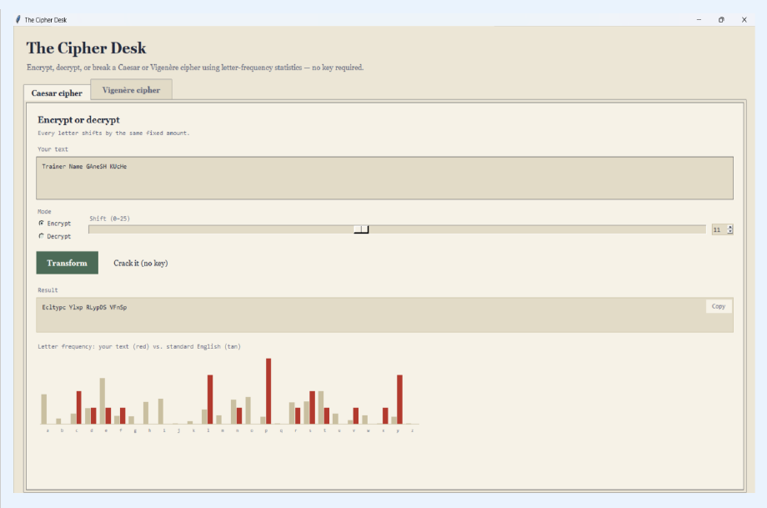
LIVE DEMO
The Cipher Desk: Caesar Panel
Shift 11 example
INPUT
Trainer Name GAneSH KUcHe
OUTPUT
Ecltypc Ylxp RLypDS VFnSp
Encrypt or decrypt with a 0 to 25 shift slider
Crack it (no key) finds the shift automatically
Red bars show your text; tan bars show standard English
Caesar & Vigenère Cipher Tool | Aharnish Dhaw Kumar
7 / 14

Slide 8
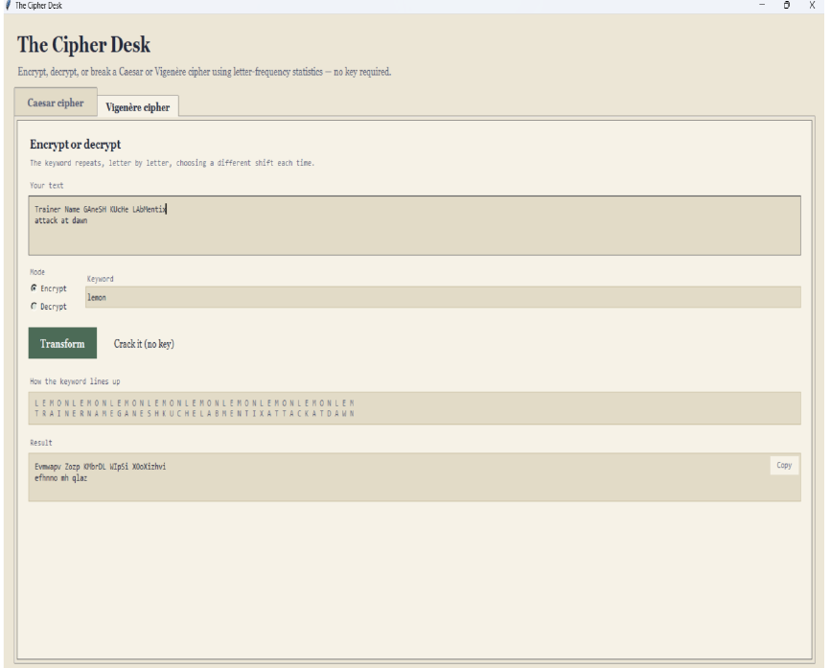
LIVE DEMO
The Cipher Desk: Vigenère Panel
Key alignment made visible
Keyword lemon repeats letter by letter, choosing a different shift each time
The panel shows how the keyword lines up under the text
Crack it (no key) evaluates candidate key lengths and plots IoC against an English threshold
The keyword is extracted and the message decrypted
Caesar & Vigenère Cipher Tool | Aharnish Dhaw Kumar
8 / 14

Slide 9
SUMMARY OF FINDINGS
Results & Observations
01
02
03
Chi-squared efficiency
Text length dependency
Kasiski repetition accuracy
Correct Caesar shifts were found by picking the lowest variance against standard English letter frequencies.
Short ciphertexts gave unstable Index of Coincidence values. Statistical cracking needs enough data.
Repeated substrings in Vigenère ciphertext reliably pointed to multiples of the keyword length.
IMPACT: HIGH
IMPACT: MEDIUM
IMPACT: HIGH
Caesar & Vigenère Cipher Tool | Aharnish Dhaw Kumar
9 / 14

Slide 10


WHY STATISTICS WIN
Analysis: Classical vs Modern
Caesar & Vigenère
Modern ciphers (AES)
Substitution mapping is consistent (Caesar) or cyclically repeating (Vigenère)
Statistical signatures survive encryption
Frequency analysis recovers key and text
Confusion and diffusion layers
Letter-frequency distributions are completely flattened
No structural pattern left to analyze
Classical ciphers are inherently weak against frequency analysis.
Caesar & Vigenère Cipher Tool | Aharnish Dhaw Kumar
10 / 14

Slide 11

PROBLEMS & SOLUTIONS
Challenges Faced
CHALLENGE
HOW I SOLVED IT
Handling short text blocks
Added conditional checks that prompt users for a longer ciphertext during automated Vigenère cracking.
Automated cryptanalysis failed on very short strings because statistical averages need a larger sample.
CHALLENGE
HOW I SOLVED IT
GUI module integration
Kept both files in the same working directory and made the GUI strictly a presentation layer.
Keeping clean imports between the Tkinter GUI file and the backend CLI script.
Caesar & Vigenère Cipher Tool | Aharnish Dhaw Kumar
11 / 14

Slide 12

01
Chi-squared in practice
Applying chi-squared statistics to match text letter frequencies against standard English.
LEARNING
02
Key-length detection
What I Took Away
Practical grasp of Kasiski examination and Index of Coincidence for polyalphabetic ciphers.
03
Clean architecture
Separating core security logic from the graphical presentation layer in Python.
04
Classical vs modern
Why diffusion-based standards resist attacks that break classical substitution.
12 / 14

Slide 13

WRAP-UP
Conclusion & Future Scope
Conclusion
Future scope
The project delivered a fully functional cryptographic analysis and transformation tool. It proved that classical ciphers can be dismantled with automated statistical frequency checks, and it underlines why modern cryptography relies on complex mathematical rounds, nonces and diffusion blocks.
Frequency curves added directly into the GUI
More classical ciphers such as Playfair and Hill
Educational modules illustrating AES round transformations
Caesar & Vigenère Cipher Tool | Aharnish Dhaw Kumar
13 / 14

Slide 14
Thank You
Aharnish Dhaw Kumar | Labmentix Cybersecurity Training Program
REFERENCES
[1] Labmentix Cybersecurity Training Program: Project Submission Guidelines
[2] Python Standard Library Documentation: collections and tkinter, docs.python.org/3/
[3] Classical cryptography and cryptanalysis textbooks (Kasiski examination, Index of Coincidence, chi-squared statistics)
Caesar & Vigenère Cipher Tool | Aharnish Dhaw Kumar
14 / 14

