Slide 1
Sensor data becomes a visible action
IoT
Server Room Monitor
DHT
simulated sensor
Real-time climate monitoring with automatic emergency control
MQTT
message broker
Aharoni Cohen 206881047
Ron Shitrit 207973264
GUI
decision and status
Application presentation
https://github.com/aharoni-cohen/iot-smart-home
RELAYS
A/C, pump, alarm
Notes:
Opening: this project presents a simulated IoT server-room monitor. It collects temperature and humidity readings, moves them through MQTT, and turns threshold violations into visible relay actions.
Source: https://github.com/aharoni-cohen/iot-smart-home and the repository files reviewed for this deck.

Slide 2
Server rooms need continuous attention
02
The application focuses on two environmental signals that can threaten the equipment.
A small change in the room can become a service interruption when nobody sees it in time.
01
High temperature
Heat can damage sensitive equipment and shorten its reliable operating window.
02
High humidity and leaks
The question
Moisture can interrupt operation and create costly maintenance work.
How can a low-cost IoT setup detect risk and trigger the first response automatically?
03
Delayed reaction
A manual response may arrive after the condition has already escalated and we may have already passed the point of no return.
IOT SMART HOME / SERVER ROOM MONITOR
github.com/aharoni-cohen/iot-smart-home
Notes:
Explain the operating context. The repository simulates temperature and humidity readings and defines automatic responses for emergency conditions.
Source: https://github.com/aharoni-cohen/iot-smart-home, especially README.md and dashboard.py.

Slide 3
Project overview
03
A compact control loop links sensing, messaging, decisions, and relay states
One dashboard for the full response
DHT feed
Temperature + humidity
MQTT
Topic-based transport
The system keeps a live view of the server room conditions and publishes a control message when an emergency threshold is reached.
9 SECOND SIMULATION TICK
Dashboard
Parse + evaluate
Relay actions
A/C, pump, alarm
dashboard starts a timer that publishes simulated DHT readings every 9 seconds.
The same MQTT connection carries measurements and relay states.
IOT SMART HOME / SERVER ROOM MONITOR
github.com/aharoni-cohen/iot-smart-home
Notes:
Describe the project as an end-to-end control loop. The dashboard subscribes to four topics and publishes control messages when the threshold logic calls for a response.
Source: https://github.com/aharoni-cohen/iot-smart-home, dashboard.py.

Slide 4
System architecture and components
05
MQTT decouples the sensor feed, the controller, and the output processes
Publishers
Message transport
Controller and outputs
DHT simulator
PyQt5 dashboard
Parse, evaluate, visualize
MQTT broker
Subscriptions and published state
DHT_TOPIC
A/C
Alarm
Pump
1
2
3
4
5
DHT simulator
MQTT broker
dashboard
Relay processes
Alarm process
Generates temperature and humidity messages for the demo.
Routes measurements and relay states between processes.
Parses messages, evaluates thresholds, and shows status.
Represent the emergency A/C and drain pump outputs.
Makes emergency state visible and audible.
IOT SMART HOME / SERVER ROOM MONITOR
github.com/aharoni-cohen/iot-smart-home
Notes:
Use the diagram to explain the loose coupling. The DHT simulation publishes a reading. The dashboard subscribes, evaluates it, and publishes relay state messages. The outputs can remain separate processes because MQTT carries the state.
Source: https://github.com/aharoni-cohen/iot-smart-home, dashboard.py and the standalone scripts.

Slide 5
Emergency response sequence
06
The control path is short enough to follow from one reading to one visible action
01
Timer tick
The 9-second QTimer requests the next simulated reading.
Recovery
02
DHT publish
A text payload carries temperature and humidity values.
When the readings return below the emergency thresholds, the application clears the alert flags and publishes 0 to the relevant relay topics.
03
Regex parse
The dashboard extracts both numbers from the payload.
04
Threshold check
Normal, warning or emergency states use code constants.
05
Relay publish
The controller sends JSON state messages.
STATEFUL ALERTS
06
Event log
The GUI records readings and the action taken.
Flags keep a condition active until the sensor feed returns to normal.
IOT SMART HOME / SERVER ROOM MONITOR
github.com/aharoni-cohen/iot-smart-home
Notes:
Explain the event order. A timer generates the demo input, the dashboard parses it, threshold logic decides whether to publish, and the event log records the result. The code also tracks whether temperature or humidity is already in alert state so that recovery can publish 0.
Source: https://github.com/aharoni-cohen/iot-smart-home, dashboard.py.

Slide 6
MQTT topics and message format
07
The topic names and payload shapes come directly from dashboard.py
Topic | Payload | Meaning
pr/home/5976397/sts | Temperature: 31.2 Humidity: 78.4 | Simulated DHT reading
pr/home/conditioner/sts | value: 1 or 0 | Engage or release emergency A/C
pr/home/pump/sts | value: 1 or 0 | Start or stop the drain pump
pr/home/alarm/sts | value: 1 or 0 | Sound or silence the alarm
1 = ACTIVE
0 = IDLE
The dashboard subscribes to all four topics and publishes control state when a threshold changes.
IOT SMART HOME / SERVER ROOM MONITOR
github.com/aharoni-cohen/iot-smart-home
Notes:
Use this table to make the communication contract concrete. The DHT feed uses a text payload. The relay topics use a JSON object with a value field.
Source: https://github.com/aharoni-cohen/iot-smart-home, dashboard.py and mqtt_init.py.

Slide 7
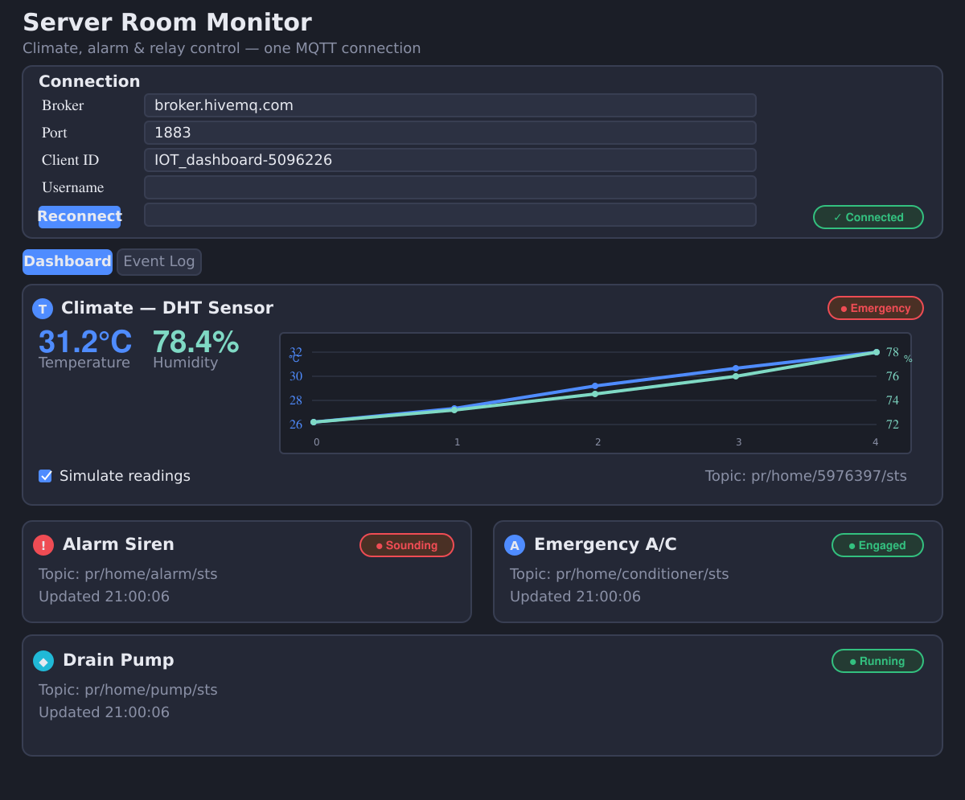
Live dashboard
08
A single window brings the broker connection, climate chart, relay states, and event log together
Current interface
One broker connection for the dashboard
Temperature and humidity metrics with a live chart
Alarm, A/C, and pump state cards
Event Log tab for traceability
EMERGENCY DEMO STATE
IOT SMART HOME / SERVER ROOM MONITOR
github.com/aharoni-cohen/iot-smart-home
Notes:
This screenshot comes from the repository's current dashboard.py. It shows a controlled demonstration state with a 31.2 degree temperature reading, 78.4 percent humidity, and active A/C, pump, and alarm states. The dashboard itself is the main user interface for this project.
Source: https://github.com/aharoni-cohen/iot-smart-home, dashboard.py. Screenshot captured from the repository code in a local offscreen run.

Slide 8
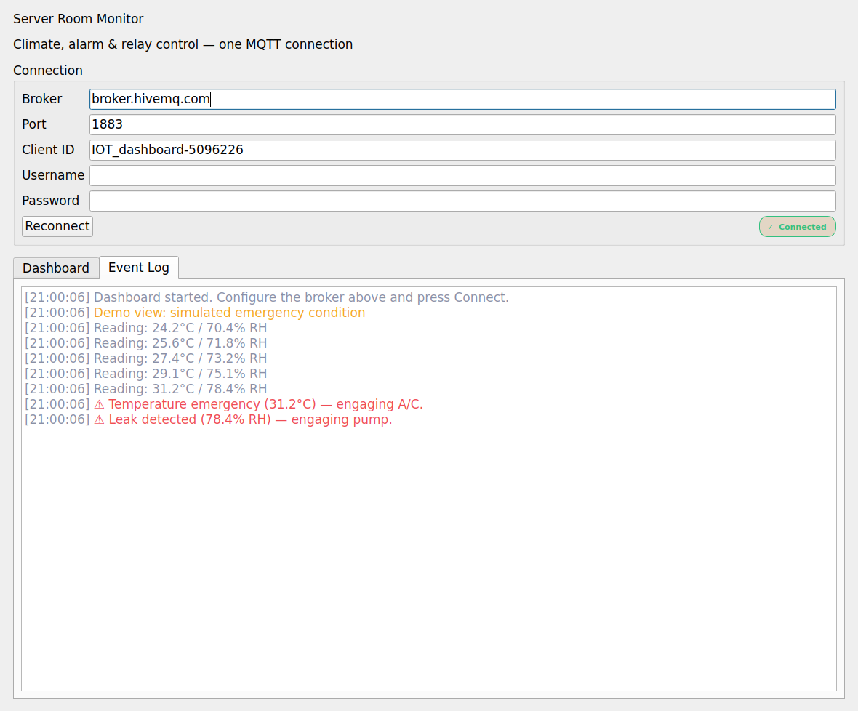
Emergency response in the GUI
09
The event log makes the decision path easy to inspect after a threshold is crossed
Demo state
31.2°C
temperature emergency
78.4%
humidity emergency
A/C engaged, pump running, alarm sounding
IOT SMART HOME / SERVER ROOM MONITOR
github.com/aharoni-cohen/iot-smart-home
Notes:
The event log records the normal readings leading into the emergency, then records the temperature and humidity actions. The values shown here come from the controlled screenshot capture and demonstrate how the UI exposes the system response.
Source: https://github.com/aharoni-cohen/iot-smart-home, dashboard.py.

Slide 9
Implementation stack
10
The application stays small by combining a desktop GUI, MQTT messaging, and a charting layer
Key implementation facts
Repository structure
PyQt5
Desktop dashboard and status controls
dashboard.py
main monitor and controller
mqtt_init.py
broker and topic configuration
paho-mqtt
MQTT client for publish and subscribe
DHT.py
standalone sensor publisher
alarm.py
standalone alarm relay
matplotlib
Temperature and humidity history chart
pump.py
standalone pump relay
emergency air conditioner.py
standalone A/C relay
TEMP_EMERGENCY = 31.2
HUMIDITY_EMERGENCY = 78.4
IOT SMART HOME / SERVER ROOM MONITOR
github.com/aharoni-cohen/iot-smart-home
Notes:
Point out the implementation choices. dashboard.py is the consolidated application. The original scripts remain in the repository as device-level references. PyQt5 renders the GUI, paho-mqtt handles messaging, and matplotlib plots the history.
Source: https://github.com/aharoni-cohen/iot-smart-home, README.md, requirements.txt, and dashboard.py.

Slide 10
What the application delivers
The project connects a simulated sensor feed to an automatic, visible response
MQTT
01
DHT
Measure
Temperature and humidity readings arrive through MQTT.
02
Decide
Threshold logic classifies the room state.
A/C, PUMP
ALARM
03
Act
A/C, pump, alarm, and event log show the response.
From message to action
IOT SMART HOME / SERVER ROOM MONITOR
Notes:
Close with the three-part story: measure, decide, act. The application demonstrates how a small MQTT-based system can make environmental risk visible and initiate the first response automatically.
Source: https://github.com/aharoni-cohen/iot-smart-home.

