Slide 1
GallTube

Slide 2
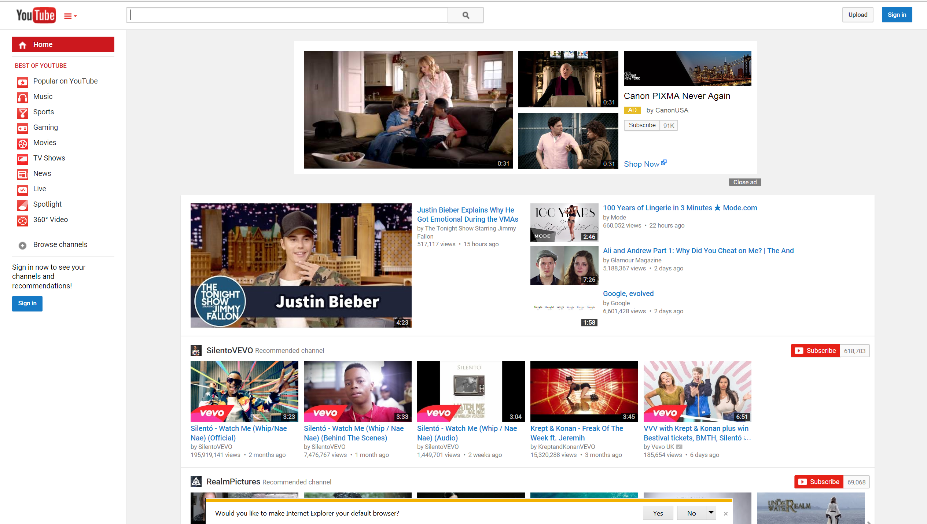
YouTube

Slide 3
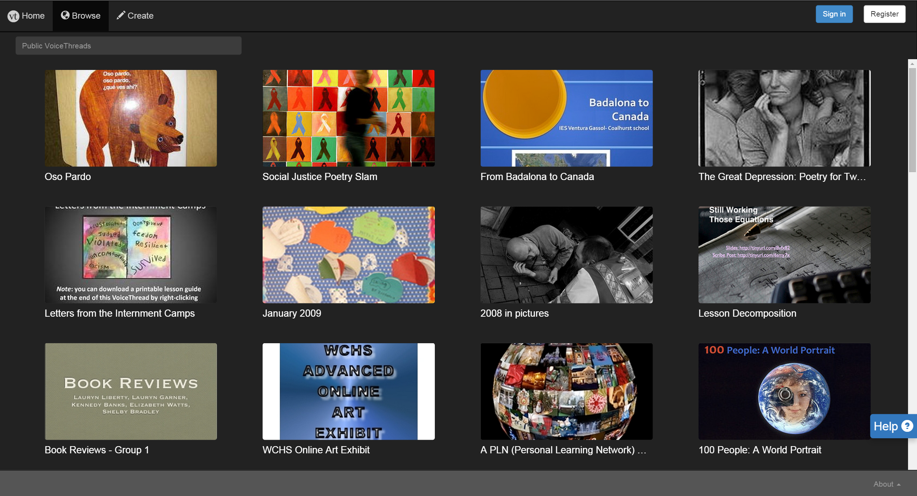
MyThread

Slide 4
Question?
People in Gallaudet want the sharing video website?
People in Gallaudet want the “information” Gallaudet contain videos?

Slide 5
Intended Users
Anyone in Gallaudet

Slide 6
Data
Videos

Slide 7
Process

Slide 8
Hardware

Slide 9
Software

Slide 10
Feature

