Slide 1
Hello, thank you for participating in our study. In this study, you will be asked to complete a version of the Corsi block tapping task. There will be 4 sets of trials and in each trial, you will be presented with an array of coloured blocks on the computer screen that will flash in sequence. You will then be asked to reproduce the sequence by clicking on the appropriate blocks in the correct order using a mouse. You will also get the opportunity to have a break in between each set of trials. When you complete all 4 trials, you will be given a debrief with further details of our study and you will also be asked a few short questions. Press any key to start the task

Slide 2
Now you will have the opportunity to take a short break. When you are ready to resume the task, press any key to move onto the next set of trials.

Slide 3
Before you start the next set of trials, we would like to point out a hidden strategy which may help you complete the task: when reproducing the sequence, pay attention to the colour that the block turns when you click on it. The colour of each block when you are reproducing the sequence is indicating something which can improve your accuracy in the task.

Slide 4
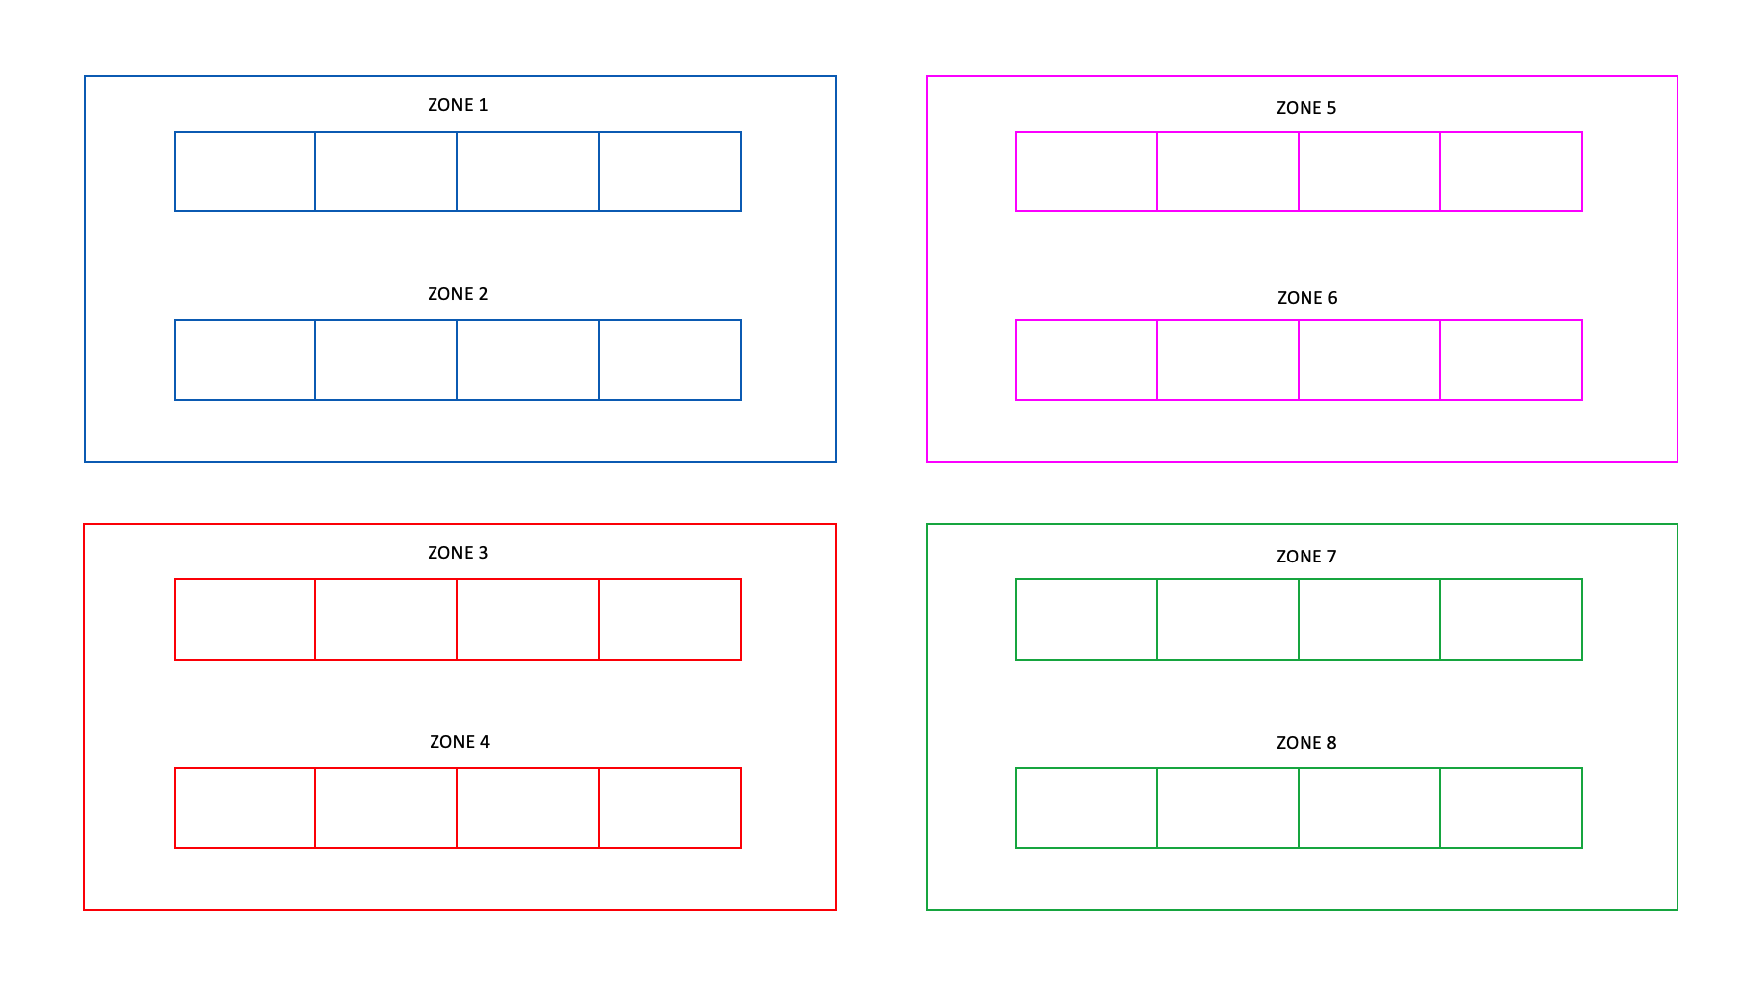
Before you start the final set of trials, we would like to provide you with all the information that explains exactly what the colour of each block is indicating when you are reproducing the sequence: the entire screen where the blocks are flashing have been split into 4 quadrants and 8 zones. For each quadrant, there is one colour assigned to it, please see the information and diagram below:
As you can see, there are 4 colours which have each been assigned to one quadrant. When you are reproducing the sequence, the colour that the block turns when you click on it corresponds to the quadrant in which the subsequent block of the sequence is located. For example, if you click on a block and it turns green, this means the next block is in the quadrant in the bottom right.
Please bear this information in mind before you complete the final set of trials. Press any key to continue.

