Slide 1
FireBase

Slide 2
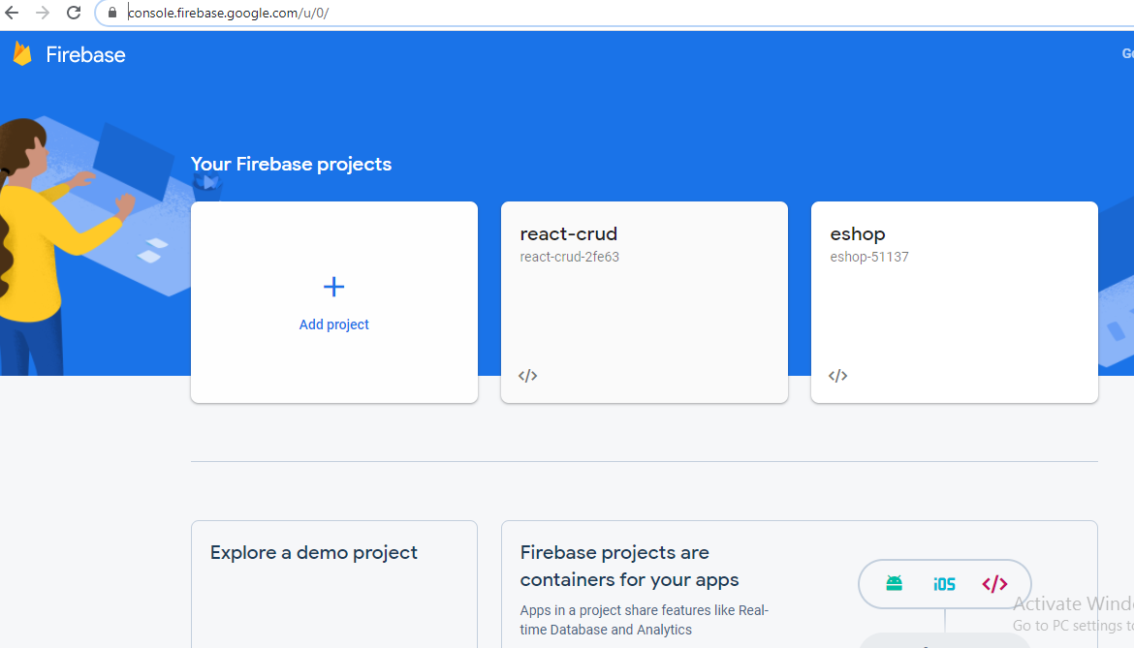
Let’s start->https://console.firebase.google.com/u/0/

Slide 3
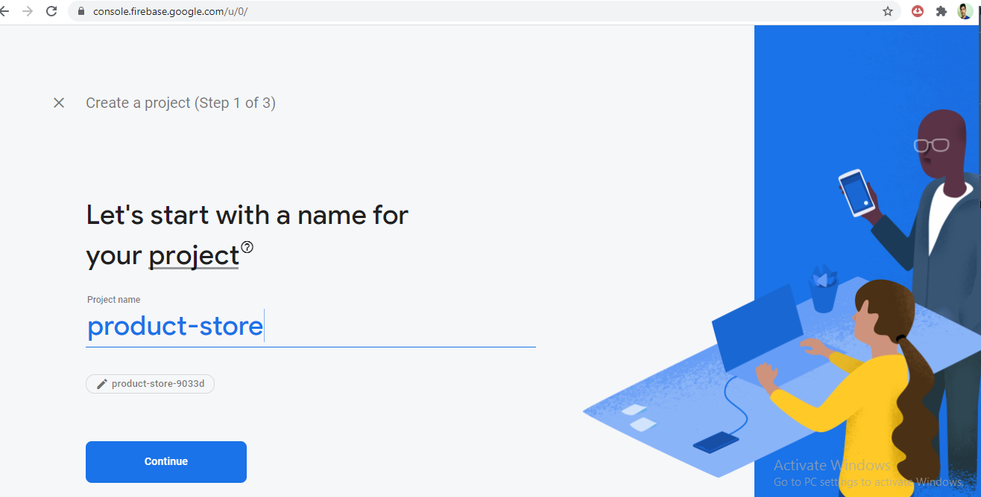
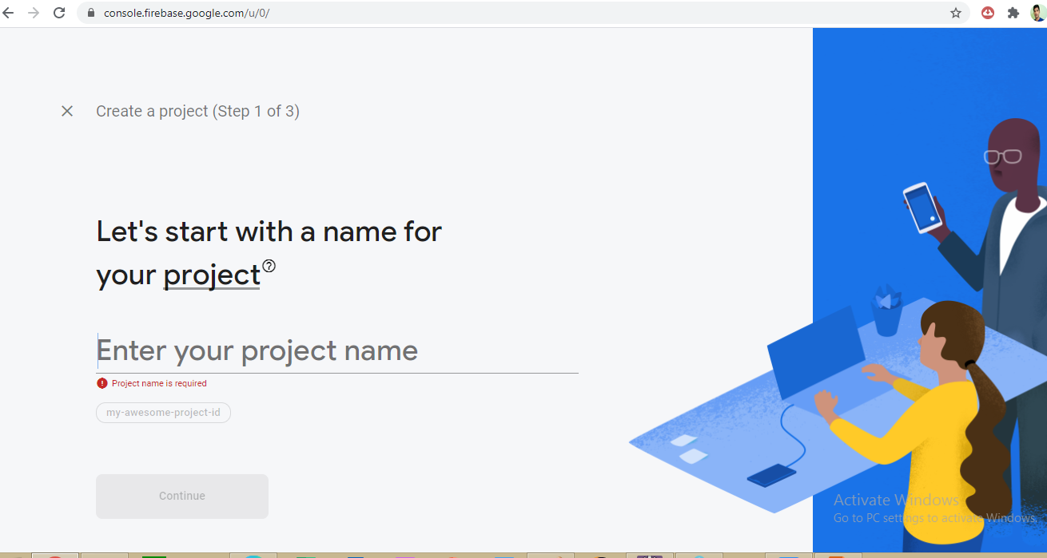
Let’s add a prooject

Slide 4
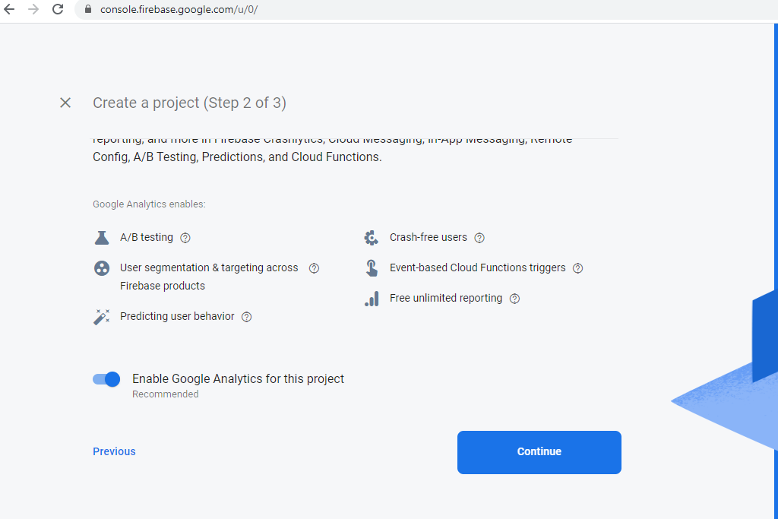
enable/disable google analytics

Slide 5
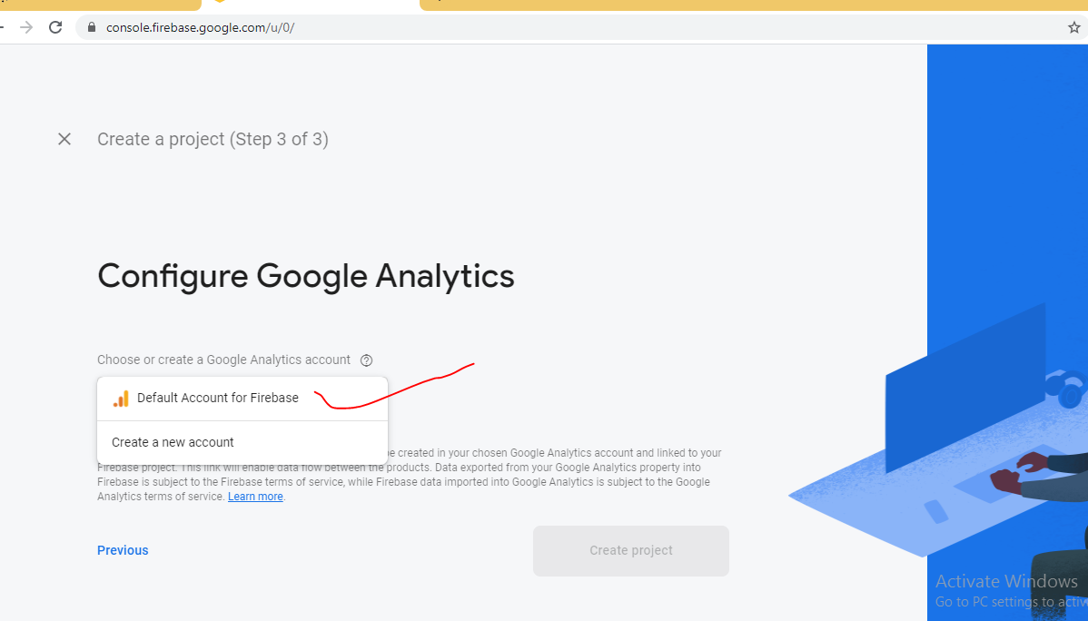
default account

Slide 6
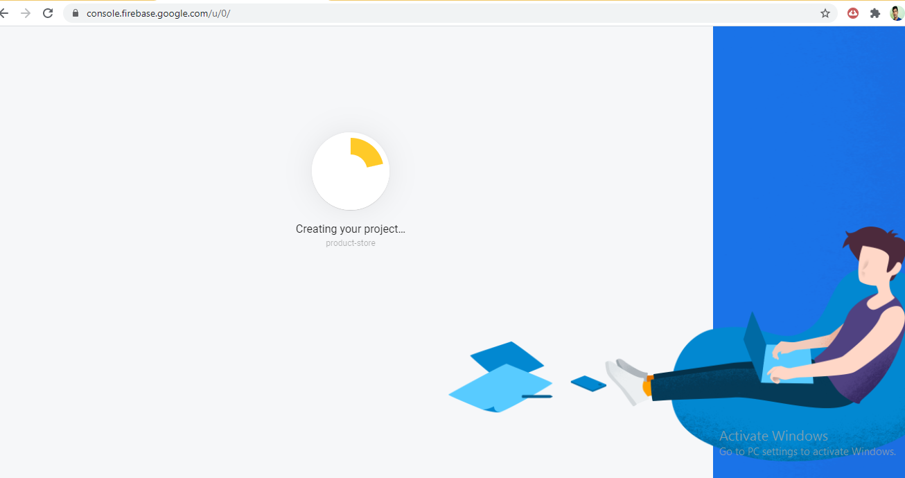
creating project

Slide 7
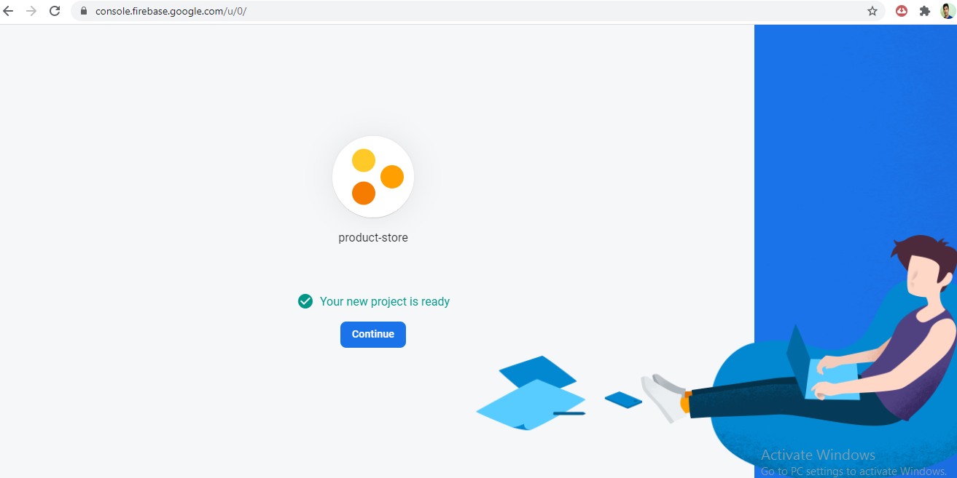
continue

Slide 8
choose app type

Slide 9
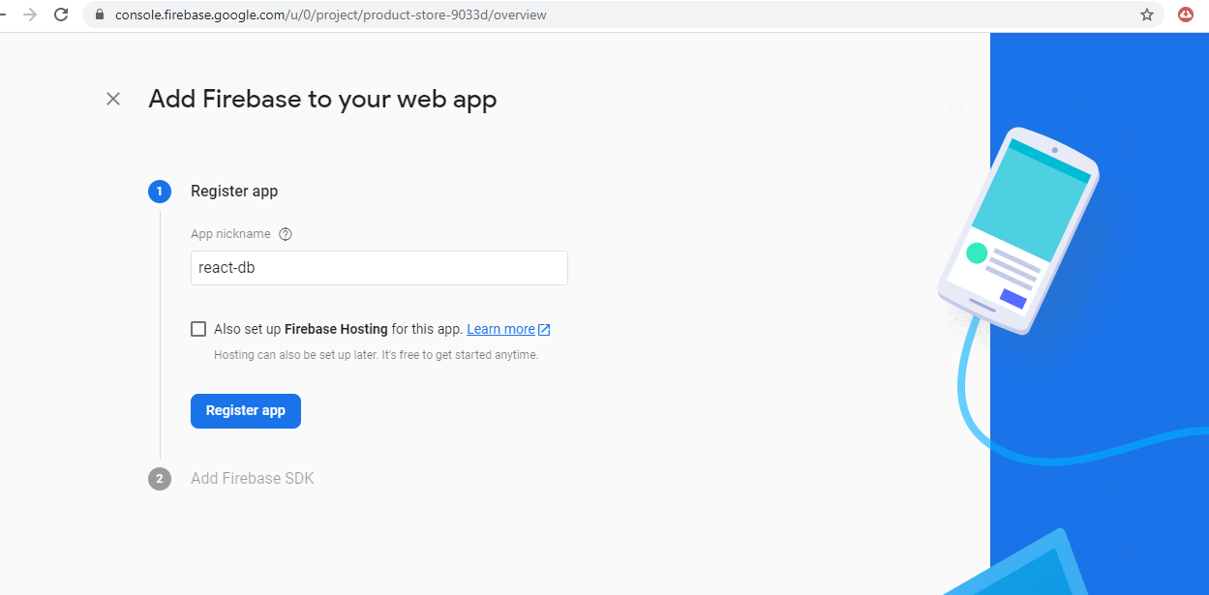
add nickname to project

Slide 10
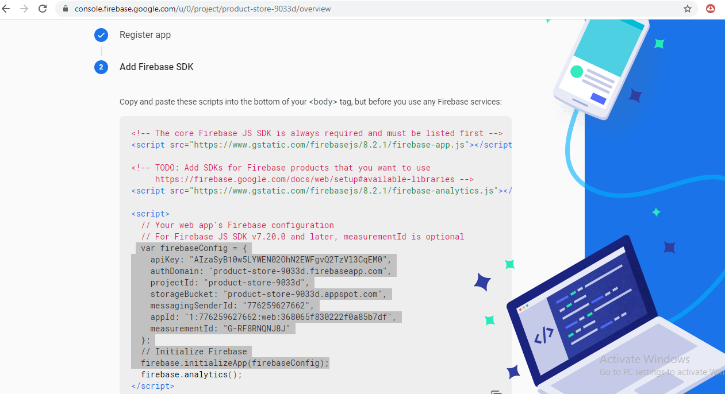
while registring app let’s copy sdk code

Slide 11
copy sdk code

Slide 12
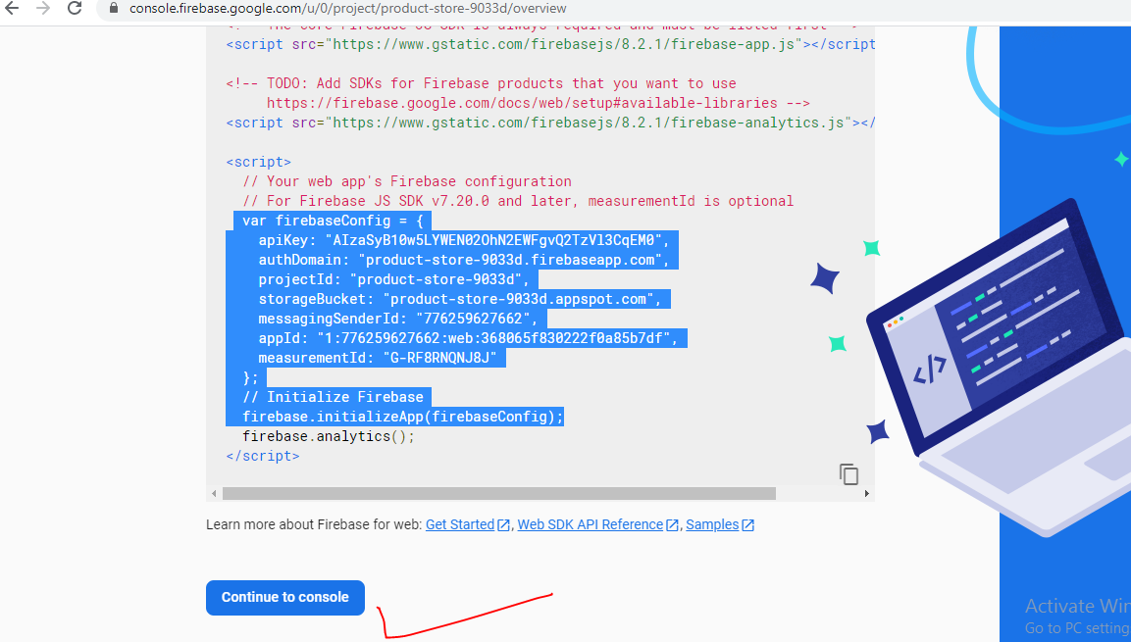
go to console

Slide 13
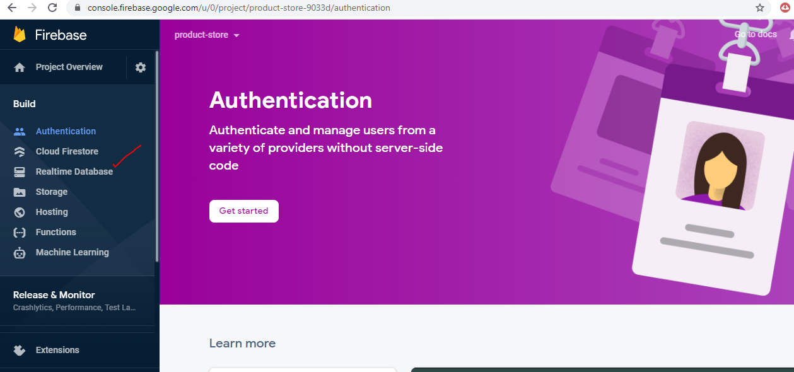
select realtime database

Slide 14
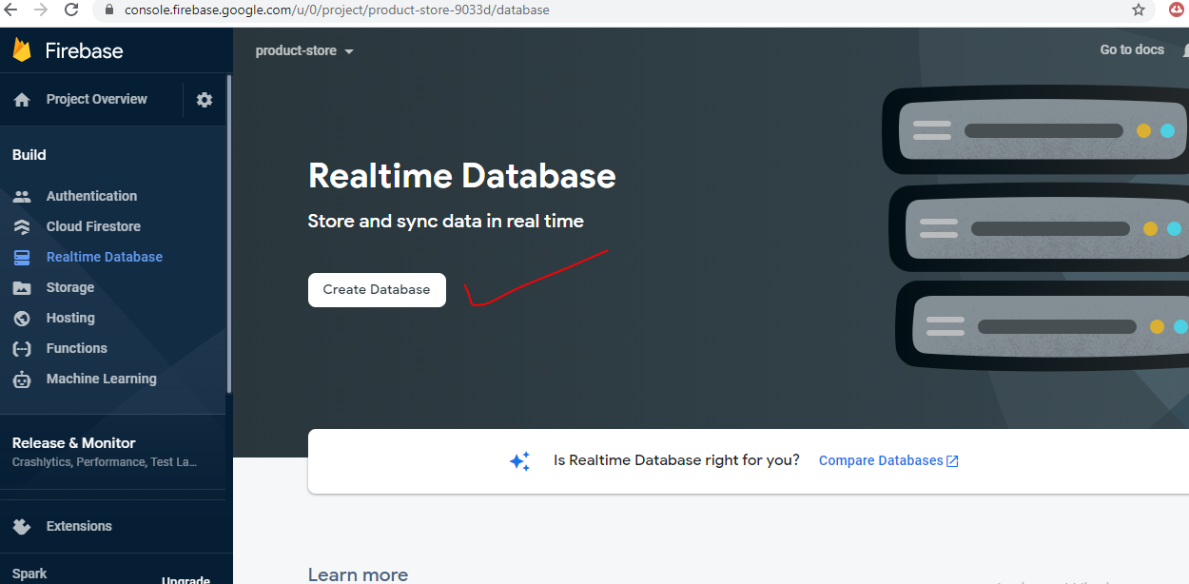
create database

Slide 15
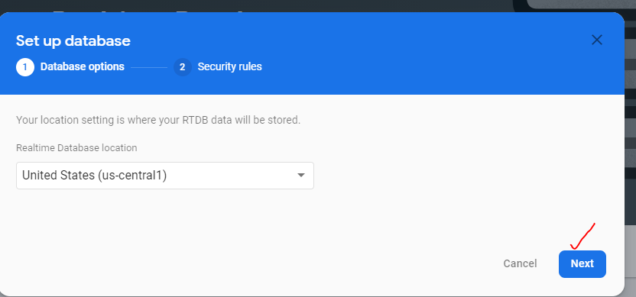
Next

Slide 16
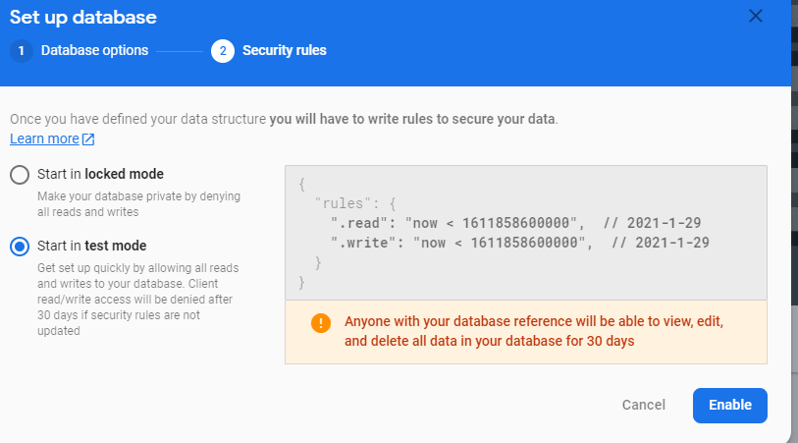
use test mode secity rule

Slide 17
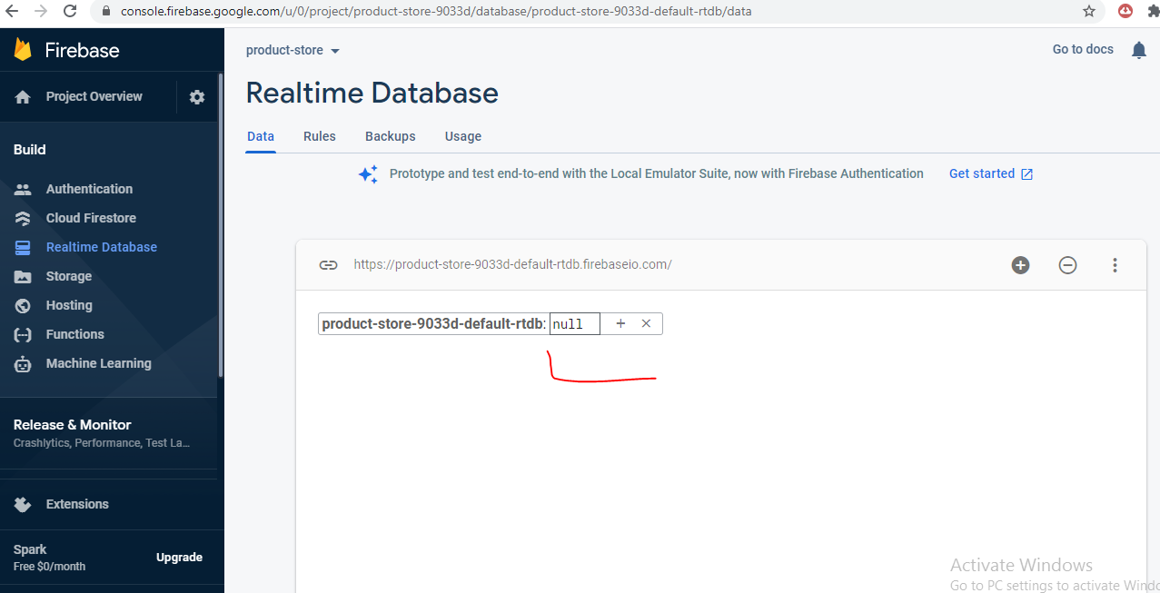
finally screen looks like after db creation

Slide 18
attach react and firebase

Slide 19
get firebase from js file and use firebase

