Slide 1
POM Workshop
Lesson
28

Slide 2
Workshop Task
Precondition
Open https://qwallity-prod.onrender.com and register user via UI
Code
Open https://qwallity-prod.onrender.com/u
Enter to Qwallity Page
Login with new registered user
Open User_Action Page
Add amount via Cash
Assert amount is added and new balance is correct
Technical requirements
Write task using Page Object Model pattern

Slide 3
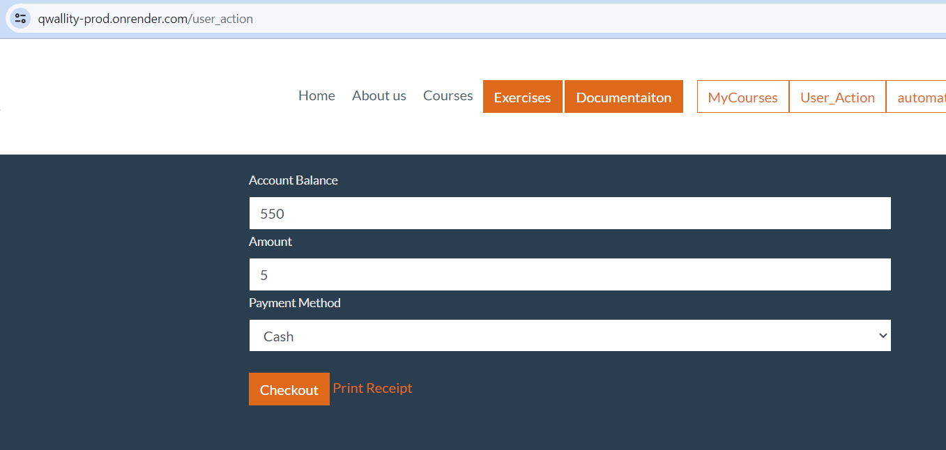

Slide 4
Thank You
Contact Us
+374 41 404 201

