Slide 1
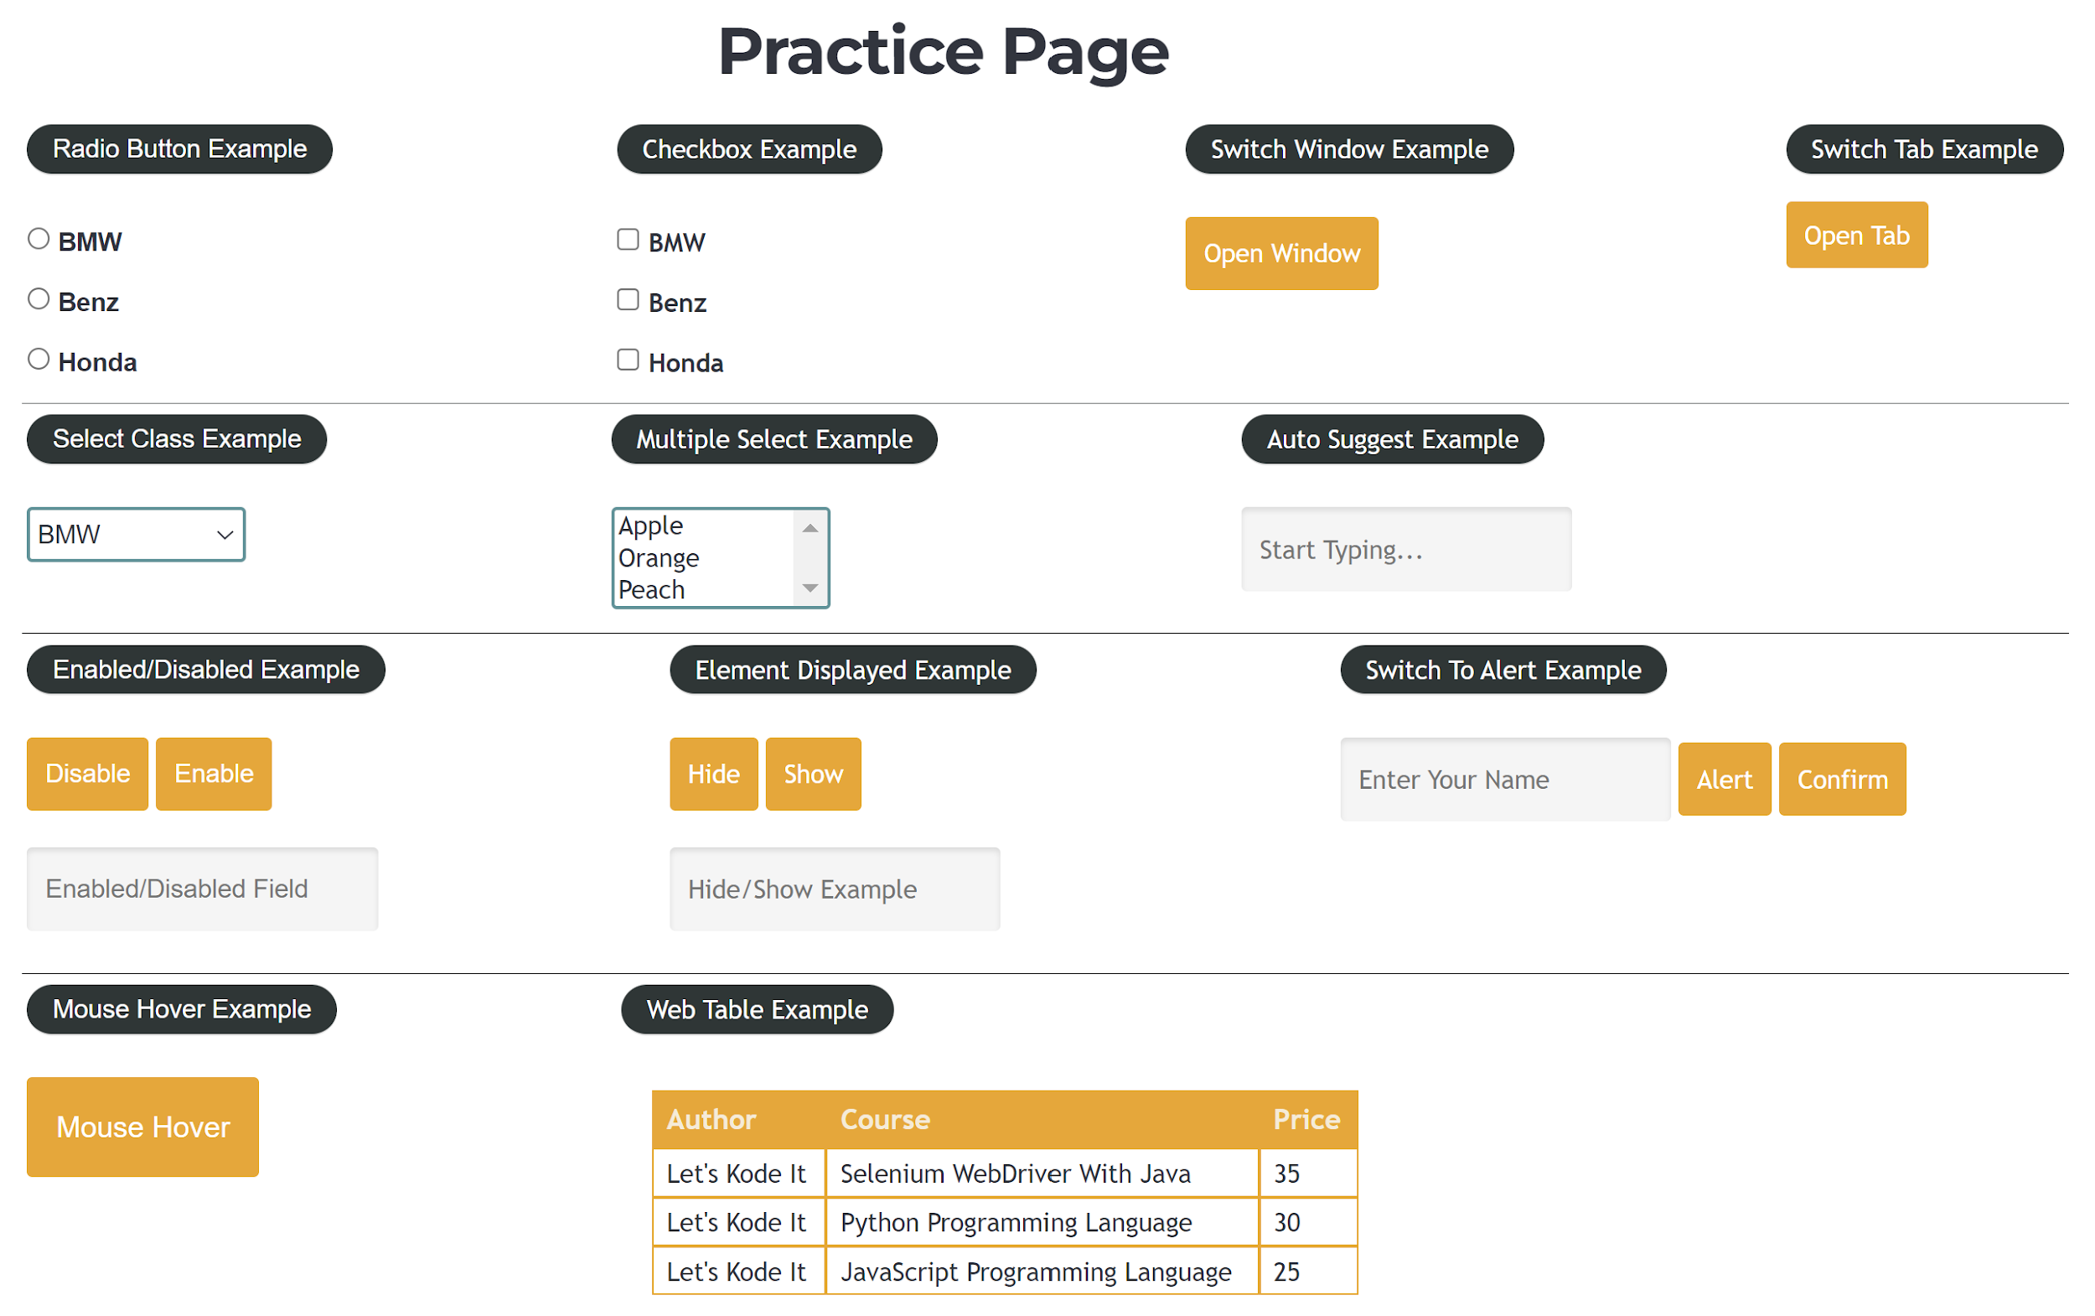
Assignments
1. Navigate by the following URL: https://www.letskodeit.com/practice ​
2. Find effective XPaths for the elements that are highlighted in the screenshot below.
3. Print how many elements you found in total.
1

