Slide 1
Super shop Management System

Slide 2
Introduction
This proposed system is named as ”Online Super shop Management System”. This project includes the information of some super shop in the website . Database has the information of customers who ordered their daily products through online.

Slide 3
Functionality
• Customers can know about some Super shop’s information and their location details
• Customers can see the food item, grocery item.
• This web-site will provide the food price.
• Customer can order here in online.

Slide 4
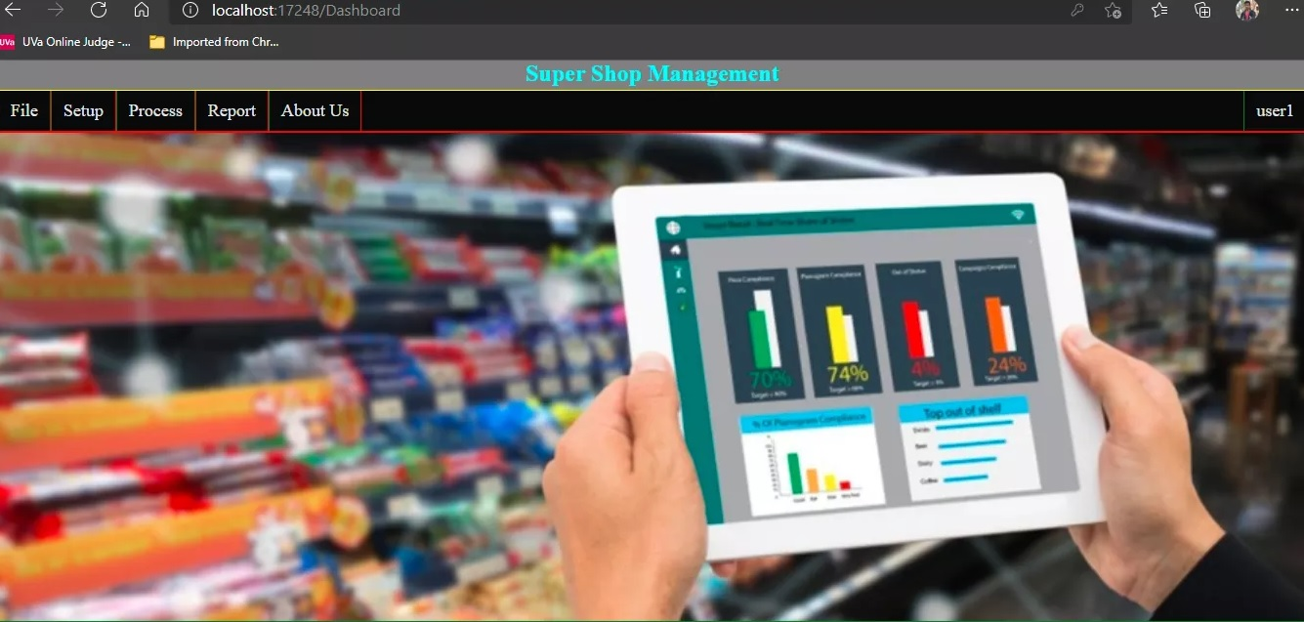
System Interfaces
Home Page

Slide 5
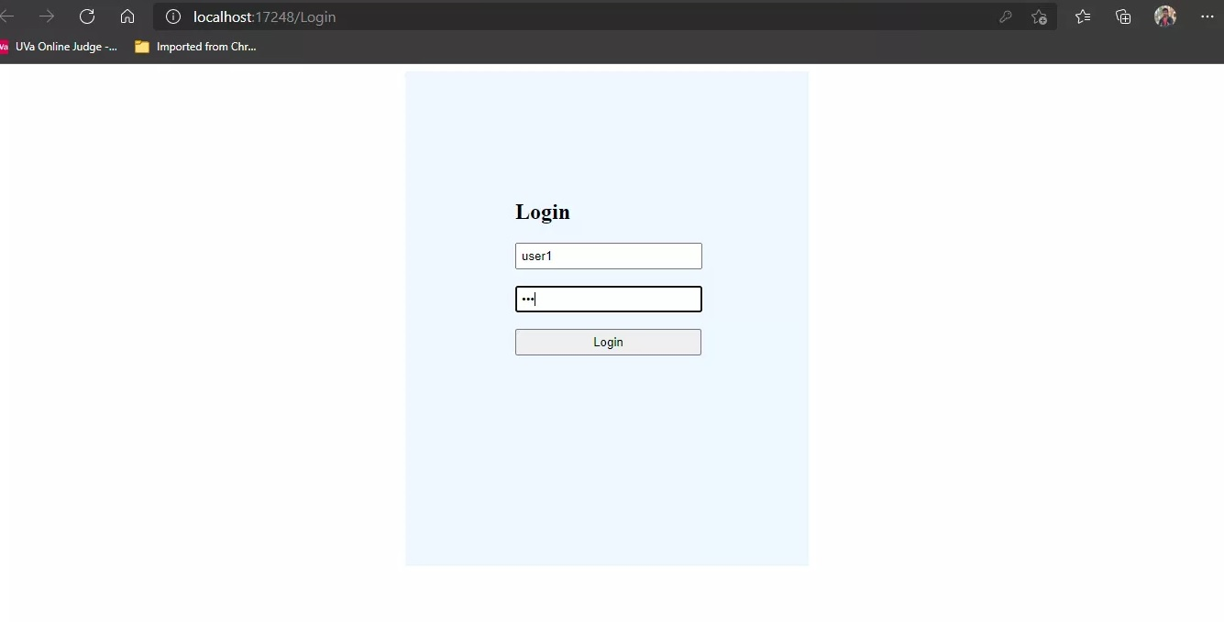
Login Page

Slide 6
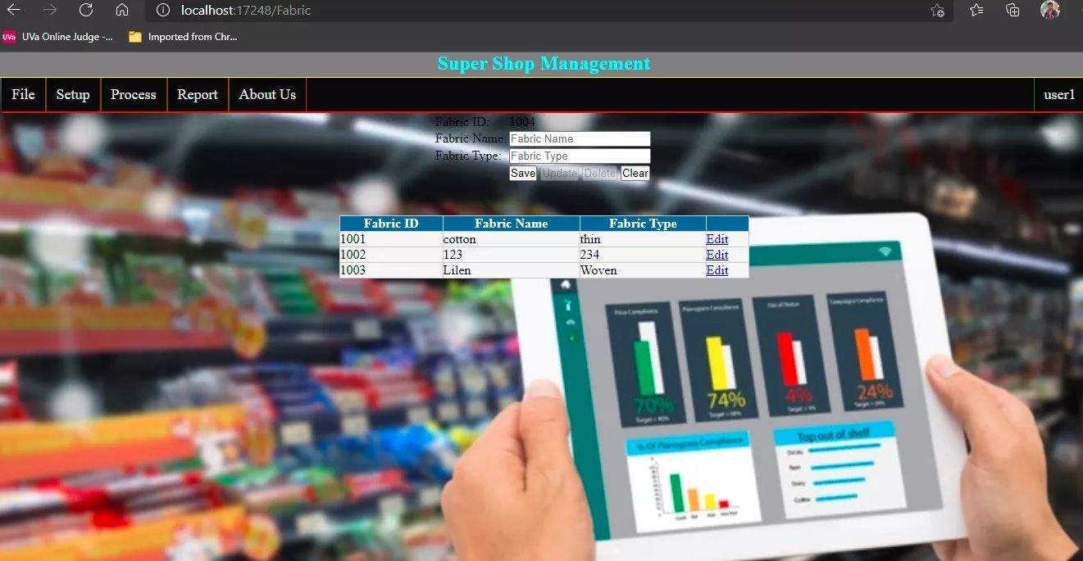
Product List

Slide 7
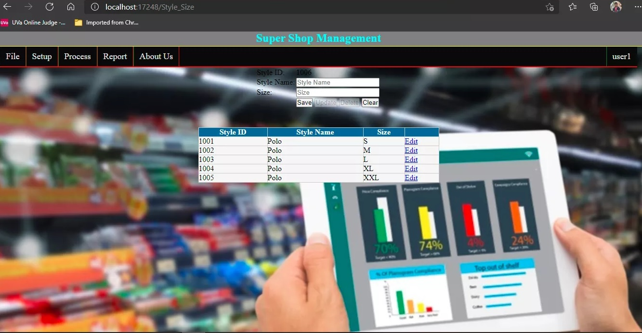
Product Type

Slide 8
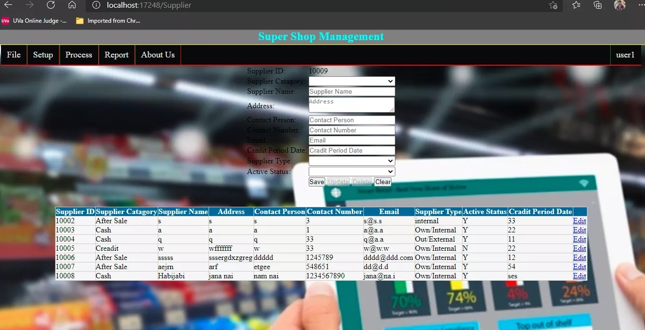
Supplier Channel

Slide 9
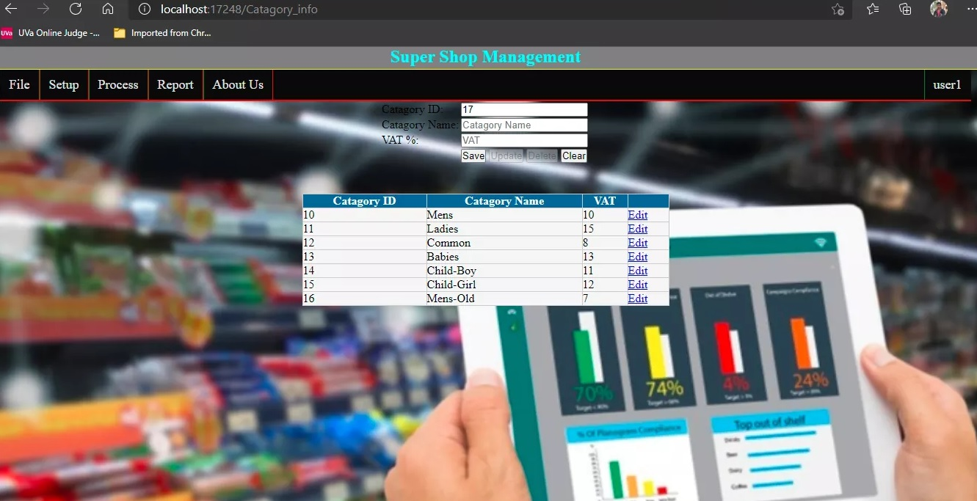
Category

Slide 10
Languages Used
Main Code –
C#
PHP
JavaScript
HTML
Database –
Microsoft SQL

