Slide 1
Mitigating Transmission Losses and Fast Voltage Stability Index (FVSI) Evaluated Collapse using Genetic Algorithm and Particle Swarm Optimization in PSS®E
EEE 306 – Power System I Laboratory | January 2026
Level 3 Term 1 | Section: B2 | Group - 5
Submitted by –
Mahfuz Alam Tonmoy
2206116
Md. Shibli Noman
2206117
Md. Abdullah Al-Noman
2206118
Md. Ahasan Habib
Kawsar - 2206119
Md. Kawsar Ahmed
2206122
Sadiq Sayeed Raha
2206128
Aritra Chowdhury
2206129

Slide 2

Outline
  Summary
  Introduction
  Design Methods & Problem Formulation
  Implementation & Results
  Design Analysis
  Teamwork & Project Management
  Course Outcomes & Program Outcomes (CO-PO) Mapping
  Future Work & References

Slide 3
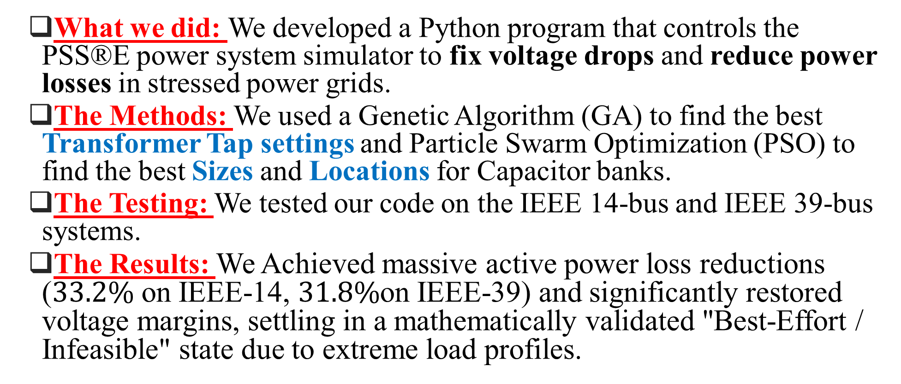
1. Summary
  What we did: We developed a Python program that controls the PSS®E power system simulator to fix voltage drops and reduce power losses in stressed power grids.
  The Methods: We used a Genetic Algorithm (GA) to find the best Transformer Tap settings and Particle Swarm Optimization (PSO) to find the best Sizes and Locations for Capacitor banks.
  The Testing: We tested our code on the IEEE 14-bus and IEEE 39-bus systems.
  The Results: We Achieved massive active power loss reductions ($33.2\%$ on IEEE-14, $31.8\%$on IEEE-39) and significantly restored voltage margins, settling in a mathematically validated "Best-Effort / Infeasible" state due to extreme load profiles.

Slide 4

2. Introduction
The Grid Crisis: Stressed transmission networks suffer from severe reactive power (𝑄) deficits, causing dangerous voltage sags and elevated power losses.
The Mitigation Strategy: Simultaneous optimization of existing discrete transformer tap ratios and the strategic deployment of new shunt capacitor banks.
Our Framework: We developed a fully automated Python-to-PSS®E co-simulation bridge to navigate this massive search space without triggering catastrophic load-flow divergence.

Slide 5
3.1 Design: Problem Formulation (PO(b))
3.1.1 Objectives and Scope of the Design
Primary Objective: Minimize total power transmission loss on a stressed transmission network while restoring bus voltages toward the statutory band 0.95 pu ≤ Vi ≤ 1.05 pu.
Control 1 – Transformer Taps: Use a discrete Genetic Algorithm (GA) to select the tap position of every adjustable transformer.
Control 2 – Shunt Capacitors: Use a discrete Particle Swarm Optimization (PSO) to choose the location and size of shunt capacitor banks.
Stability Check: Screen every transmission line with the Fast Voltage Stability Index (FVSI), before and after each optimization.
Validation Scope: Both controls are tested independently, on the same stressed base case, on the IEEE 14-Bus and IEEE 39-Bus (New England) systems.

Slide 6
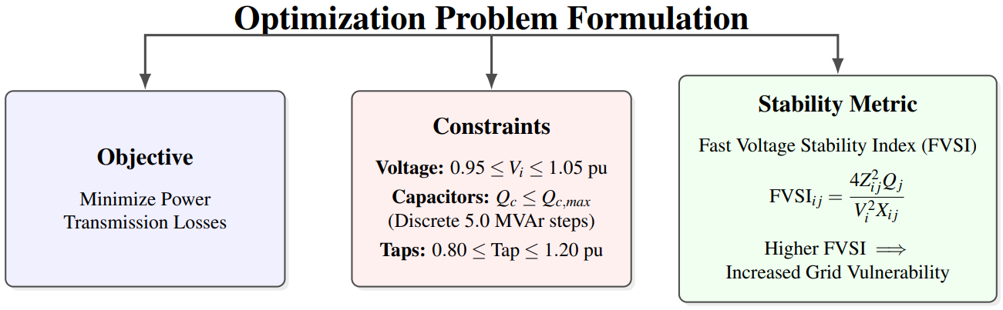
3.1.2 Formulation of Problem
Primary Objective: Maximize overall grid efficiency by minimizing total power transmission losses.
Operational Limits: Enforce strict statutory voltage boundaries and respect the maximum physical capacities of real-world hardware.
Vulnerability Metric: Evaluate line stress using FVSI; Higher values indicate diminishing reactive margins and increased grid vulnerability.

Slide 7
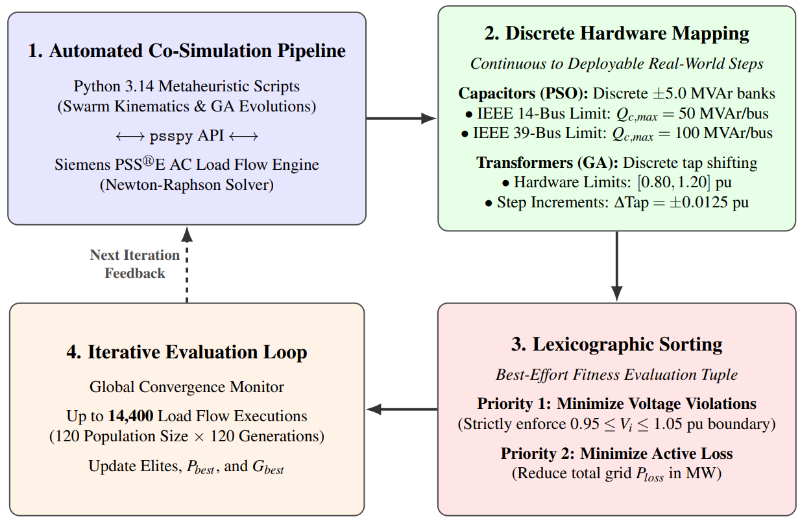
3.2 Design Methods (PO(a))

Slide 8
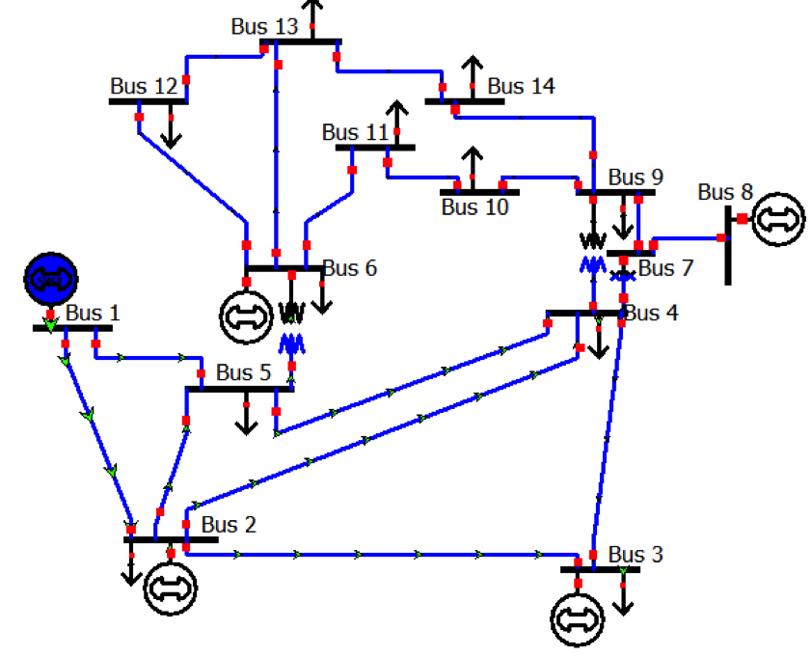
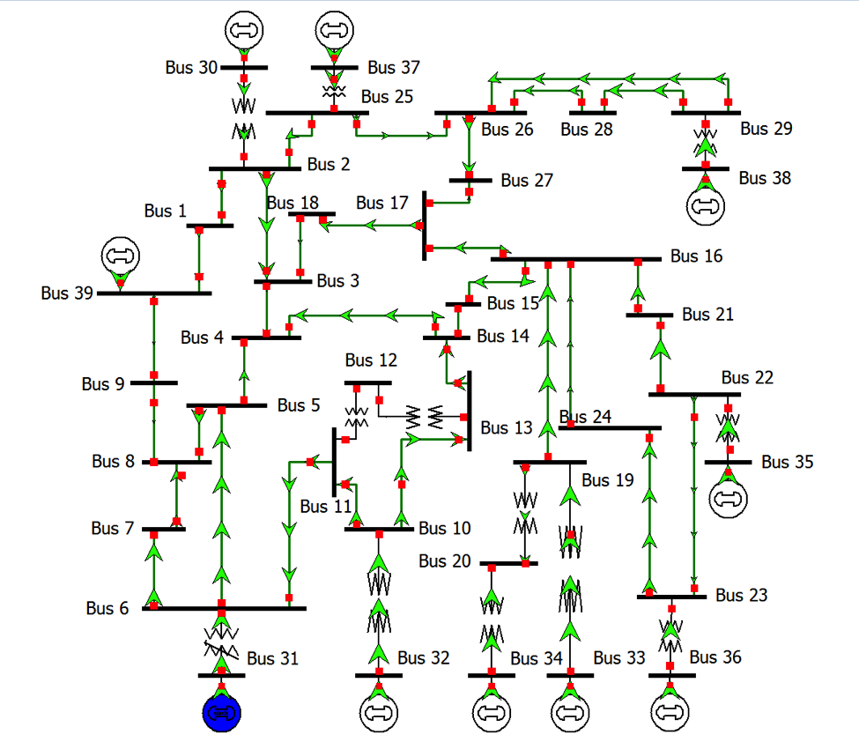
3.3 Design Consideration: Circuit Diagram ((PO(c))
IEEE 14-Bus System: A heavily coupled sub-transmission loop featuring 5 Generators, 3Transformers and 9 load buses(PQ).
IEEE 39-Bus System: The New England bulk transmission backbone, containing 10 Generators, 12 Transformers and 29 candidate Load substations(PQ).
EEE 306 – Power System I Laboratory

Slide 9
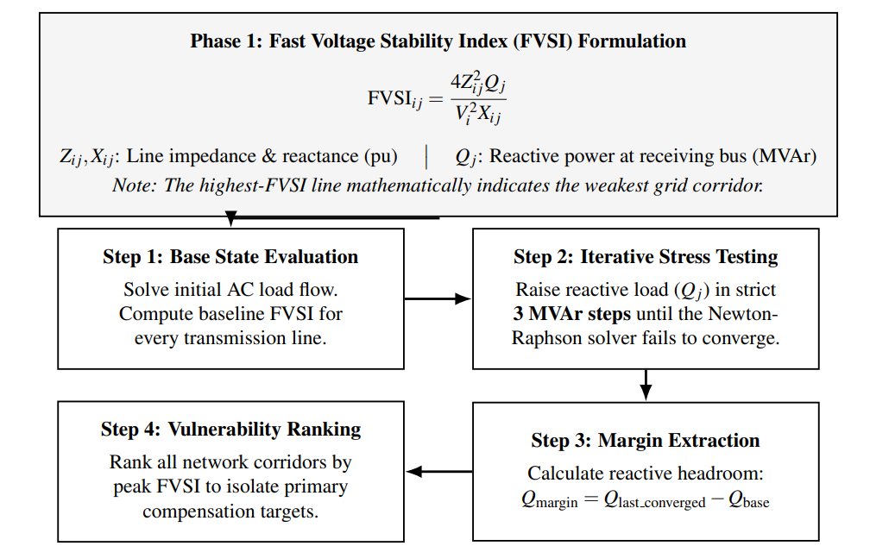
3.4 Design: Simulation - Fast Voltage Stability Index (FVSI)
EEE 306 – Power System I Laboratory

Slide 10
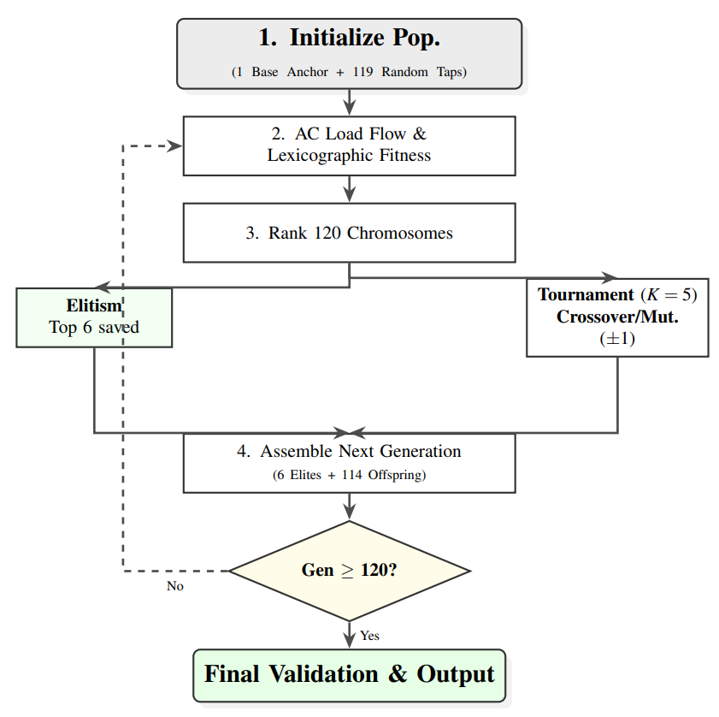
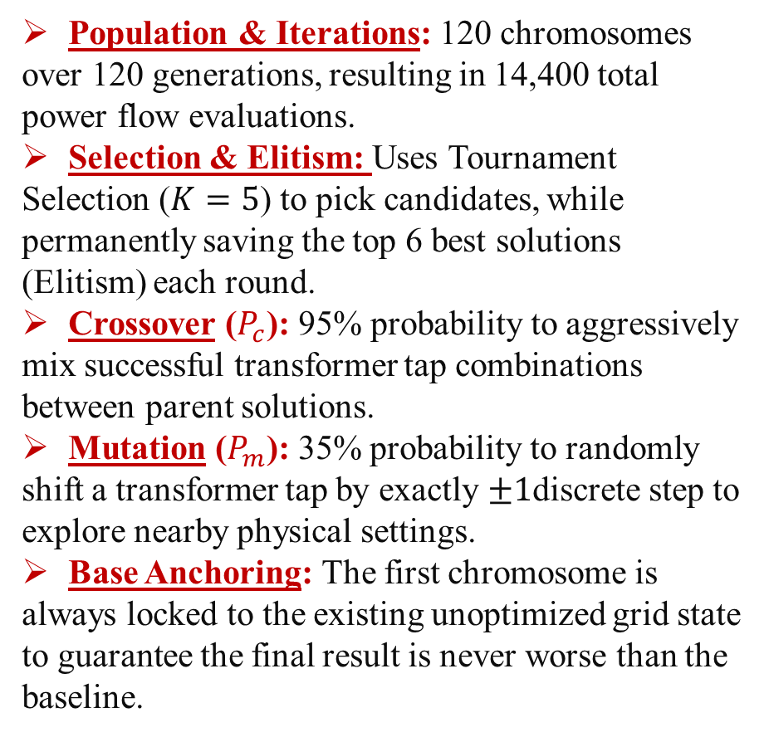
3.4 Design: Simulation- Genetic Algorithm (GA)
Population & Iterations: 120 chromosomes over 120 generations, resulting in 14,400 total power flow evaluations.
Selection & Elitism: Uses Tournament Selection ($K=5$) to pick candidates, while permanently saving the top 6 best solutions (Elitism) each round.
Crossover ($P_{c}$): 95% probability to aggressively mix successful transformer tap combinations between parent solutions.
Mutation ($P_{m}$): 35% probability to randomly shift a transformer tap by exactly $±1$discrete step to explore nearby physical settings.
Base Anchoring: The first chromosome is always locked to the existing unoptimized grid state to guarantee the final result is never worse than the baseline.

Slide 11
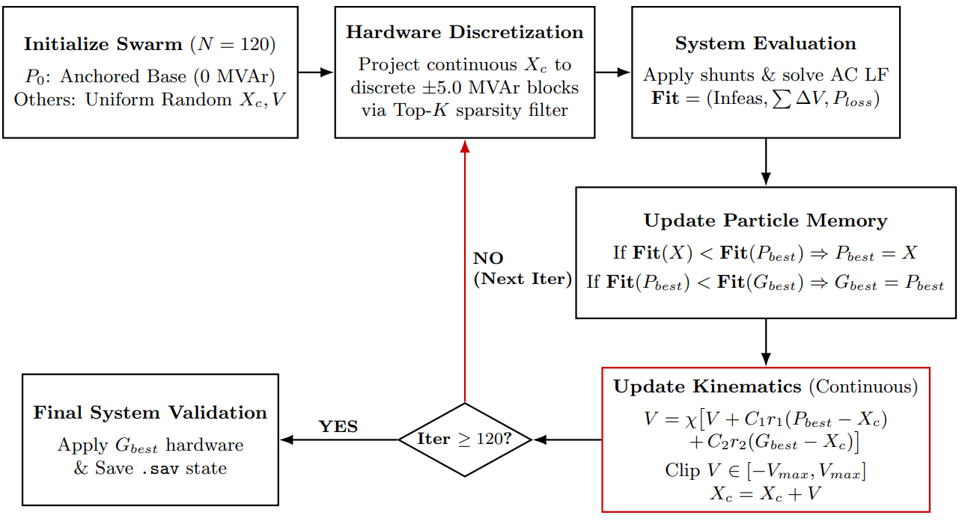
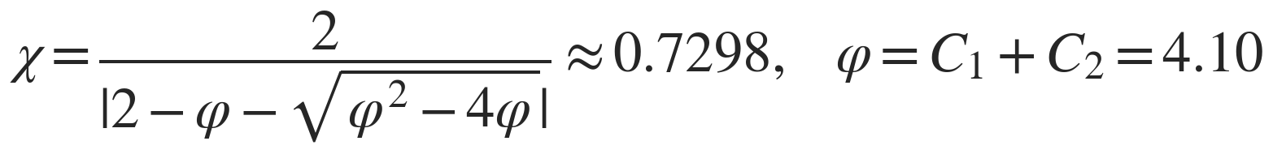
3.4 Design: Simulation- Particle Swarm Optimization (PSO)Algorithm
Xc: Capacitor Size Vector
Pbest: Personal Best
Gbest: Global Best

Slide 12
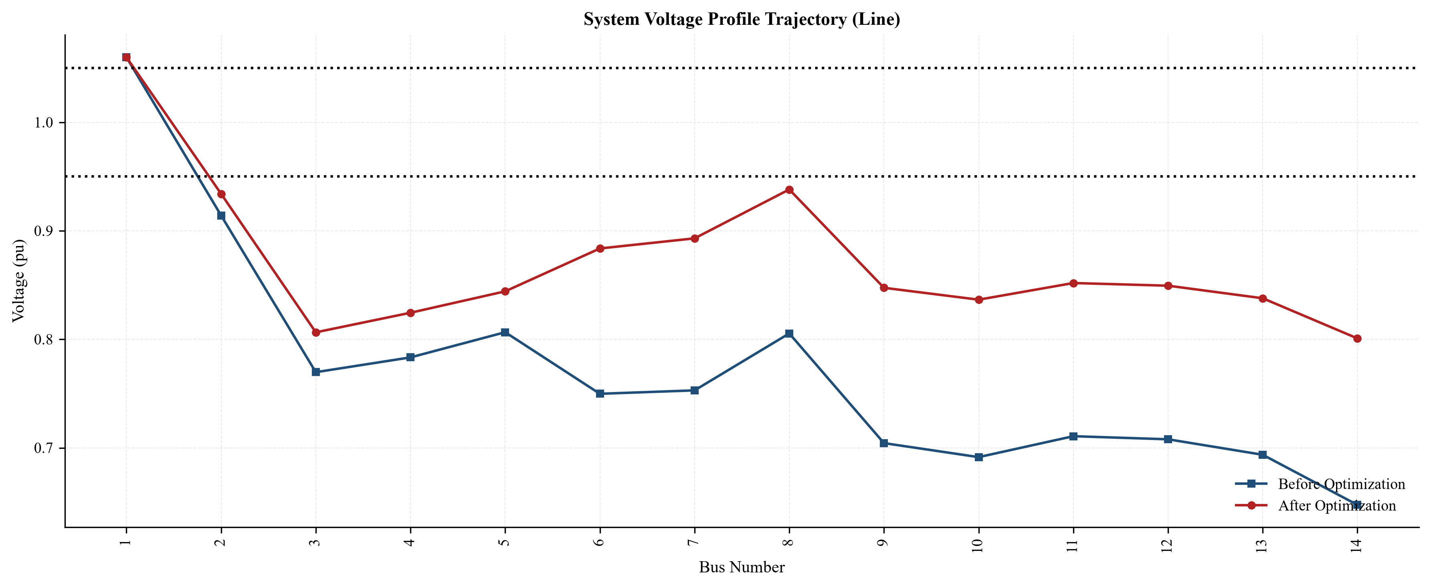
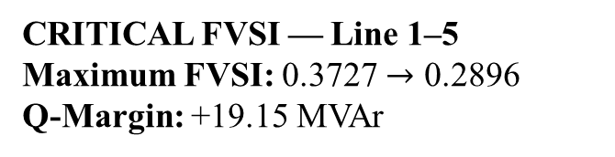
4. Investigation: Results and Analysis(PO(d))
IEEE 14-Bus — GA Tap Optimization Results
+23.7%
Minimum voltage: 0.6474 → 0.8008 pu (bus 14)
Reading the result: Voltage violation falls 53.8%
(2.6229 → 1.2121 pu) but several buses remain below 0.95 pu.
CRITICAL FVSI — Line 1–5
Maximum FVSI: 0.3727 $→$ 0.2896
Q-Margin: +19.15 MVAr

Slide 13
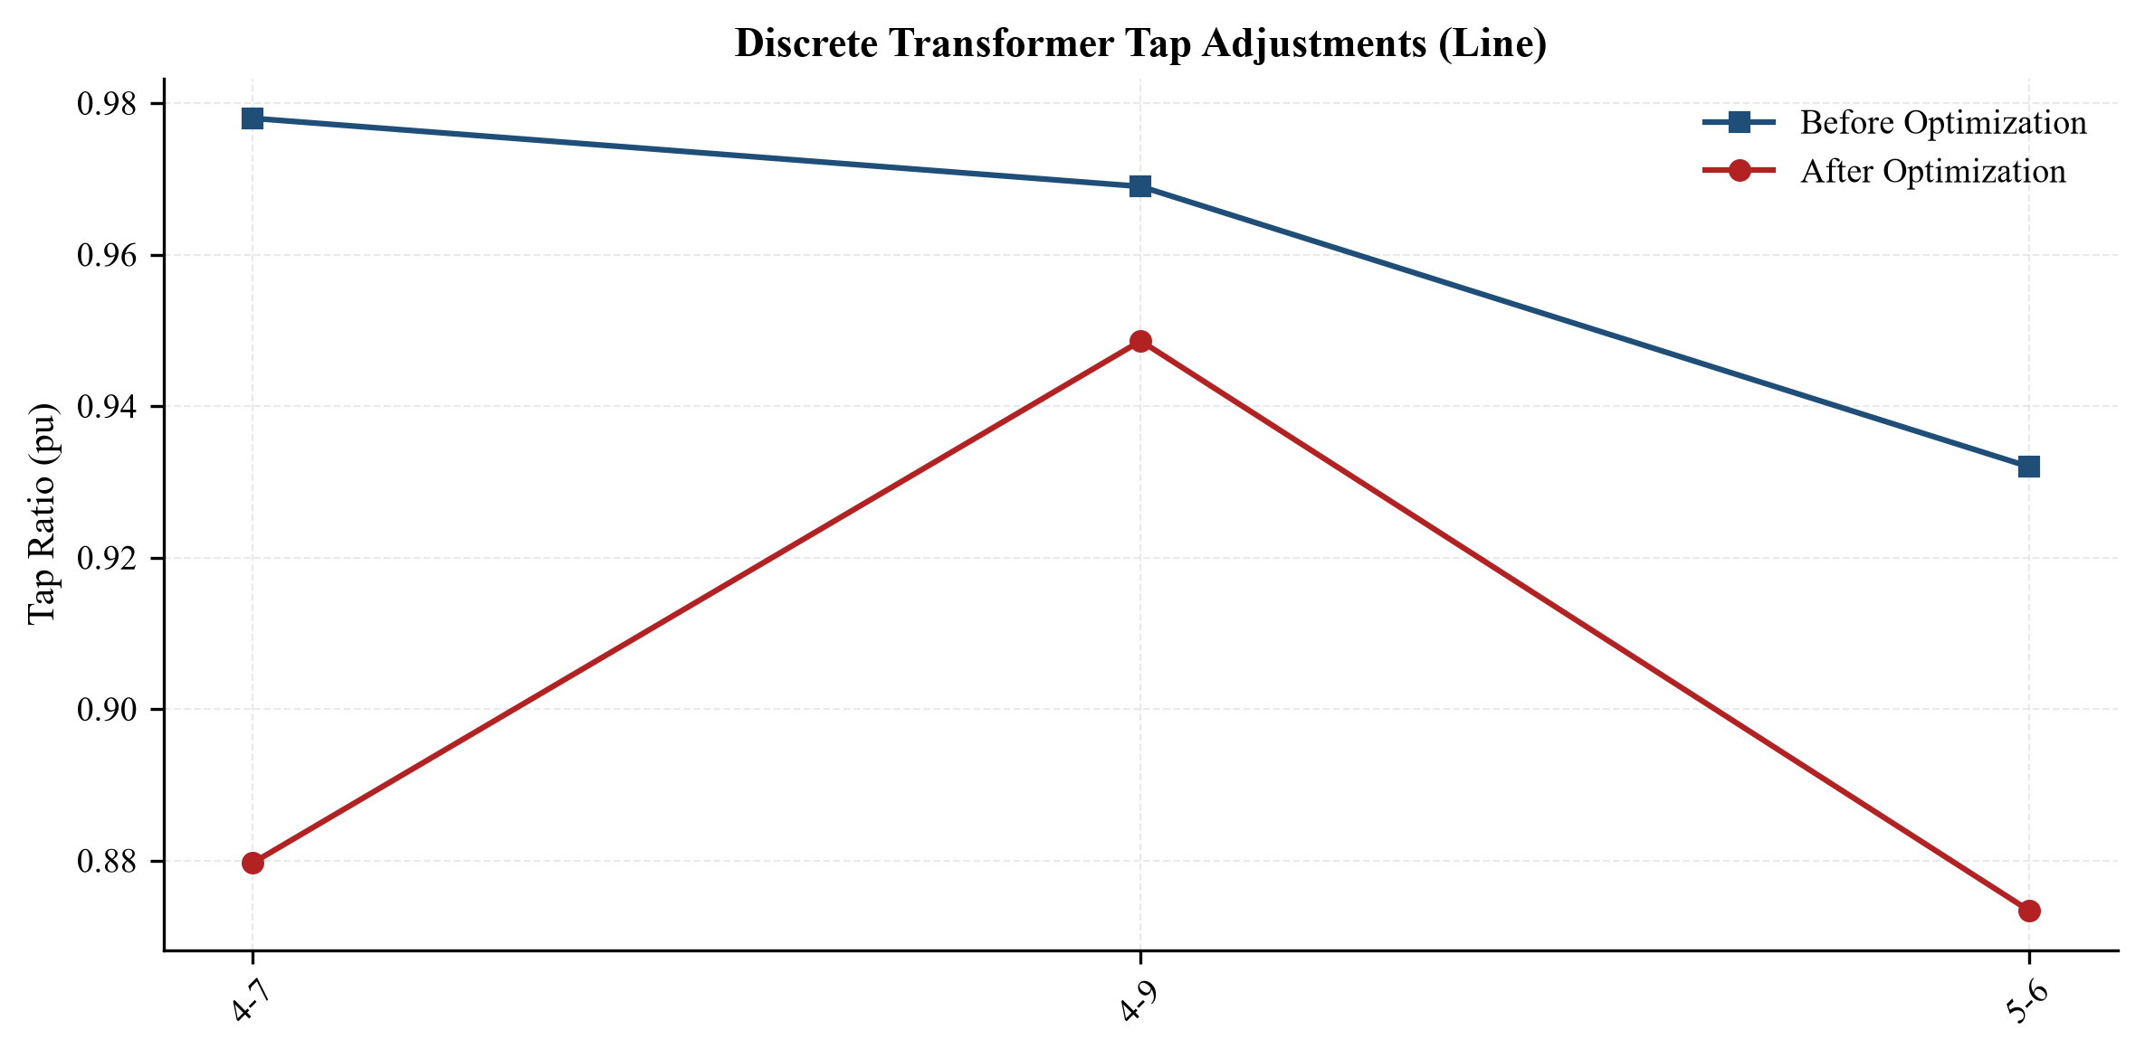
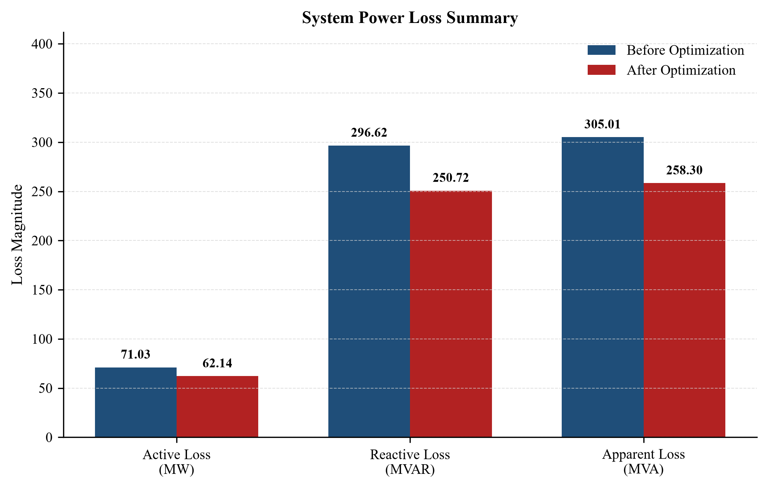
IEEE 14-Bus — GA Tap Optimization Results
Optimized Tap Ratios
4–7: 0.978 → 0.880
4–9: 0.969 → 0.949
5–6: 0.932 → 0.873
12.5% ↓
Active power loss: 71.03 → 62.14 MW

Slide 14
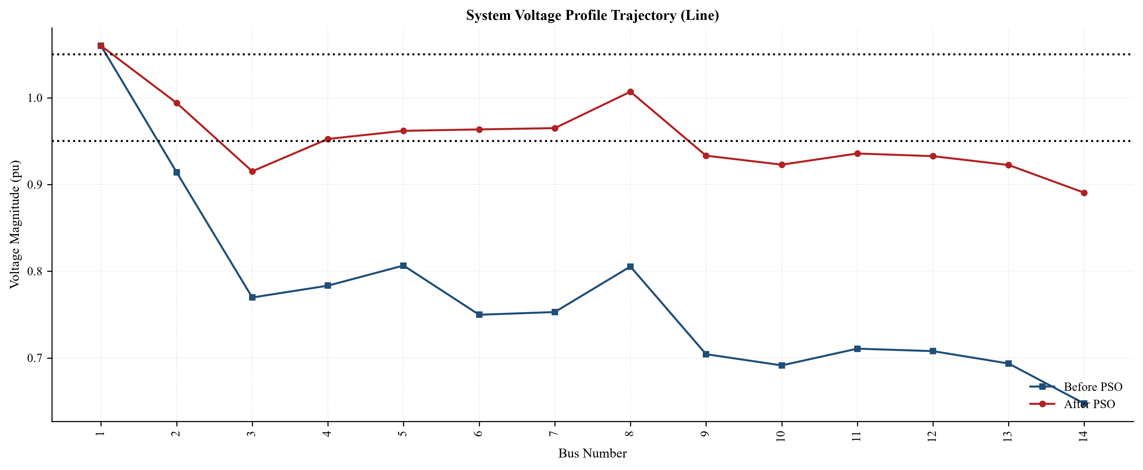
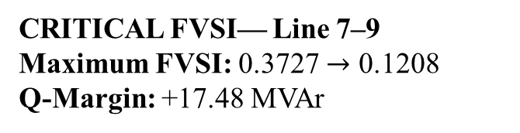
IEEE 14-Bus — PSO Capacitor Allocation Results
+37.6%
Minimum voltage:
0.6474 → 0.8905 pu (bus 14)
CRITICAL FVSI— Line 7–9
Maximum FVSI: 0.3727 $→$ 0.1208
Q-Margin: +17.48 MVAr
Reading the result: Voltage violation falls 92.1% (2.6229 → 0.2074 pu)

Slide 15
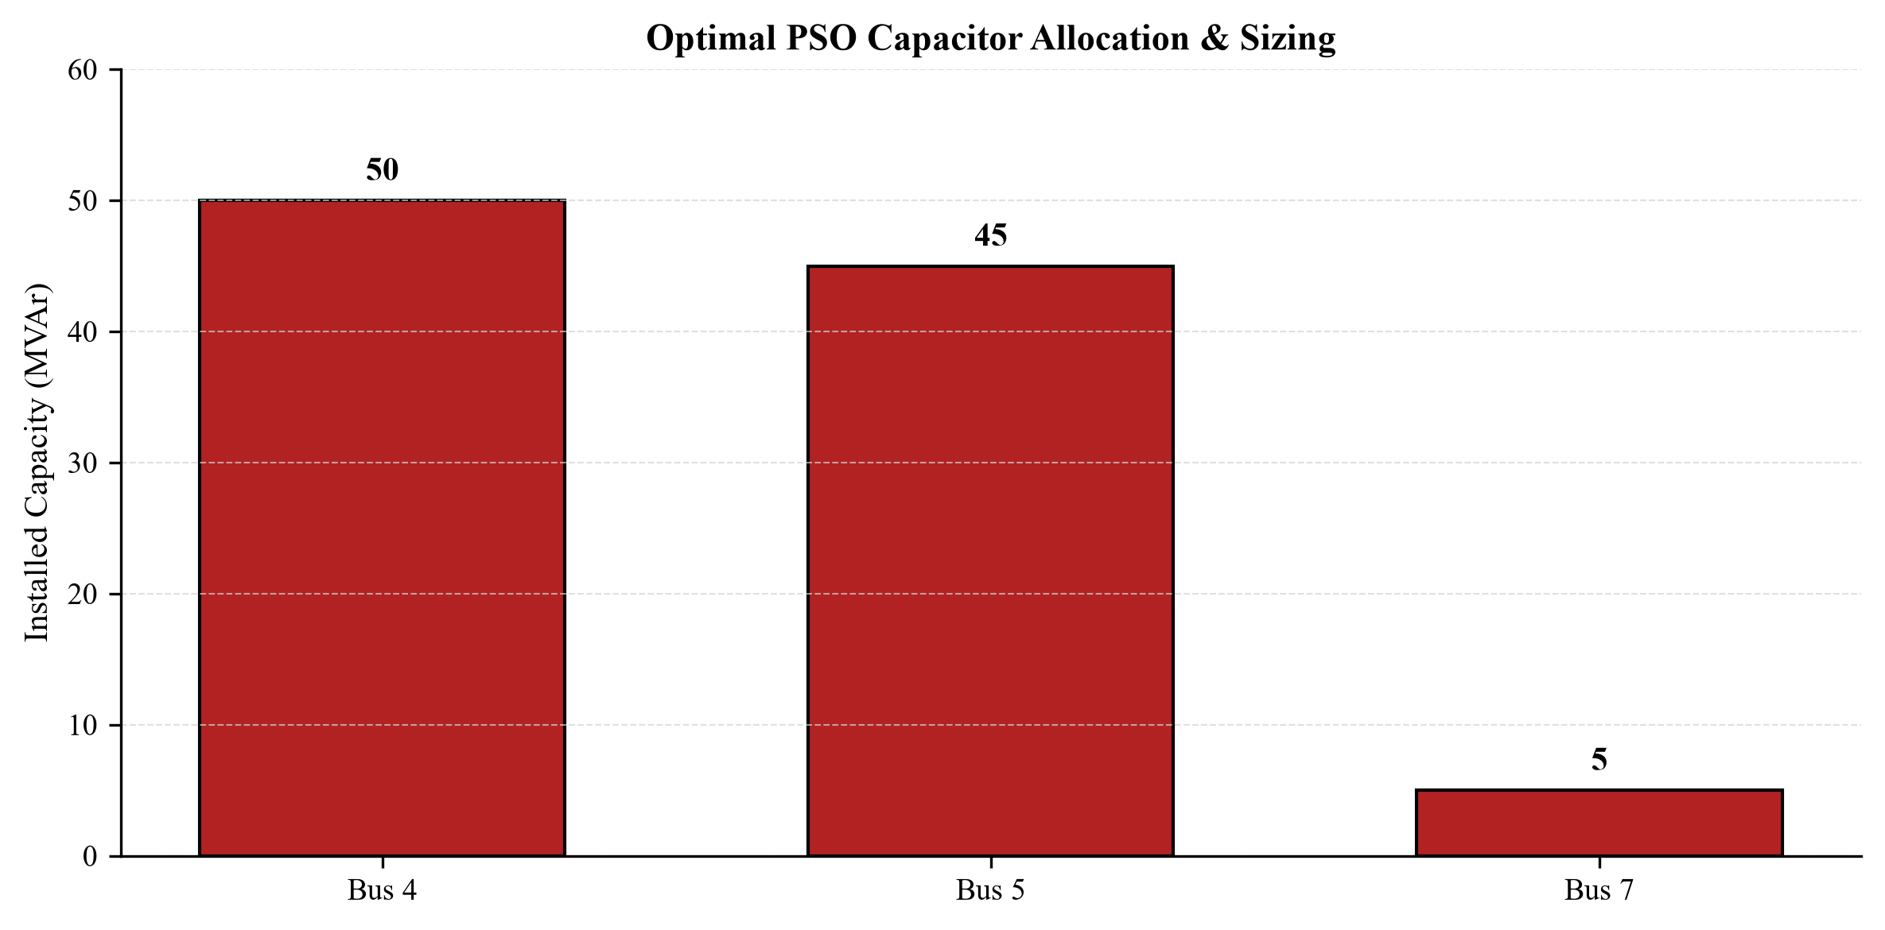
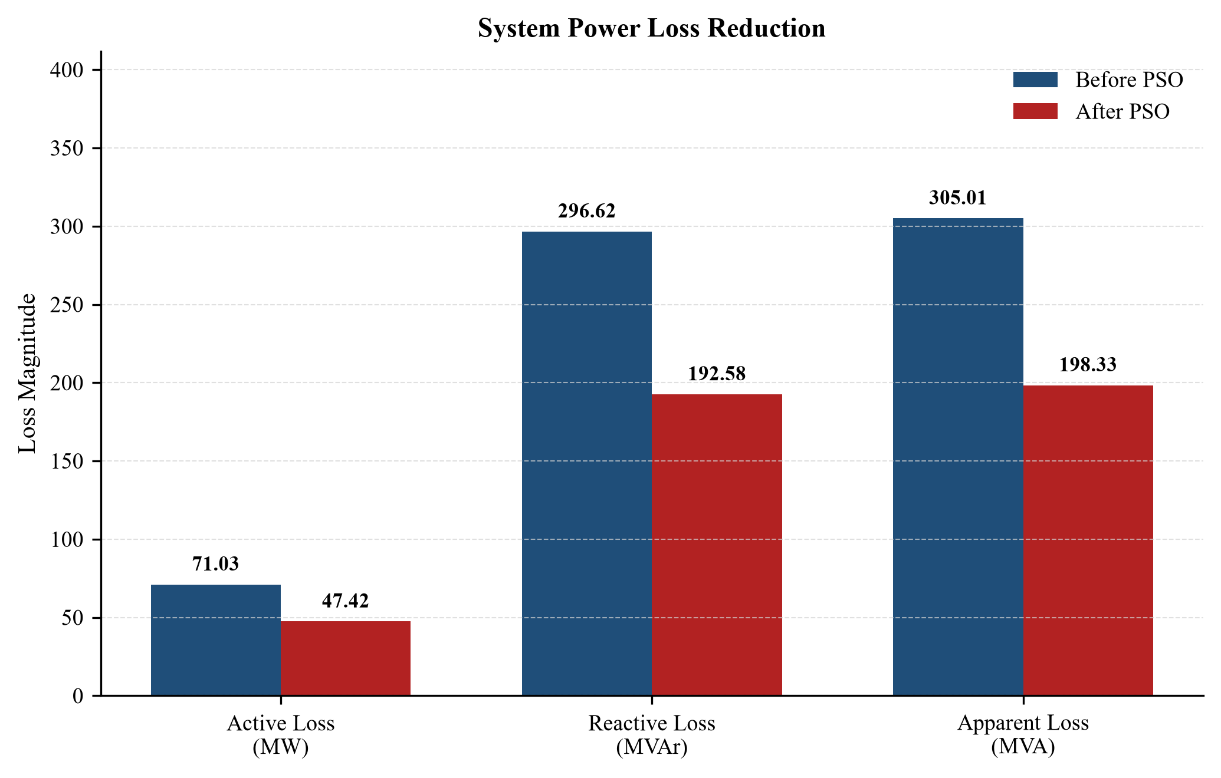
IEEE 14-Bus — PSO Capacitor Allocation Results
Bus 4: 50.0 MVAr
Bus 5: 45.0 MVAr
Bus 7: 5.0 MVAr (100 MVAr total, 3 sites)
33.2% ↓
Active power loss: 71.03 → 47.42 MW

Slide 16
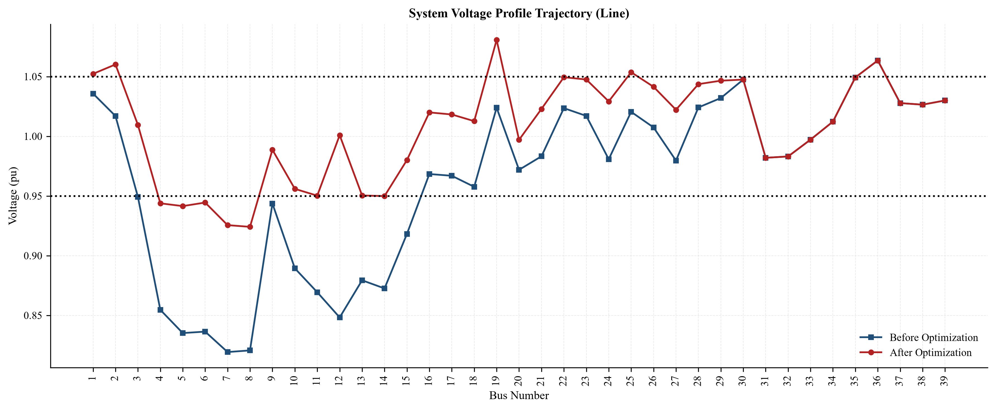
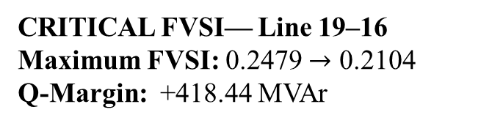
IEEE 39-Bus — GA Tap Optimization Results
+12.8%
Minimum voltage: 0.8193 → 0.9242 pu (bus 7)
CRITICAL FVSI— Line 19–16
Maximum FVSI: 0.2479 $→$ 0.2104
Q-Margin: +418.44 MVAr
Reading the result: Voltage violation falls 87.3% (1.0267 → 0.1307 pu)

Slide 17
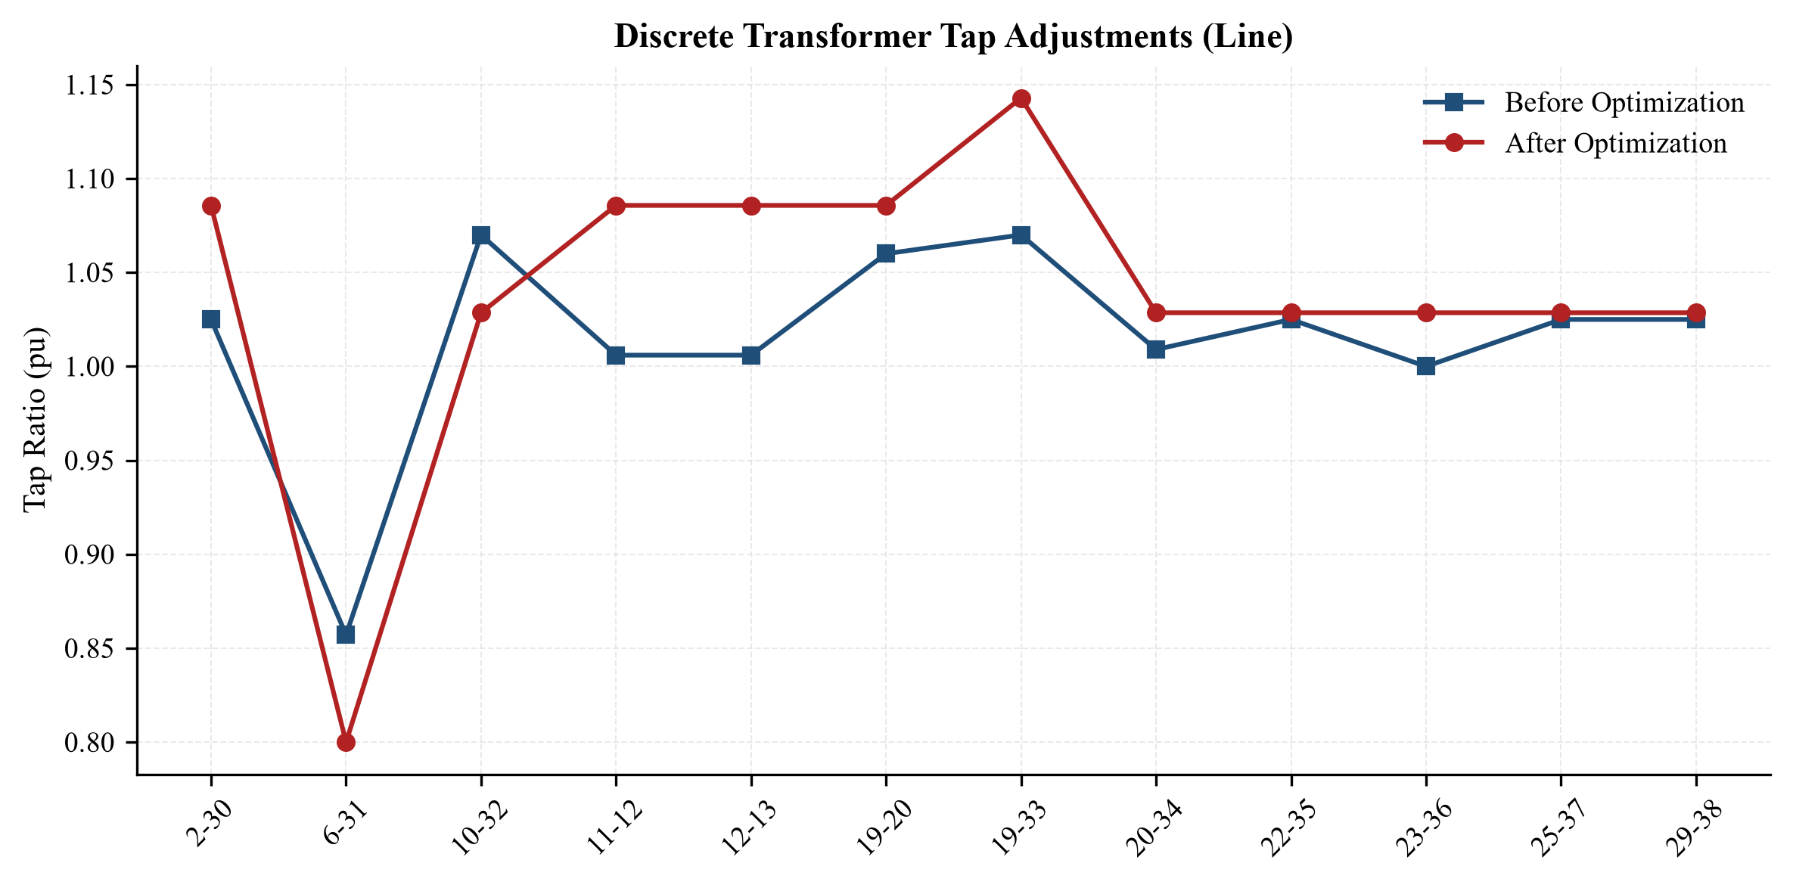
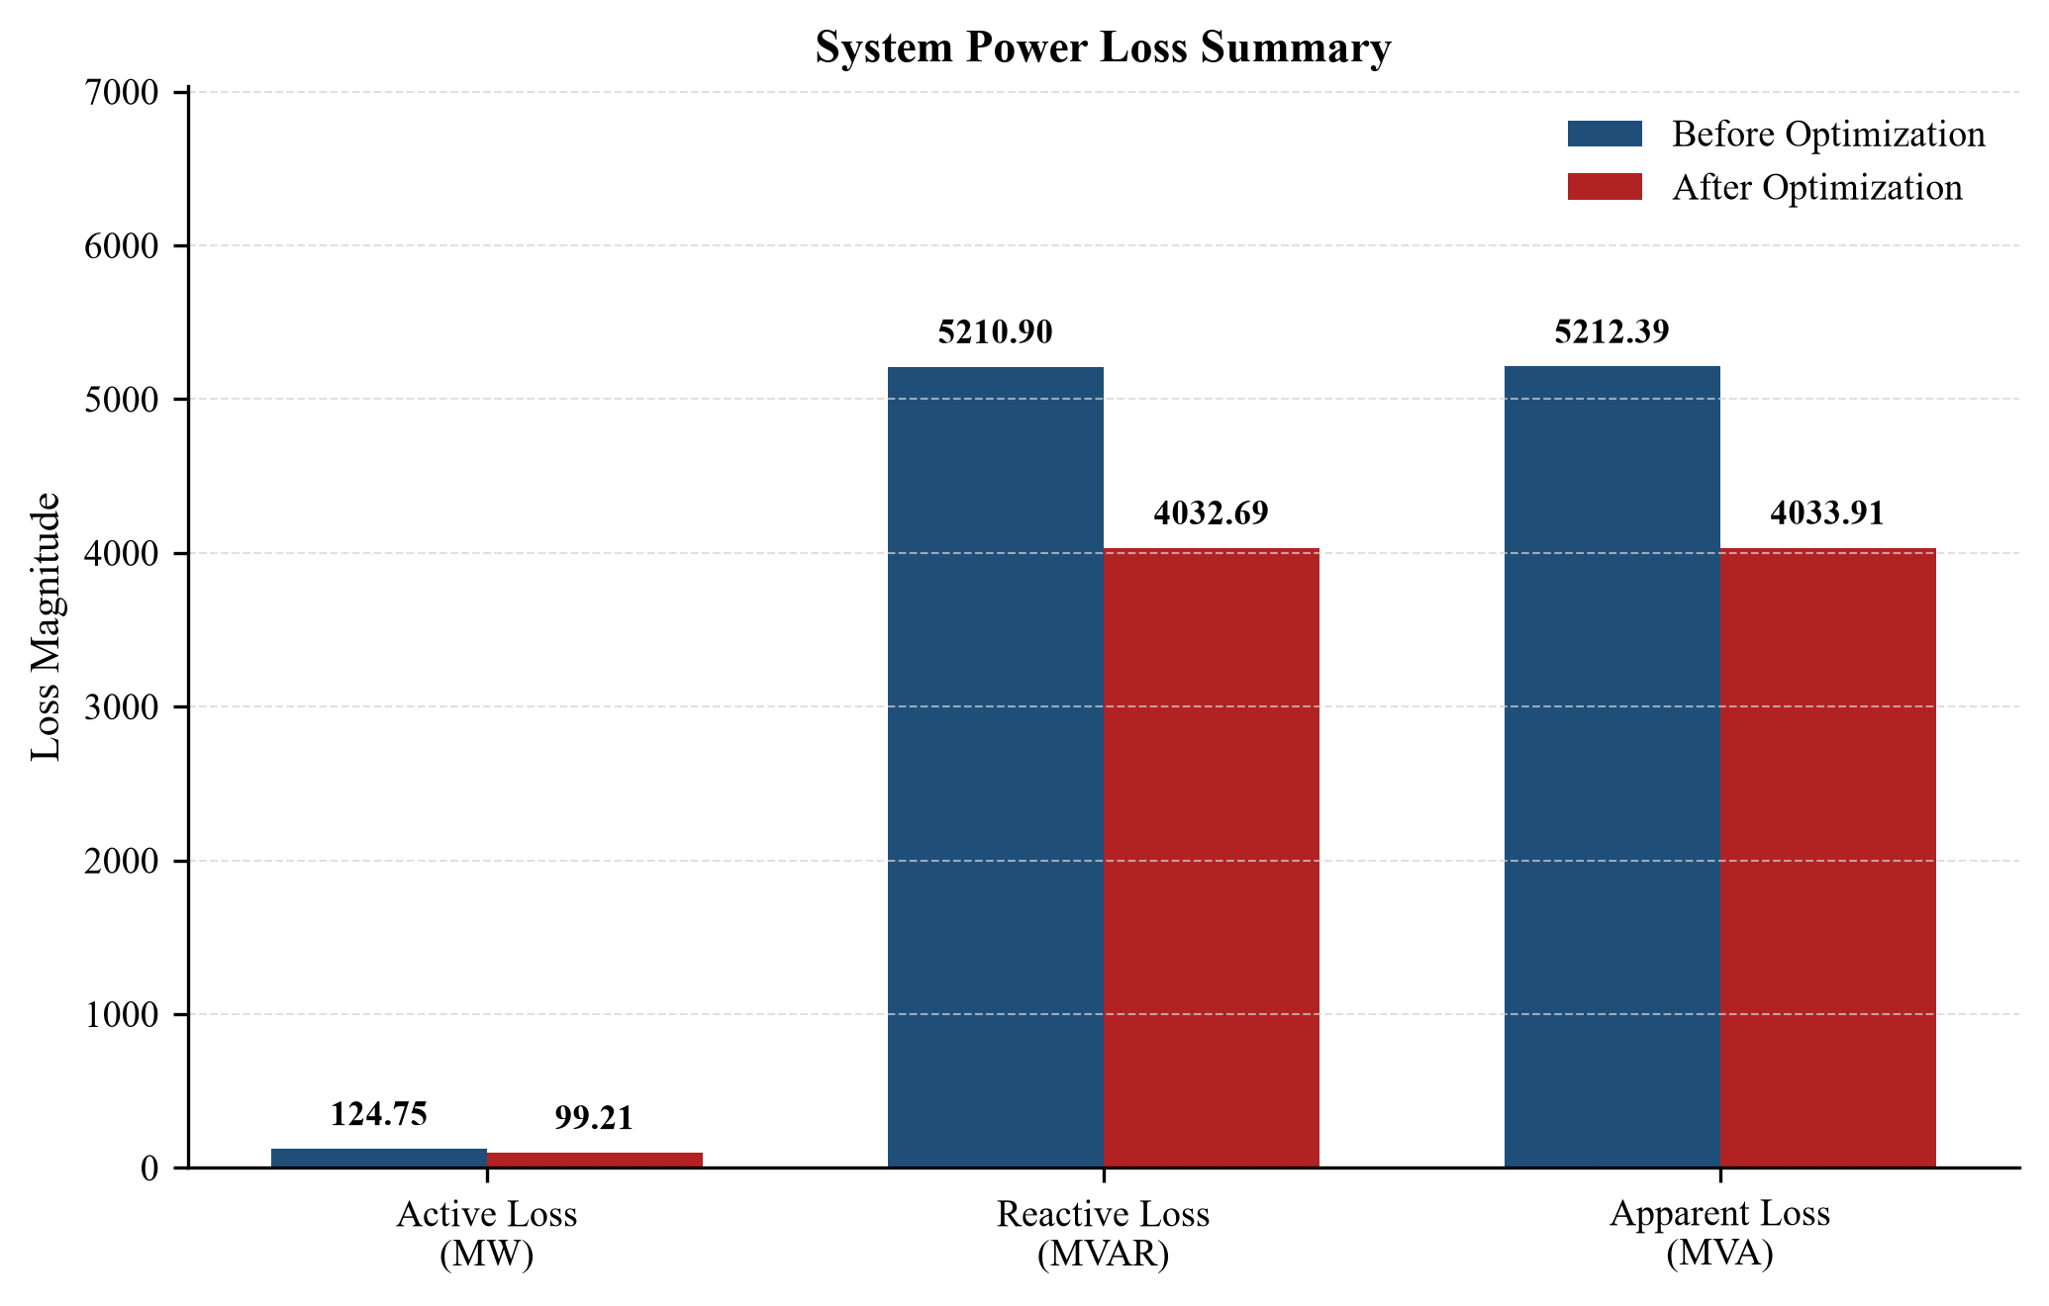
IEEE 39-Bus — GA Tap Optimization Results
Tap Adjustment Summary
20.5% ↓
Active power loss: 124.75 → 99.21 MW
12 of 12 transformers moved
Largest shift: 19–33, 1.070 → 1.143

Slide 18
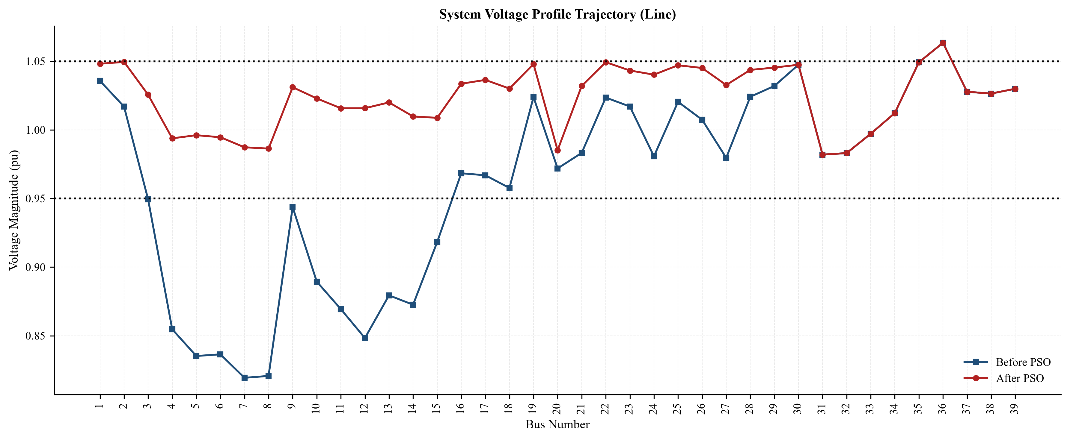
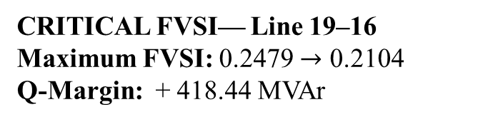
IEEE 39-Bus — PSO Capacitor Allocation Results
CRITICAL FVSI— Line 19–16
Maximum FVSI: 0.2479 $→$ 0.2104
Q-Margin: + 418.44 MVAr
+19.9% (Bus 7)
Minimum voltage: 0.8193 → 0.9820 pu
Reading the result: Every load bus clears 0.95 pu (violation falls 98.7%, 1.0267 → 0.0135 pu). The one remaining violation is generator bus 36 at 1.0635 pu, which no capacitor can move.

Slide 19
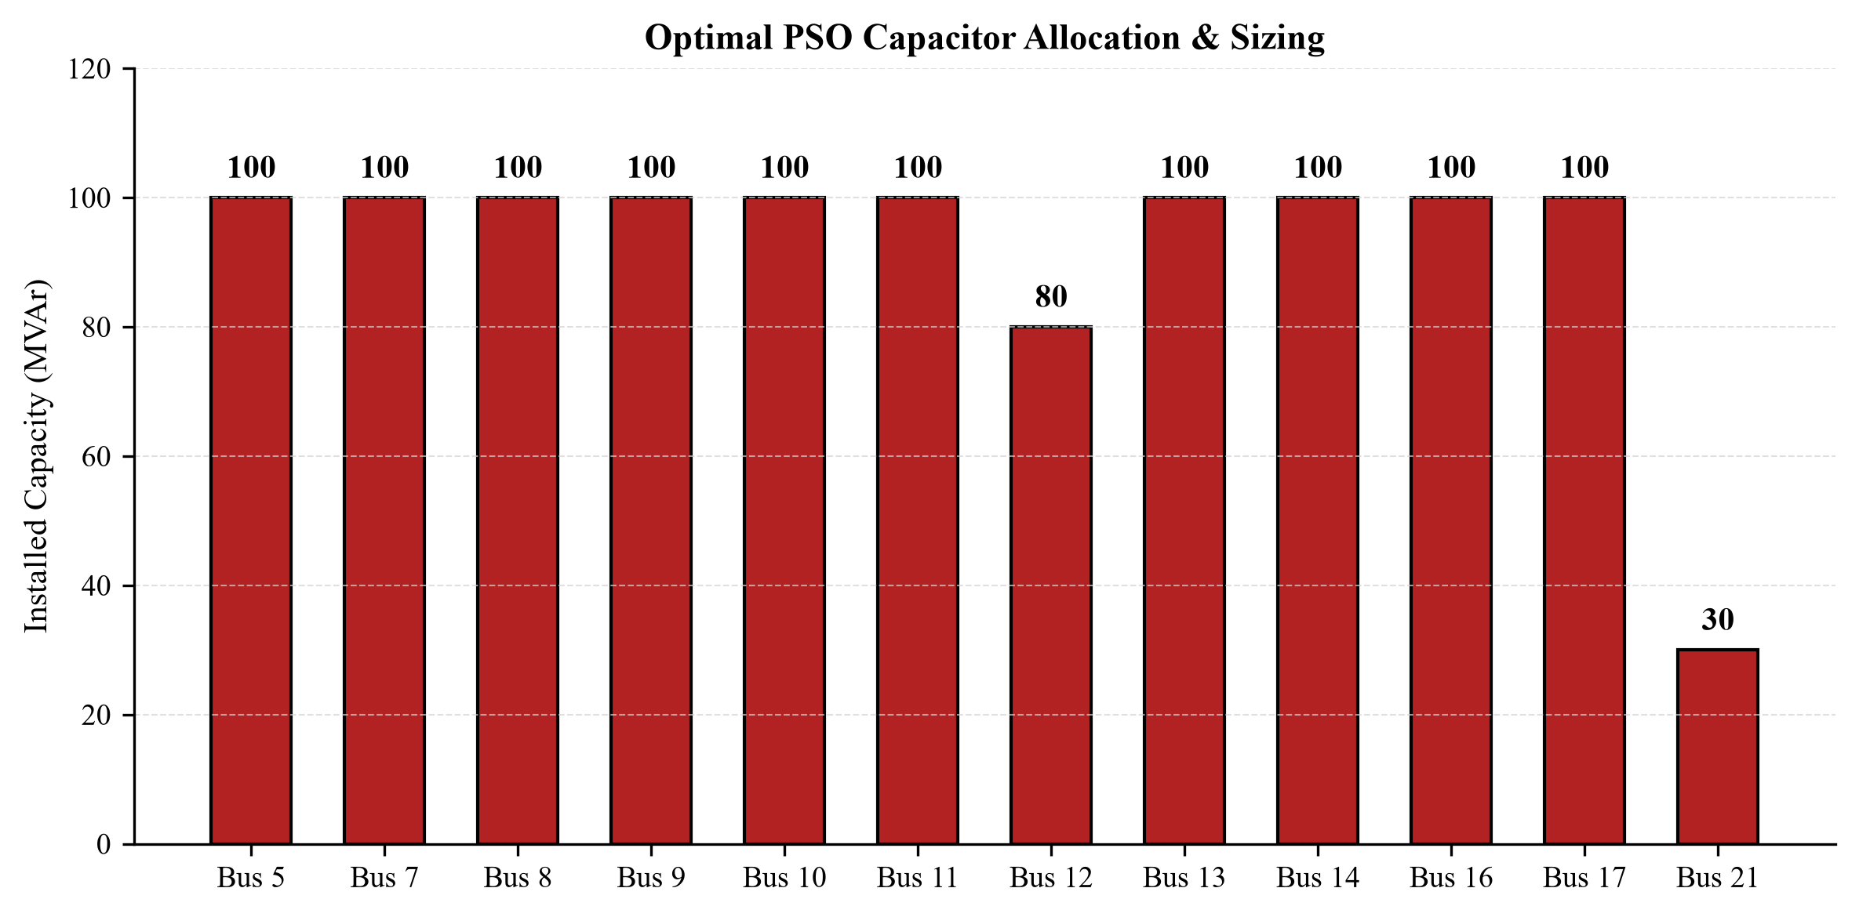
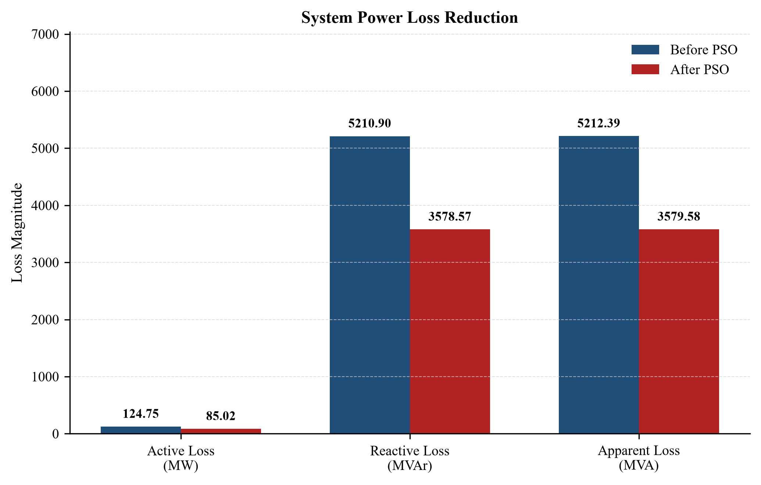
IEEE 39-Bus — PSO Capacitor Allocation Results
Capacitor Deployment
31.9% ↓
Active power loss: 124.75 → 85.02 MW
12 buses used, up to 100 MVAr each
1110 MVAr installed in total

Slide 20
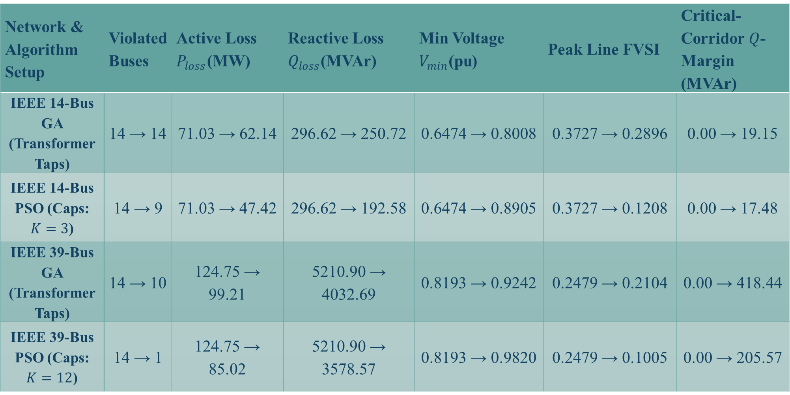
Results and Analysis
Network & Algorithm Setup | Violated Buses | Active Loss $P_{loss}$(MW) | Reactive Loss $Q_{loss}$(MVAr) | Min Voltage $V_{min}$(pu) | Peak Line FVSI | Critical-Corridor $Q$-Margin (MVAr)
IEEE 14-Bus GA (Transformer Taps) | 14 → 14 | 71.03 → 62.14 | 296.62 → 250.72 | 0.6474 → 0.8008 | 0.3727 → 0.2896 | 0.00 → 19.15
IEEE 14-Bus PSO (Caps: $K=3$) | 14 → 9 | 71.03 → 47.42 | 296.62 → 192.58 | 0.6474 → 0.8905 | 0.3727 → 0.1208 | 0.00 → 17.48
IEEE 39-Bus GA (Transformer Taps) | 14 → 10 | 124.75 → 99.21 | 5210.90 → 4032.69 | 0.8193 → 0.9242 | 0.2479 → 0.2104 | 0.00 → 418.44
IEEE 39-Bus PSO (Caps: $K=12$) | 14 → 1 | 124.75 → 85.02 | 5210.90 → 3578.57 | 0.8193 → 0.9820 | 0.2479 → 0.1005 | 0.00 → 205.57

Slide 21
5. Communication to External Stakeholders (PO(j))
  Drive Link
  https://drive.google.com/file/d/1S16e6D9CnCVc4tx-kQVD8_oTBZiHku-k/view?usp=sharing
21

Slide 22
Limitations of Tools (PO(e))
  API Memory Leaks: The psspy API retains load-flow states in memory; 14,400 iterations caused buffer overflows until terminal outputs were explicitly suppressed.
  Single-Threaded Bottleneck: PSS®E structurally locks the active .sav memory block, meaning the algorithms could not utilize multi-core parallel processing.
  Stochastic Uncertainty: Metaheuristics lack mathematical gradient proofs that the final solution is the absolute global minimum.

Slide 23
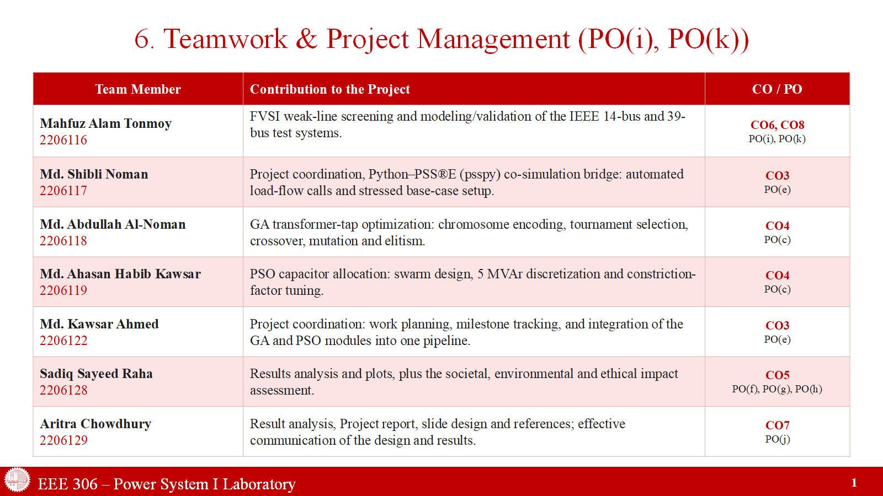
23

Slide 24
7. Future Work
To further enhance the robustness of this optimization framework, future iterations should incorporate the following developments:
Dynamic ZIP Load Modeling: Transitioning from static Constant Power (PQ) load models to voltage-dependent ZIP (Impedance, Current, Power) models to evaluate optimization performance under dynamic, non-linear load variations.
N-1 Contingency Optimization: Integrating the PSS®E ACCC (AC Contingency Calculation) module into the Python fitness function. This would force the PSO to allocate capacitor banks such that the grid remains stable even if the largest generator or transmission line unexpectedly trips.
Parallel Processing: Circumventing the single-thread limitation of psspy by deploying the algorithm across multiple independent Python virtual environments or Docker containers, thereby evaluating multiple load flows simultaneously to drastically reduce execution time.

Slide 25
8.Course Outcomes (CO) & Program Outcomes (PO) Mapping
This design project fulfils the following EEE 306 Course Outcomes (CO) and their mapped Program Outcomes (PO):
CO | Corresponding PO(s) | How This Lab & Project Address It
CO3 | PO(e) | Used Siemens PSS®E as the core power-flow analysis tool to model, simulate and study voltage profiles and losses on the IEEE 14-Bus and 39-Bus systems.
CO4 | PO(c) | Investigated the impact of modifying transformer taps and adding shunt capacitor banks, then designed the GA/PSO-based system upgrade to correct the identified deficiencies.
CO5 | PO(c), PO(f), PO(g) | Weighed technical feasibility, hardware cost, and environmental/safety impact of voltage violations while formulating the optimization objectives and constraints.
CO6 | PO(i) | Worked as a team, dividing GA development, PSO development, testing and result validation among members throughout the project.
CO7 | PO(j) | Communicated the design, methodology and results through this final presentation and the accompanying project report.
CO8 | PO(k) | Managed project milestones and evaluated computational cost, tracking up to 14,400 load-flow evaluations across both algorithms and both test systems.

Slide 26
9.References
I. Musirin and T. K. Abdul Rahman, "Voltage Stability Margin Enhancement Using Evolutionary Programming," IEEE Power Engineering Society General Meeting, pp. 1-6, 2007.
I. Musirin et al., "Improved genetic algorithms for loss minimisation in power system," International Journal of Power and Energy Systems, 2008.
Siemens PTI, PSS®E 36.0 Program Application Guide, Siemens Power Technologies International, 2024.
M. Clerc and J. Kennedy, "The particle swarm - explosion, stability, and convergence in a multidimensional complex space," IEEE Transactions on Evolutionary Computation, vol. 6, no. 1, pp. 58-73, Feb. 2002.
J. J. Grainger and W. D. Stevenson, Power System Analysis. New York, NY, USA: McGraw-Hill, 1994.

