Slide 1
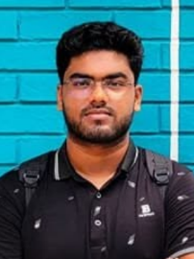
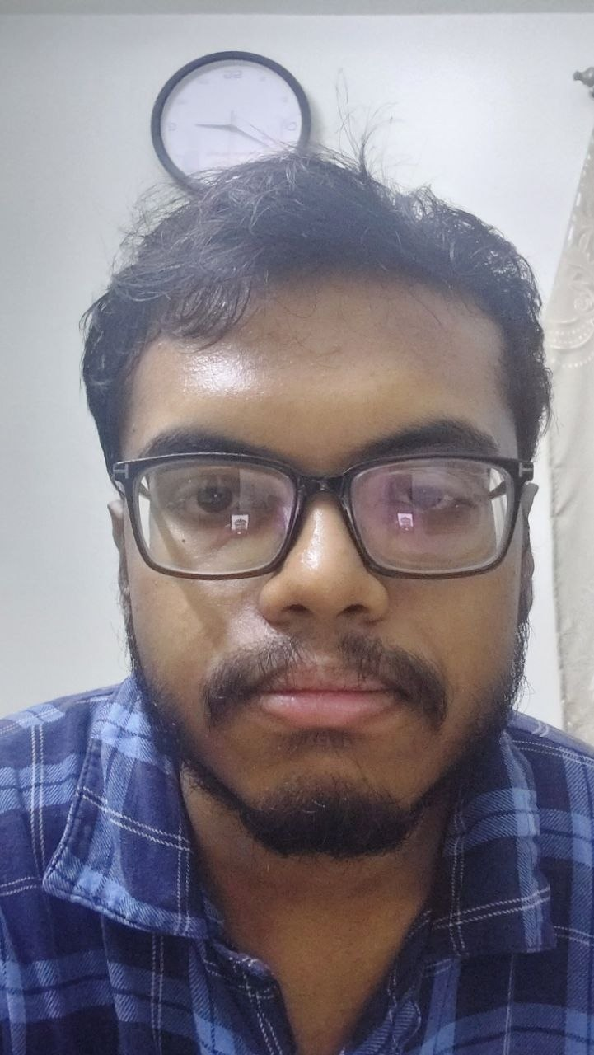
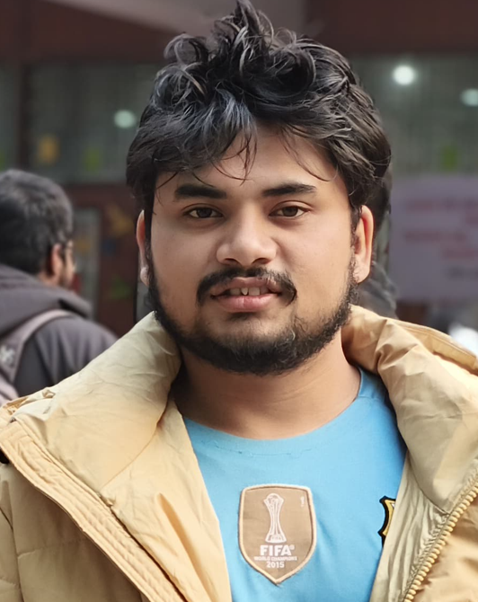
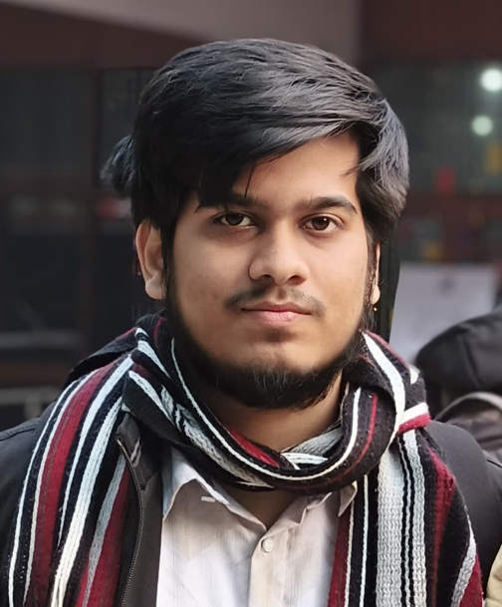
Digital Signal Processing and Deep Learning-Based Urban Change Detection Using Satellite Imagery
Submitted by – Group 04
Mustasin Rahman 2206104
Fahim Shahriyar
2206114
Md. Ahasan Habib Kawsar
2206119
Md. Kawsar Ahmed
2206122
Notes:
[Fahim Shahriyar (2206114) · about 21 s]
Assalamu Alaikum. We are Group 04 from Section B2 of EEE 312, Digital Signal Processing One Laboratory. Our project is Digital Signal Processing and Deep Learning-Based Urban Change Detection Using Satellite Imagery. I am Fahim Shahriyar, and my teammates are Mustasin Rahman, Md. Ahasan Habib Kawsar and Md. Kawsar Ahmed.

Slide 2
Outline
1
Summary
2
Introduction
3
Design
Literature · Methods PO(a) · DSP · Network · Training
4
Implementation
GUI demonstration · results gallery
5
Analysis & Evaluation
Results · Novelty · PO(c) · PO(d) · PO(e) · PO(h)
6
Team Work
PO(i)
7
Communication
PO(j)
8
Future Work
PO(l)
9
References
Presented by: 2206114
Notes:
[Fahim Shahriyar (2206114) · about 13 s]
We will first summarise the project and the problem, then explain our design, show the working software, evaluate it against the program outcomes, and finish with teamwork, future work and references.

Slide 3
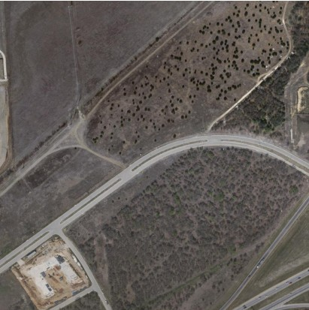
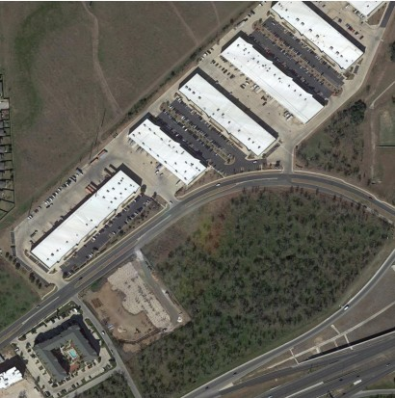
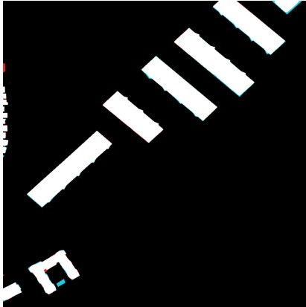
1. Summary / Abstract
Problem: find new buildings between two satellite images of the same place taken years apart.
DSP front-end: Gaussian low-pass filter + Canny edge detector; the standardised edge map is stacked with RGB as a 4th input channel.
Deep learning: Siamese ResNet-34 U-Net with spatial-temporal attention (BAM), Siam-Concat fusion and a Sobel-supervised edge head.
Data: LEVIR-CD – 637 image pairs, 1024 × 1024 px at 0.5 m/pixel (445 train / 64 val / 128 test).
Deployment: PyQt5 desktop app with live threshold, test-time augmentation and polygon post-processing.
91.2%
F1-score (test)
83.8%
IoU (test)
99.1%
Overall accuracy
0.907
Cohen's κ
128 full-resolution LEVIR-CD test images; threshold 0.41 chosen on the validation set.
Before
After
Detected
Presented by: 2206114
Notes:
[Fahim Shahriyar (2206114) · about 36 s]
Our system takes two satellite images of the same place, taken years apart, and marks every pixel where a new building has appeared. A Gaussian filter and the Canny edge detector extract structural edges, which we add to the colour image as a fourth channel. A Siamese neural network with attention then compares the two dates. On 128 unseen test images of the LEVIR-CD dataset, it reaches an F1-score of 91.2 percent and an IoU of 83.8 percent, and it runs in a desktop application.

Slide 4
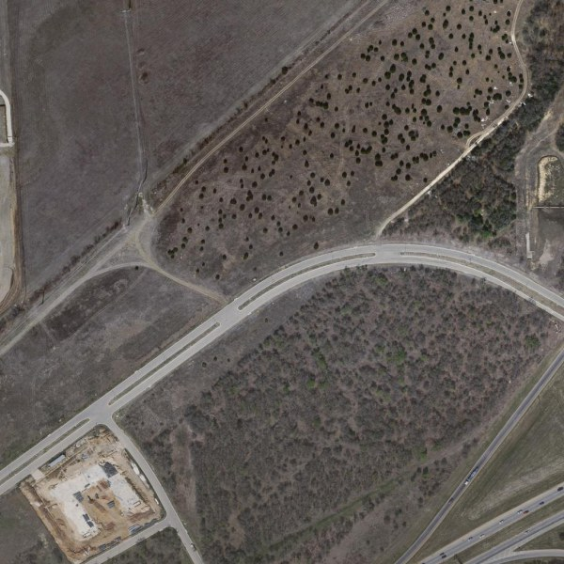

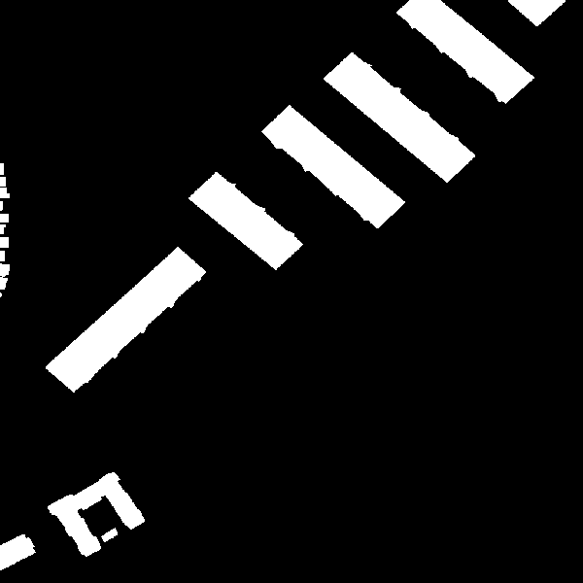
2. Introduction
Why urban change detection?
Cities such as Dhaka grow faster than manual surveys can map them.
Planners need to know where buildings and roads appear: unauthorised construction, encroachment on wetlands and flood zones, post-disaster damage.
Very-high-resolution satellite images are available regularly – the bottleneck is analysing them.
Why is it hard?
Pseudo-changes: sun angle, season, shadows, sensor colour.
Extreme imbalance: only ≈ 4.6 % of pixels change; 18 % of images have no change at all.
Small objects: a house is only 10–20 px wide at 0.5 m/pixel.
T1 – before
T2 – after
Ground-truth change mask
Presented by: 2206114
Notes:
[Fahim Shahriyar (2206114) · about 34 s]
Cities like Dhaka grow faster than manual surveys can map them. Planners need to know where new buildings appear: unauthorised construction, encroachment on wetlands, or damage after a disaster. The task is hard for three reasons: shadows, seasons and sensor colour change the image even when nothing is built; only about 4.6 percent of pixels actually change; and a house is only ten to twenty pixels wide. On the right, an empty field has become a row of warehouses.

Slide 5
3.1 Design: Literature Review
Classical: image differencing, change-vector analysis, PCA – fast but sensitive to illumination.
Siamese CNNs: FC-Siam-diff / conc (Daudt 2018) – two weight-sharing encoders, feature difference.
Attention: STANet (Chen & Shi 2020) – spatial-temporal attention; introduced LEVIR-CD.
Transformers: BIT (2021), ChangeFormer (2022) – global context, higher cost.
Edge priors: HED-style class-balanced edge supervision sharpens boundaries.
Gap we address: explicit DSP edge features + attention in a light CNN that trains on a laptop.
Published values from Bandara & Patel (2022). Our figure uses sliding-window inference with test-time augmentation on the same 128 test images, so the comparison is indicative, not identical protocol.
Presented by: 2206114
Notes:
[Fahim Shahriyar (2206114) · about 33 s]
Early methods simply subtracted the two images, which is very sensitive to lighting. Siamese networks pass both images through the same encoder; STANet added attention and published LEVIR-CD, and transformers such as BIT and ChangeFormer pushed F1 above 89 percent. Our aim was a lighter design that trains on a laptop and adds an explicit DSP edge channel. The chart compares our test F1 with published results; our inference settings differ slightly, so it is an indicative comparison.

Slide 6
3.2 Design Methods (PO(a))
Bi-temporal pair
T1, T2 RGB
1024×1024, 0.5 m/px
DSP front-end
Gray → Gaussian
→ Canny edges
4-ch input
RGB + edge,
standardised
Siamese encoder
ResNet-34,
shared weights
Fusion + decoder
BAM attention,
Siam-Concat, U-Net
Change map
Threshold 0.41,
polygons, GUI
DSP stages (red) Deep-learning stages (dark)
Mathematics & DSP
2-D convolution with Gaussian and Sobel kernels
Gradient magnitude / direction, non-max suppression, hysteresis
Channel standardisation (zero mean, unit variance)
Machine learning
Weight-sharing Siamese CNN, transfer learning (ImageNet)
Scaled dot-product attention across both dates
Multi-task loss: BCE + Dice + class-balanced edge
Engineering / software
Python, PyTorch (Apple MPS GPU), OpenCV
Sliding-window inference with cosine blending
PyQt5 multithreaded GUI
Presented by: 2206104
Notes:
[Mustasin Rahman (2206104) · about 30 s]
I am Mustasin Rahman, and I will explain the design. This is the complete pipeline. The before and after images first pass through our DSP front-end, shown in red: grayscale conversion, Gaussian smoothing and Canny edge detection. The edge map is stacked with the colour channels and standardised. The dark blocks are the deep-learning stages: a shared ResNet-34 encoder, attention-based fusion, and a U-Net decoder that produces the change map.

Slide 7
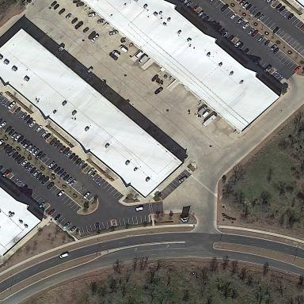
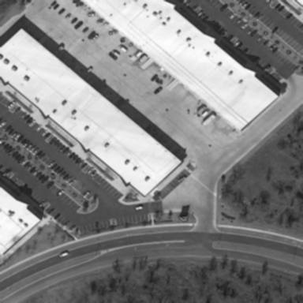
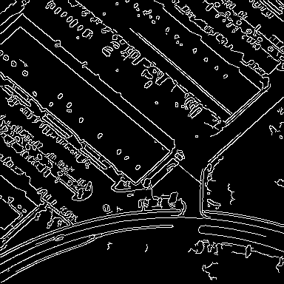
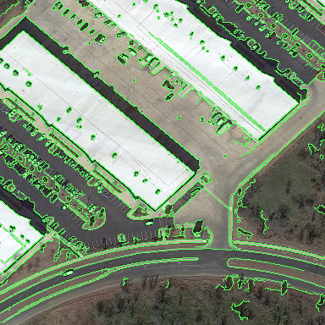
3.2 Design Methods: DSP Front-End
RGB (After image)
Gaussian low-pass, 5×5, σ = 1
Canny edges, thresholds 50 / 150
RGB + edge (4th channel)
Smoothing (2-D convolution)
G(x,y) = exp(−(x² + y²) / 2σ²) / 2πσ²
Is = I ∗ G (5 × 5 kernel, σ = 1)
Gradient (Sobel)
Gx = Sx ∗ Is, Gy = Sy ∗ Is
|∇I| = √(Gx² + Gy²)
θ = atan2(Gy, Gx)
Edge decision
Non-maximum suppression along θ
Hysteresis: strong > 150, weak 50–150
Channel balancing
x′ = (x − μ) / σ
edge: μ = 0.12, σ = 0.33 (measured)
Presented by: 2206104
Notes:
[Mustasin Rahman (2206104) · about 36 s]
Here is each DSP stage on a real image. We convolve the grayscale image with a five-by-five Gaussian kernel, sigma equal to one; this low-pass filter removes noise that would create false edges. Canny then computes Sobel gradients, thins edges by non-maximum suppression, and applies hysteresis thresholds of 50 and 150. Finally, every channel is standardised to zero mean and unit variance. This was critical: in our first version the edge channel was 255 times weaker than the colour channels, so the network ignored it.

Slide 8
3.2 Design Methods: Network Architecture
Siamese encoder
ResNet-34 (ImageNet)
shared weights
5 scales:
1/2 · 1/4 · 1/8 · 1/16 · 1/32
64 → 512 channels
Fusion at every scale
BAM: attention over
both dates (1/4 … 1/32)
Siam-Concat:
[F₁, F₂, |F₁ − F₂|]
→ 1×1 conv
U-Net decoder
1/32 → 1/2 with skip
connections, edge-guided
fusion, ×2 up + 3×3
refinement
Change map
1 × 256 × 256
BCE + Dice
T1: 4 × 256 × 256
T2: 4 × 256 × 256
Edge head
fused 1/2 + 1/4 + context
Edge map
Sobel target
26.0 M parameters. Large images are predicted with 256 × 256 tiles, 64 px overlap and cosine blending – the network always sees the native 0.5 m/pixel scale.
Edge-guided decoding: the edge head's features are concatenated into the last decoder stage, so boundary knowledge directly shapes the change map.
Presented by: 2206119
Notes:
[Md. Ahasan Habib Kawsar (2206119) · about 35 s]
I am Md. Ahasan Habib Kawsar, and I will explain the network. Both four-channel images pass through the same pre-trained ResNet-34 encoder, giving features at five scales, and at every scale a fusion block compares the two dates. The decoder rebuilds a full-resolution change map. An edge head predicts the outlines of changed buildings and feeds them into the decoder, which sharpens boundaries. Large images are predicted as overlapping 256-pixel tiles, so the network always works at the original half-metre resolution.

Slide 9
3.2 Design Methods: Attention, Fusion, Loss
Spatial-temporal attention (BAM)
X = [F₁ ‖ F₂] (dates side by side)
A = softmax(QᵀK / √d)
X′ = X + γ · V Aᵀ, γ = 0 at start
Every pixel of either date can attend to every pixel of both dates; γ = 0 at start keeps ImageNet features intact.
Siam-Concat fusion
D = |F₁′ − F₂′|
F = ReLU(BN(W₁ₓ₁ ∗ [F₁′, F₂′, D]))
Keeps the appearance of both dates and their difference instead of the difference only.
Multi-task loss
L = L(BCE) + L(Dice) + 0.4 · L(edge)
L(Dice) = 1 − (2Σpy + 1) / (Σp + Σy + 1)
L(edge): β-weighted BCE, β = |Y⁻| / |Y|
Dice fights the 95 % background; class-balanced BCE makes the rare edge pixels count.
Evaluation metrics
P = TP/(TP+FP), R = TP/(TP+FN)
F1 = 2PR/(P+R), IoU = TP/(TP+FP+FN)
Computed over all test pixels (dataset level), as in the literature.
Presented by: 2206119
Notes:
[Md. Ahasan Habib Kawsar (2206119) · about 27 s]
The attention module places both dates side by side, so every pixel can attend to every pixel of both images. The fusion block keeps the before features, the after features and their absolute difference. The loss adds binary cross-entropy, Dice loss for the class imbalance, and a class-balanced edge loss. We evaluate with precision, recall, F1 and IoU over all test pixels.

Slide 10
3.3 Design: Training and Inference
Training
Native-resolution 256 × 256 random crops, 4 per image per epoch; 30 % centred on a change
Synchronised flips / 90° rotations; independent brightness–contrast–colour jitter per date
AdamW, lr 1e-4, warm-up + cosine decay, batch 4, gradient clipping
Apple M-series GPU (MPS): ≈ 6.3 min/epoch; early stop at epoch 47, best at 32
Inference
Full 1024 × 1024 images, 256-px tiles with 64-px overlap
Test-time augmentation: average of 4 flips
Threshold 0.41 chosen on the validation set only
Presented by: 2206119
Notes:
[Md. Ahasan Habib Kawsar (2206119) · about 26 s]
We train on random 256-pixel crops of the full-resolution images, so small buildings keep their detail. Both dates are flipped and rotated together, while brightness and colour are changed separately, so lighting differences are not learned as change. Training ran on a MacBook GPU; validation F1 reached 0.91 at epoch 32. The threshold, 0.41, was chosen on the validation set only.

Slide 11
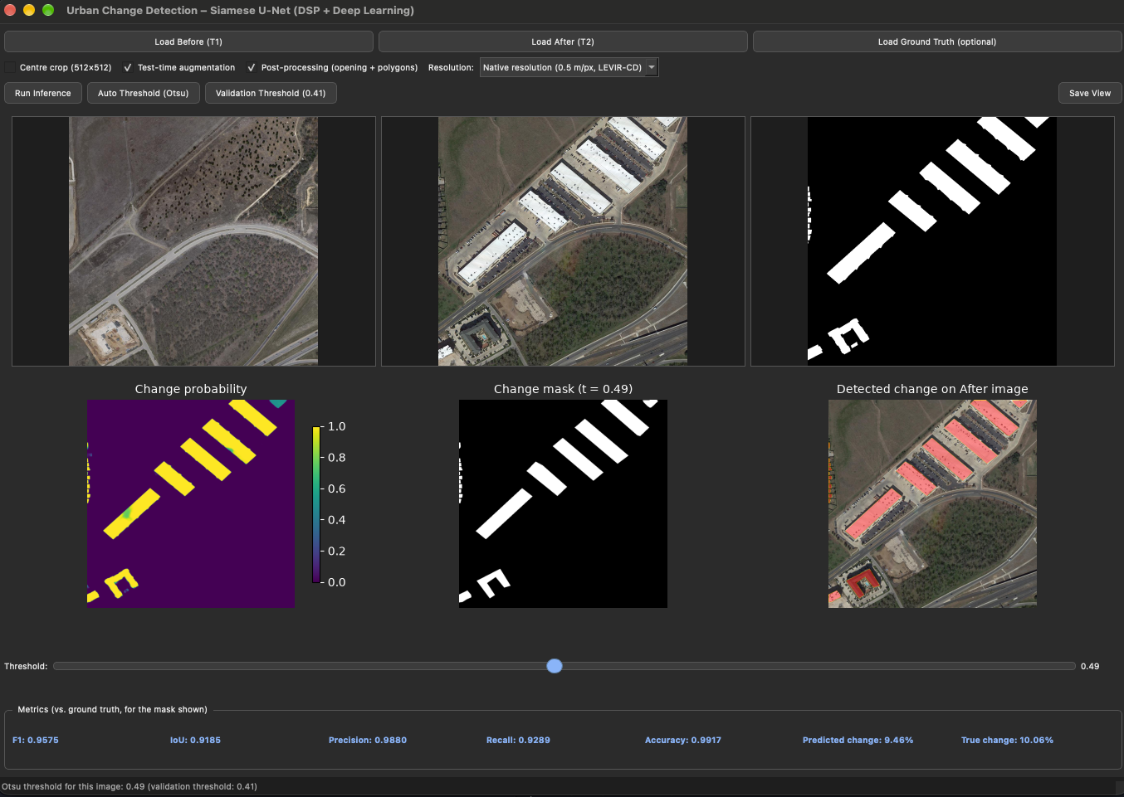
4 Implementation: Demonstration
PyQt5 desktop application
Load Before / After (and optional ground truth)
Model loaded once; inference in a background QThread – the window never freezes
Native-resolution sliding window, optional TTA
Live threshold slider, validation / Otsu presets
Post-processing: opening, small-region removal, approxPolyDP polygons
Live F1, IoU, precision, recall and changed-area %
Run: python app.py
Live run on test_102: F1 0.958, IoU 0.919 (Otsu threshold 0.49, post-processing on)
Presented by: 2206122
Notes:
[Md. Kawsar Ahmed (2206122) · about 44 s]
I am Md. Kawsar Ahmed, and I will show the software. This is our PyQt5 desktop application. We load the before image, the after image and, optionally, the ground truth, and press Run Inference. The model runs in a background thread, so the window never freezes. The bottom row shows the change probability, the final mask, and the detected buildings in red on the after image. When I move the threshold slider, the mask and the metrics update instantly. For this test image, F1 is 95.8 percent and IoU is 91.9 percent. Post-processing removes small noise and straightens building outlines into polygons.

Slide 12
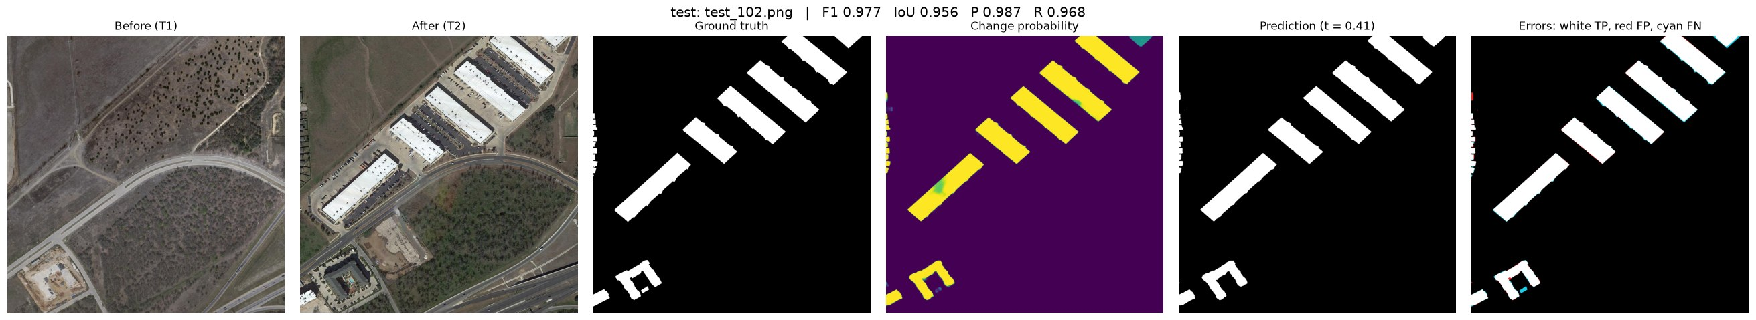
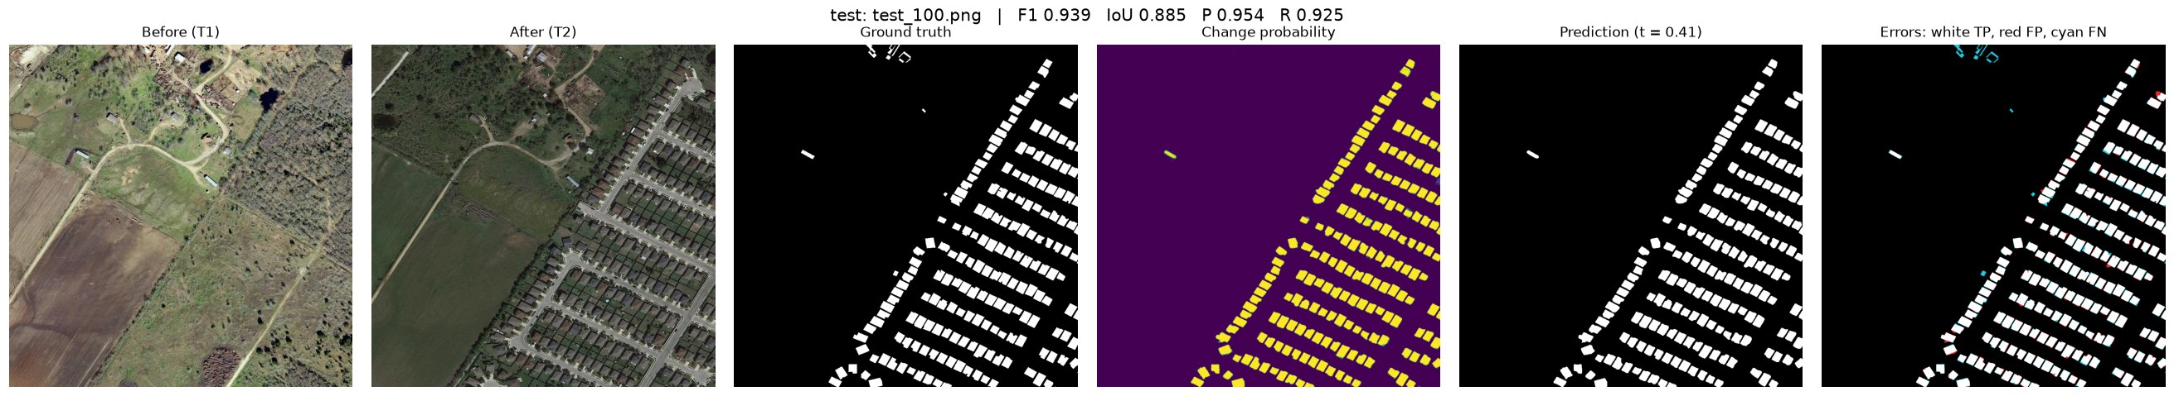
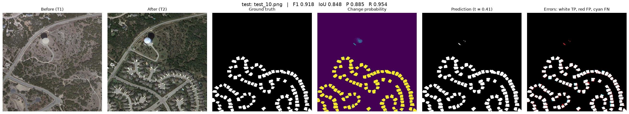
4.1 Implementation: Results Gallery
test_102 – warehouses
F1 0.977 · IoU 0.956
test_100 – new housing estate
F1 0.939 · IoU 0.885
test_10 – suburban cul-de-sacs
F1 0.918 · IoU 0.848
Presented by: 2206122
Notes:
[Md. Kawsar Ahmed (2206122) · about 24 s]
Here are three more test results. From left to right: before, after, ground truth, probability, prediction, and an error map, where white is correct, red is a false alarm and cyan is a miss. The outlines are sharp, and even closely spaced houses in a new housing estate are separated, with F1 between 0.92 and 0.98.

Slide 13
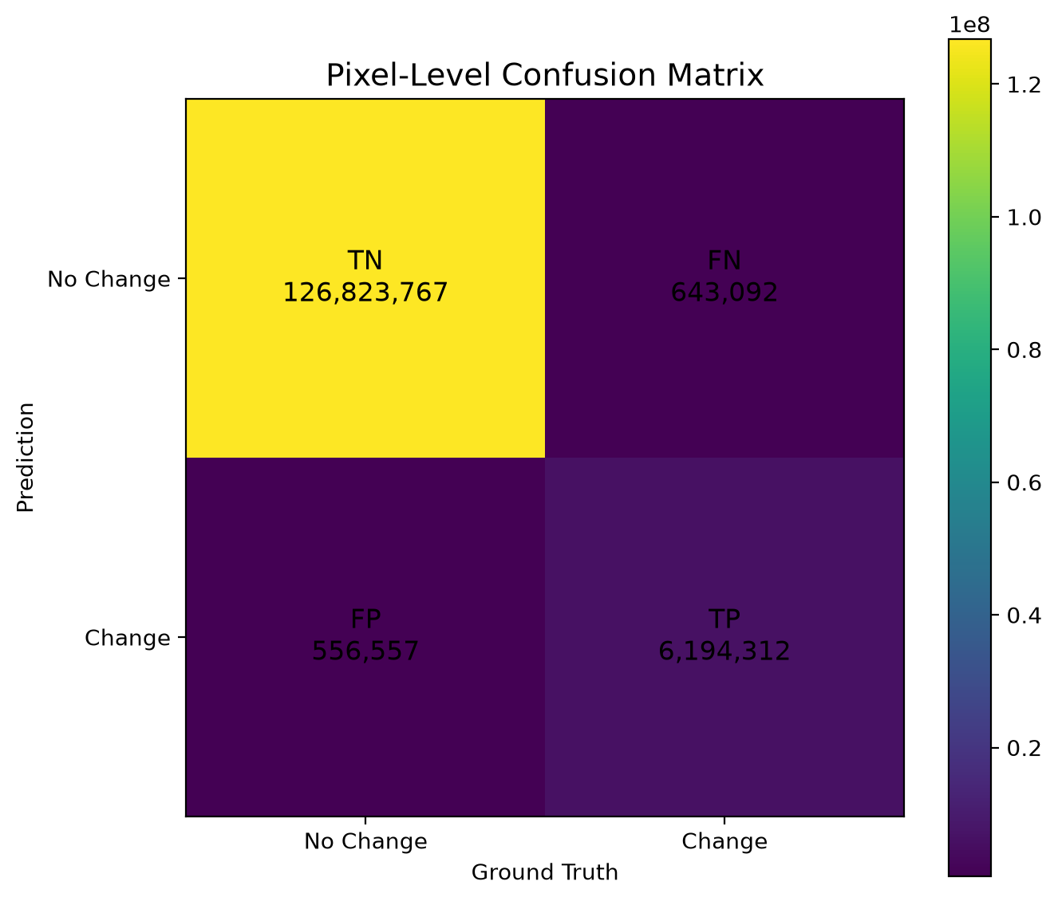
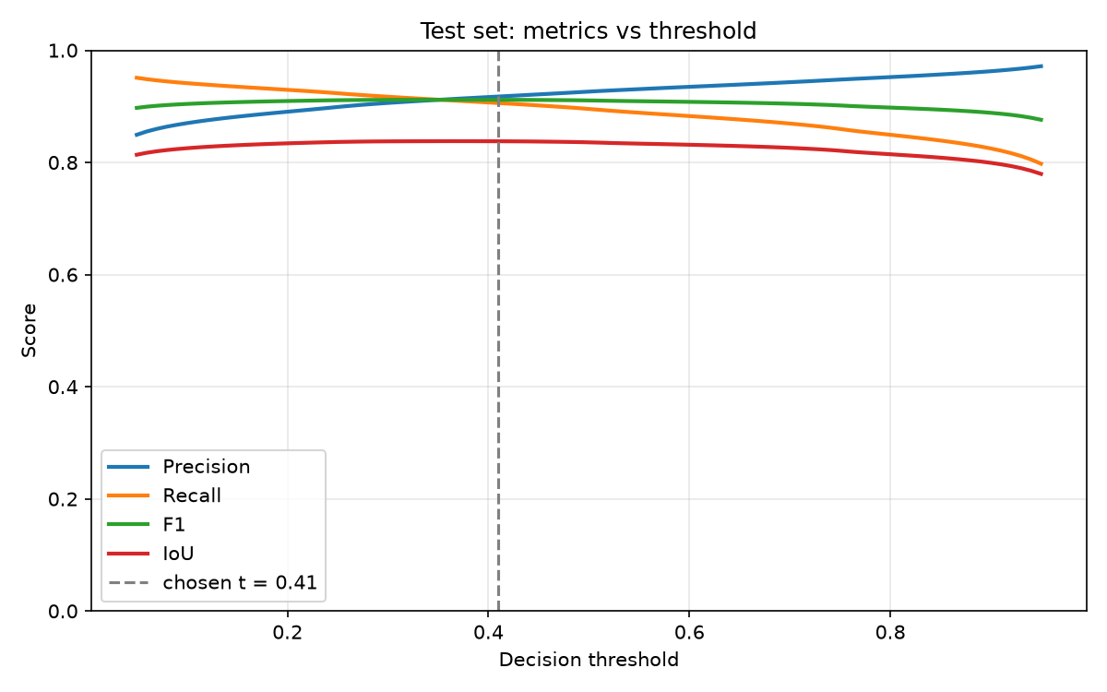
5. Analysis and Evaluation: Test Results
Metric (128 test images) | v1 (initial) | v2 (final) | Change
Precision | 75.8% | 91.8% | +16.0 pts
Recall | 78.5% | 90.6% | +12.1 pts
F1-score | 77.1% | 91.2% | +14.1 pts
IoU | 62.8% | 83.8% | +21.0 pts
Overall accuracy | 97.6% | 99.1% | +1.5 pts
v1 resized images to 256 × 256; v2 works at the native 1024 × 1024 resolution (same 128 test images).
Dataset-level IoU obeys IoU = F1/(2 − F1): 0.9117/1.0883 = 0.8377, measured 0.8378 ✓
Validation-chosen threshold 0.41 gives F1 0.9117; the best possible test threshold would give 0.9118 – the threshold transfers.
Presented by: 2206119
Notes:
[Md. Ahasan Habib Kawsar (2206119) · about 25 s]
On all 128 test images, the final model reaches 91.8 percent precision, 90.6 percent recall, 91.2 percent F1 and 83.8 percent IoU; that is 14 F1 points and 21 IoU points above our first version. False alarms and misses are balanced, and the validation threshold is almost exactly the best test threshold, so the result is not over-tuned.

Slide 14
5.1 Novelty
1
DSP-guided input
A classical Canny edge map, standardised with measured statistics, is fused with RGB inside an ImageNet encoder – DSP and deep learning cooperate at the input.
2
Attention + Siam-Concat at every scale
Spatial-temporal attention across both dates, then before / after / difference fusion from 1/2 to 1/32 resolution.
3
Edge-guided decoder
A DSP operator (Sobel) creates the edge supervision; the edge features steer the change decoder.
4
Native-resolution, deployable
Sliding-window inference with cosine blending, validation-selected threshold and a real-time desktop GUI.
Engineering finding: three silent bugs in v1 (batch mixing in attention, unscaled edge channel, 4× down-sampling) were found and fixed → +14 F1 points.
Presented by: 2206119
Notes:
[Md. Ahasan Habib Kawsar (2206119) · about 24 s]
Our design is novel in four ways: a standardised DSP edge channel fused with colour inside a pre-trained encoder; attention and difference-based fusion at every scale; an edge-guided decoder supervised with a Sobel operator; and native-resolution deployment in a real-time application. Finding and fixing three silent bugs in our first version added 14 F1 points.

Slide 15
5.2 Design Considerations (PO(c))
5.2.1 Public health and safety
Flags unauthorised construction in flood-prone and earthquake-risk zones for inspection
Rapid mapping of damage after floods or cyclones
A miss (false negative) can hide a hazard → output is decision support, a human verifies
5.2.2 Environment
Monitors encroachment on wetlands, farmland and green cover
Replaces field survey trips with remote analysis
Trained on a laptop GPU in ≈ 5 h – small energy footprint
5.2.3 Cultural and societal needs
Supports city planners (e.g. RAJUK) with up-to-date maps
Threshold slider lets users trade false alarms for misses to suit the task
Must not be used to target informal settlements for eviction
Design response: human-in-the-loop threshold slider, polygon output for GIS use, and fully offline operation on an ordinary laptop.
Presented by: 2206104
Notes:
[Mustasin Rahman (2206104) · about 36 s]
For public health and safety, the system can flag unauthorised construction in flood-prone or earthquake-risk areas, and map damage quickly after a disaster. Because a missed building could hide a hazard, the output is decision support, and a human always verifies it. Environmentally, it monitors encroachment on wetlands and farmland without field trips. For society, it can support city planners, and the threshold slider lets users choose between fewer false alarms and fewer misses. It must not be used to target informal settlements.

Slide 16
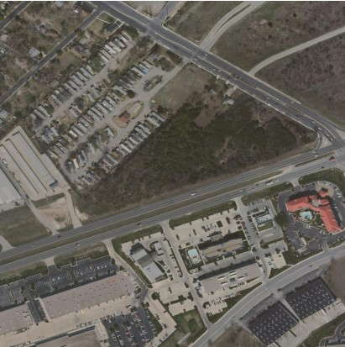
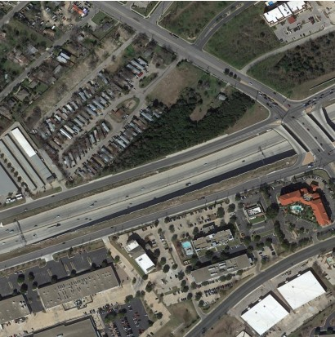
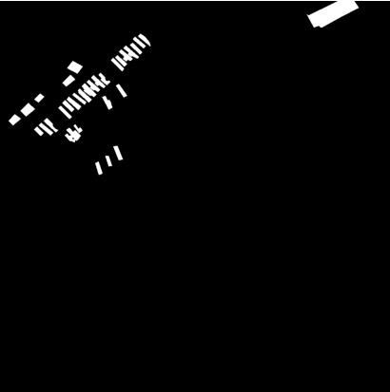
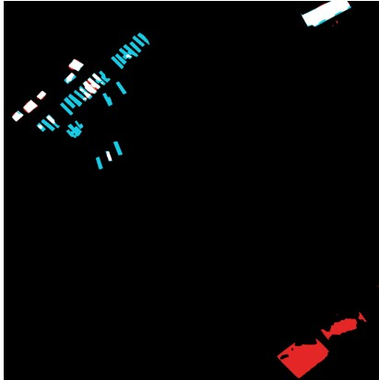
5.3 Investigations (PO(d))
Experiment | Result
v1 → v2 (all fixes) | Test F1 0.771 → 0.912
Per-image vs dataset-level F1 | 0.840 vs 0.912
BAM batch test (v1 bug) | Output change 0.241 → 0
Edge / RGB channel std | 0.002 → 1.01
Theory vs experiment | IoU = F1/(2−F1) ✓
Val threshold on test | 0.9117 vs best 0.9118
Before
After
Failure analysis (right, worst test image, F1 0.46):
Misses: tiny mobile homes, 3–5 px wide
False alarm: re-roofed buildings look new (pseudo-change)
Ground truth
Errors (red FP, cyan FN)
Presented by: 2206119
Notes:
[Md. Ahasan Habib Kawsar (2206119) · about 26 s]
A controlled test showed that our old attention module changed an image's output by 0.24 depending on the other images in its batch; now the difference is zero. Theory predicts IoU equals F1 over two minus F1, which gives 0.8377; we measured 0.8378. In our worst test image, tiny mobile homes are missed and re-roofed buildings are mistaken for new ones.

Slide 17
5.4 Limitations of Tools (PO(e))
Hardware
MacBook GPU (MPS): batch size 4, ≈ 5 h per training run
MPS has no float64 → metrics accumulated on CPU
Inference ≈ 3 s per 1024² image with TTA
Data
LEVIR-CD: 0.5 m/px, US cities, buildings only (no roads)
Label noise: some re-roofed buildings unlabelled
Domain shift to dense Bangladeshi areas (Purbachal)
Algorithms
Canny thresholds fixed (50 / 150) – contrast dependent
Objects under ≈ 4 × 4 px (2 m) are unreliable
Tile context 128 m; mis-registration causes false alarms
Mitigations: native-resolution tiling, test-time augmentation, validation-selected threshold and an automated sanity-check script.
Presented by: 2206104
Notes:
[Mustasin Rahman (2206104) · about 30 s]
Our tools have limits. Training on a laptop GPU restricted the batch size to four and took about five hours. LEVIR-CD contains only buildings in American cities at half-metre resolution, so dense Bangladeshi areas are a domain shift. Canny thresholds are fixed, objects smaller than about two metres are unreliable, and badly aligned image pairs cause false alarms. We reduced these effects with native-resolution tiling, test-time augmentation and a validation-selected threshold.

Slide 18
5.5 Ethical Issues (PO(h))
1
Data and credit
Public LEVIR-CD used under its academic licence; every dataset, paper and library is cited.
2
Privacy and dual use
High-resolution imagery reveals private property. Intended for planning and disaster response, not surveillance or forced eviction.
3
Honest evaluation
Test set never used for tuning; threshold chosen on validation; the v1 bugs and the failure cases are reported openly.
4
Transparency
Code and model are shared; use of AI coding assistance is disclosed in the report.
Presented by: 2206104
Notes:
[Mustasin Rahman (2206104) · about 26 s]
On ethics: we used the public LEVIR-CD dataset under its licence and cite every source. High-resolution imagery can reveal private property, so the intended use is planning and disaster response, not surveillance. We never used the test set for tuning, and we report our earlier bugs and failure cases openly. Our use of AI coding assistance is disclosed in the report.

Slide 19
6.1 Individual Contribution (PO(i))
Member | ID | Main contributions
Mustasin Rahman | 2206104 | Dataset preparation, DSP pre-processing (Gaussian, Canny), augmentation
Fahim Shahriyar | 2206114 | Literature review, error-type and spatial analyses, report writing
Md. Ahasan Habib Kawsar | 2206119 | Network architecture, training pipeline, v2 debugging, evaluation
Md. Kawsar Ahmed | 2206122 | PyQt5 GUI, inference and post-processing, video and presentation
Mode of teamwork
Weekly meetings, shared code folder and task list; every module reviewed by a second member
Training runs shared across members' laptops; decisions logged in the project logbook
Presented by: 2206122
Notes:
[Md. Kawsar Ahmed (2206122) · about 23 s]
Each member led one part. Mustasin prepared the data and the DSP pre-processing, Fahim led the literature review and the error analysis, Ahasan designed and trained the network, and I built the GUI and the inference pipeline. We met weekly, shared one code folder, and every module was reviewed by a second member.

Slide 20
7 Communication to External Stakeholders (PO(j))
GitHub repository
github.com/<group-04-repo> (code, model, user manual)
YouTube video
youtu.be/<video-id> (10-minute presentation)
Video title
Urban Change Detection with DSP & Deep Learning | B2.04 | EEE 312 (Jan 2026) Project | Dept of EEE, BUET
Deliverables: detailed report, user manual (installation, GUI usage), recorded presentation, source code with sanity check.
Presented by: 2206122
Notes:
[Md. Kawsar Ahmed (2206122) · about 11 s]
Our code, the trained model and a user manual are available on GitHub, and this video is on YouTube. The links are on this slide.

Slide 21
8. Future Work (PO(l))
1
DSP ablation: Finish the RGB-only vs RGB + Canny run to measure the edge channel's exact gain.
2
Local dataset: Label Purbachal / Dhaka image pairs and fine-tune for dense South-Asian settlements.
3
Multi-class change: Separate buildings, roads, demolition and vegetation loss.
4
Stronger backbones: Transformer encoders (BIT / ChangeFormer style) and learnable DSP filters.
5
Time series: Use more than two dates to reject seasonal pseudo-changes.
6
Deployment: Web service or GIS plug-in (QGIS) with GeoTIFF input and polygon export.
Presented by: 2206122
Notes:
[Md. Kawsar Ahmed (2206122) · about 21 s]
First, we will finish the RGB-only comparison to measure exactly how much the edge channel adds. We also want to label image pairs from Dhaka and Purbachal, detect roads and demolition as separate classes, try transformer backbones and longer image time series, and turn the tool into a GIS plug-in.

Slide 22
9. References
[1] H. Chen and Z. Shi, “A spatial-temporal attention-based method and a new dataset for remote sensing image change detection,” Remote Sensing, vol. 12, no. 10, p. 1662, 2020.
[2] R. C. Daudt, B. Le Saux, and A. Boulch, “Fully convolutional Siamese networks for change detection,” in Proc. IEEE ICIP, 2018.
[3] H. Chen, Z. Qi, and Z. Shi, “Remote sensing image change detection with transformers,” IEEE Trans. Geosci. Remote Sens., vol. 60, 2022.
[4] W. G. C. Bandara and V. M. Patel, “A transformer-based Siamese network for change detection,” in Proc. IEEE IGARSS, 2022.
[5] K. He, X. Zhang, S. Ren, and J. Sun, “Deep residual learning for image recognition,” in Proc. IEEE CVPR, 2016.
[6] O. Ronneberger, P. Fischer, and T. Brox, “U-Net: Convolutional networks for biomedical image segmentation,” in Proc. MICCAI, 2015.
[7] J. Canny, “A computational approach to edge detection,” IEEE Trans. Pattern Anal. Mach. Intell., vol. 8, no. 6, pp. 679–698, 1986.
[8] S. Xie and Z. Tu, “Holistically-nested edge detection,” in Proc. IEEE ICCV, 2015.
[9] F. Milletari, N. Navab, and S.-A. Ahmadi, “V-Net: Fully convolutional neural networks for volumetric medical image segmentation,” in Proc. 3DV, 2016.
[10] A. Paszke et al., “PyTorch: An imperative style, high-performance deep learning library,” in Proc. NeurIPS, 2019.
[11] G. Bradski, “The OpenCV library,” Dr. Dobb’s Journal of Software Tools, 2000.
Presented by: 2206122
Notes:
[Md. Kawsar Ahmed (2206122) · about 3 s]
These are our references. Thank you for watching.

