Slide 1

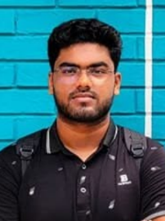
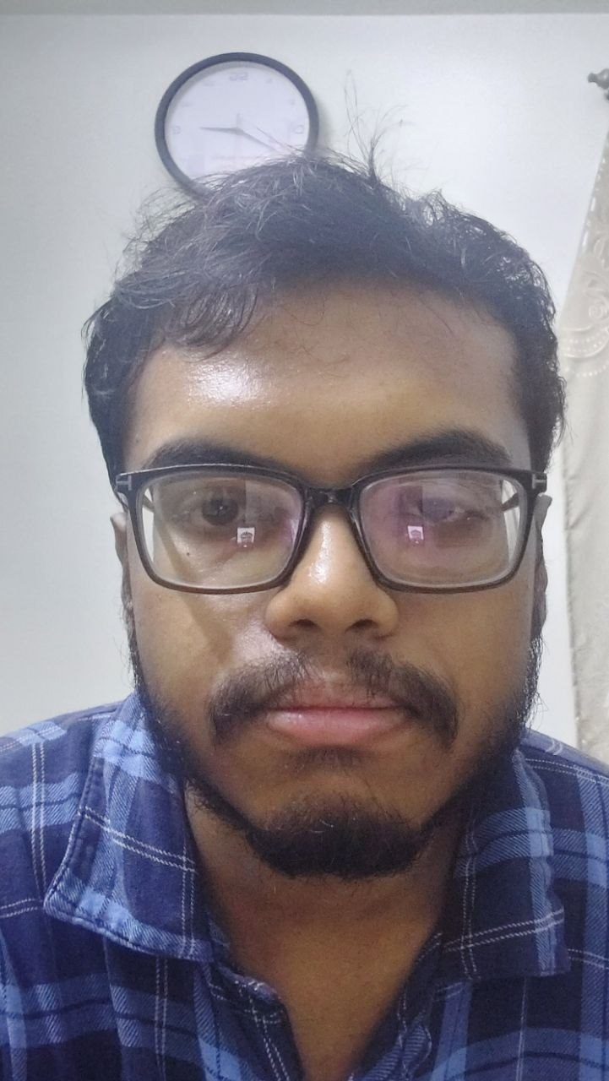
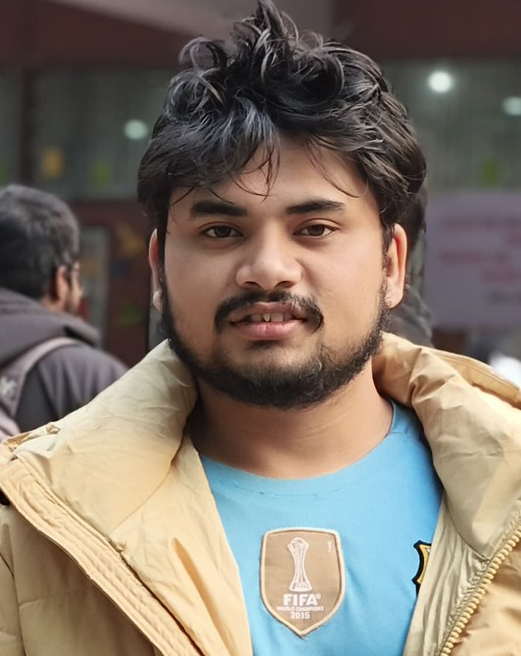
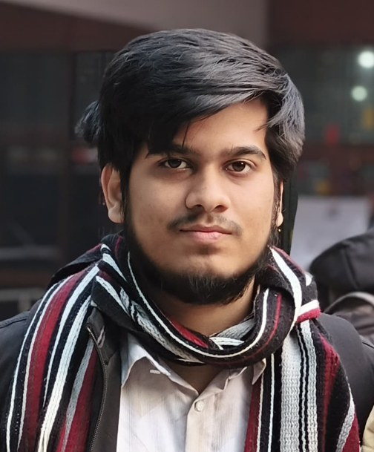
Digital Signal Processing and Deep Learning-Based Urban Change Detection Using Satellite Imagery
EEE 312 – Digital Signal Processing I Laboratory
January 2026 - Level-3 Term-I - Section B2
Project Presentation
Submitted by – Group 04
Mustasin Rahman 2206104
Fahim Shahriyar
2206114
Md. Ahasan Habib Kawsar
2206119
Md. Kawsar Ahmed
2206122
Notes:
[Md. Ahasan Habib Kawsar (2206119) · about 21 s]
Assalamu Alaikum. We are Group 04 from Section B2 of EEE 312, Digital Signal Processing One Laboratory. Our project is Digital Signal Processing and Deep Learning-Based Urban Change Detection Using Satellite Imagery. I am Md. Ahasan Habib Kawsar, and my teammates are Mustasin Rahman, Fahim Shahriyar and Md. Kawsar Ahmed.

Slide 2
Outline
Design
Literature · Methods PO(a) · Data · DSP · Network · Training
1
Abstract
2
Introduction
3
Analysis & Evaluation
Results · old vs new · PO(d) · PO(e) · PO(c) · PO(h)
4
Implementation
GUI demo · LEVIR-CD & Bangladesh results
5
6
Team Work
PO(i)
Future Work
PO(l)
7
Communication
PO(j)
8
9
References
EEE 312 (Jan 2026) — Section B2 — Group 04
DSP & Deep Learning-Based Urban Change Detection
Presented by: 2206119
‹#›
.
Notes:
[Md. Ahasan Habib Kawsar (2206119) · about 12 s]
We will summarise the project, explain the problem and our design, demonstrate the software, evaluate the results against the program outcomes, and finish with teamwork, future work and references.

Slide 3
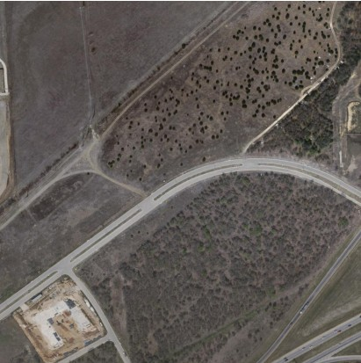
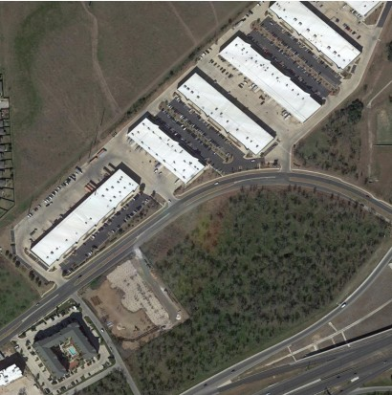
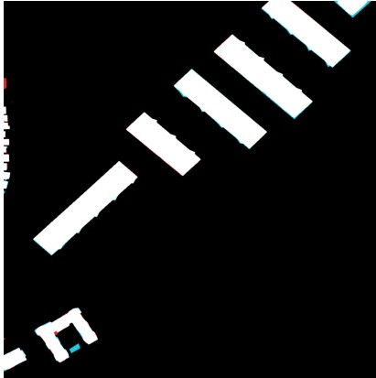
1. Abstract
Problem: Identifying new construction or demolition between two satellite images taken years apart.
DSP Front-end: Applied Gaussian smoothing and Canny edge detection to isolate building boundaries.
Deep Learning: Engineered a Siamese ResNet-34 U-Net to process the images and detect changes.
Performance: Achieved a 91.2% F1-score and 83.8% IoU on the LEVIR-CD test set
91.2%
F1-score (test)
83.8%
IoU (test)
99.1%
Overall accuracy
0.907
Cohen's κ
EEE 312 (Jan 2026) — Section B2 — Group 04
DSP & Deep Learning-Based Urban Change Detection
Presented by: 2206119
‹#›
Notes:
[Md. Ahasan Habib Kawsar (2206119) · about 25 s]
Our system takes two satellite images of the same place, taken years apart, and marks every pixel where a building has appeared. A Gaussian filter and the Canny detector extract edges as a fourth input channel, and a Siamese network compares the two dates. On 128 unseen test images it reaches 91.2 percent F1 and 83.8 percent IoU.

Slide 4
2. Introduction
The Objective: Automating the mapping of rapid urban growth, unauthorized constructions, and post-disaster damage.
The Engineering Challenges:
  Pseudo-changes: Seasonal color shifts, sun angles and shadows trigger false alarms.
  Extreme Imbalance: Only small portion of pixels in the dataset actually represent true urban change.
  Scale: Small objects like houses are only 10–20 pixels wide at 0.5 m/pixel resolution
EEE 312 (Jan 2026) — Section B2 — Group 04
DSP & Deep Learning-Based Urban Change Detection
Presented by: 2206119
‹#›
Notes:
[Md. Ahasan Habib Kawsar (2206119) · about 26 s]
Cities like Dhaka grow faster than manual surveys can map them, so planners need an automatic way to find new construction and post-disaster damage. The task is hard for three reasons: shadows and seasons change the image even when nothing is built; only a small fraction of pixels actually change; and a house is only ten to twenty pixels wide.

Slide 5
3.1 Design: Literature Review
Scope: Training on the LEVIR-CD dataset (637 image pairs) and validating on real-world local imagery.
Literature Gap: Classical DSP methods are fast but sensitive to illumination changes. Standard CNNs lack explicit edge features, causing blurry architectural boundaries.
Proposed Approach: Fusing explicit DSP edge features with spatial-temporal attention in a lightweight CNN
Published values from Bandara & Patel (2022). Our figure uses sliding-window inference with test-time augmentation on the same 128 test images, so the comparison is indicative, not identical protocol.
EEE 312 (Jan 2026) — Section B2 — Group 04
DSP & Deep Learning-Based Urban Change Detection
Presented by: 2206114
‹#›
Notes:
[Fahim Shahriyar (2206114) · about 29 s]
Classical methods simply subtract the two images, which is fast but very sensitive to lighting. Siamese networks pass both images through the same encoder, and attention and transformer models such as STANet, BIT and ChangeFormer reach around ninety percent F1. We combine explicit DSP edge features with attention in a network that trains on a laptop. The chart compares our F1 with published results; the protocols differ slightly.

Slide 6
3.2 Design Methods (PO(a))
1. Data Preparation:
LEVIR-CD: 637 bi-temporal pairs, 1024 × 1024 px, 0.5 m/pixel
2. Preprocessing
Native-resolution 256 × 256 crops, joint augmentation, channel standardisation
3. DSP Feature Engineering
Converting RGB to a 4-channel input by fusing standard color with Grayscale, Gaussian Filtering, and Canny Edge Detection.
4. Siamese U-Net Model
Shared-weight encoding & Feature fusion
5. Training
AdamW · BCE + Dice + class-balanced edge loss · LEVIR-CD train split
6. Evaluation & Demonstration
IoU, Precision, Recall, F1 & Qualitative inference
9
EEE 312 (Jan 2026) — Section B2 — Group 04
DSP & Deep Learning-Based Urban Change Detection
Presented by: 2206119
‹#›
Notes:
[Md. Ahasan Habib Kawsar (2206119) · about 14 s]
This is our complete design flow in six steps: data preparation, preprocessing, DSP feature engineering, the Siamese U-Net model, training, and finally evaluation and demonstration. My teammates will now explain each step.

Slide 7
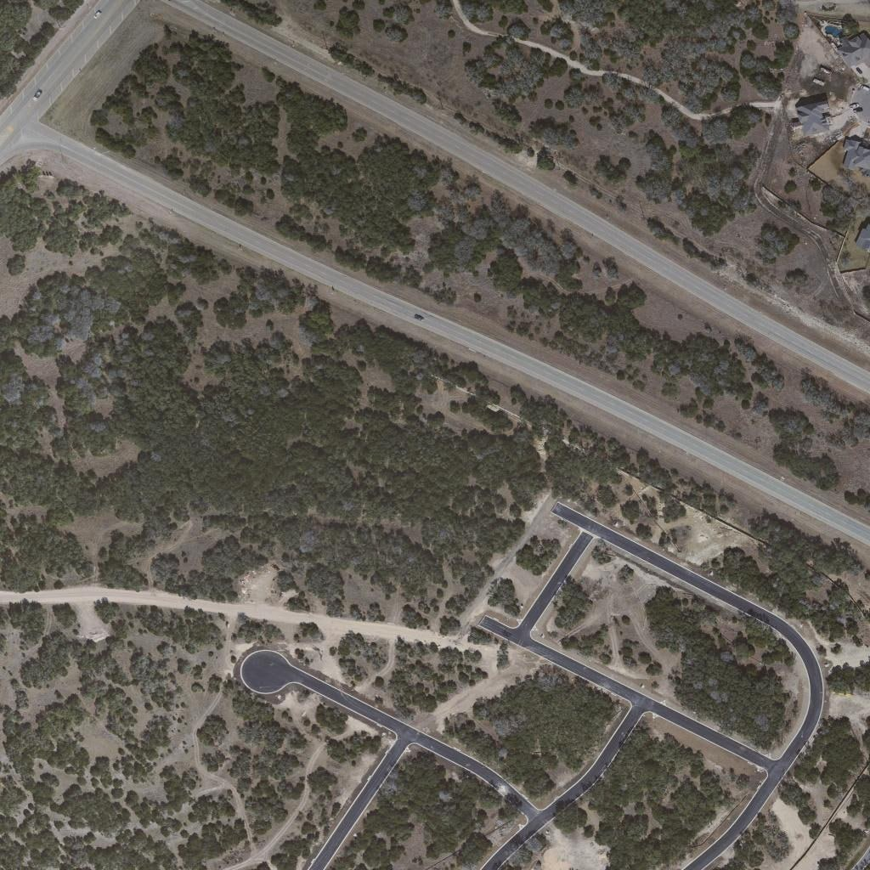
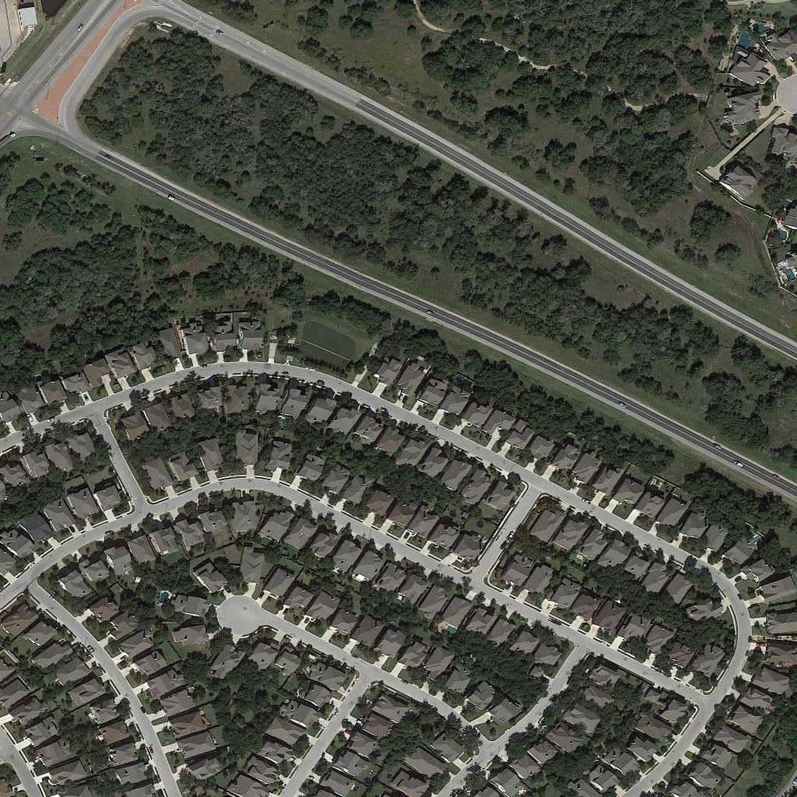
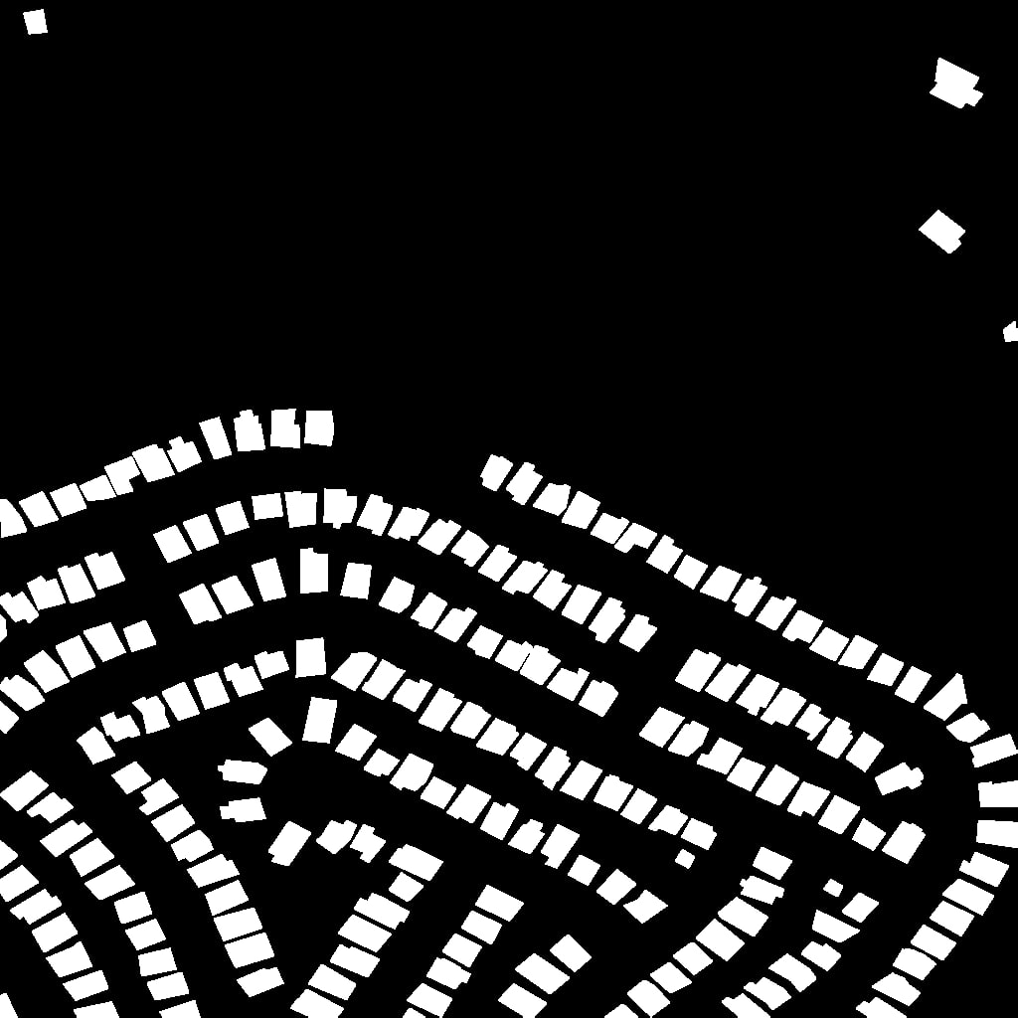
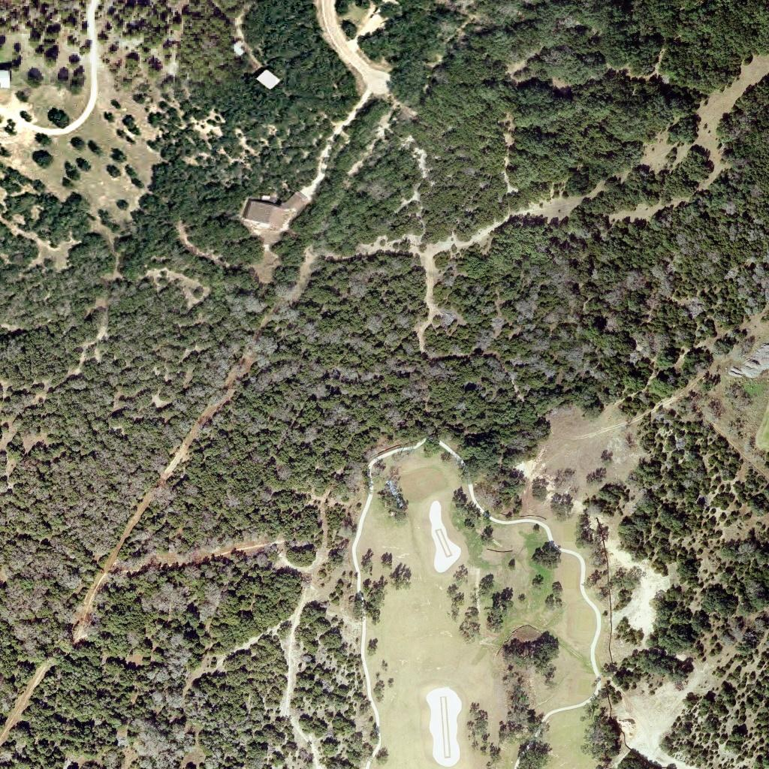
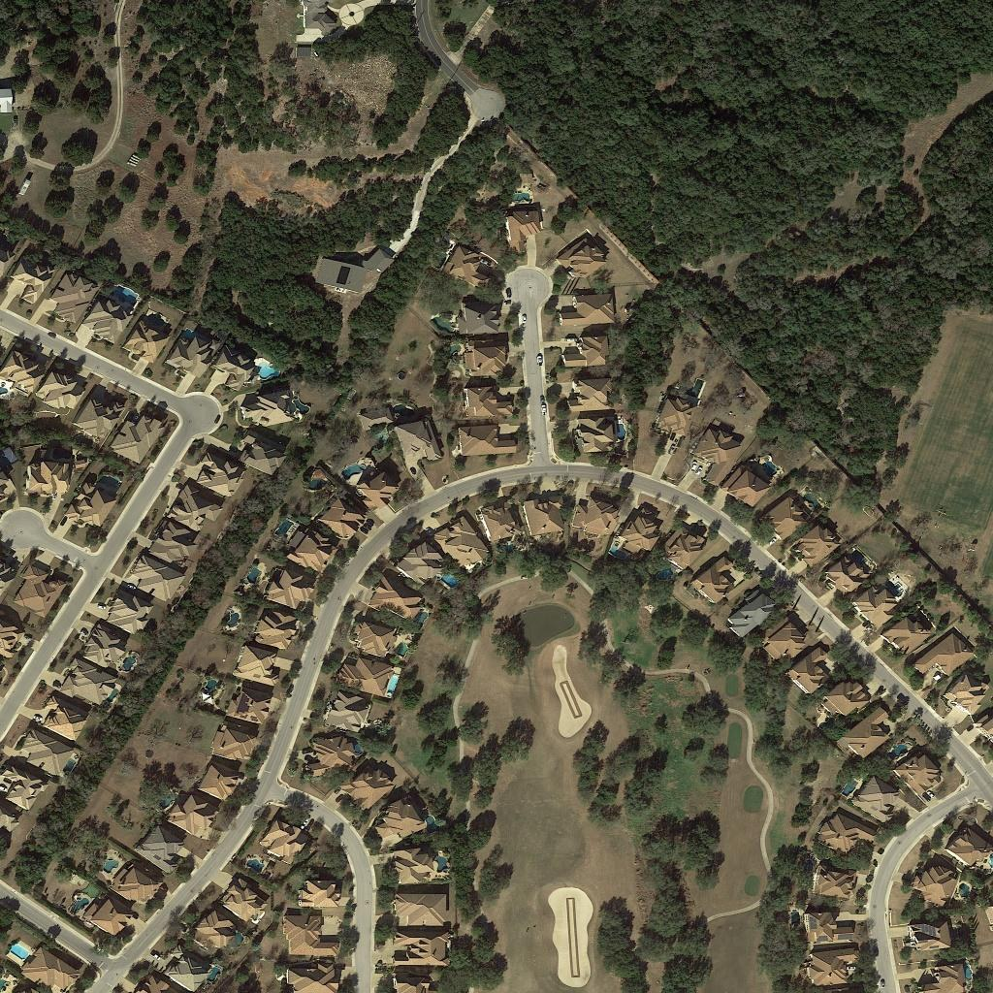
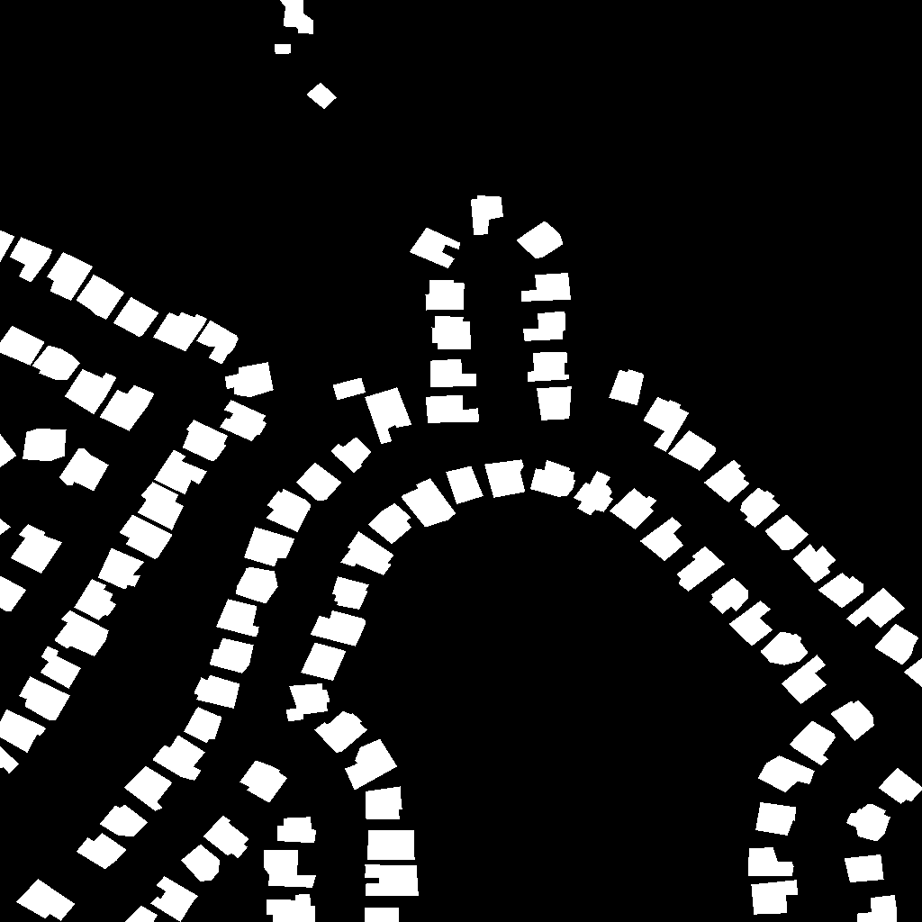
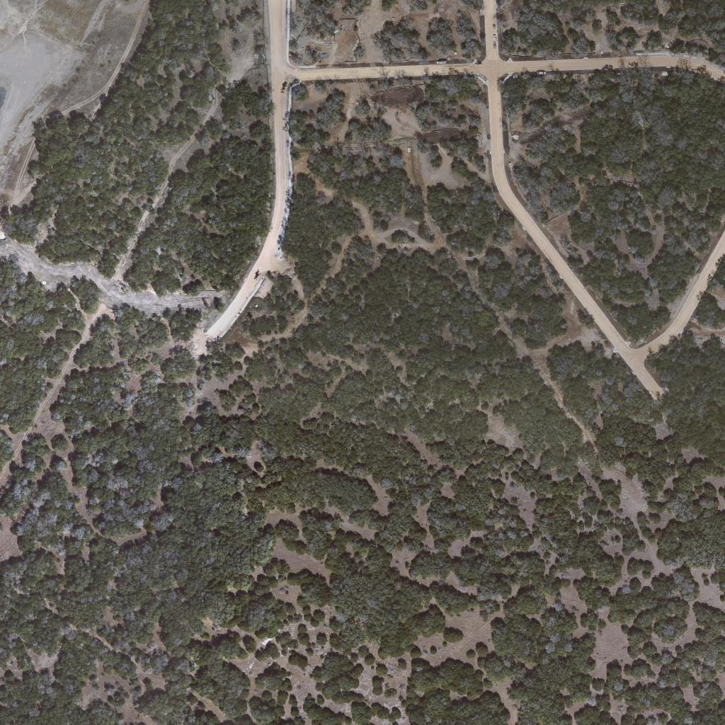
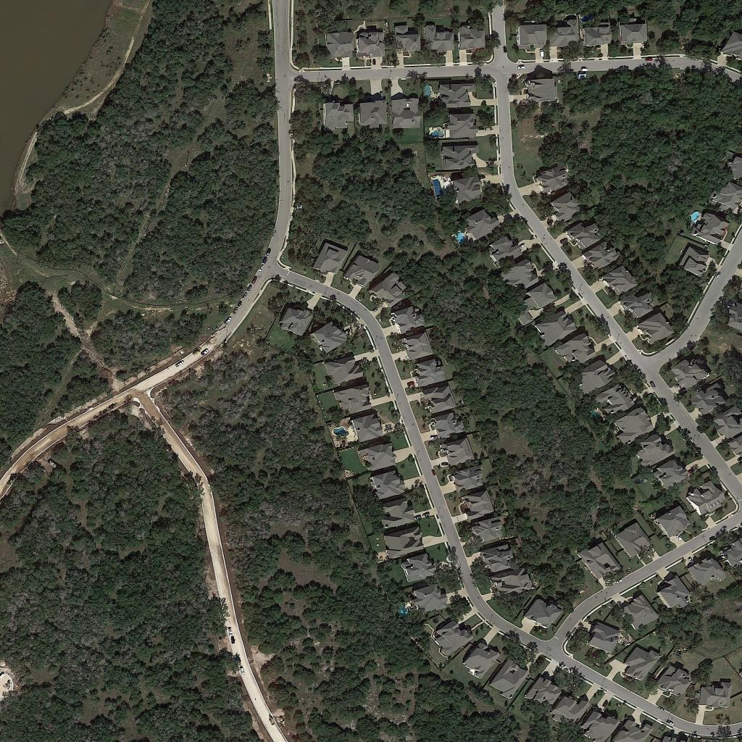
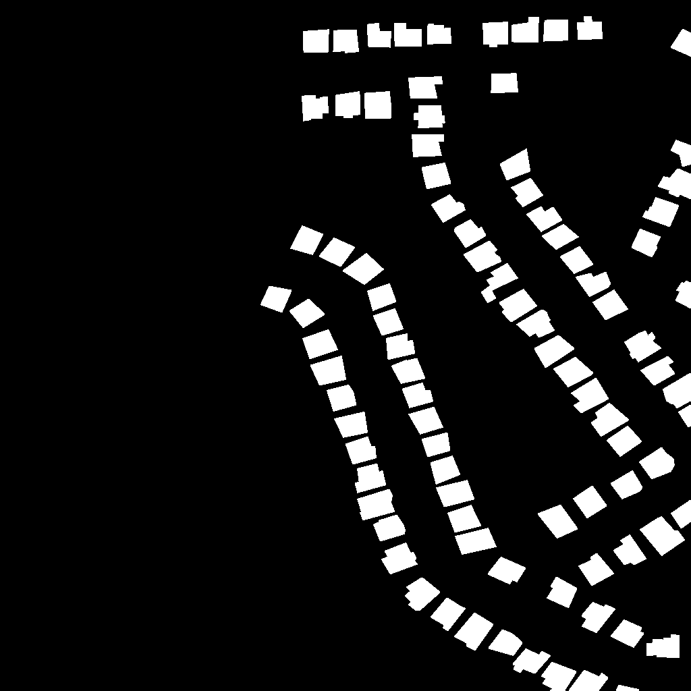
3.2.1 Design Methods: Data Preparation
1
LEVIR-CD — Primary Dataset [1]
Before (T₁)
After (T₂)
Ground Truth
Bi-Temporal Data (Before / After)
Time T₁ — Before
Time T₂ — After
↓
↓
Ground-Truth Change Mask
637 bi-temporal RGB image pairs
Spatial size: 1024 × 1024 pixels
Spatial resolution: 0.5 m/pixel
Train: 445 · Validation: 64 · Test: 128
[1] H. Chen and Z. Shi, "A Spatial-Temporal Attention-Based Method and a New Dataset for Remote Sensing Image Change Detection," Remote Sensing, 12(10), 2020.
EEE 312 (Jan 2026) — Section B2 — Group 04
DSP & Deep Learning-Based Urban Change Detection
Presented by: 2206104
‹#›
Notes:
[Mustasin Rahman (2206104) · about 22 s]
I am Mustasin Rahman. We use the LEVIR-CD dataset: 637 pairs of before and after images, each 1024 by 1024 pixels at half a metre per pixel, with a ground-truth mask that marks every changed pixel. The official split is 445 pairs for training, 64 for validation and 128 for testing.

Slide 8
3.2.2 Design Methods: Image Preprocessing
2
Native-Resolution Cropping, Joint Augmentation & Standardisation
1024 × 1024
Image Pair
Standardisation
x′ = (x/255 − μ) / σ
RGB: ImageNet μ, σ · Edge: μ = 0.12, σ = 0.33
256 × 256
patch
→
→
Joint Augmentation
Flips and 90° rotations applied identically to T₁, T₂ and the mask; brightness / contrast jitter applied to each date separately.
Training: random 256 × 256 crops (4 per pair per epoch)
Inference: overlapping 256-px tiles, stride 192 px → 5 × 5 = 25 tiles per 1024² image, cosine-blended
Crop → Joint Augmentation → DSP (Canny) → Standardisation → Model Input
EEE 312 (Jan 2026) — Section B2 — Group 04
DSP & Deep Learning-Based Urban Change Detection
Presented by: 2206104
‹#›
Notes:
[Mustasin Rahman (2206104) · about 27 s]
Instead of shrinking the images, we cut random 256 by 256 crops at full resolution, so small buildings keep their detail. Flips and rotations are applied identically to both dates and the mask, while brightness and colour are changed separately for each date. Every channel is then standardised. At test time, the full image is covered by 25 overlapping tiles that are blended smoothly.

Slide 9
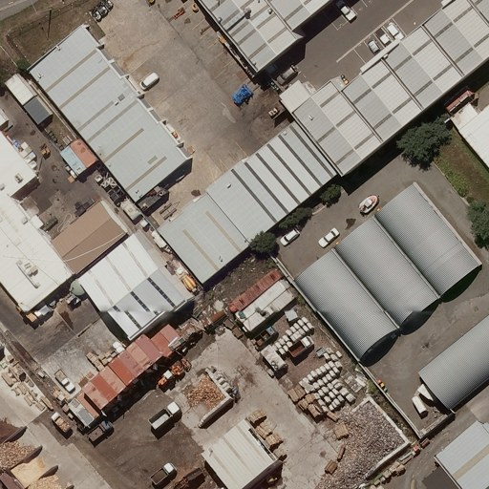
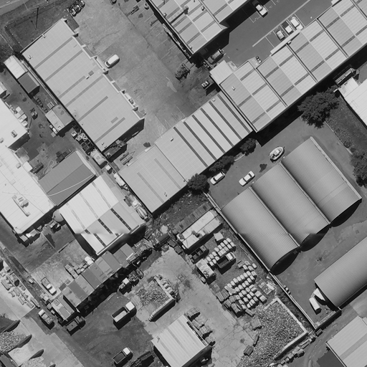

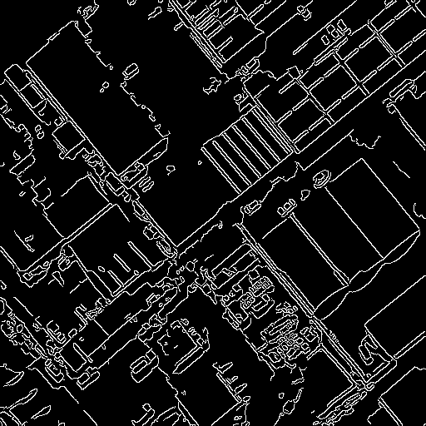
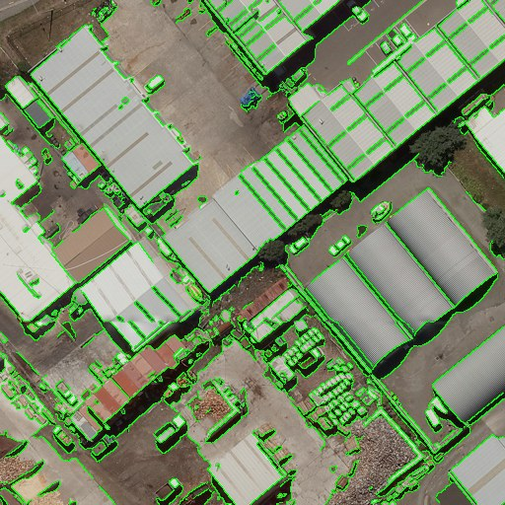
3.2.3 Design Methods: DSP Feature Engineering
3
Extracting an Explicit Structural Edge Representation from RGB Imagery
→
→
→
→
RGB Image
Grayscale
Gaussian-Filtered
Canny Edge Map
RGB + Canny Fusion
3-channel RGB + 1-channel Canny = 4-channel input
DSP processing extracts an explicit structural Edge representation from the RGB image;
Grayscale Conversion and Gaussian Filtering are intermediate stages used to generate the Canny Edge channel.
EEE 312 (Jan 2026) — Section B2 — Group 04
DSP & Deep Learning-Based Urban Change Detection
Presented by: 2206104
‹#›
Notes:
[Mustasin Rahman (2206104) · about 17 s]
Our DSP front-end turns each RGB image into a four-channel input. The image is converted to grayscale, smoothed with a Gaussian filter, and passed through the Canny edge detector; the edge map is then stacked with the original colour channels.

Slide 10
Grayscale Conversion
4
RGB → Single-Channel Luminance Representation
Y = 0.299R + 0.587G + 0.114B [2]
→
Applies ITU-R BT.601 Weighted Coefficients
to Compute Structural Luminance.
RGB Image
Grayscale Image
Reduces 3-channel RGB to a 1-channel spatial intensity map.
Eliminates color variance while preserving architectural geometry for Gradient Analysis.
[2] ITU-R BT.601-7, "Studio Encoding Parameters of Digital Television," 2011
EEE 312 (Jan 2026) — Section B2 — Group 04
DSP & Deep Learning-Based Urban Change Detection
Presented by: 2206104
‹#›
Notes:
[Mustasin Rahman (2206104) · about 15 s]
Grayscale conversion uses the ITU-R BT.601 weights: Y equals 0.299 R plus 0.587 G plus 0.114 B. This reduces three colour channels to one intensity map while keeping the geometry of buildings for gradient analysis.

Slide 11
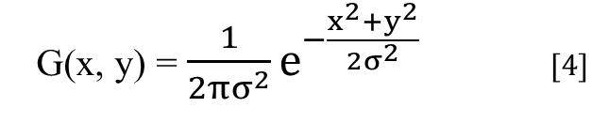
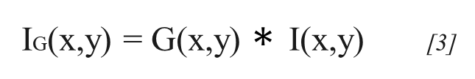
Gaussian Filtering
5
Smoothing Before Gradient-Based Edge Detection
G(x, y) = $\frac{1}{{2πσ}^{2}}e^{−\frac{x^{2}{+y}^{2}}{{2σ}^{2}}}$ [4]
IG(x,y) = G(x,y) $∗$ I(x,y) [3]
→
Gaussian Smoothing: Applies a 2-D Low-Pass Convolution to strip away High-Frequency Spatial Noise.
Artifact Suppression: Ensures downstream Gradient Operators lock onto true structural boundaries rather than spurious pixel variations.
Grayscale Image
Gaussian-Smoothed Image
[3] J. Canny, "A Computational Approach to Edge Detection," IEEE TPAMI, PAMI-8(6), 679-698, 1986.
[4] D. Marr and E. Hildreth, "Theory of Edge Detection," Proc. R. Soc. B, 207(1167), 187-217, 1980.
EEE 312 (Jan 2026) — Section B2 — Group 04
DSP & Deep Learning-Based Urban Change Detection
Presented by: 2206104
‹#›
Notes:
[Mustasin Rahman (2206104) · about 15 s]
Next, we convolve the grayscale image with a five-by-five Gaussian kernel with sigma equal to one. This low-pass filter removes high-frequency noise, so the gradient operators respond to real structural edges instead of pixel noise.

Slide 12
Canny Edge Detection & RGB + Canny Channel Fusion
6
Gradient Estimation (Gx, Gy) → Non-Maximum Suppression
→ Double Threshold → Hysteresis → Binary Edge Map
→
M(x,y) = √(Gx² + Gy²) [3]
Extracts Significant Local Intensity Boundaries as a Thin Binary Edge Map.
Gaussian-Smoothed → Binary Edge Map
ℝ^(H×W×3) ⊕ ℝ^(H×W×1) = ℝ^(H×W×4)
+
=
Canny map appended as a 4th channel; all 4 channels are then standardised (zero mean, unit variance).
RGB
H×W×3
Canny
H×W×1
RGB + Canny
H×W×4
[3] J. Canny, "A Computational Approach to Edge Detection," 1986.
EEE 312 (Jan 2026) — Section B2 — Group 04
DSP & Deep Learning-Based Urban Change Detection
Presented by: 2206104
‹#›
Notes:
[Mustasin Rahman (2206104) · about 22 s]
Canny computes the horizontal and vertical Sobel gradients and their magnitude, thins the edges by non-maximum suppression, and applies hysteresis thresholds of 50 and 150. The binary edge map is appended as a fourth channel, and all four channels are standardised so that the edge channel carries the same weight as colour.

Slide 13
3.2.4 Design Methods:The Siamese U-Net Architecture
Siamese encoder
ResNet-34 (ImageNet)
shared weights
5 scales:
1/2 · 1/4 · 1/8 · 1/16 · 1/32
64 → 512 channels
Fusion at every scale
BAM: attention over
both dates (1/4 … 1/32)
Siam-Concat:
[F₁, F₂, |F₁ − F₂|]
→ 1×1 conv
U-Net decoder
1/32 → 1/2 with skip
connections, edge-guided
fusion, ×2 up + 3×3
refinement
Change map
1 × 256 × 256
BCE + Dice
T1: 4 × 256 × 256
T2: 4 × 256 × 256
Edge head
fused 1/2 + 1/4 + context
Edge map
EEE 312 (Jan 2026) — Section B2 — Group 04
DSP & Deep Learning-Based Urban Change Detection
Presented by: 2206119
‹#›
Notes:
[Md. Ahasan Habib Kawsar (2206119) · about 20 s]
Both four-channel images pass through the same pre-trained ResNet-34 encoder, which gives features at five scales. At every scale, a fusion block compares the two dates. The U-Net decoder rebuilds a full-resolution change map, guided by an edge head that predicts the outlines of changed buildings.

Slide 14
3.2.5 Design Methods: Attention, Fusion, Loss
Spatial-temporal attention (BAM)
X = [F₁ ‖ F₂] (dates side by side)
A = softmax(QᵀK / √d)
X′ = X + γ · V Aᵀ, γ = 0 at start
Every pixel of either date can attend to every pixel of both dates; γ = 0 at start keeps ImageNet features intact.
Siam-Concat Fusion
D = |F₁′ − F₂′|
F = ReLU(BN(W₁ₓ₁ ∗ [F₁′, F₂′, D]))
Keeps the appearance of both dates and their difference instead of the difference only.
Multi-task loss
L = L(BCE) + L(Dice) + 0.4 · L(edge)
L(Dice) = 1 − (2Σpy + 1) / (Σp + Σy + 1)
L(edge): β-weighted BCE, β = |Y⁻| / |Y|
Dice fights the 95 % background;
class-balanced BCE makes the rare edge pixels count.
Evaluation metrics
P = TP/(TP+FP), R = TP/(TP+FN)
F1 = 2PR/(P+R)
IoU = TP/(TP+FP+FN)
Computed over all test pixels (Dataset level)
EEE 312 (Jan 2026) — Section B2 — Group 04
DSP & Deep Learning-Based Urban Change Detection
Presented by: 2206119
‹#›
Notes:
[Md. Ahasan Habib Kawsar (2206119) · about 21 s]
The attention module places both dates side by side, so every pixel can attend to every pixel of both images. The fusion keeps the before features, the after features and their absolute difference. The loss combines binary cross-entropy, Dice loss for the class imbalance, and a class-balanced edge loss.

Slide 15
3.3 Design: Training and Inference
Training
Native-resolution 256 × 256 random crops, 4 per image per epoch; 30 % centred on a change
Synchronised flips / 90° rotations; independent brightness–contrast–colour jitter per date
AdamW, lr 1e-4, warm-up + cosine decay, batch 4, gradient clipping
Apple M-series GPU (MPS): ≈ 6.3 min/epoch; early stop at epoch 47, best at 32
Inference
Full 1024 × 1024 images, 256-px tiles with 64-px overlap
Test-time augmentation: average of 4 flips
Threshold 0.41 chosen on the validation set only
EEE 312 (Jan 2026) — Section B2 — Group 04
DSP & Deep Learning-Based Urban Change Detection
Presented by: 2206119
‹#›
Notes:
[Md. Ahasan Habib Kawsar (2206119) · about 20 s]
We trained with the AdamW optimiser and a cosine learning-rate schedule on a MacBook GPU, at about six minutes per epoch. Validation F1 reached 0.91 at epoch 32, and training stopped automatically at epoch 47. The decision threshold, 0.41, was chosen on the validation set only.

Slide 16
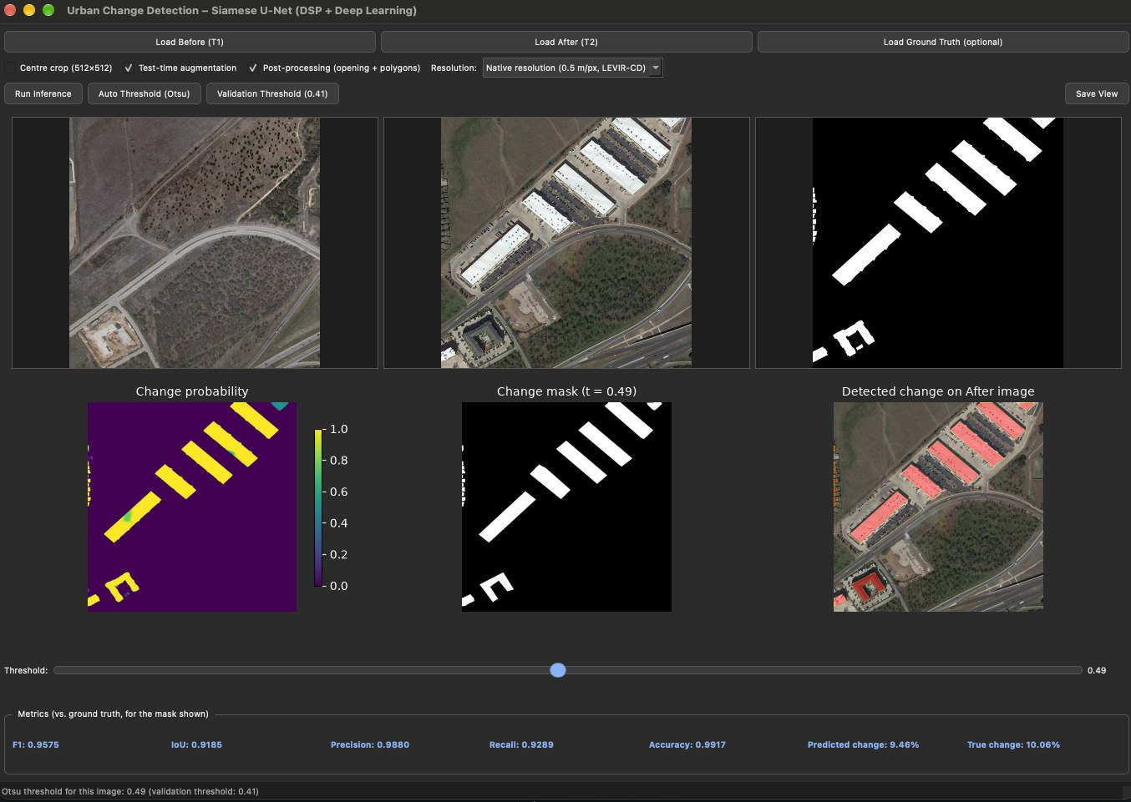
4. Implementation: Demonstration
PyQt5 desktop application
Load Before / After (and optional ground truth)
Model menu: v2 4-ch (final), v2 3-ch, old v1, two v1 + v2 ensembles
“Compare all models” – every model side by side on one pair
Overlay on the Before (default) or After image
Threshold slider, validation / Otsu presets; optional TTA
Live F1, IoU, precision, recall and changed-area %
Run: python app.py
Live run on test_102
EEE 312 (Jan 2026) — Section B2 — Group 04
DSP & Deep Learning-Based Urban Change Detection
Presented by: 2206122
‹#›
Notes:
[Md. Kawsar Ahmed (2206122) · about 33 s]
I am Md. Kawsar Ahmed, and this is our PyQt5 application. We load the before and after images and the ground truth, and press Run Inference; the model runs in a background thread, so the window never freezes. The Model menu lets us switch between the final model, the RGB-only model, our old model and two ensembles, and Compare all models shows them side by side. On this test image, the final model reaches 95.8 percent F1.

Slide 17
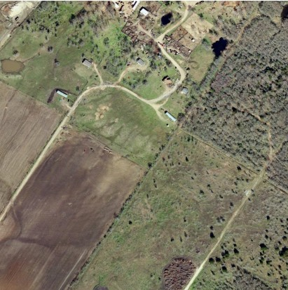
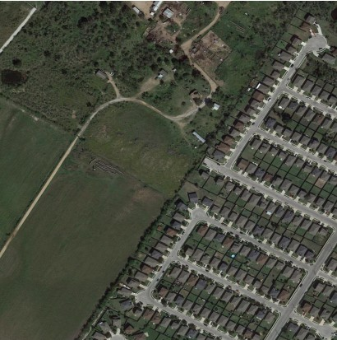
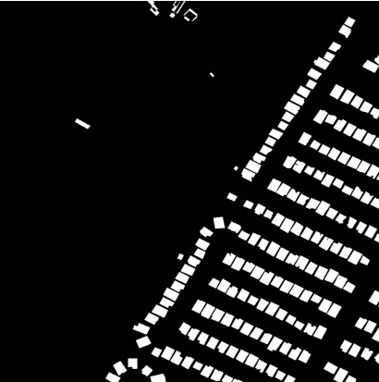
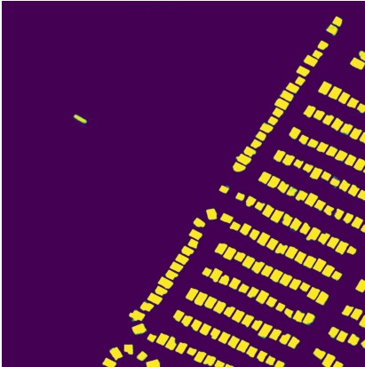
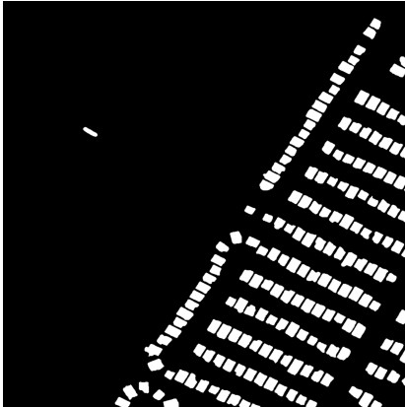
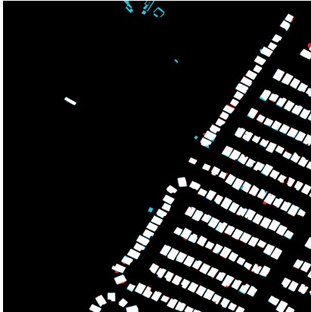
4.1 Results on the LEVIR-CD Test Set
Example test_100 — farmland turned into a housing estate (F1 0.939 · IoU 0.885)
Input: an empty field (T₁) becomes a dense estate of new houses and roads (T₂).
Probability map: high confidence on every new house, clean background.
Prediction: threshold t = 0.41 (chosen on validation) closely matches the ground truth.
Error map: white = correct, red = false alarm, cyan = miss; errors are thin 1–2 px rims on house outlines.
Result: precision 0.954, recall 0.925 — closely spaced houses are separated.
Before (T₁)
After (T₂)
Ground truth
Probability
Prediction
Errors
EEE 312 (Jan 2026) — Section B2 — Group 04
DSP & Deep Learning-Based Urban Change Detection
Presented by: 2206114
‹#›
Notes:
[Fahim Shahriyar (2206114) · about 19 s]
I am Fahim Shahriyar. Here an empty field has become a new housing estate. The probability map is confident on the new houses and clean on the background, and the error map shows mostly white, meaning correct pixels. F1 on this image is 0.939.

Slide 18
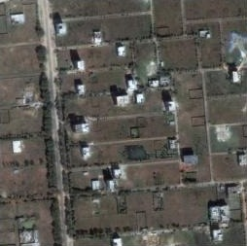
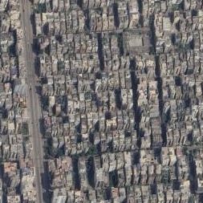
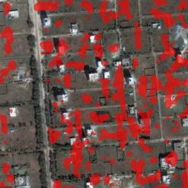
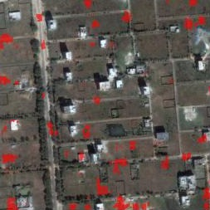
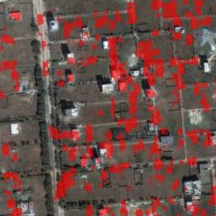
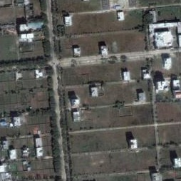
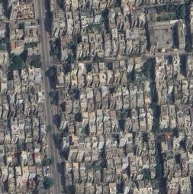
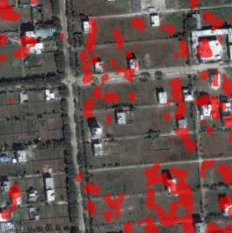
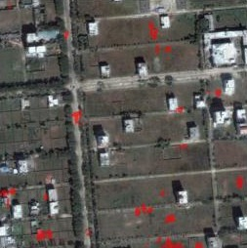
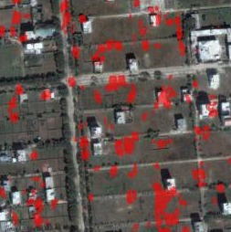
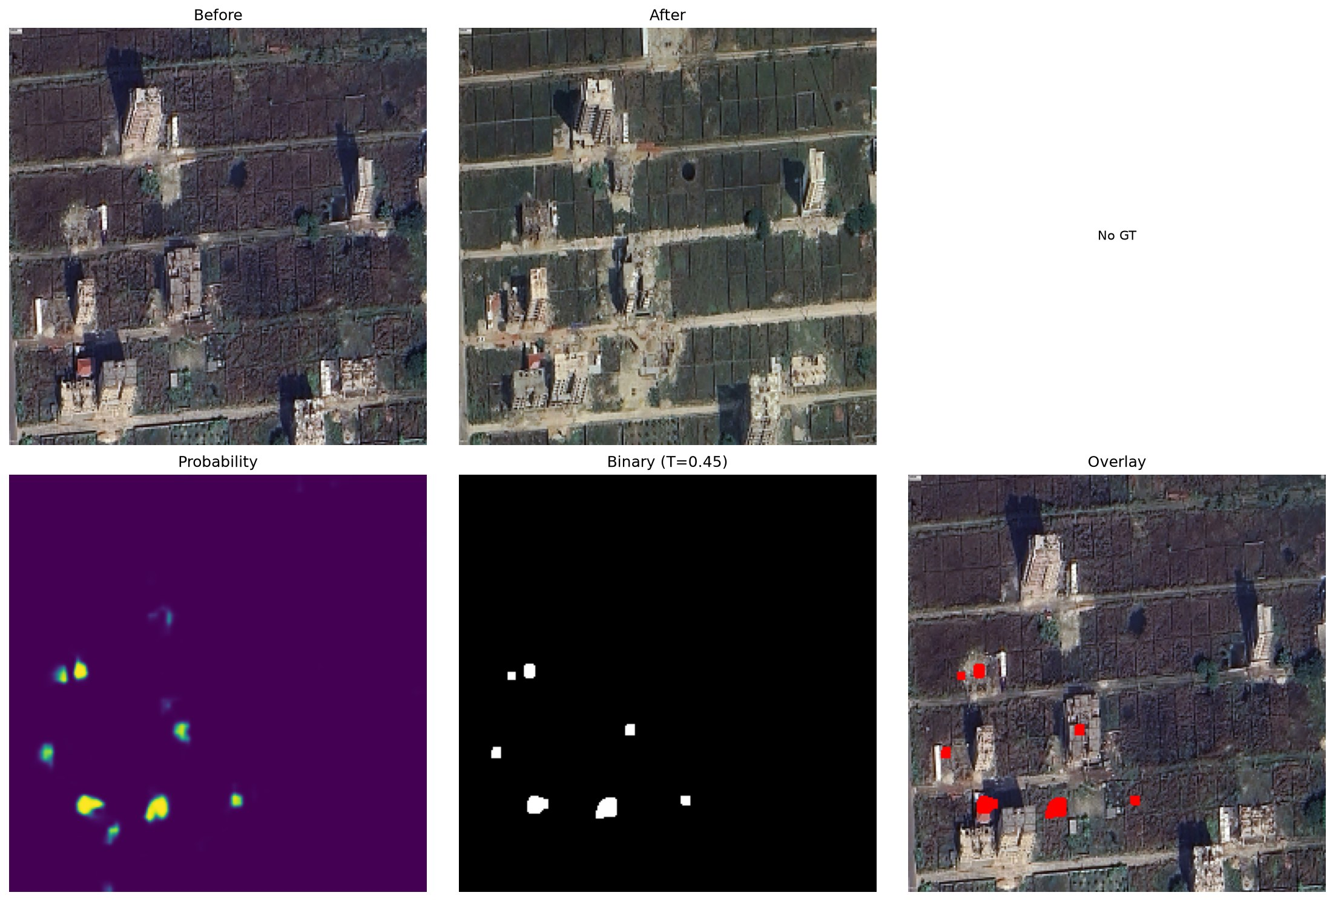
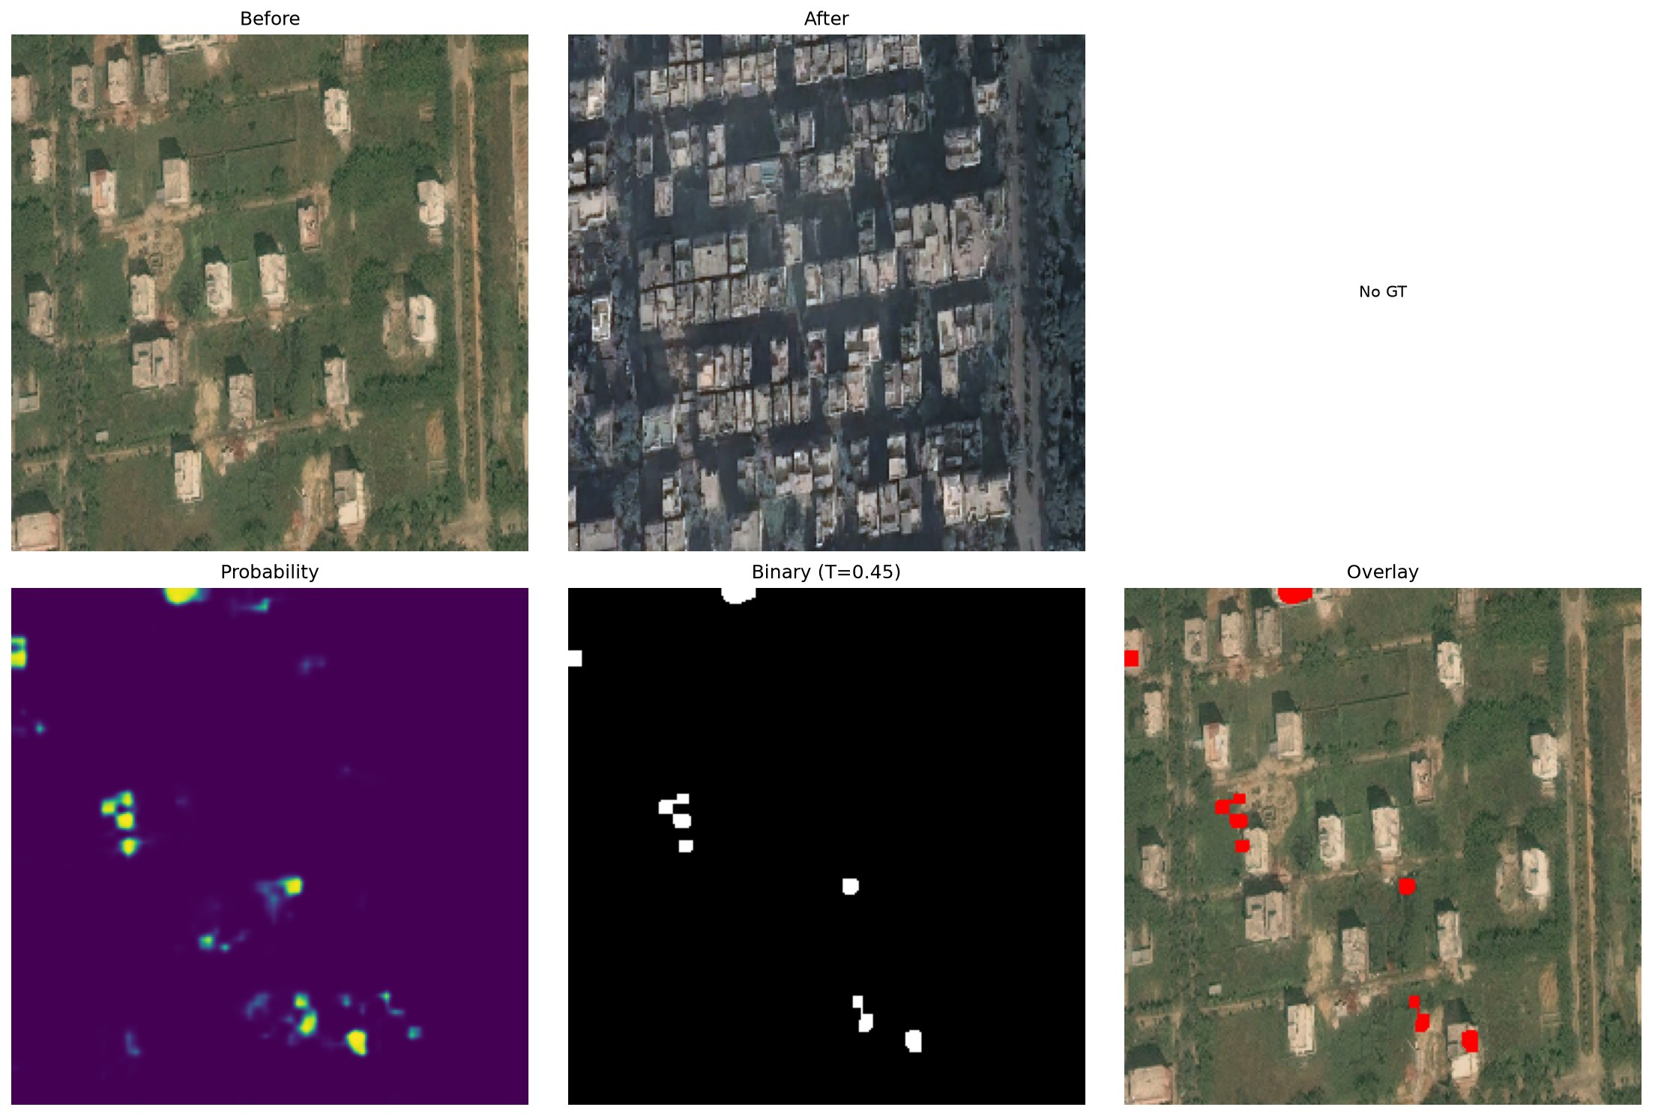
4.2 Bangladeshi Imagery: Old vs New Model
Purbachal, Dhaka — 12 image pairs (1024 × 1024), no ground truth available
Scene: open plots in T₁ became dense apartment blocks in T₂ – most of the area changed.
Old v1 model: marks 9.7 % of pixels, many on plots that are built up in T₂.
New v2 (4-ch): only 1.8 % – very conservative; RGB-only v2 marks 7.9 %.
Up-sampling ×2 / ×4 did not help → domain shift, not scale.
No labels: these cannot be scored – see WHU-CD in 5.3.
Before (T₁)
After (T₂)
v1 (old)
v2 4-ch
v2 3-ch
Rows: test_2 (top), test_5 (bottom). Red = detected change, drawn on the Before image.
Reading: v1 appears to catch more of the new construction here, but on labelled data it raised many false alarms; the real fix is labelled local data and fine-tuning.
EEE 312 (Jan 2026) — Section B2 — Group 04
DSP & Deep Learning-Based Urban Change Detection
Presented by: 2206114
‹#›
Notes:
[Fahim Shahriyar (2206114) · about 30 s]
We also tested twelve image pairs from Purbachal in Dhaka, where open plots became dense apartment blocks. Here our old model marks almost ten percent of the pixels as changed, while the final model marks under two percent, so the old model seems to catch more of the new construction. But these images have no labels, so we cannot score them, and making the input larger did not help.

Slide 19
5.1 Final Quantitative Results
128 LEVIR-CD test images · full 1024 × 1024 resolution · dataset-level metrics
91.17 %
Test F1-score
83.78 %
Test IoU
99.11 %
Overall accuracy
0.907
Cohen's κ
Error balance: false positives 0.41 % vs. false negatives 0.48 % of all pixels. No-change images: 0 false-alarm pixels on all 10. Threshold: 0.41, selected on the validation set only.
EEE 312 (Jan 2026) — Section B2 — Group 04
DSP & Deep Learning-Based Urban Change Detection
Presented by: 2206114
‹#›
Notes:
[Fahim Shahriyar (2206114) · about 20 s]
On all 128 test images the final model reaches 91.8 percent precision, 90.6 percent recall, 91.2 percent F1 and 83.8 percent IoU. False alarms and misses are balanced. F1 rises with the amount of change, from 84 percent for small changes to 92 percent for large ones.

Slide 20
5.2 Investigations (PO(d))
Controlled experiments on the same 128 test images, threshold 0.41
Configuration | Input | Test F1 (%) | Test IoU (%)
v1 – first model (resized 256², 3 bugs) | RGB + Canny | 77.12 | 62.76
v2 – final model, no TTA | RGB + Canny | 90.77 | 83.10
v2 – final model + TTA | RGB + Canny | 91.17 | 83.78
v2 – DSP ablation + TTA | RGB only | 91.63 | 84.56
DSP ablation
Removing the Canny channel did not lower F1 (91.63 % vs 91.17 %). The fixed edge channel gives no measurable gain on LEVIR-CD – the ImageNet encoder's first layer already learns edge filters.
Bug fixes (v1 → v2)
Batch-mixing in attention, a 255× weaker edge channel and 4× down-sampling: fixing them gave +14.05 F1.
Test-time augmentation
Averaging 4 flipped predictions: +0.40 F1, +0.68 IoU.
Theory vs experiment
IoU = F1 / (2 − F1) = 0.9117 / 1.0883 = 0.8378, identical to the measured 0.8378.
Threshold transfer
Validation-chosen 0.41 gives 0.9117 F1; best possible on test is 0.9118.
EEE 312 (Jan 2026) — Section B2 — Group 04
DSP & Deep Learning-Based Urban Change Detection
Presented by: 2206114
‹#›
Notes:
[Fahim Shahriyar (2206114) · about 21 s]
We ran controlled experiments. Fixing three bugs in our first version raised F1 from 77 to 91 percent, and test-time augmentation added 0.4 points. Our key finding: without the Canny channel, F1 did not drop; it was 91.6 percent with RGB only, because the encoder already learns edge filters itself.

Slide 21
5.3 Old vs New Model · 3-Channel vs 4-Channel Input
Same protocol: full resolution, thresholds from LEVIR-CD validation; WHU-CD never seen in training
Model | Input | LEVIR F1 | LEVIR IoU | WHU F1 | WHU IoU
v1 – old (256 px) | raw RGB + Canny | 78.21 | 64.21 | 66.72 | 50.06
v2 – final | RGB + Canny (4-ch) | 91.17 | 83.78 | 82.85 | 70.72
v2 – ablation | RGB only (3-ch) | 91.69 | 84.65 | 83.09 | 71.07
Ensemble average | v1 + v2 | 89.13 | 80.39 | 83.01 | 70.95
Ensemble max (union) | v1 + v2 | 87.18 | 77.27 | 76.81 | 62.35
Old model (v1)
Lowest F1 on both labelled sets. On WHU-CD its precision is only 57 % – many false alarms.
3 vs 4 channels
RGB only matches or beats RGB + Canny (+0.5 F1 on LEVIR-CD, +0.2 on WHU-CD): the fixed Canny channel adds no information.
Ensembles
Averaging v1 + v2 gives no real gain (−2.0 F1 on LEVIR-CD, +0.2 on WHU-CD); the union adds false alarms. Matching WHU's 0.3 m/px resolution gives v2 +1.8 F1.
WHU-CD: 638 labelled 512-px tiles, Christchurch, 0.3 m/px. v1 scores 77.12 % on LEVIR-CD when measured at 256 × 256 (5.2); here every model is scored at full resolution. RGB-only uses its own validation threshold (0.47).
EEE 312 (Jan 2026) — Section B2 — Group 04
DSP & Deep Learning-Based Urban Change Detection
Presented by: 2206119
‹#›
Notes:
[Md. Ahasan Habib Kawsar (2206119) · about 29 s]
To compare the old and new models fairly, we also tested on WHU-CD, a labelled dataset from New Zealand that neither model has seen. The final model reaches 82.9 percent F1 there, and the old model only 66.7 percent, with many false alarms. The RGB-only model is as good as the four-channel model on both datasets, and combining the old and new models gave no real gain.

Slide 22
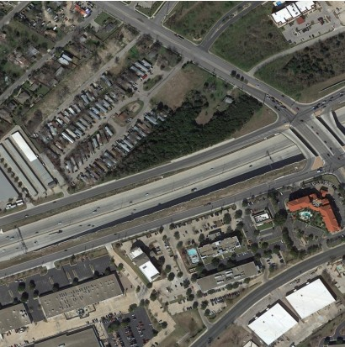
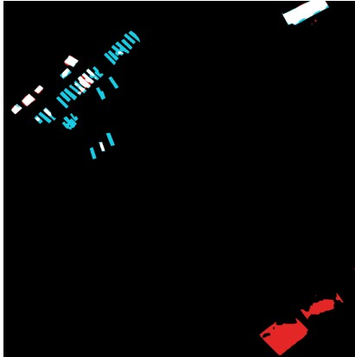
5.4 Limitations of Tools & Failure Modes (PO(e))
1. Small-structure misses
FN-dominated
Mobile homes only 3–5 px (1.5–2.5 m) wide are missed; the network needs ≈ 4 × 4 px to respond.
2. Pseudo-change alarms
FP-dominated
Re-roofed or resurfaced buildings look new between dates (label noise also contributes).
3. Tool & data limits
Scope
Trained on US suburbs only (0.5 m/px); no labels for Bangladeshi scenes; laptop GPU → batch 4, ≈ 5 h per run.
After (T₂)
Errors: red FP, cyan FN
Worst test image (test_103, F1 0.46)
Most images have < 0.5 % false-positive and < 0.5 % false-negative pixels.
EEE 312 (Jan 2026) — Section B2 — Group 04
DSP & Deep Learning-Based Urban Change Detection
Presented by: 2206114
‹#›
Notes:
[Fahim Shahriyar (2206114) · about 15 s]
Tiny mobile homes, only three to five pixels wide, are missed; re-roofed buildings are mistaken for new ones; and dense Bangladeshi scenes cause a domain shift. A laptop GPU allowed only batch size four.

Slide 23
5.5 Design Considerations (PO(c))
5.5.1 Public health & safety
Flags unauthorised construction in flood-prone and earthquake-risk zones
Rapid damage mapping after floods or cyclones
A miss can hide a hazard → output is decision support; a human verifies
5.5.2 Environment
Monitors encroachment on wetlands, farmland and green cover
Replaces field-survey trips with remote analysis
Trained on a laptop GPU in ≈ 5 h – small energy footprint
5.5.3 Cultural & societal needs
Supports city planners (e.g. RAJUK) with current maps
Threshold slider trades false alarms against misses
Must not be used to target informal settlements
Design response: human-in-the-loop threshold, polygon output for GIS, fully offline on an ordinary laptop.
EEE 312 (Jan 2026) — Section B2 — Group 04
DSP & Deep Learning-Based Urban Change Detection
Presented by: 2206104
‹#›
Notes:
[Mustasin Rahman (2206104) · about 17 s]
For public health and safety, the system can flag unauthorised construction in flood-prone or earthquake-risk areas and map damage after a disaster, but a human always verifies the output. It also monitors encroachment on wetlands and farmland without field trips.

Slide 24
5.6 Ethical Issues (PO(h))
Data and credit
Public LEVIR-CD used under its academic licence; every dataset, paper and library is cited.
1
Privacy and dual use
High-resolution imagery reveals private property – intended for planning and disaster response, not surveillance or forced eviction.
2
Honest evaluation
Test set never used for tuning; threshold chosen on validation; the v1 bugs, the negative DSP ablation and the failure cases are reported openly.
3
Transparency
Code and model are shared publicly; use of AI coding assistance is disclosed in the report.
4
EEE 312 (Jan 2026) — Section B2 — Group 04
DSP & Deep Learning-Based Urban Change Detection
Presented by: 2206104
‹#›
Notes:
[Mustasin Rahman (2206104) · about 21 s]
We used the public LEVIR-CD dataset under its licence and cite every source. High-resolution imagery can reveal private property, so the intended use is planning and disaster response, not surveillance or eviction. We never tuned on the test set, and we report our negative DSP result and failure cases openly.

Slide 25
6. Individual Contribution & Teamwork (PO(i))
Member | Student ID | Main contributions
Mustasin Rahman | 2206104 | Dataset preparation, DSP pre-processing (grayscale, Gaussian, Canny), augmentation
Fahim Shahriyar | 2206114 | Literature review, results & error analysis, failure-mode study, report writing
Md. Ahasan Habib Kawsar | 2206119 | Network architecture, training pipeline, v2 debugging, evaluation & ablations
Md. Kawsar Ahmed | 2206122 | PyQt5 GUI, inference & post-processing, video, GitHub and presentation
Mode of teamwork
Weekly meetings with a shared task list and one shared code folder
Every module reviewed and tested by a second member before merging
Training runs shared across members' laptops; decisions recorded in the project logbook
EEE 312 (Jan 2026) — Section B2 — Group 04
DSP & Deep Learning-Based Urban Change Detection
Presented by: 2206122
‹#›
Notes:
[Md. Kawsar Ahmed (2206122) · about 17 s]
Each member led one part: Mustasin the data and DSP pre-processing, Fahim the literature review and error analysis, Ahasan the network and training, and I built the GUI and inference pipeline. Every module was reviewed by a second member.

Slide 26
7. Communication to External Stakeholders (PO(j))
GitHub repository
github.com/ahasanhabibkawsar/EEE-312-Group-04-Urban-change-detection-DSP-deep-learning- — code, model (Releases), user manual
YouTube video
youtu.be/<video-id> — 10-minute project presentation
Video title
Urban Change Detection with DSP & Deep Learning | B2.04 | EEE 312 (Jan 2026) Project | Dept of EEE, BUET
Deliverables: detailed report, user manual (installation and GUI usage), recorded presentation, source code with a sanity-check script.
EEE 312 (Jan 2026) — Section B2 — Group 04
DSP & Deep Learning-Based Urban Change Detection
Presented by: 2206122
‹#›
Notes:
[Md. Kawsar Ahmed (2206122) · about 9 s]
Our code, trained model and user manual are on GitHub, and this video is on YouTube. The links are on this slide.

Slide 27
8. Future Work (PO(l))
Local dataset creation
Collect and annotate bi-temporal imagery of Dhaka to build a region-specific benchmark.
Fine-tuning & domain adaptation
Label Purbachal pairs and fine-tune v2; v1 flags 5× more change there, but it cannot be scored without labels.
1
2
Adaptive DSP features
Replace fixed Canny thresholds with learnable, multi-scale edge filters – the fixed channel gave no gain.
Dense & high-rise scenes
Improve robustness to shadows, off-nadir views and tightly packed buildings.
3
4
Semantic change detection
Classify the change type: new construction, demolition, extension.
Efficient deployment
Faster inference for large satellite scenes; GIS plug-in with polygon export.
5
6
EEE 312 (Jan 2026) — Section B2 — Group 04
DSP & Deep Learning-Based Urban Change Detection
Presented by: 2206122
‹#›
Notes:
[Md. Kawsar Ahmed (2206122) · about 17 s]
Next, we want to build a labelled dataset of Dhaka image pairs and fine-tune the model on it, learn adaptive edge filters instead of fixed Canny thresholds, classify the type of change, and deploy the tool for large-scale imagery.

Slide 28
9. References
[1] H. Chen and Z. Shi, “A spatial-temporal attention-based method and a new dataset for remote sensing image change detection,” Remote Sensing, vol. 12, no. 10, p. 1662, 2020.
[2] ITU-R Recommendation BT.601-7, “Studio encoding parameters of digital television for standard 4:3 and wide-screen 16:9 aspect ratios,” 2011.
[3] J. Canny, “A computational approach to edge detection,” IEEE Trans. Pattern Anal. Mach. Intell., vol. PAMI-8, no. 6, pp. 679–698, 1986.
[4] D. Marr and E. Hildreth, “Theory of edge detection,” Proc. R. Soc. Lond. B, vol. 207, no. 1167, pp. 187–217, 1980.
[5] R. C. Daudt, B. Le Saux, and A. Boulch, “Fully convolutional Siamese networks for change detection,” in Proc. IEEE ICIP, 2018.
[6] H. Chen, Z. Qi, and Z. Shi, “Remote sensing image change detection with transformers,” IEEE Trans. Geosci. Remote Sens., vol. 60, 2022.
[7] W. G. C. Bandara and V. M. Patel, “A transformer-based Siamese network for change detection,” in Proc. IEEE IGARSS, 2022.
[8] K. He, X. Zhang, S. Ren, and J. Sun, “Deep residual learning for image recognition,” in Proc. IEEE CVPR, 2016.
[9] O. Ronneberger, P. Fischer, and T. Brox, “U-Net: Convolutional networks for biomedical image segmentation,” in Proc. MICCAI, 2015.
[10] S. Xie and Z. Tu, “Holistically-nested edge detection,” in Proc. IEEE ICCV, 2015.
[11] F. Milletari, N. Navab, and S.-A. Ahmadi, “V-Net: Fully convolutional neural networks for volumetric medical image segmentation,” in Proc. 3DV, 2016.
[12] A. Paszke et al., “PyTorch: An imperative style, high-performance deep learning library,” in Proc. NeurIPS, 2019.
[13] G. Bradski, “The OpenCV library,” Dr. Dobb’s Journal of Software Tools, 2000.
EEE 312 (Jan 2026) — Section B2 — Group 04
DSP & Deep Learning-Based Urban Change Detection
Presented by: 2206122
‹#›
Notes:
[Md. Kawsar Ahmed (2206122) · about 3 s]
These are our references. Thank you for watching.

