Slide 1
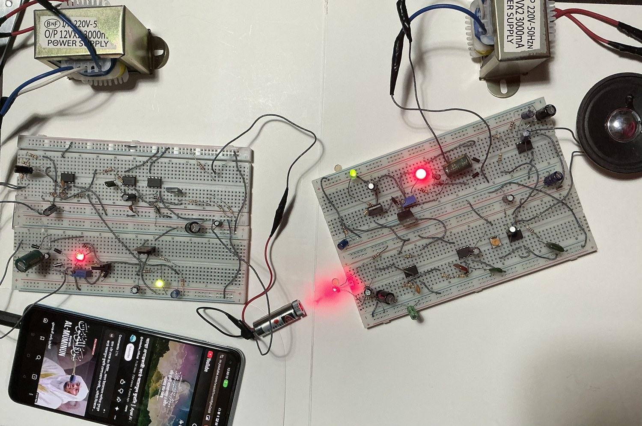






LI-FI:
AUDIO TRANSMISSION
OVER A LASER BEAM
EEE 310 – Communication System I Laboratory
September 2026 | Level 3 Term 1 | Section: B2
Final Project Demonstration
Submitted by – Group 5
Md. Mahedi Hasan Saikot
2206111
Md. Ahasan Habib Kawsar
2206119
MD. Saruwer Hossan Pial
2206099
Mustasin Rahman Ador
2206104
Md. Imran Shajid
2206120
Afnan Bin Obaid
2206121

Slide 2

Outline
1. Summary / Abstract
6. Team Work
2. Introduction
7. Communication to External Stakeholders
3. Design
8. Project Management and Cost Analysis
4. Implementation
9. References
5. Design Analysis and Evaluation
EEE 310 – Comm. System I Lab | Group 05
Li-Fi: Audio Transmission over a Laser Beam
Presented by: 2206111
2

Slide 3
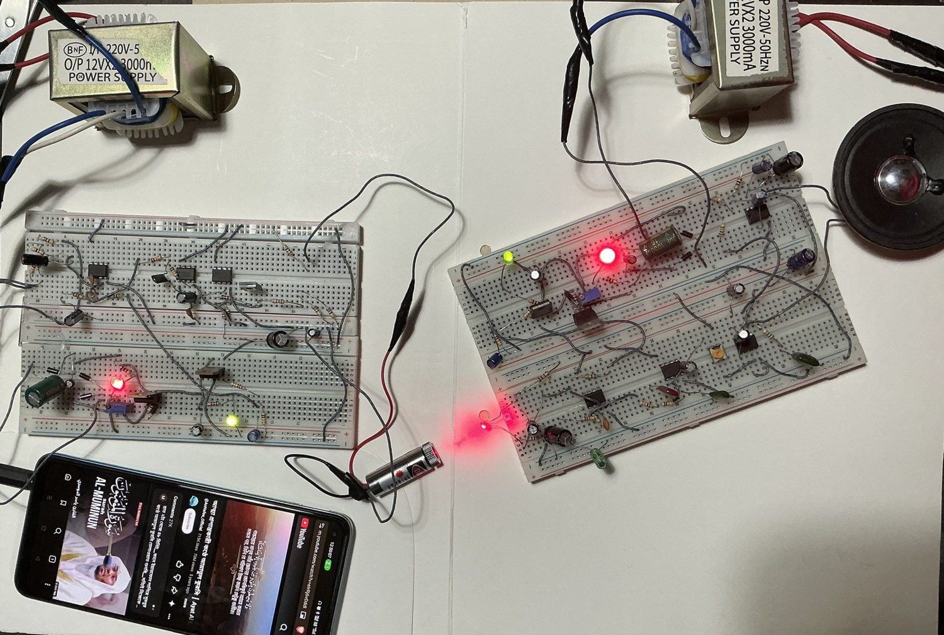
1. Summary / Abstract
An analog Li-Fi Link, sends audio through a free-space laser beam. no radio, no microcontroller, no firmware.
Transmitter amplifies, band-limits the audio, modulates the current of a 650 nm, 5 mW laser diode through a closed-loop constant-current driver (LM358 + BD135).
Receiver detects the modulated light with a BPW34 photodiode, amplifies and filters it, drives an 8 Ω loudspeaker through an LM386.
Simulated in PSpice, then built on two independent breadboards with separate 9 V supplies.
Measured result: intelligible speech and music over 10 m indoors, with a 3 dB bandwidth of about 40 Hz – 12 kHz.
The completed link in operation
EEE 310 – Comm. System I Lab | Group 05
Li-Fi: Audio Transmission over a Laser Beam
Presented by: 2206111
EEE 310 – Comm. System I Lab | Group 05
Li-Fi: Audio Transmission over a Laser Beam
Presented by: 2206119
3
3

Slide 4
2. Introduction
Why send sound on light?
Radio spectrum- congested, restricted in hospitals, aircraft, industrial plants.
Light- unlicensed, uncongested medium. Doesn’t pass through walls — the link is naturally confined to one room.
Solves Complex engineering problem: needs device physics (laser threshold, photodiode responsivity), analog feedback theory, communication-system reasoning about bandwidth and noise.
The modulated beam between transmitter and receiver
EEE 310 – Comm. System I Lab | Group 05
Li-Fi: Audio Transmission over a Laser Beam
Presented by: 2206111
EEE 310 – Comm. System I Lab | Group 05
Li-Fi: Audio Transmission over a Laser Beam
Presented by: 2206119
4
4

Slide 5
2. Introduction
Alternative solutions considered
Alternative | Advantage | Why not chosen
Bluetooth / Wi-Fi audio | Mature, robust, no alignment needed | congested radio spectrum; no optical content
Infrared LED link | Eye-safe, very cheap | Wide beam, low irradiance, short range
Optical fibre | Immune to ambient light, huge bandwidth | Guided medium ; doesn’t demonstrate free-space propagation
Digital (PWM / PCM) over light | Robust against ambient light | Needs high switching bandwidth and coding hardware
Analog intensity modulation (chosen) | Smallest component count; shows the full communication chain | Demands careful linearisation of the laser ; core design problem
Direct analog intensity modulation was selected because it exposes the linearity and noise problems that make optical communication interesting, with the fewest parts.
EEE 310 – Comm. System I Lab | Group 05
Li-Fi: Audio Transmission over a Laser Beam
Presented by: 2206111
EEE 310 – Comm. System I Lab | Group 05
Li-Fi: Audio Transmission over a Laser Beam
Presented by: 2206119
5
5

Slide 6
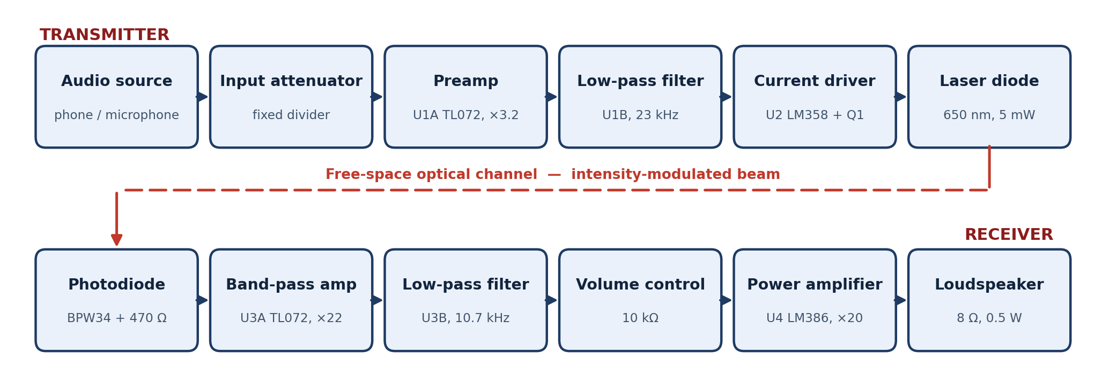
3.1 Design Methods (PO(a))
System architecture
Transmitter: fixed attenuator → preamp (U1A, ×3.2) → Sallen-Key LPF (U1B, 23 kHz) → constant-current laser driver (U2 + Q1).
Receiver: BPW34 photodiode + 470 Ω → band-pass amplifier (U3A,×22) → Sallen-Key LPF (U3B,10.7 kHz) → LM386 → 8 Ω speaker.
Filters are staggered, not duplicated: the sharper filter sits at the receiver, where the noise is actually generated.
EEE 310 – Comm. System I Lab | Group 05
Li-Fi: Audio Transmission over a Laser Beam
Presented by: 2206111-119
EEE 310 – Comm. System I Lab | Group 05
Li-Fi: Audio Transmission over a Laser Beam
Presented by: 2206119
6
6

Slide 7

3.1 Design Methods (PO(a))
Applying the mathematics
Linear optical modulation
Popt ≈ η (I − Ith)
A laser emits only above threshold, so it must be biased above I_th and modulated in current, not voltage.
Constant-current driver
Ilaser = Vin / R11
Feedback makes the current independent of the laser I–V curve, temperature and transistor β.
V_bias = 9 × 10/(68+10) = 1.154 V → 30 mA with R11 = 38 Ω
Sallen-Key filters
fc =$\frac{1}{\text{(2}\text{π} \text{R}\text{ √(}\text{C}\text{1}\text{C}\text{2)}}$ , Q = ½√(C1/C2)
Transmitter: 10 kΩ, 1 nF, 470 pF → 23 kHz, Q = 0.73
Receiver: 10 kΩ, 2.2 nF, 1 nF → 10.7 kHz, Q = 0.74
Detector bandwidth and gain
f = 1/(2π R18 Cj) ≈ 13.5 kHz
R18 = 470 Ω balances signal against bandwidth.
U3A gain = 1 + 47k/2.2k ≈ 22; C13 sets a 154 Hz high-pass that rejects 100 Hz lamp flicker.
EEE 310 – Comm. System I Lab | Group 05
Li-Fi: Audio Transmission over a Laser Beam
Presented by: 2206119
EEE 310 – Comm. System I Lab | Group 05
Li-Fi: Audio Transmission over a Laser Beam
Presented by: 2206119
7
7

Slide 8
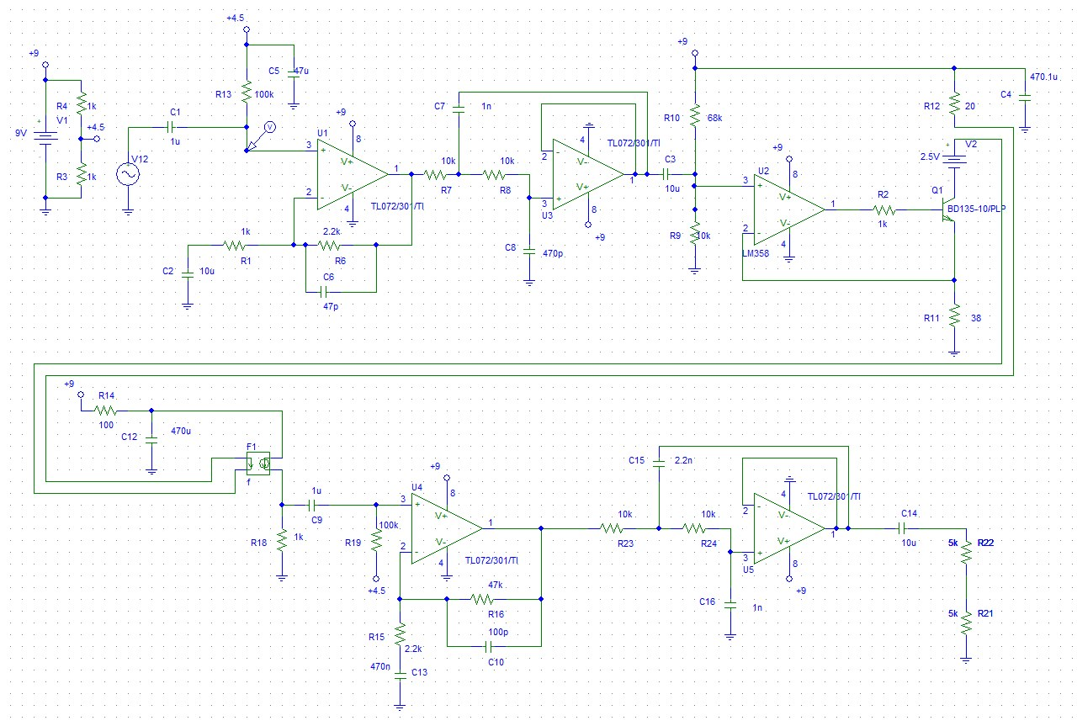
3.2 Design: Circuit Diagram
Complete link: transmitter (top) and receiver (bottom). F1 models the optical channel as a current-controlled current source.
EEE 310 – Comm. System I Lab | Group 05
Li-Fi: Audio Transmission over a Laser Beam
Presented by: 2206119
EEE 310 – Comm. System I Lab | Group 05
Li-Fi: Audio Transmission over a Laser Beam
Presented by: 2206119
8
8

Slide 9
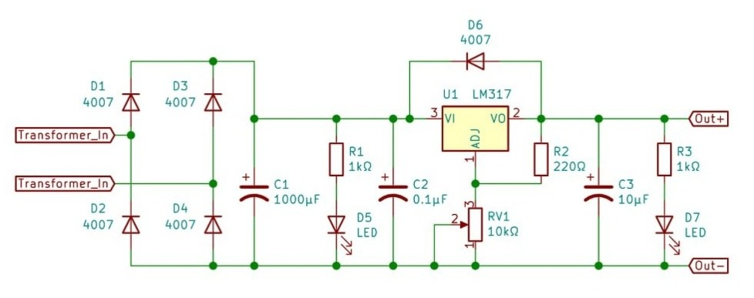
3.2 Design: Power Supply
Bench supply built by the group
12 V step-down transformer with a 1N4007 bridge rectifier.
1000 µF reservoir capacitor, then an LM317 adjustable regulator.
A fixed 7809 regulator provides the 9 V rail for the boards.
Transmitter and receiver are powered separately — no common ground path, which removes hum from the audio.
Measured: transmitter 8.83 V; receiver 7.96 V at 10.48 mA.
EEE 310 – Comm. System I Lab | Group 05
Li-Fi: Audio Transmission over a Laser Beam
Presented by: 2206119
EEE 310 – Comm. System I Lab | Group 05
Li-Fi: Audio Transmission over a Laser Beam
Presented by: 2206119
9
9

Slide 10
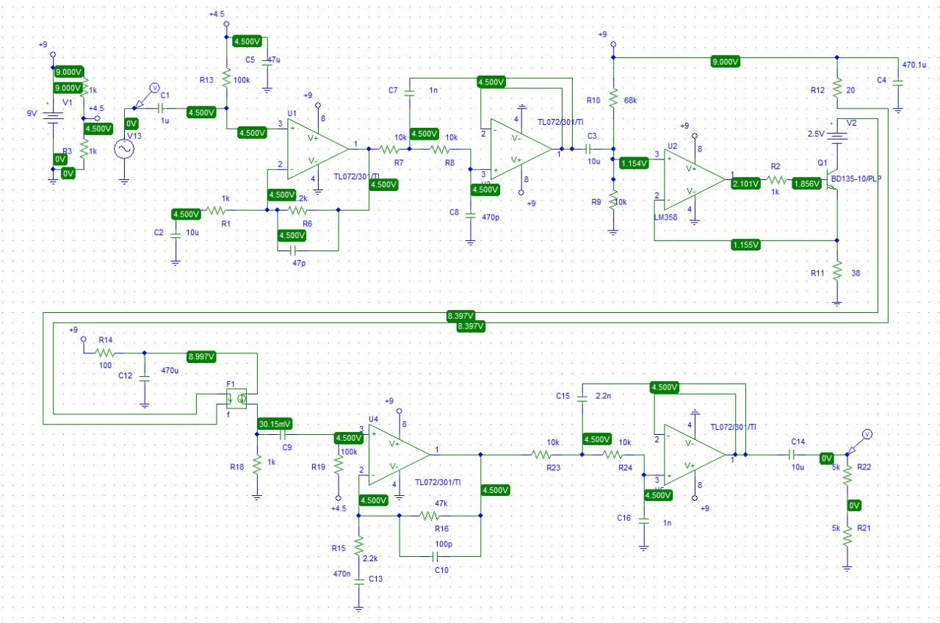
3.3 Design: Simulation
Bias point analysis
Mid-rail reference sits at 4.500 V, as designed.
U2 pin 3 at 1.154 V and Q1 emitter at 1.155 V — the current feedback loop is closing correctly.
Simulated laser current: 1.155 V / 38 Ω ≈ 30 mA, above threshold and below the 40 mA rating.
Q1 stays in the active region with adequate collector-emitter headroom.
EEE 310 – Comm. System I Lab | Group 05
Li-Fi: Audio Transmission over a Laser Beam
Presented by: 2206119
EEE 310 – Comm. System I Lab | Group 05
Li-Fi: Audio Transmission over a Laser Beam
Presented by: 2206119
10
10

Slide 11
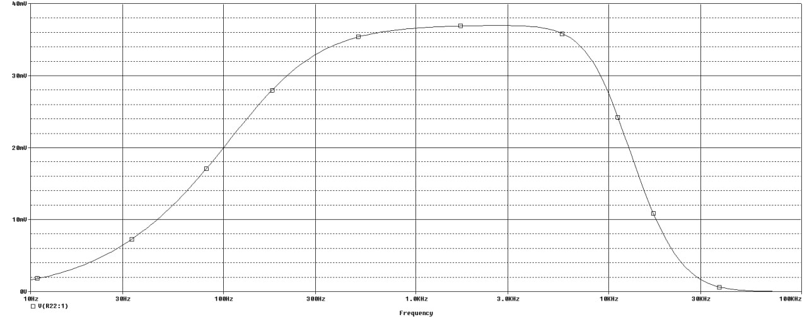
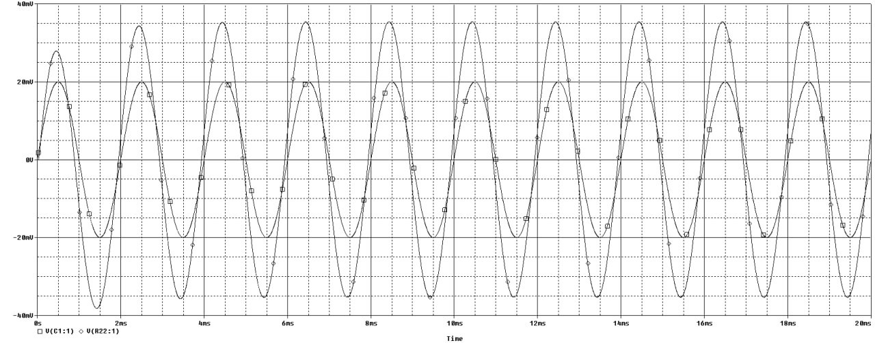
3.3 Design: Simulation
Frequency and transient response
AC sweep of the whole link
Transient: input vs recovered output
The passband is flat through the mid-band; the receiver filter sets the upper corner near 10.7 kHz.
Below a few hundred hertz the AC-coupling networks roll the response off — this is what rejects ambient-light flicker.
The recovered transient waveform is a clean sinusoid with no flattening of either peak: the laser stays above threshold and no stage clips.
EEE 310 – Comm. System I Lab | Group 05
Li-Fi: Audio Transmission over a Laser Beam
Presented by: 2206119
EEE 310 – Comm. System I Lab | Group 05
Li-Fi: Audio Transmission over a Laser Beam
Presented by: 2206119
11
11

Slide 12
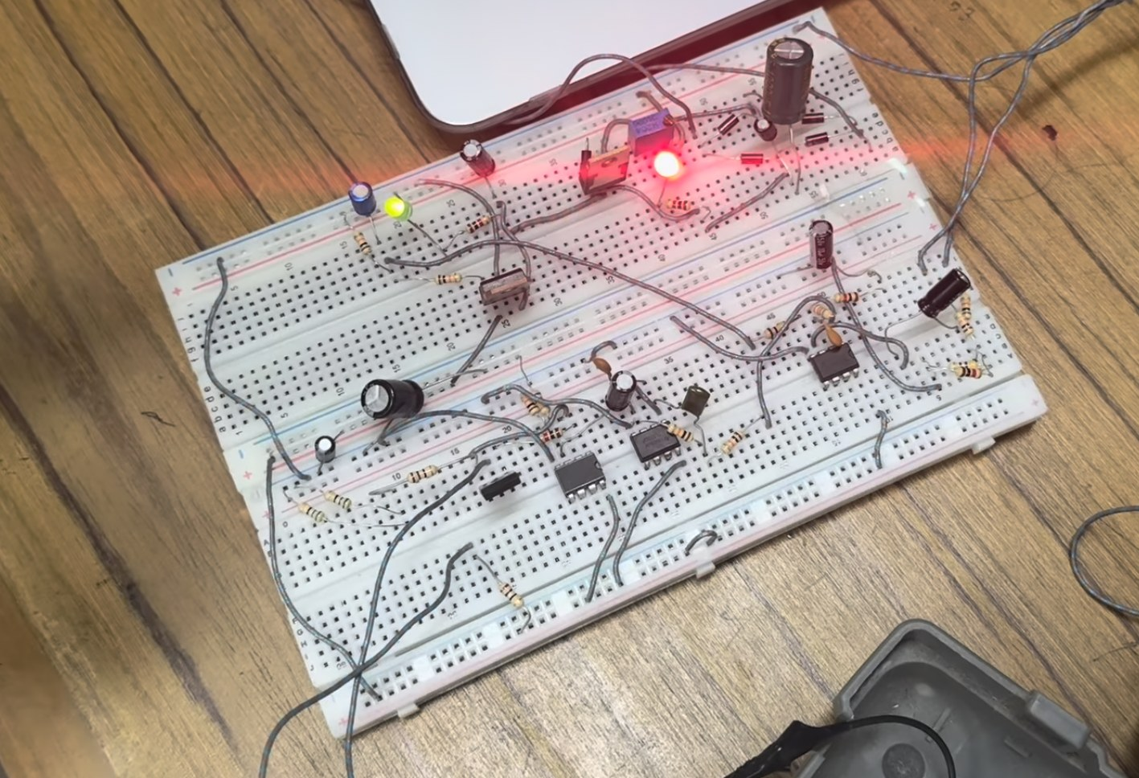
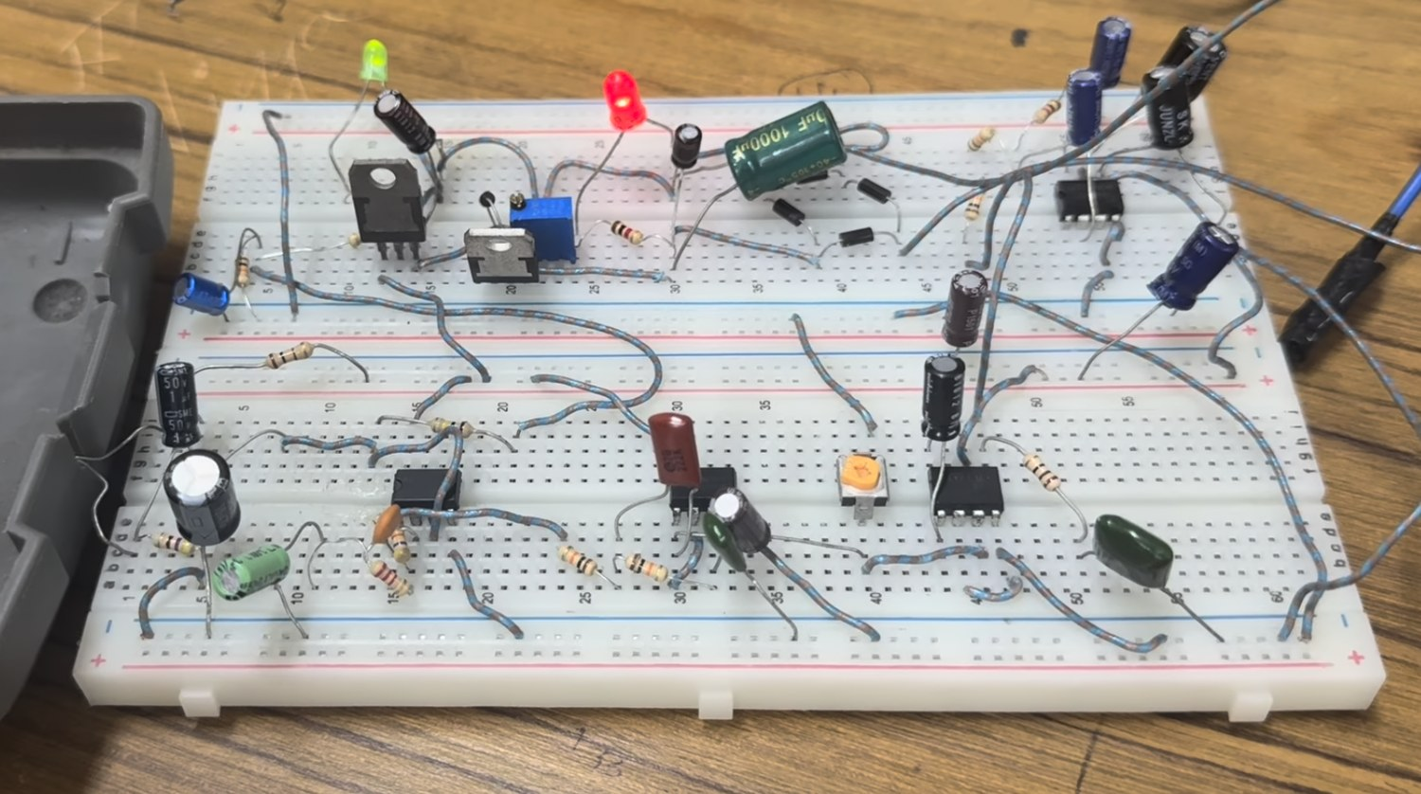
3.4 Design: Hardware Implementation
Receiver board — photodiode front end, filter and LM386
Transmitter board — laser module under modulation
Two independent breadboards, each with its own 9 V supply, ground and decoupling.
Every IC has a 100 nF ceramic at its supply pin; the photodiode stage is fed through 100 Ω + 470 µF so speaker current cannot modulate it.
EEE 310 – Comm. System I Lab | Group 05
Li-Fi: Audio Transmission over a Laser Beam
Presented by: 2206119
EEE 310 – Comm. System I Lab | Group 05
Li-Fi: Audio Transmission over a Laser Beam
Presented by: 2206119
12
12

Slide 13
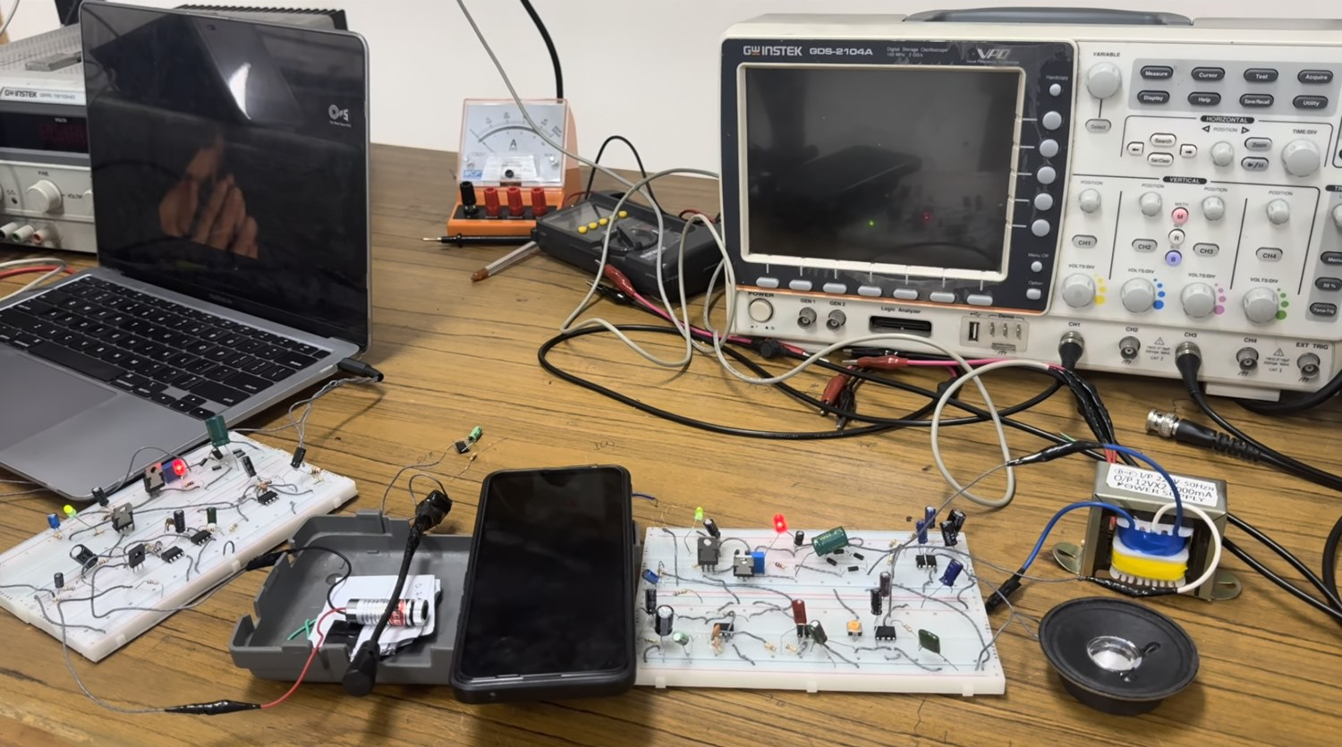
4. Implementation: Demonstration
Audio source, transmitter, optical path, receiver, loudspeaker and instrumentation
Audio plays from a laptop or phone (or the on-board microphone), travels the bench as a modulated beam, and is reproduced by the loudspeaker at the far end.
EEE 310 – Comm. System I Lab | Group 05
Li-Fi: Audio Transmission over a Laser Beam
Presented by: 2206119
EEE 310 – Comm. System I Lab | Group 05
Li-Fi: Audio Transmission over a Laser Beam
Presented by: 2206119
13
13

Slide 14
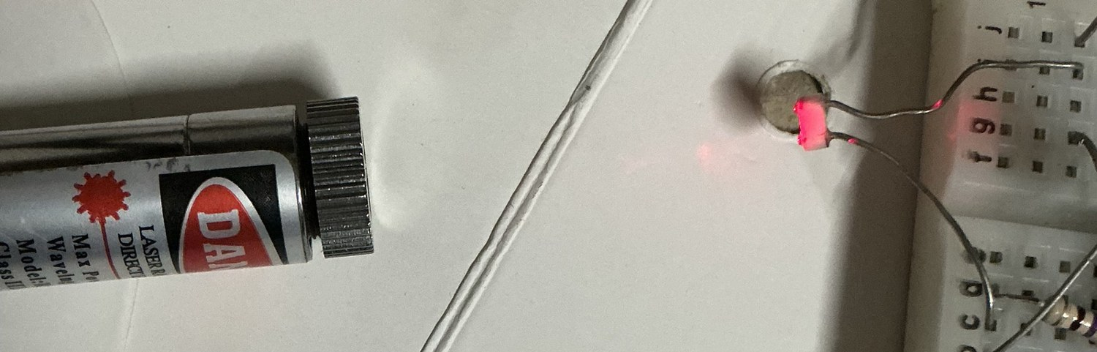
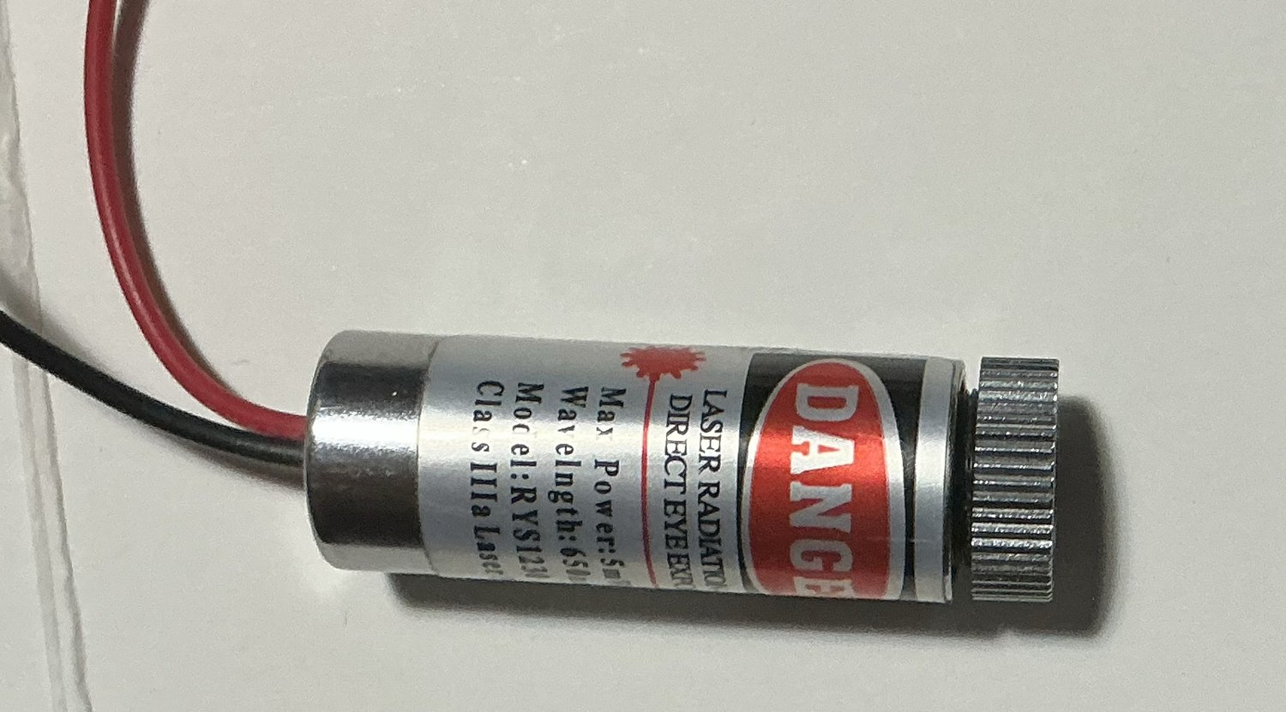
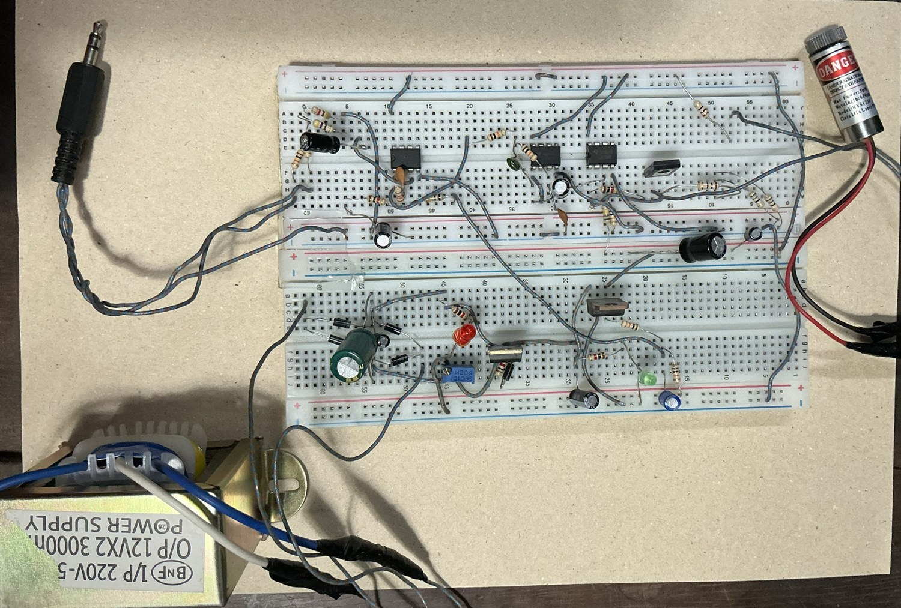
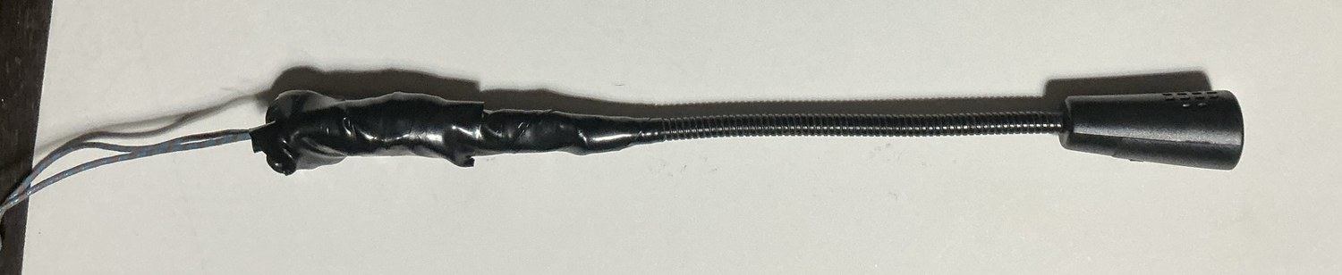
4.1 Implementation: Photo Gallery
Link operating with the beam visible
Laser spot on the photodiode active area
Electret microphone input
650 nm, 5 mW laser module
Transmitter with 3.5 mm audio socket
EEE 310 – Comm. System I Lab | Group 05
Li-Fi: Audio Transmission over a Laser Beam
Presented by: 2206099
EEE 310 – Comm. System I Lab | Group 05
Li-Fi: Audio Transmission over a Laser Beam
Presented by: 2206119
14
14

Slide 15
5. Design Analysis and Evaluation
5.1 Novelty
5.2 Design Considerations (PO(c))
5.3 Investigations (PO(d))
5.4 Impact Assessment (PO(f))
5.5 Sustainability and Environmental Impact Evaluation (PO(g))
EEE 310 – Comm. System I Lab | Group 05
Li-Fi: Audio Transmission over a Laser Beam
Presented by: 2206099
EEE 310 – Comm. System I Lab | Group 05
Li-Fi: Audio Transmission over a Laser Beam
Presented by: 2206119
15
15

Slide 16
5.1 Novelty
The laser is treated as a current-controlled device inside a feedback loop, not as a lamp switched by a voltage.
  Most student Li-Fi demonstrations drive the optical source straight from an audio amplifier; the source then switches off on negative half-cycles and the sound is audibly distorted.
  Here an op-amp servo-controls the laser current, so optical power follows the message linearly over the whole cycle.
Filters are staggered between the two units rather than duplicated - noise is removed where it is generated, without narrowing the useful band.
Ambient-light immunity comes from a deliberate 154 Hz high-pass corner that rejects 100 Hz lamp flicker, not from shielding alone.
The input level is fixed by a resistive divider instead of a potentiometer, so modulation depth — and laser safety — is independent of the user.
Fully analog: no microcontroller, no firmware. Behaviour is predictable from circuit theory and verifiable by simulation.
EEE 310 – Comm. System I Lab | Group 05
Li-Fi: Audio Transmission over a Laser Beam
Presented by: 2206099
EEE 310 – Comm. System I Lab | Group 05
Li-Fi: Audio Transmission over a Laser Beam
Presented by: 2206119
16
16

Slide 17
5.2 Design Considerations (PO(c))
Public health and safety
Environment
Cultural and societal needs
5 mW, 650 nm laser is Class 3R - direct viewing can injure the retina.
Beam kept below eye level, terminated at the detector, never aimed at a person.
Reflective objects kept out of the beam path.
The current driver limits the laser to below its 40 mA rating under all signal conditions.
Boards run at 9 V; the mains-connected bench supply is isolated by a transformer.
Reusable breadboards and through-hole parts - no PCB etching chemicals, no permanent e-waste.
Receiver draws 10.48 mA at 7.96 V ≈ 83 mW; the whole link runs on under a quarter of a watt.
Laser module rated for over 2000 hours, which limits the replacement rate.
Every component is available in local Dhaka markets for a few hundred taka.
Reproducible by any undergraduate group - suitable as a low-cost teaching demonstrator.
Serves places where radio is restricted: hospitals, industrial areas, secure rooms.
EEE 310 – Comm. System I Lab | Group 05
Li-Fi: Audio Transmission over a Laser Beam
Presented by: 22060999
EEE 310 – Comm. System I Lab | Group 05
Li-Fi: Audio Transmission over a Laser Beam
Presented by: 2206119
17
17

Slide 18
5.3 Investigations (PO(d))
Design of experiment and DC measurements
Signal-chain tracing — waveform observed at four successive points to confirm each stage works without clipping.
Frequency response — constant-amplitude tone swept from 40 Hz to 13 kHz, output amplitude recorded.
Ambient-light sensitivity — recovered waveform compared with room lights dim and with a lamp beside the receiver.
Detector comparison and range — phototransistor vs bare photodiode vs shrouded photodiode; maximum usable distance found by listening.
Instrument: GW Instek GDS-2104A 100 MHz DSO; source: MacBook headphone output measured at 0.5 V RMS.
Quantity | Measured
Transmitter supply voltage | 8.83 V
Receiver supply voltage | 7.96 V
Receiver supply current | 10.48 mA
Laser bias current | 7.75 mA
Laser peak current | ≈ 10 mA
Laser forward voltage | 2.06 V
Range (indoors) | ≈ 10 m verified
EEE 310 – Comm. System I Lab | Group 05
Li-Fi: Audio Transmission over a Laser Beam
Presented by: 2206104
EEE 310 – Comm. System I Lab | Group 05
Li-Fi: Audio Transmission over a Laser Beam
Presented by: 2206119
18
18

Slide 19
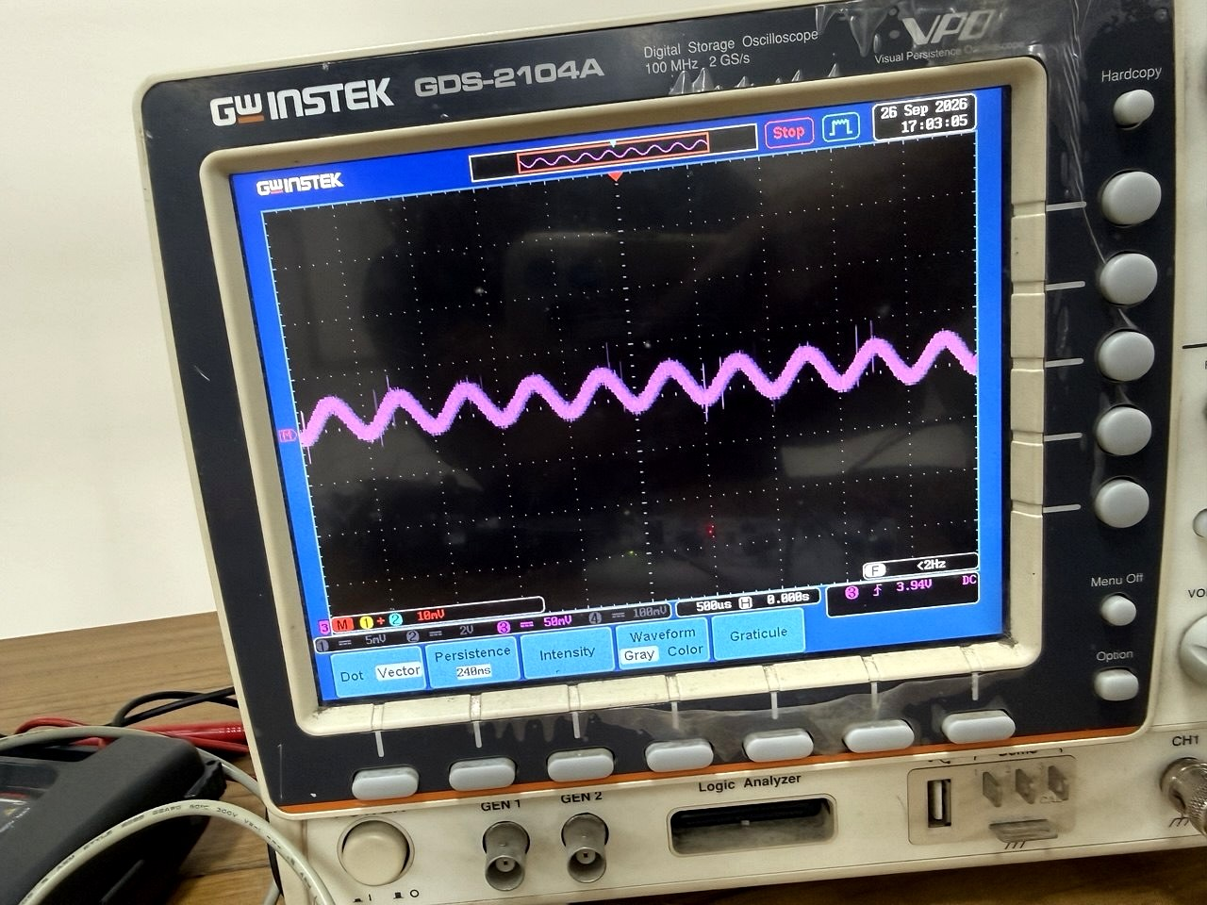
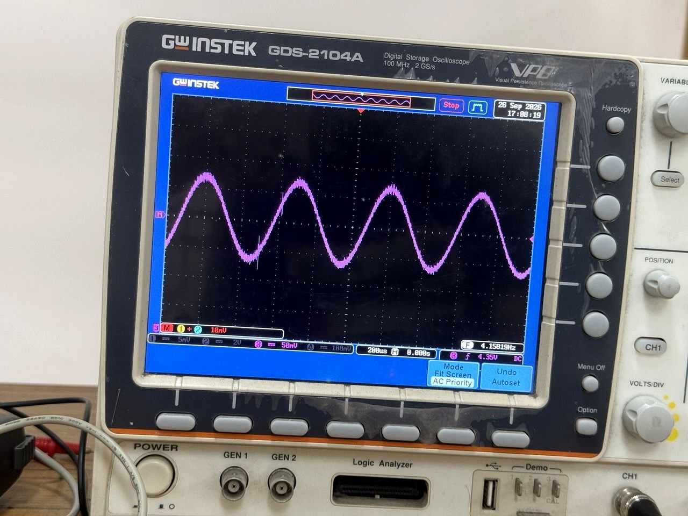
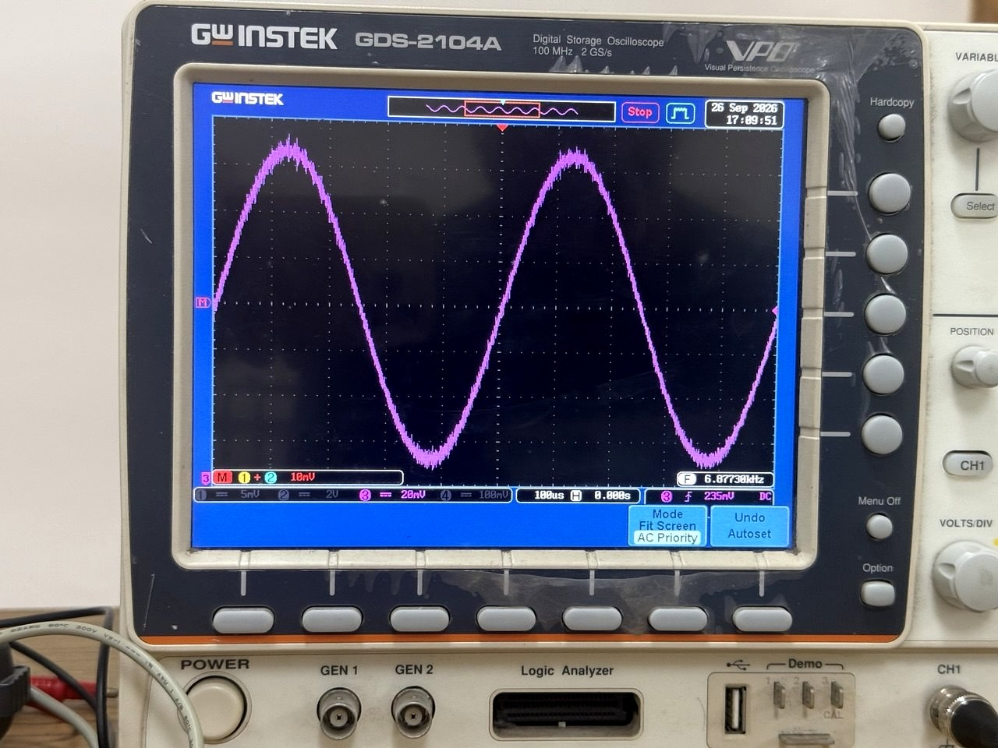
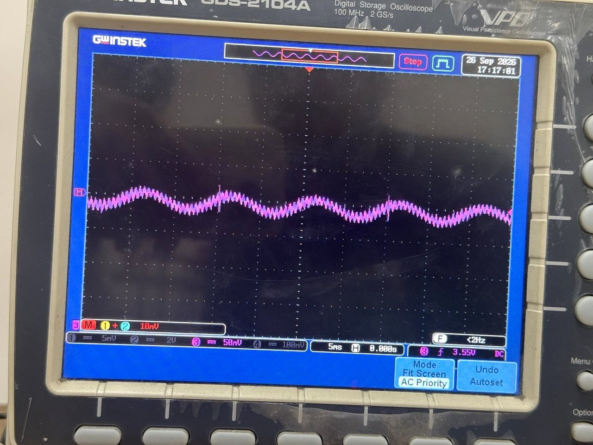
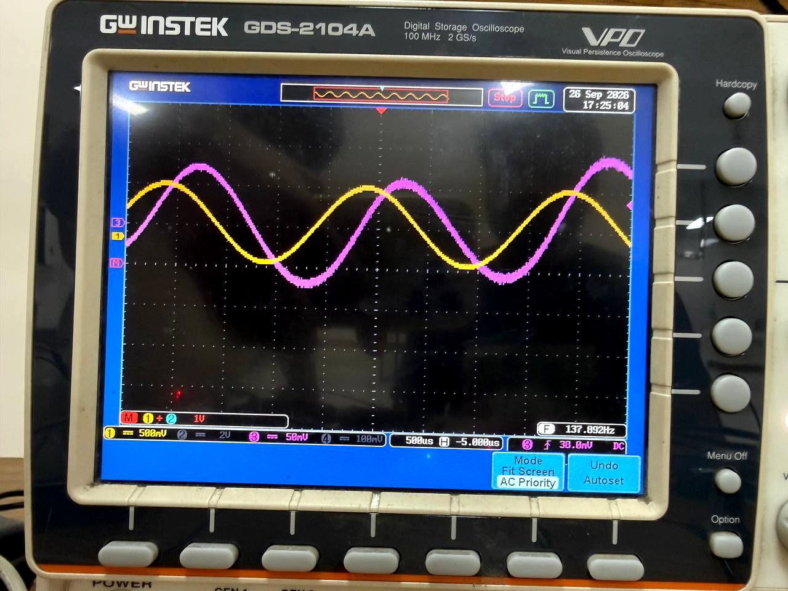
5.3 Investigations (PO(d))
Signal traced through the link
Audio in at U1A pin 3
Filtered audio at U1B pin 7
Voltage across R11 = laser current
Recovered signal at the photodiode
Transmitted (yellow) and recovered (magenta) waveforms on one screen
EEE 310 – Comm. System I Lab | Group 05
Li-Fi: Audio Transmission over a Laser Beam
Presented by: 2206104
EEE 310 – Comm. System I Lab | Group 05
Li-Fi: Audio Transmission over a Laser Beam
Presented by: 2206119
19
19

Slide 20
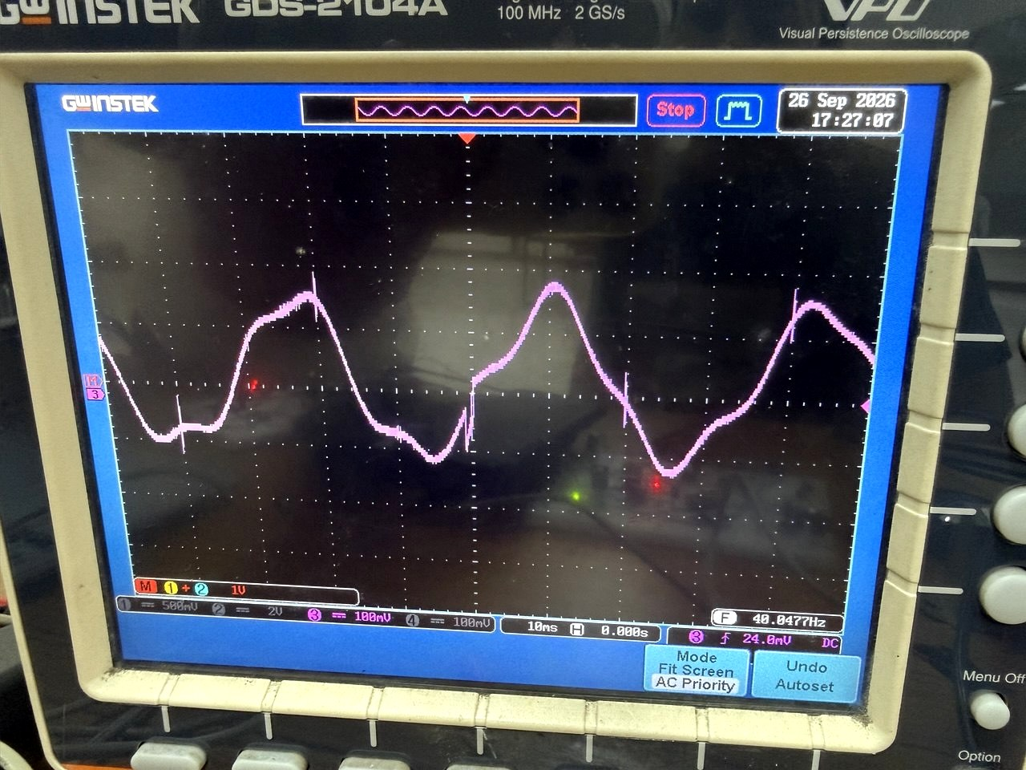
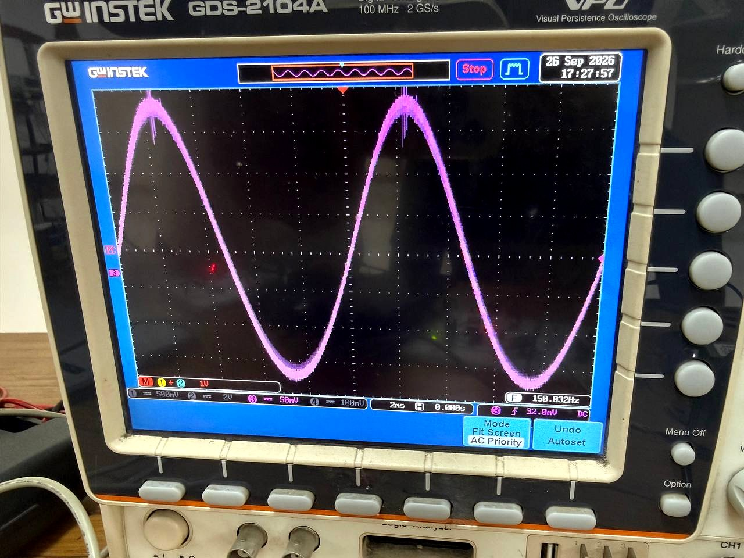
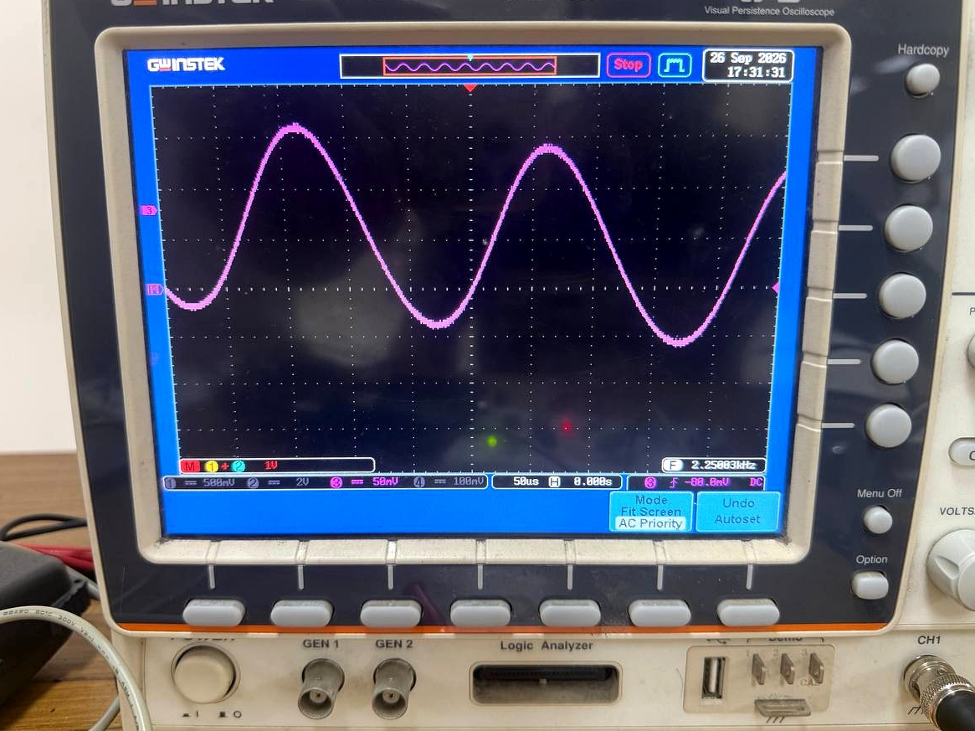
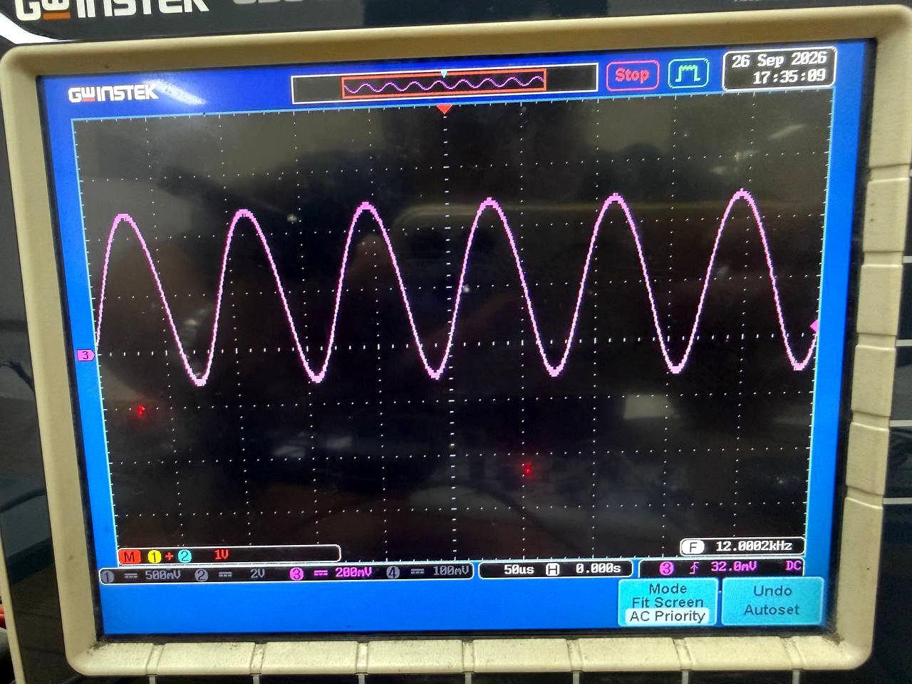
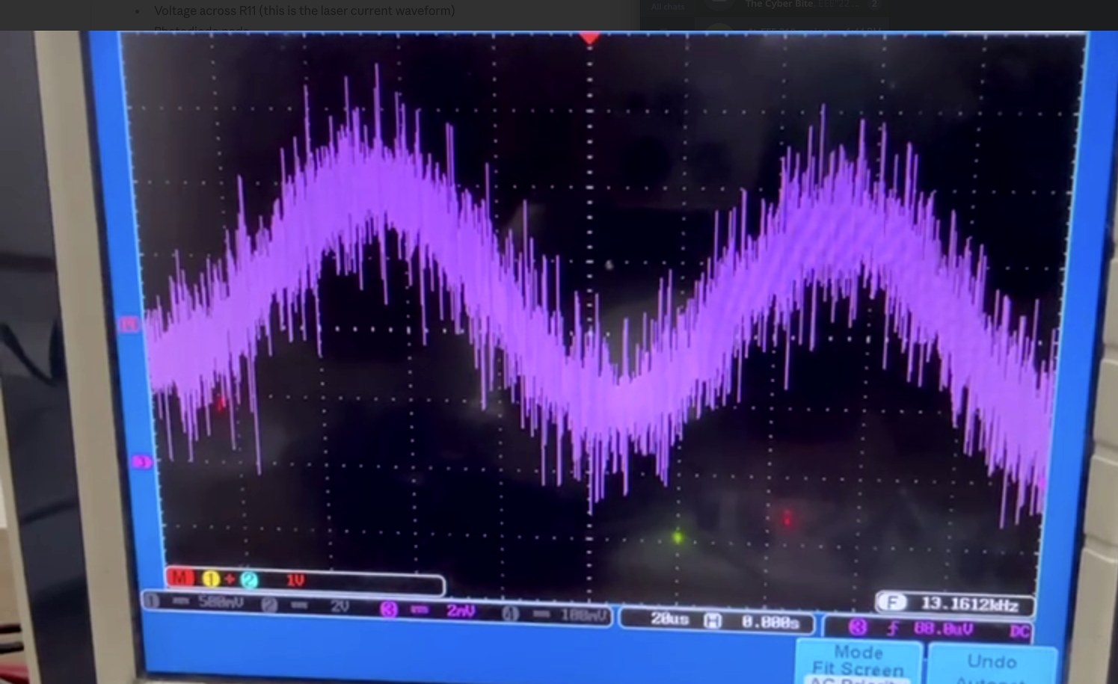
5.3 Investigations (PO(d))
Measured frequency response: 40 Hz to 13 kHz
40 Hz — lower band edge
150 Hz
2.25 kHz — flat mid-band
12 kHz — upper band edge
13 kHz — beyond cut-off, noise dominates
EEE 310 – Comm. System I Lab | Group 05
Li-Fi: Audio Transmission over a Laser Beam
Presented by: 2206104
EEE 310 – Comm. System I Lab | Group 05
Li-Fi: Audio Transmission over a Laser Beam
Presented by: 2206119
20
20

Slide 21
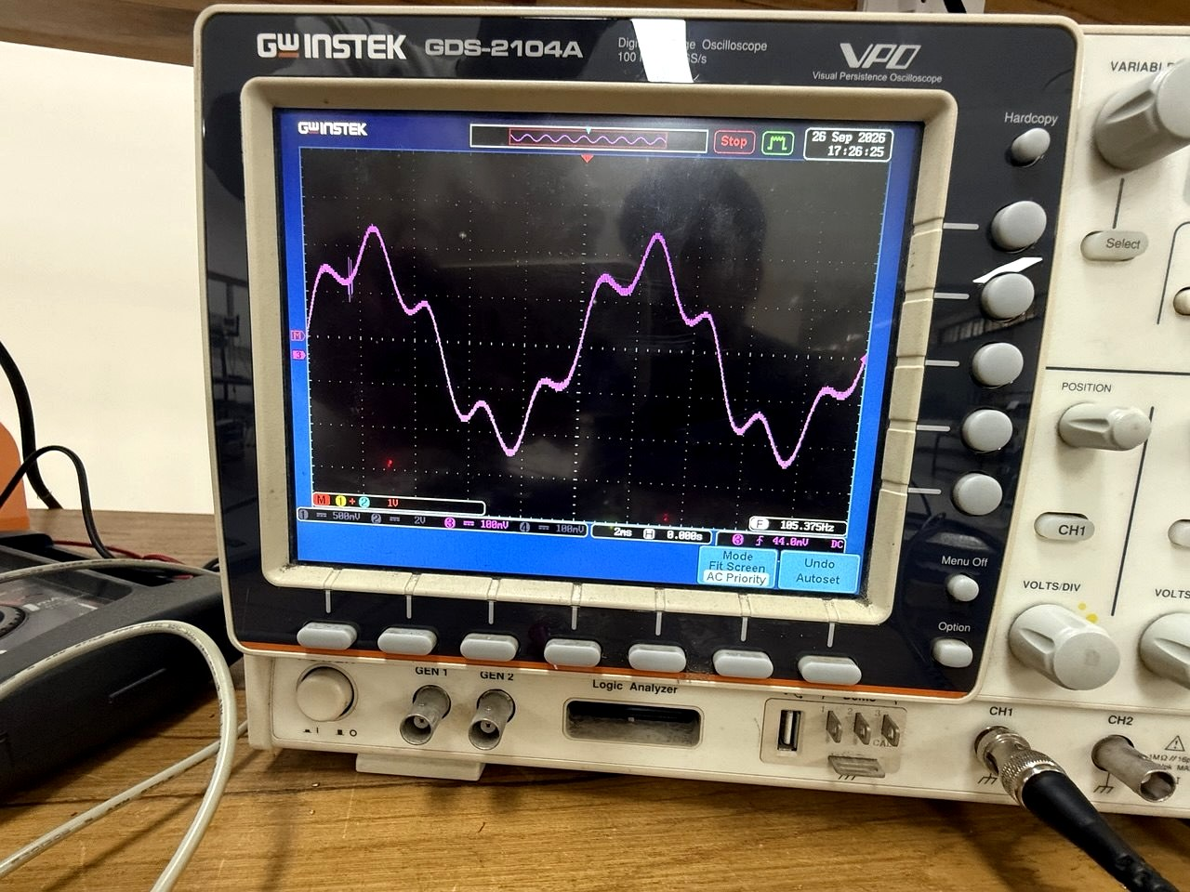
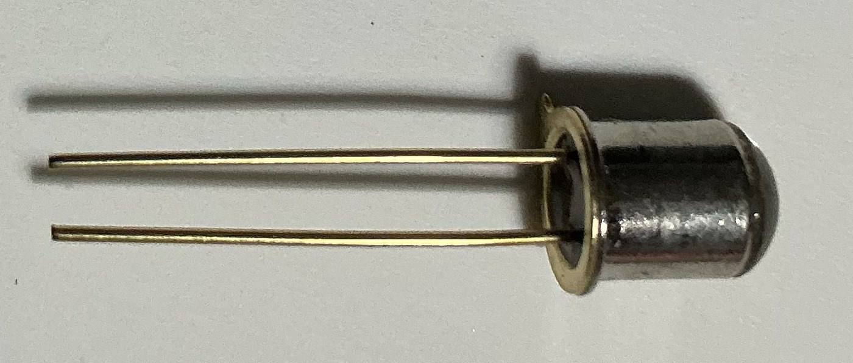
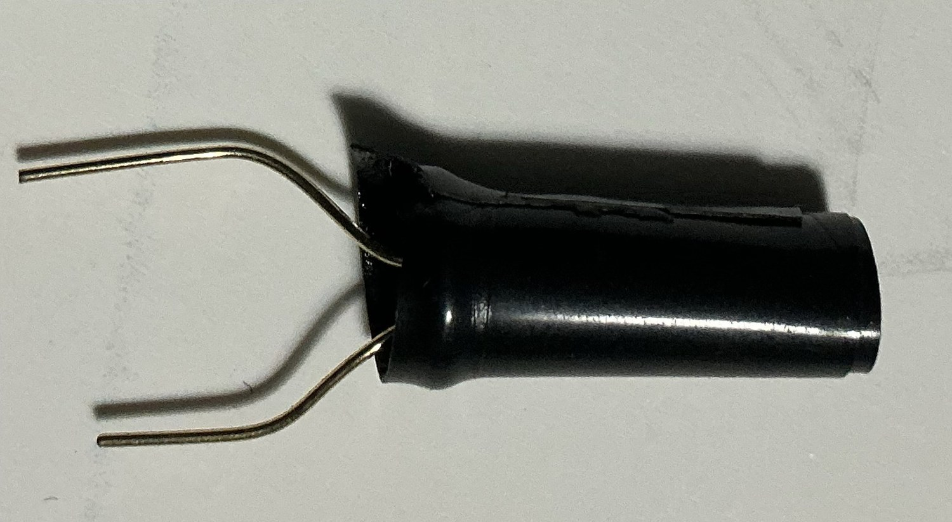
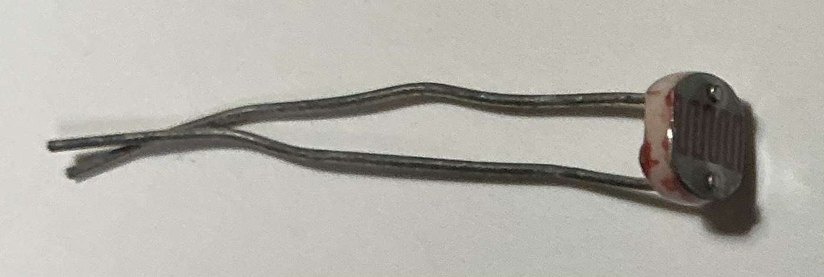
5.3 Investigations (PO(d))
Ambient light and detector comparison
Detector | Observed | Outcome
L14F1 phototransistor | Strong but dull, muffled; slow | Rejected
BPW34, unshielded | Clearer treble, light-sensitive | Improved
BPW34 + black shroud | Clean audio, far less affected by lighting | Adopted
Recovered waveform with a lamp switched on beside the receiver
With the room light dimmed the waveform is clean; with a lamp close by, a low-frequency ripple and visible noise appear and the sound is hazy with an audible hum.
The disturbance appears as ripple rather than broadband noise - exactly what 100 Hz lamp flicker produces after partial attenuation by the 154 Hz high-pass corner.
First detector
With black cover
Final detector
EEE 310 – Comm. System I Lab | Group 05
Li-Fi: Audio Transmission over a Laser Beam
Presented by: 2206104
EEE 310 – Comm. System I Lab | Group 05
Li-Fi: Audio Transmission over a Laser Beam
Presented by: 2206119
21
21

Slide 22
5.3 Investigations (PO(d))
Simulated vs measured — results and interpretation
Quantity | Simulated | Measured | Comment
Mid-rail reference | 4.500 V | ≈ 4.4 V | Agrees
Driver input bias (U2 pin 3) | 1.154 V | ≈ 1.15 V | Agrees
Laser bias current | 30.4 mA | 7.75 mA | Large deviation — see below
Upper −3 dB frequency | ≈ 10.7 kHz | ≈ 12 kHz | Within capacitor tolerance (±10 %)
Lower −3 dB frequency | ≈ 154 Hz | ≈ 40 Hz | Coarse reading + capacitor tolerance
Waveform fidelity at 1 kHz | No clipping | No clipping | Agrees
Why the laser current differs: in simulation the laser is an ideal 2.5 V source with 20 Ω, so the loop can always source the demanded current. The real module presented 2.06 V forward and the loop settled lower — reduced optical power, reduced modulation depth, and hence the modest SNR observed.
Conclusions: the link works over 10 m; bandwidth is set deliberately by the receiver filter; constant-current drive is the decisive choice that removed the distortion of the first prototype; and ambient light, not electronic noise, limits quality in a lit room.
EEE 310 – Comm. System I Lab | Group 05
Li-Fi: Audio Transmission over a Laser Beam
Presented by: 2206121
EEE 310 – Comm. System I Lab | Group 05
Li-Fi: Audio Transmission over a Laser Beam
Presented by: 2206119
22
22

Slide 23
5.4 Impact Assessment (PO(f))
Societal and cultural
Health and safety
Legal
Communication without adding to RF emissions — relevant in a dense city like Dhaka.
Confined to the room, so privacy is easy for a non-technical user to understand.
The beam is visible, which makes an abstract principle immediately intuitive for teaching.
Limitation: requires unobstructed line of sight, so it cannot replace radio for mobile users.
Optical exposure is the principal hazard; bystanders are most at risk.
Mitigated by beam termination, below-eye-level axis, current limiting and the user manual.
Mains-connected bench supply isolated by a step-down transformer.
No device on either board became warm in extended operation.
Visible-light communication needs no spectrum licence in Bangladesh.
A commercial version would need IEC 60825-1 Class 3R labelling, housing and interlock.
All parts are standard, off-the-shelf; all reference designs cited.
EEE 310 – Comm. System I Lab | Group 05
Li-Fi: Audio Transmission over a Laser Beam
Presented by: 2206121
EEE 310 – Comm. System I Lab | Group 05
Li-Fi: Audio Transmission over a Laser Beam
Presented by: 2206119
23
23

Slide 24
5.5 Sustainability and Environmental Impact Evaluation (PO(g))
Resource use and reusability Through-hole components on reusable breadboards. No PCB was etched, so no etching chemicals were consumed and no permanent e-waste was created. Every component — both TL072s, the LM358, the LM386, the laser and the photodiode — can be recovered and reused.
Energy consumption Receiver: 10.48 mA at 7.96 V ≈ 83 mW. The transmitter is comparable, dominated by the laser. The complete link runs on under a quarter of a watt, and generates no electromagnetic interference because there is no switching circuitry.
Long-term sustainability Purely analog: no firmware to maintain, no processor to go out of production. The laser is rated for 2000+ hours; the rest are commodity parts. At end of life the boards are disassembled by hand; only the electrolytics and semiconductors need controlled disposal.
EEE 310 – Comm. System I Lab | Group 05
Li-Fi: Audio Transmission over a Laser Beam
Presented by: 2206121
EEE 310 – Comm. System I Lab | Group 05
Li-Fi: Audio Transmission over a Laser Beam
Presented by: 2206119
24
24

Slide 25
6.1 Individual Contribution of Each Member
Member name | Student ID | Individual contribution
Md. Ahasan Habib Kawsar | 2206119 | Circuit design, PSpice simulation, laser driver, integration, debugging, demonstration (Project Leading)
Md. Mahedi Hasan Saikot | 2206111 | Data collection, oscilloscope measurements, frequency response testing,slides revision
MD. Saruwer Hossan Pial | 2206099 | Receiver board assembly and soldering
Mustasin Rahman Ador | 2206104 | Transmitter board assembly, optical alignment and mounting
Md. Imran Shajid | 2206120 | Component procurement, BOM and cost analysis
Afnan Bin Obaid | 2206121 | Report writing, slides, demo video
Mode of team work: design decisions were circulated before implementation; every significant change - constant-current drive, relocation of the dominant filter, the fixed input divider - was discussed by the group. Measurement sessions were attended together and components procured jointly, with cost shared equally.
EEE 310 – Comm. System I Lab | Group 05
Li-Fi: Audio Transmission over a Laser Beam
Presented by: 2206121
EEE 310 – Comm. System I Lab | Group 05
Li-Fi: Audio Transmission over a Laser Beam
Presented by: 2206119
25
25

Slide 26
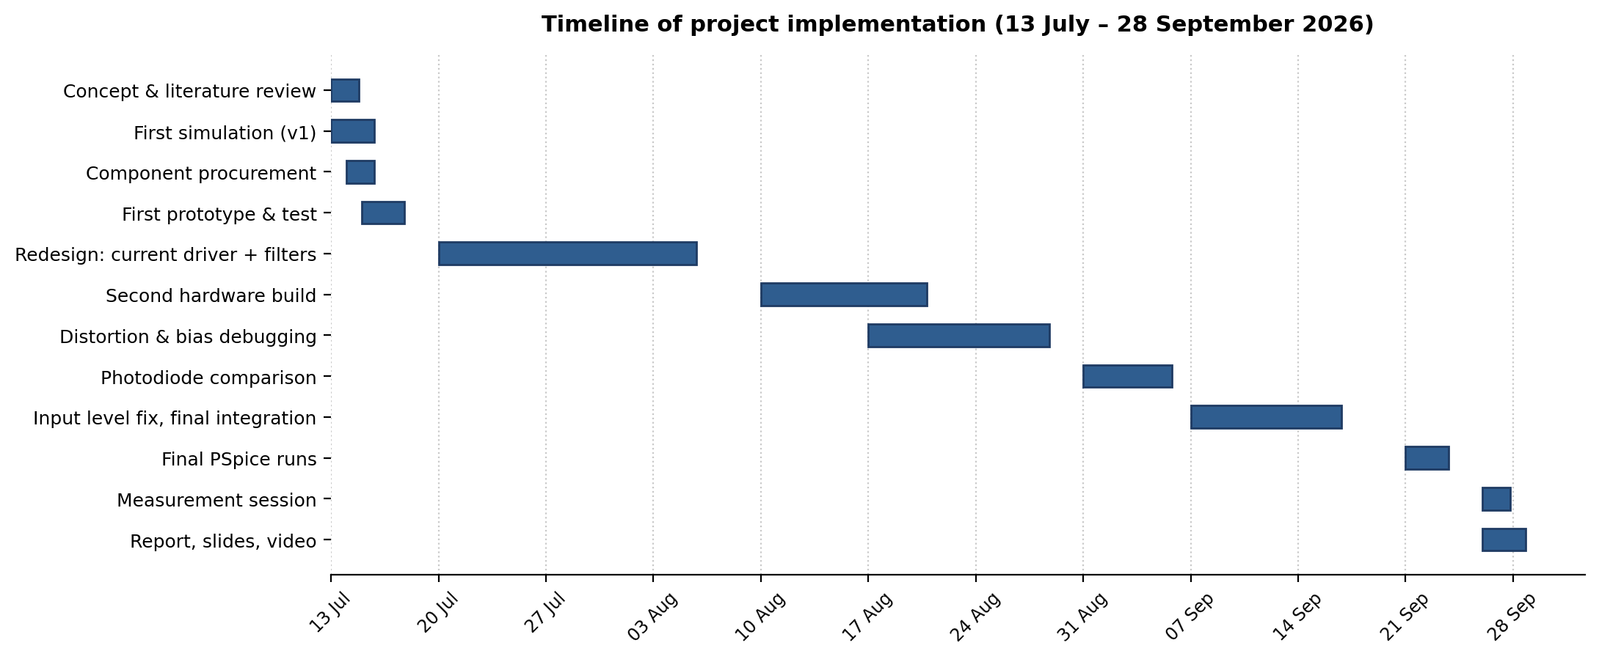
6.4 Log Book and Timeline of Implementation
13 Jul — scope fixed, first simulation and prototype.
16 Jul — link works but sound is distorted.
20 Jul – 5 Aug — redesign: constant-current driver, corrected filter values, staggered cut-offs.
10 – 28 Aug — second build; distortion traced to excess preamp gain; laser bias raised.
31 Aug — detector comparison; shrouded BPW34 adopted.
7 – 16 Sep — fixed input divider, final integration, 10 m link.
21 – 26 Sep — final PSpice runs and full measurement session.
28 Sep — submission and demonstration.
EEE 310 – Comm. System I Lab | Group 05
Li-Fi: Audio Transmission over a Laser Beam
Presented by: 2206120
EEE 310 – Comm. System I Lab | Group 05
Li-Fi: Audio Transmission over a Laser Beam
Presented by: 2206119
26
26

Slide 27
7. Communication to External Stakeholders (PO(j))
Executive summary Students at BUET have built a working communication link that sends sound on a beam of light. Music played on a mobile phone is converted into rapid variations in the brightness of a small red laser; across the room, a light sensor picks up those variations and a loudspeaker turns them back into sound. The link carries speech and music clearly over about ten metres, uses no radio waves at all, and costs under fifteen hundred taka to build from parts available in any local electronics market. Because light does not pass through walls, the signal stays in the room it was sent in.
Demonstration video
User manual — six steps
https://youtu.be/T3q3XpJ2jnU
Power both boards from separate 9 V supplies.
Check the laser spot — never look into the beam.
Align the spot at the centre of the photodiode.
Connect the phone or laptop to the 3.5 mm socket.
Set the source to about one third volume and play.
Dim the room lights and shroud the detector for best results.
GitHub: the project is implemented entirely in hardware and contains no firmware, so no software repository is associated with it. The PSpice file and measurement data are available on request.
EEE 310 – Comm. System I Lab | Group 05
Li-Fi: Audio Transmission over a Laser Beam
Presented by: 2206120
EEE 310 – Comm. System I Lab | Group 05
Li-Fi: Audio Transmission over a Laser Beam
Presented by: 2206119
27
27

Slide 28
8. Project Management and Cost Analysis (PO(k))
Component | Qty | Total (BDT)
TL072 / LM358 / LM386 op-amps | 4 | 85
BD135, BPW34, laser module | 3 | 105
Resistors, capacitors, potentiometer | 64 | 155
Speaker, microphone, jack and cable | 4 | 145
Breadboards and jumper wire | 3 | 390
Bench power supply (transformer, LM317, 7809, diodes, LEDs) | 10 | 211
9 V batteries with snaps | 2 | 80
Total prototype cost |  | 1171
Cost analysis | BDT
Components in the delivered prototype | 1171
Components consumed during development | 170
Total project expenditure | 1341
Mass-produced unit at 1000 off:
Bulk components (≈ 45 % discount) | 210
PCB, enclosure, adaptor | 280
Assembly, test, packaging | 150
Estimated factory cost per unit | 640
Indicative selling price (25 % margin) | 800
Volume production removes the breadboards and individually bought passives
a 45 % reduction. The laser module and photodiode are finished optical parts and do not fall in price as steeply.
EEE 310 – Comm. System I Lab | Group 05
Li-Fi: Audio Transmission over a Laser Beam
Presented by: 2206120
EEE 310 – Comm. System I Lab | Group 05
Li-Fi: Audio Transmission over a Laser Beam
Presented by: 2206119
28
28

Slide 29
9. References
[1] B. P. Lathi and Z. Ding, Modern Digital and Analog Communication Systems, 4th ed., Oxford University Press, 2009.
[2] S. Haykin, Communication Systems, 4th ed., John Wiley & Sons, 2001.
[3] Course lecture slides, EEE 309: Communication System I, Dept. of EEE, BUET, September 2026.
[4] Texas Instruments, TL072 Low-Noise JFET-Input Operational Amplifier, datasheet SLOS080.
[5] Texas Instruments, LM358 Dual Operational Amplifier, datasheet SNOSBT3.
[6] Texas Instruments, LM386 Low Voltage Audio Power Amplifier, datasheet SLOS264.
[7] Vishay Semiconductors, BPW34 Silicon PIN Photodiode, datasheet 81521.
[8] ON Semiconductor, BD135/BD137/BD139 NPN Transistor, datasheet Rev. 1.0.2.
[9] Robotics Bangladesh, 5 mW Adjustable Laser Dot Diode Module, product specification.
[10] IEC 60825-1: Safety of Laser Products — Part 1, 3rd ed., 2014.
[11] Dept. of EEE, BUET, EEE 310 Course Outcomes and PO Mapping, eee.buet.ac.bd.
EEE 310 – Comm. System I Lab | Group 05
Li-Fi: Audio Transmission over a Laser Beam
Presented by: 2206120
EEE 310 – Comm. System I Lab | Group 05
Li-Fi: Audio Transmission over a Laser Beam
Presented by: 2206119
29
29

Slide 30

Appendix: Mapping of Course Outcomes and Program Outcomes
CO | PO | Description | Addressed in | Achieved
CO1 | PO(a) | Explain practical aspects using modules and equipment | Section 3.1 | ✓
CO2 | PO(d) | Compare theoretical and experimental results | Section 5.3 | ✓
CO3 | PO(c) | Design with safety, cultural, societal, environmental considerations | Section 5.2 | ✓
CO4 | PO(f) | Assess societal, health, safety, legal and cultural impact | Section 5.4 | ✓
CO5 | PO(g) | Evaluate sustainability and environmental impact | Section 5.5 | ✓
CO6 | PO(i) | Demonstrate participation and leadership in teamwork | Section 6 | ✓
CO7 | PO(j) | Communicate effectively with presentation and report | Section 7 | ✓
CO8 | PO(k) | Demonstrate project management and cost analysis | Section 8 | ✓
EEE 310 – Comm. System I Lab | Group 05
Li-Fi: Audio Transmission over a Laser Beam
Presented by: 2206120
EEE 310 – Comm. System I Lab | Group 05
Li-Fi: Audio Transmission over a Laser Beam
Presented by: 2206119
30
30

Slide 31
CO | PO | Description | Addressed in | Achieved
CO1 | PO(a) | Explain practical aspects using modules and equipment | Section 3.1 | ✓
CO2 | PO(d) | Compare theoretical and experimental results | Section 5.3 | ✓
CO3 | PO(c) | Design with safety, cultural, societal, environmental considerations | Section 5.2 | ✓
CO4 | PO(f) | Assess societal, health, safety, legal and cultural impact | Section 5.4 | ✓
CO5 | PO(g) | Evaluate sustainability and environmental impact | Section 5.5 | ✓
CO6 | PO(i) | Demonstrate participation and leadership in teamwork | Section 6 | ✓
CO7 | PO(j) | Communicate effectively with presentation and report | Section 7 | ✓
CO8 | PO(k) | Demonstrate project management and cost analysis | Section 8 | ✓
Appendix: Mapping of Course Outcomes and Program Outcomes
Thank You
Questions?
EEE 310 – Comm. System I Lab | Group 05
Li-Fi: Audio Transmission over a Laser Beam
EEE 310 – Comm. System I Lab | Group 05
Li-Fi: Audio Transmission over a Laser Beam
Presented by: 2206119
31
30

