Slide 1
Team #HappyNLP
SemEval 2016 Task 3 - Community Question Answering
Sriram Jegadeesh
Sriram Balaguru
Murali Krishnan
Naveen

Slide 2
INTRODUCTION
Community Question Answering forums?
A great place for people to ask question of any kind and get responses from people from all walks of life.
Example: Quora, Stackoverflow and the like.
What’s the problem?
User does not get a direct answer for his question but he gets only the views of various people
The new questions to be raised are most likely to have been already answered.
What can solve the problem?
Community Question Answering can benefit greatly with the help of Natural Language Processing techniques.

Slide 3
TASKS DESCRIPTION
A. Question - Comment similarity
A question Q and 10 comments to it are provided. We need to re-rank the comments with respect to their relevance to the question Q.
B. Question - Question similarity
A question Q and 10 questions related to it are provided, we need to re-rank the questions which are most similar to the question Q.
C. Question - External Comment similarity
A question Q and 10 more questions (Q1 to Q10) relevant to Q, having 10 comments each (100 comments in total) are provided. We need to re-rank the 100 comments according to the relevance of original question.

Slide 4
PRE PROCESSING
What the need for preprocessing?
A wide spectrum of people from all walks of life are exposed to the internet, instant messaging, emails, blogs and various other forms of human-computer interaction.
This has led to changes in the spellings and usage of words giving birth to almost a new language and a study on it called internet linguistics.
No wonder the community question and answers affected by these new words and modified spellings and our machines do not know them.
Techniques Employed
Tokenization,
Stop word removal - removing user names in comments , removing greetings and acknowledgment, etc.
Lemmatization

Slide 5
APPROACH - TASK A
Classification of questions:
We classified the questions into factual questions and descriptive questions.and processed them in different ways which yielded good results.
Factual questions
Expects response in terms of the names of things, such as person, company names and the like.
Example: Who is the richest man in the world?
Descriptive questions
Expects the user to make some analysis and give a descriptive type of comment.
These questions are not satisfied by a particular word but they require a collection of words related to the question posted.
Example: Why is the apple logo bitten?

Slide 6
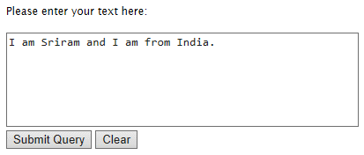
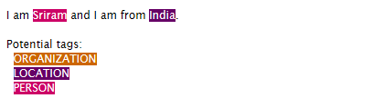
APPROACH - TASK A
FACTOID QUESTIONS
The factual questions expect only the names of people or places in its comments to get satisfied.
Stanford NER tagger
Good named entity recognizers for English, particularly for the 3 classes (PERSON, ORGANIZATION, LOCATION)
(screenshots taken from http://nlp.stanford.edu:8080/ner/process)
Coupled with the NER, we have also employed OKAPI BM25 to helps us rank the comments.

Slide 7
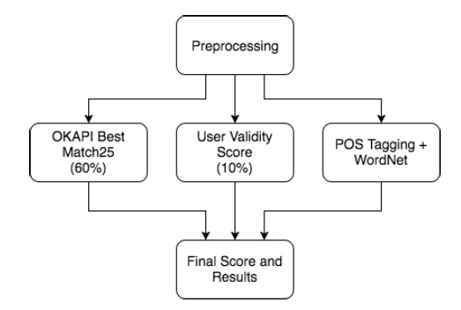
APPROACH - TASK A
DESCRIPTIVE QUESTIONS
(i) Flow diagram

Slide 8
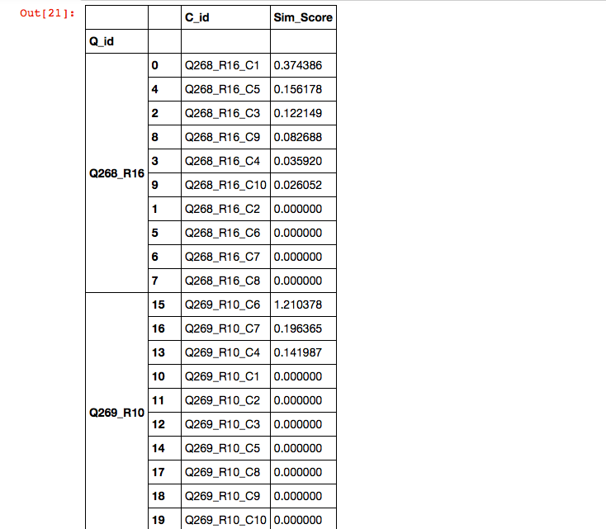
APPROACH - TASK A
DESCRIPTIVE QUESTIONS
Okapi BM25 (BM stands for Best Matching)
Probabilistic retrieval framework
It is a ranking function used by search engines to rank matching documents according to their relevance to a given search query
Collection of whole family of scoring functions – bag of words, tf-idf ,etc
Disadvantage :
Does not takes care of inter-relationship between the question and the words
Reference : https://en.wikipedia.org/wiki/Okapi_BM25

Slide 9
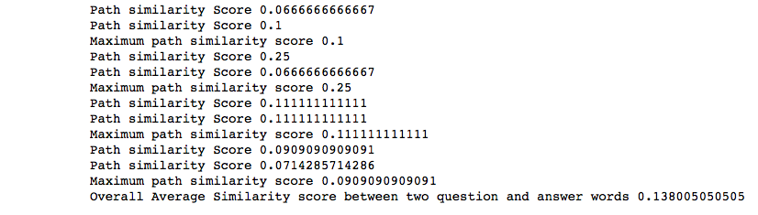
APPROACH - TASK A
DESCRIPTIVE QUESTIONS
POS tagging
Stanford Log-linear Part-Of-Speech Tagger
WordNet
Semantic network
Edge-based methods
Similarity measure – Path similarity
It is proposed by Leacock and Chodorow (lch)
-log (length / (2 * D)) , where length is the length of the shortest path and D is the maximum depth of the taxonomy.
Semantic Similarity

Slide 10
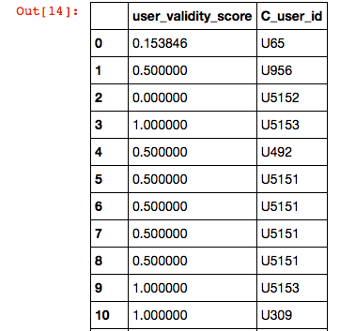
APPROACH - TASK A
DESCRIPTIVE QUESTIONS
User Validation Score
User Validity Score = g / ( g + b )
Where,
g - No of Good comments ,
b - No of Bad comments

Slide 11
APPROACH TASK B
Siamese Networks adaptation
Main objective is to differentiate the data objects rather than classification.
Consists of two identical neural networks.
Shares the same weights for two networks which is easier to train
Word Embeddings with Manhattan Long-Short Term Memory(LSTM) Neural Network
Used Google’s Word2Vec for Embedding process
LSTM Neural Network is designed to avoid long-term dependency problem

Slide 12
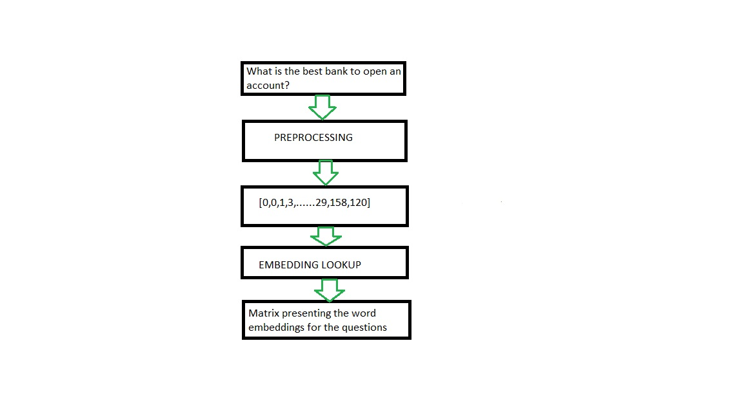
APPROACH TASK B - Word Embedding Process

Slide 13
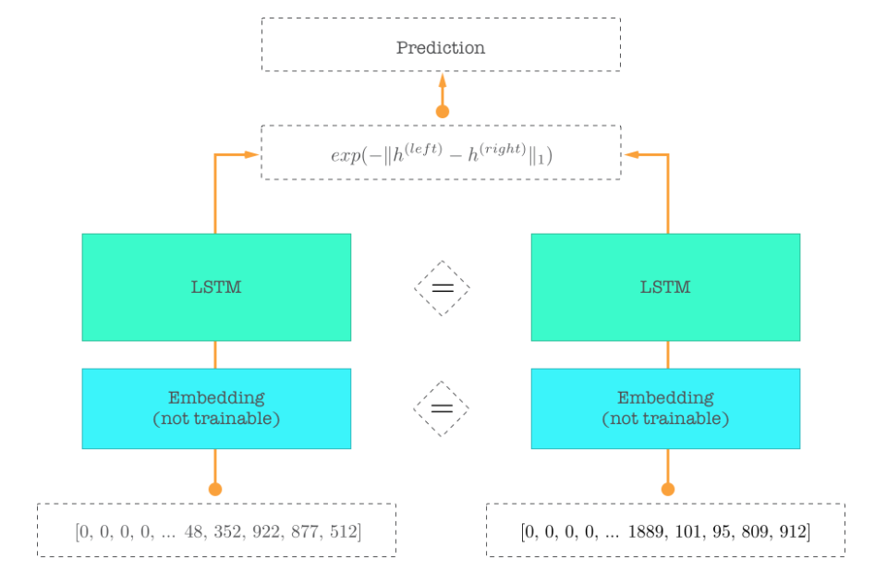
APPROACH TASK B - LSTM Model

Slide 14
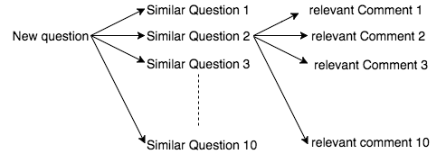
APPROACH TASK C
Task B Task A
Cumulatively choose best answer among 100 possibilities

Slide 15
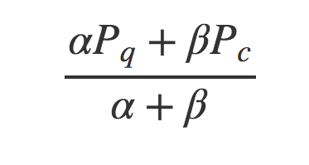
APPROACH TASK C
Cumulative accuracy for a question - comment is given by below formula
α = weightage of question similarity = 0.75,
β = weightage of comment relevance = 0.25
Pq = Probability of the similar question,
Pc = Probability of relevant answer

Slide 16
UNIQUENESS OF THE MODEL
Task A
Ensemble learning - Combining okapi BM25 + POS tagging + Wordnet
Addition of User validity feature
Task B
Word2Vec is used for word embeddings which is then trained on LSTM recurrent neural network
Also, we have used Manhattan similarity function instead of Euclidean distance to reduce the errors during the stages of training the LSTM

Slide 17
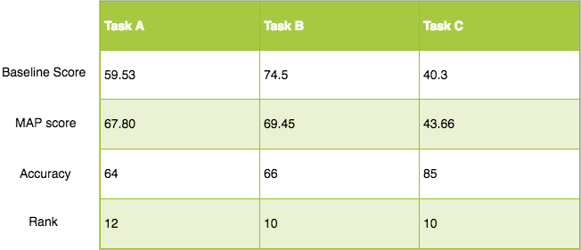
METRICS OF THE MODEL

Slide 18
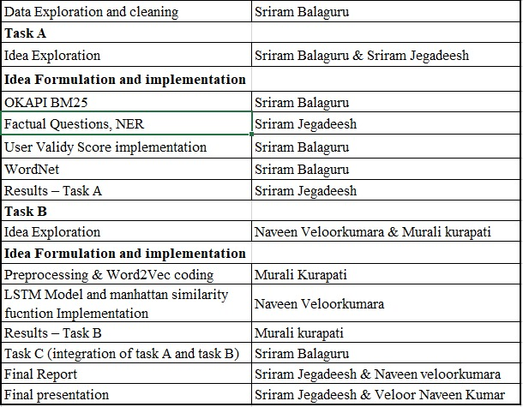
Work distribution

Slide 19
Thank you

