Slide 1
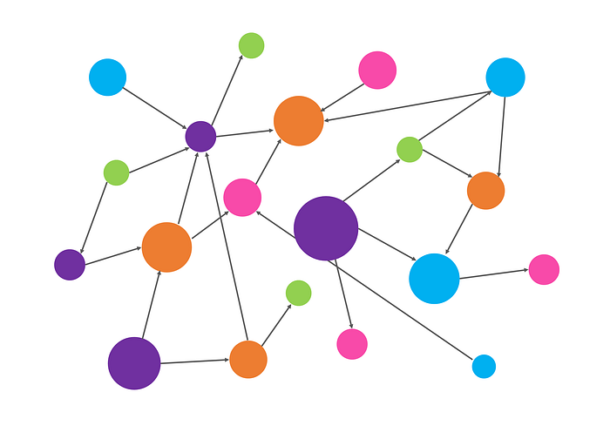
Ontologies: Theory & Applications
Trustworthy CoE February 2024
Ali Hashmi

Slide 2

A little about me and today’s talk
Senior Data Scientist for IBM Consulting – US Federal Market
Came to IBM via acquisition about 7 years ago
Been heavily involved in data and analytics for over 20 years
And about a year ago… I knew nothing about ontologies!
So, this presentation is my learning journey
And the folks who have helped me along the way ☺
I hope you will learn something and enjoy!

Slide 3
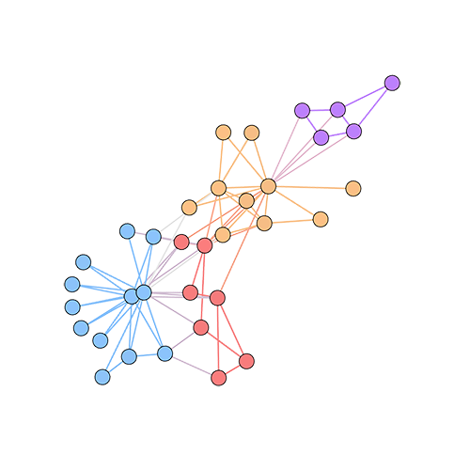
Agenda
It began with a blog post
What are ontologies?
What can they do for us?
Multiple Roles for Ontologies in Trustworthy AI
Some examples of related work from around IBM
Tools & Resources
References
Q&A

Slide 4
Linux Foundation – Trustworthy AI Committee
LF hosts working groups & committees
IBM is a big supporter and encourages our involvement
Trusted AI Committee - LF AI Foundation - Confluence (lfaidata.foundation)
Open call for blog posts last Spring
Some senior researchers from Hewlett Packard Labs and I teamed up

Slide 5
Role of Ontologies in Enabling AI Transparency (link)
Co-authors
Revathy Venkataramanan, AI Institute at University of South Carolina
Aalap Tripathy, Principal Research Engineer
Recently released a tool, the Common Metadata Framework
“to facilitate the inclusion of additional semantic and statistical properties to enhance the richness and comprehensiveness of the metadata associated with ML pipelines”
Investigated bias mitigation in combination with AI Fairness 360

Slide 6
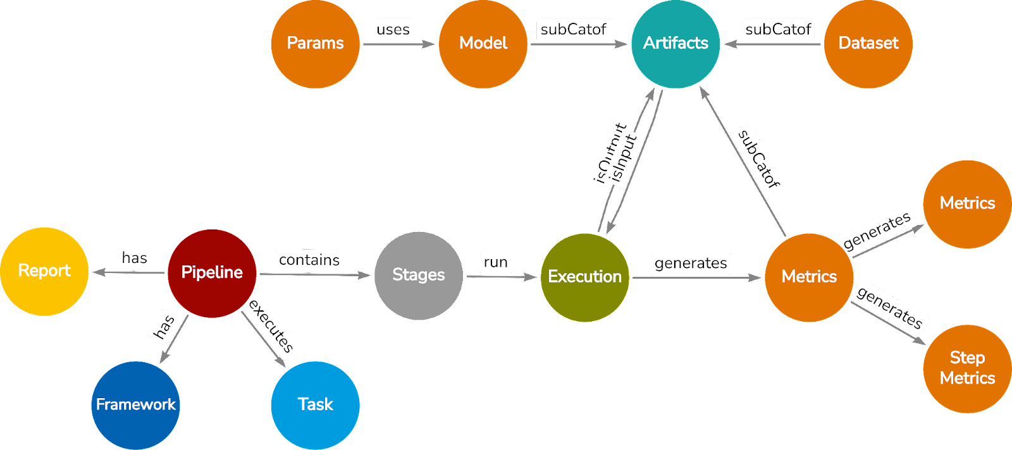
Abstraction
Let’s start here
Relatable Concept
Notes:
Figure 1: The nodes represent the pipeline and the components of a pipeline which consists of stages, executions, report, framework, intermediate artifacts, and metrics.

Slide 7
What Are Ontologies?
From philosophy: An ontology is a description of things that exist and how they relate to each other
An ontology is a formal description of knowledge as a set of concepts within a domain and the relationships that hold between them.
"thinking about thinking"

Slide 8
What can ontologies do for us?
They can be aids, tools that help us better understand concepts
Helping us to be better organized, by providing structure to our thinking
Helping us to be more precise, by adding clarity and refinement to our thinking
Helping us to share our thinking with others, by enabling clear and consistent communication

Slide 9
Multiple Roles of Ontologies in Explainable AI
Paper by Roberto Confalonieri & Giancarlo Guizzardi
[2311.04778] arxiv.or g
By combining the strengths of statistical analysis, which provides insights into the internal workings of models, with the power of symbolic knowledge represented by ontologies, researchers aim to achieve a more comprehensive and robust approach to explainability

Slide 10
Three Key
Roles
Reference Modelling
By utilizing ontologies, it becomes possible to capture system requirements effectively and promote the reuse of components.
Common-Sense Reasoning
They support common-sense reasoning, which is essential for effectively transmitting knowledge to users, enhancing their ability to comprehend.
Abstraction & Refinement
These mechanisms assist us in integrating knowledge from diverse sources and customizing the specificity and generality of explanations based on specific user profiles.

Slide 11
Sample Ontology Work around IBM
AI Enabled Workforce Transformation
Participation in developing the IEEE Standard Ontology for Ethically Aligned Robotic and Autonomous Systems
OIC Initiative: Utilizing Ontologies to Drive Risk Appropriate Factsheet Generation
With Jackie Csonka ☺

Slide 12
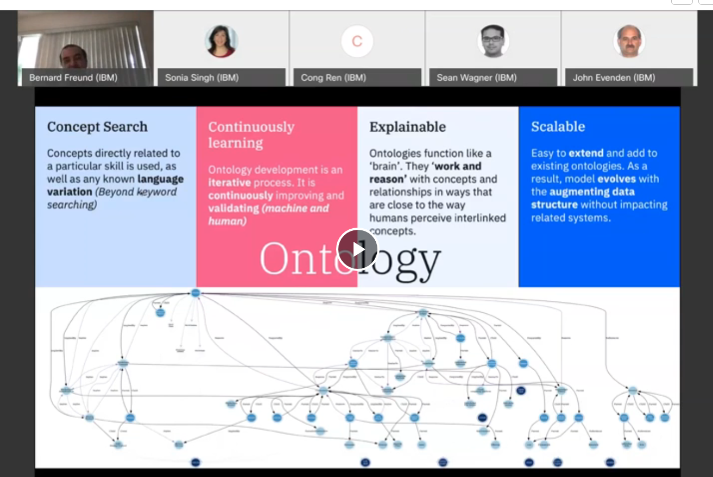
Transforming the IBM Workforce
Internal effort a few years ago
Ontologies were used to expedite understanding of the knowledge contained in unstructured HR data
Excellent talk on the topic and project by Bernard Freund from February 2021
https://ec.yourlearning.ibm.com/w3/playback/10161801

Slide 13

7007-2021 IEEE Ontological Standard
For Ethically Driven Robotics and Automation Systems
Recent paper discussing the approach and rationale
IBM co-authors: Michael Houghtaling (retired) & Sandro Fiorini
https://doi.org/10.1109/TSMC.2023.3330981
Constituent ontologies
Top-Level Ontology (TLO)
Norms and Ethical Principles (NEPs)
Data Privacy and Protection (DPP) Ontology
Transparency and Accountability (TA) Ontology
Ethical Violation Management (EVM) Ontology

Slide 14
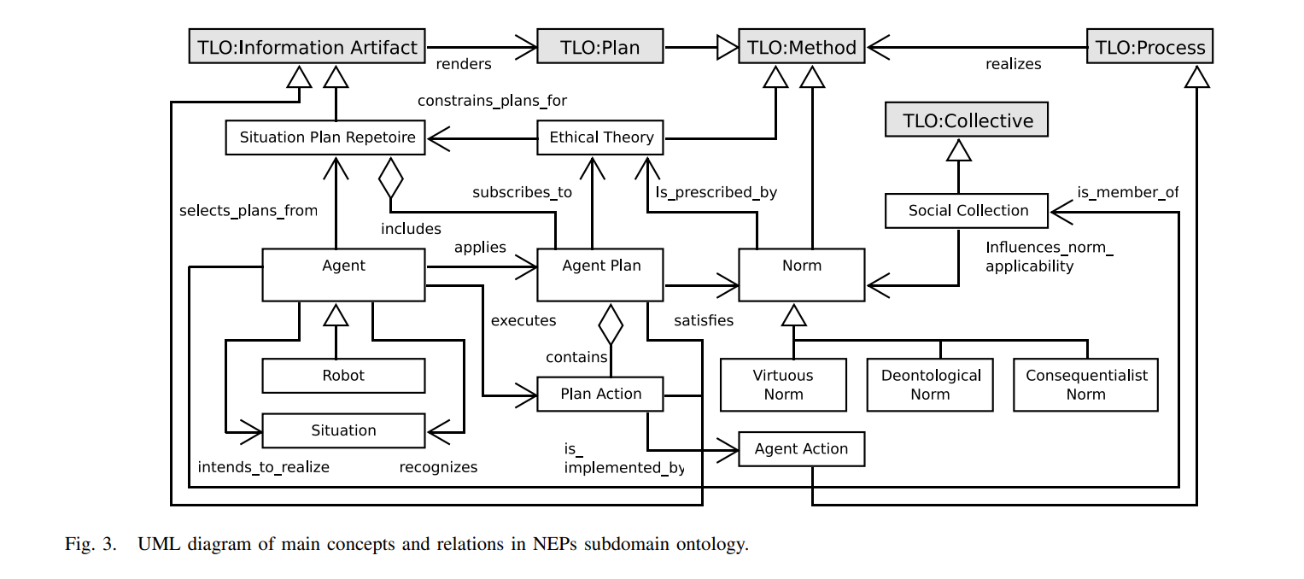

Slide 15
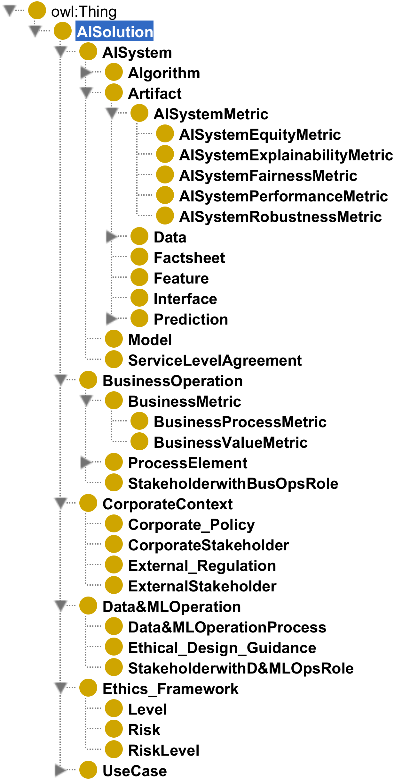
OIC Initiative Sample ontology
Common semantic data structure
A formalization of domain knowledge
Facilitates communication
Continual refinement of concepts, definitions, relationships
Ontology for Factsheets
Contact: Jackie.Csonka@ibm.com

Slide 16
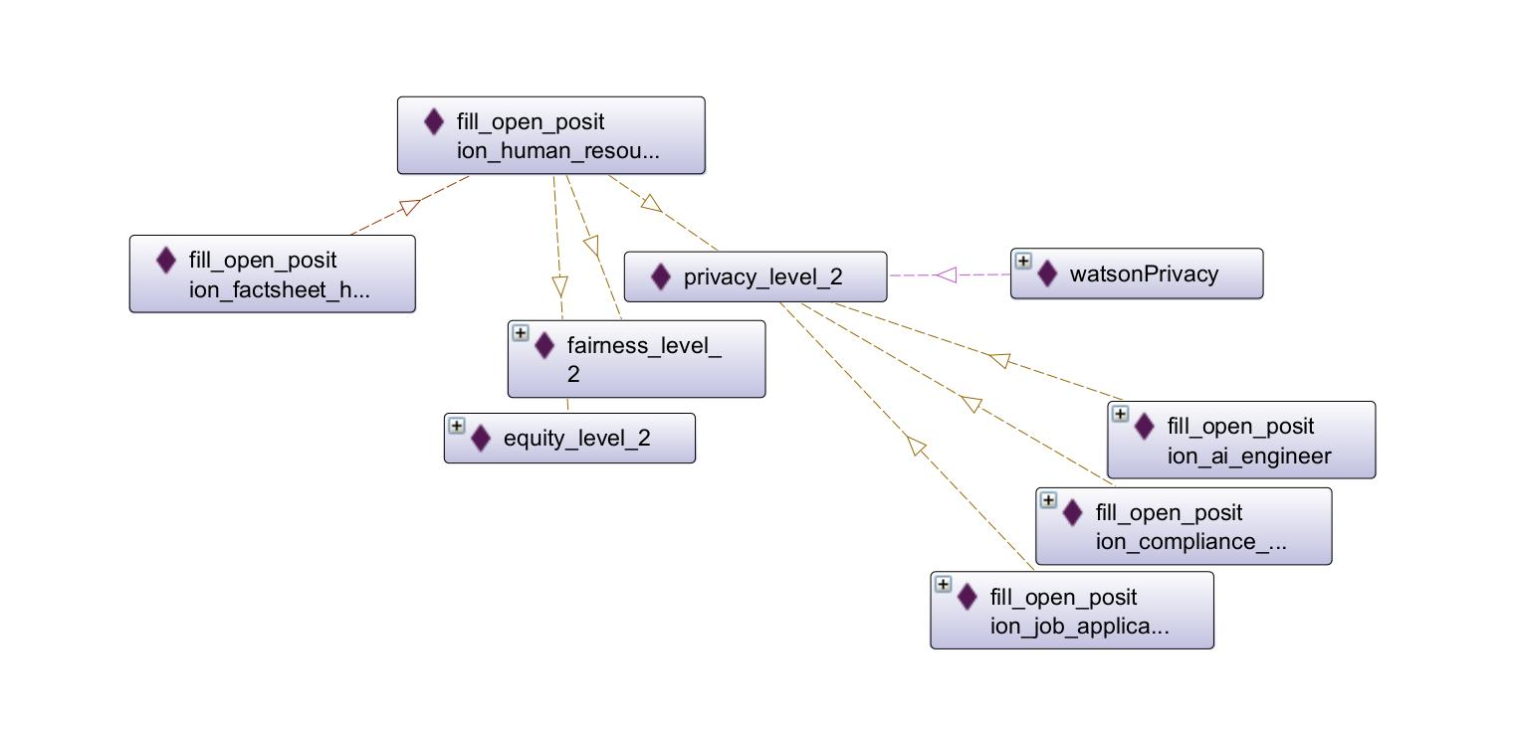
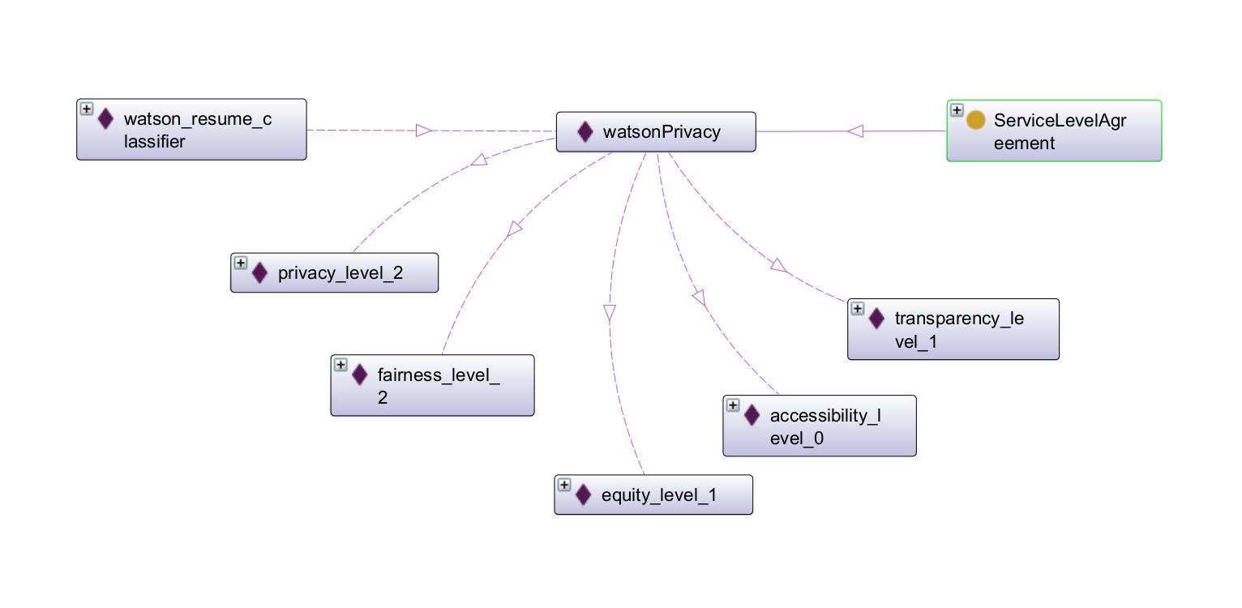
Ontology
for Factsheets
Human Resources Representative
AI to screen candidates
Ontology informs customization of Factsheet reports
Contact: Jackie.Csonka@ibm.com

Slide 17
Implementing ontology for Factsheets
Operationalization could include the following:
Workflow for gathering relevant facts, including both quantitative facts (e.g., model metrics) and qualitative facts (e.g., qualitative assessment of job applicant)
Governance of the lineage, modifications to, and retrieval of facts
Generation of customized Factsheet for stakeholders
Risk management
Continual improvement of the ontology
Contact: Jackie.Csonka@ibm.com

Slide 18
Operationalization example
ontology
Transparency matrix
(watson) Knowledge Catalog
Factsheet report
Customized for
each stakeholder
Governance is central
Knowledge Catalog contains all facts
Proof of concept using Transparency matrix
Factsheet for a stakeholder contains facts associated with that stakeholder
Sample matrix (YES: include in factsheet)
 | Data Scientist | Human Resources Representative | Job Candidate
Name | YES | YES
Created by | YES | YES
Last modified date of AI system | YES | YES
Input schema | YES
Input schema (explained) |  | YES
Hiring prediction | YES
Hiring prediction (explained) |  | YES | YES
Drift metric | YES
Privacy metric | YES
Privacy (explained) |  | YES | YES
Fairness metric | YES
Fairness (explained) |  | YES | YES
Equity metric | YES
Equity (explained) |  | YES | YES
Contact: Jackie.Csonka@ibm.com

Slide 19



Tools & Resources
Protégé: Free, open-source ontology editor and framework
SPARQL: Semantic query language for databases
From our enterprise github:
https://github.ibm.com/GTS-CDO/unstructured-analytics
https://github.ibm.com/IBMAoT/i-ontology-template

Slide 20
References
On the Multiple Roles of Ontologies in Explainable AI Confalonieri & Guizzardi
https://doi.org/10.48550/arXiv.2311.04778
Towards FAIR Explainable AI: a standardized ontology for mapping XAI solutions to use cases, explanations, and AI systems Adhikari, et. al.
https://doi.org/10.1145/3529190.3535693
Standardizing an Ontology for Ethically Aligned Robotic and Autonomous Systems Houghtaling, Fiorini, et. al.
https://doi.org/10.1109/TSMC.2023.3330981
Knowledge Graph Empowered Machine Learning Pipelines for Improved Efficiency, Reusability, and Explainability Venkataramanan, Tripathy, et. al.
https://doi.ieeecomputersociety.org/10.1109/MIC.2022.3228087
Role of Ontologies in Enabling AI Transparency Venkataramanan, Tripathy, & Hashmi
https://lfaidata.foundation/blog/2023/09/29/role-of-ontologies-in-enabling-ai-transparency/

Slide 22
Appendix
For reference only

Slide 23
Sample ontology
Common semantic data structure
A formalization of domain knowledge
Facilitates communication
Continual refinement of concepts, definitions, relationships
Ontology for Factsheets
Contact: Jackie.Csonka@ibm.com

Slide 24
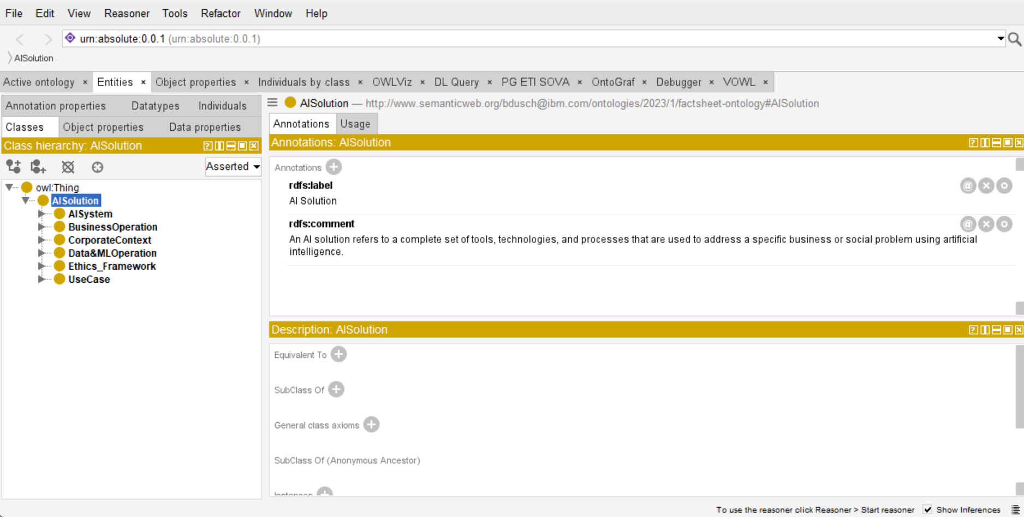
Contact: Jackie.Csonka@ibm.com

