Slide 1
WiDS Datathon 2023
https://www.kaggle.com/competitions/widsdatathon2023
#wids

Slide 2
General tips
Browse through the Datathon specific tutorials before it starts
Check the Discussion and Code tabs early on
Check to make sure your training data looks the same as test data
This year the test data had some rounding issue preventing some latitude and longitude from matching matching up

Slide 3
Special Challenges Your task is to predict the arithmetic mean of the maximum and minimum temperature over the next 14 days, for each location (514) and start date.
So many features (274) with many very highly correlated with each other.
No actuals for historical data - we are forecasting based on forecasts, and “averages of averages” of forecasts.
Relatively speaking small duration of training data.
There is a long gap in when training period ends and test hold out starts
Training: Sept 2014 - Aug 2016
Scoring: Nov 2022 – Dec 2022 (5+ years later)
Not sure what to do with location…leave lat and lon? Convert to categorical? Train model per location?

Slide 4
The Journey Begins
Started with feature analysis and used Random Forest just to get a baseline and idea on feature importance. Various other Boosted Trees gave same performance or worse. (RMSE 1.701)
CatBoostRegressor (1.332)
Really fast training, good defaults
Seemed to like all the variables!?!
Preferred all locations together, with location as a categorical variable
More feature engineering, and parameter tuning (1.135)
0.376 local RMSE on test split
Hyperparameters = {'iterations': 3000, 'learning_rate': 0.098, 'subsample': 0.744, 'l2_leaf_reg': 2.372, 'max_depth': 6, 'loss_function': 'RMSE', 'model_size_reg': 0.483}

Slide 5
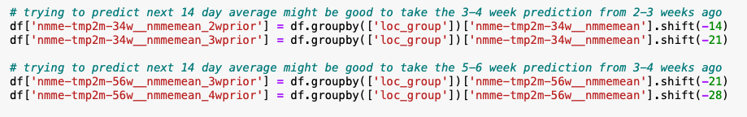
Various new features based on the following didn’t have much effect:
Rolling averages, min/max temps
StdDev
Spreads
Shift and Diffs helped us…
Forward filled the nans created from the shifts (sorted by location and time)
Backfilled the nans created from the diff

Slide 6
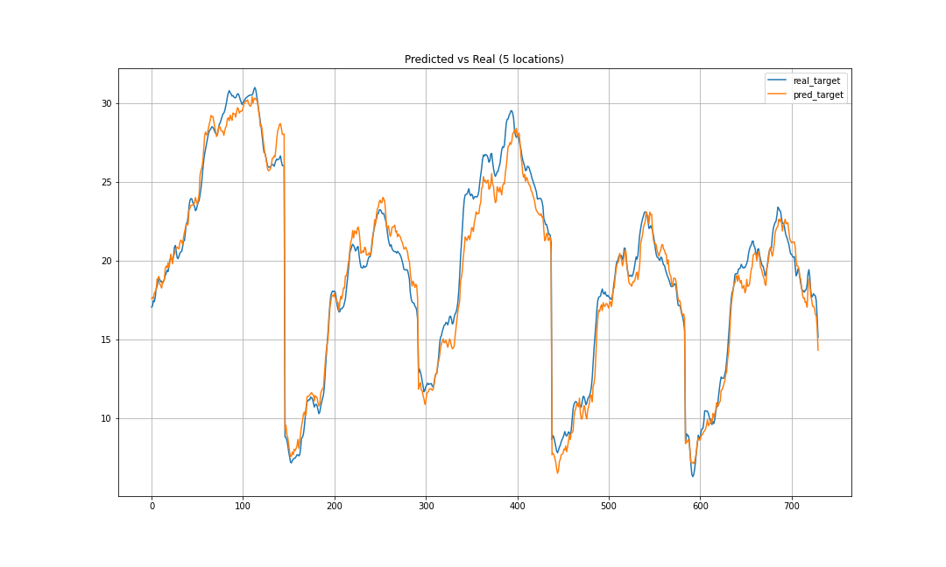
The Journey Continues
XGBoost Regressor (1.412)
More tentative approach to modeling: e.g. started w/ 1 location then expanded, similar with columns
Added 1-day lag features
Training time was reasonable ~10-20 minutes
Performance appeared to degrade with addition of columns, but did not pursue
Basic hyper-parameters
Estimators: 1800
Learning Rate: 0.1
Early-stopping rounds: 50
Metrics
R2: 97.8%
RMSE: 0.938 local test split
Visualizing sample predictions: 5 locations

Slide 7
The Journey Continues
SarimaX…. seemed like a good idea
Vast improvement over Univariate model (Sarima) but…
5 year gap from training to scoring window
All exogenous variables need to be forecast during the gap
Nearly endless combinations of variables… which would all need to be forecast… with model parameters
Occasionally the models predicted wildly inaccurate temperatures

Slide 8
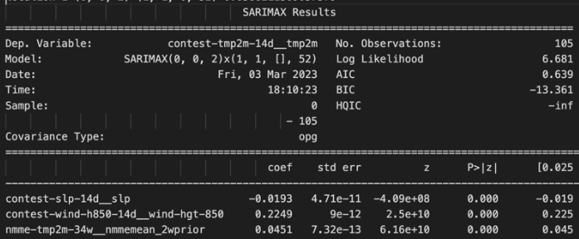
Inspect the AIC/BIC…
Less is more…
AIC – prediction ability
BIC – quality of model
There is interplay between the features based on presence of other features and model parameters

Slide 9
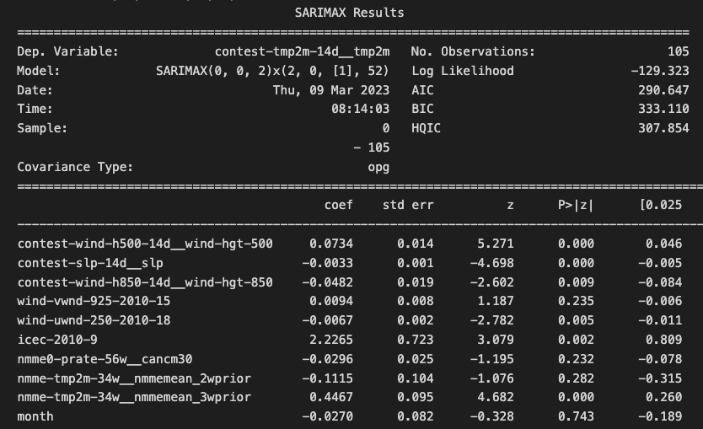
and Exogeneous Features Significance
Significant feature defined as:
P>|z| less than 0.05
Model selected impacts features used
6 significant
4 not significant

Slide 10
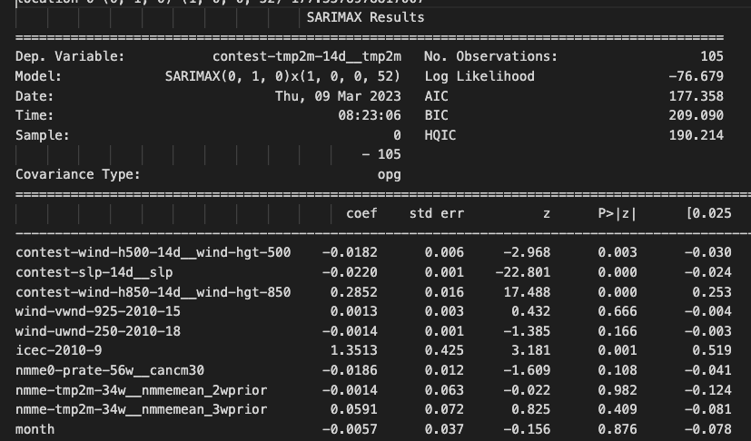
and Exogeneous Features Significance
Model changed relevant features:
4 significant
6 not significant
Dropping / adding features will also change significance of other features

Slide 11
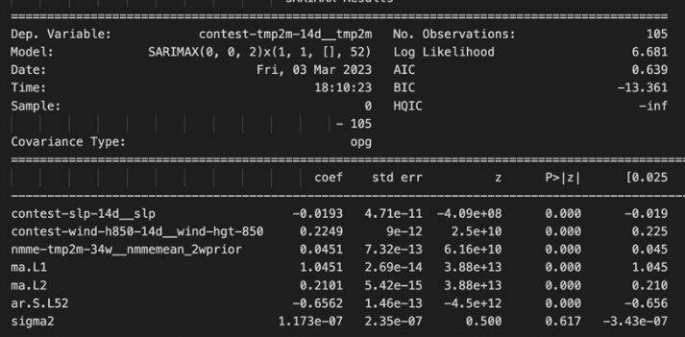
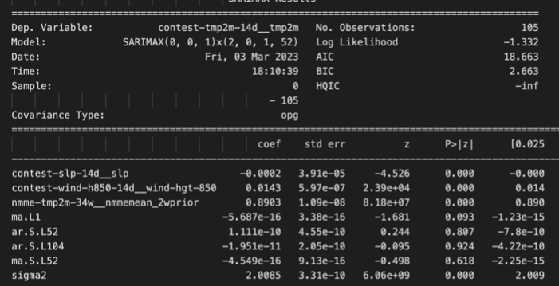
Parameters for SarimaX influence weight of exogenous variables
Orders: (0,0,2) – (1,1,0,52)
Highest impact: wind-hgt-850
Orders: (0,0,1) – (2,0,1,52)
Highest impact: 2wprior

Slide 12
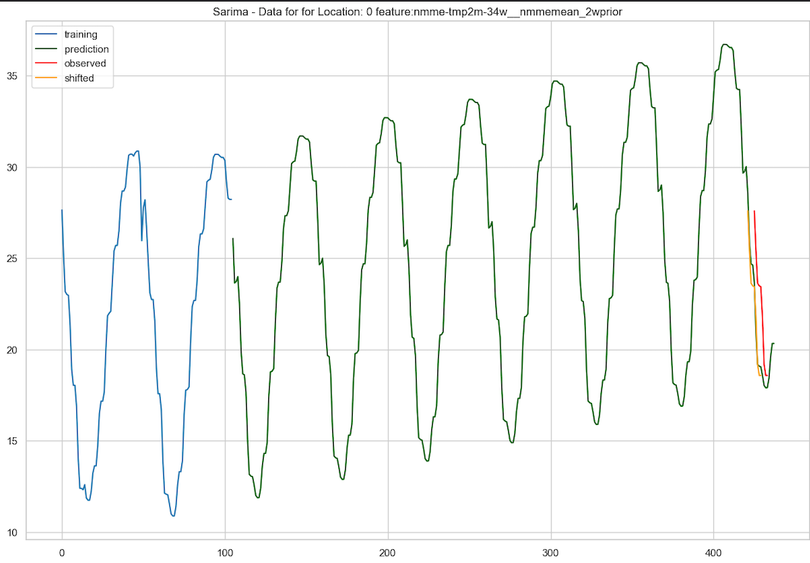
2wk Prior: Training + Forecasting + Observed
Notes:
Sept 2014 – August 2016 – training
Nov 2022 – Dec 2022 – observed (used for scoring)
Yellow is 4 week phase shift
Note assertion of the model of the upward trend

Slide 13
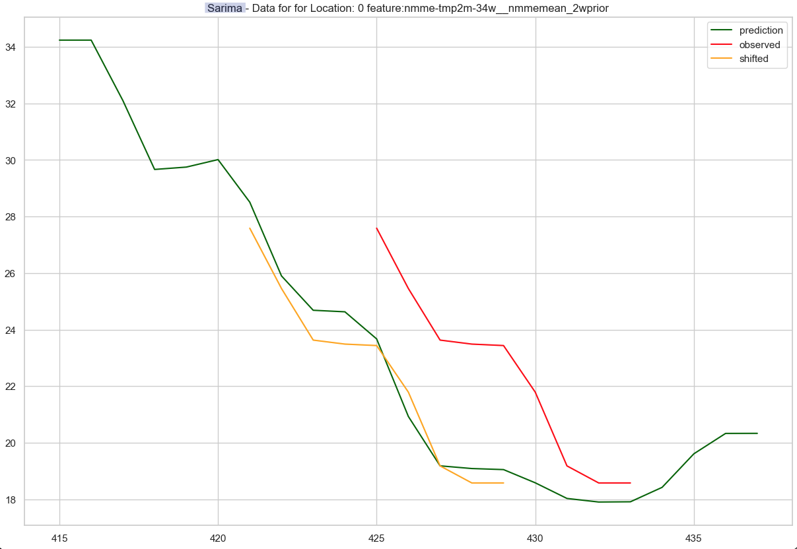
2wk Prior: maybe it is out of phase?
Notes:
As we look years in the future, highly likely that we are "out of phase" and the cycle is off week(s)
Note the descending prediction looks "off" by 4 weeks compared to observed data

Slide 14
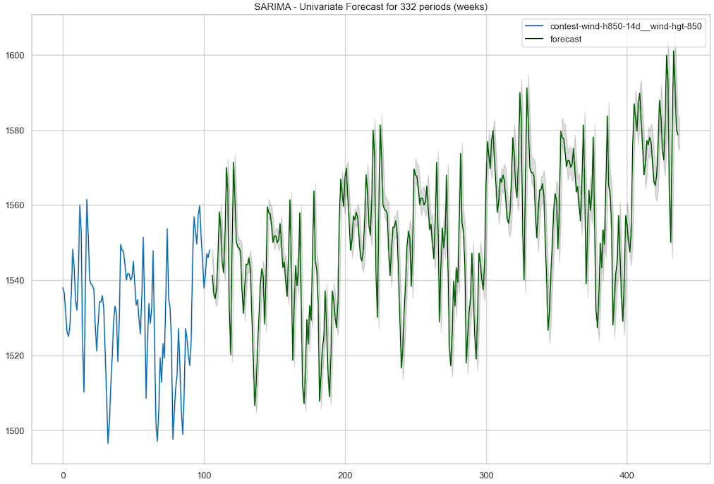
Confident in its wind prediction?
Notes:
At least the model is fairly confident in the rising wind speeds

Slide 15
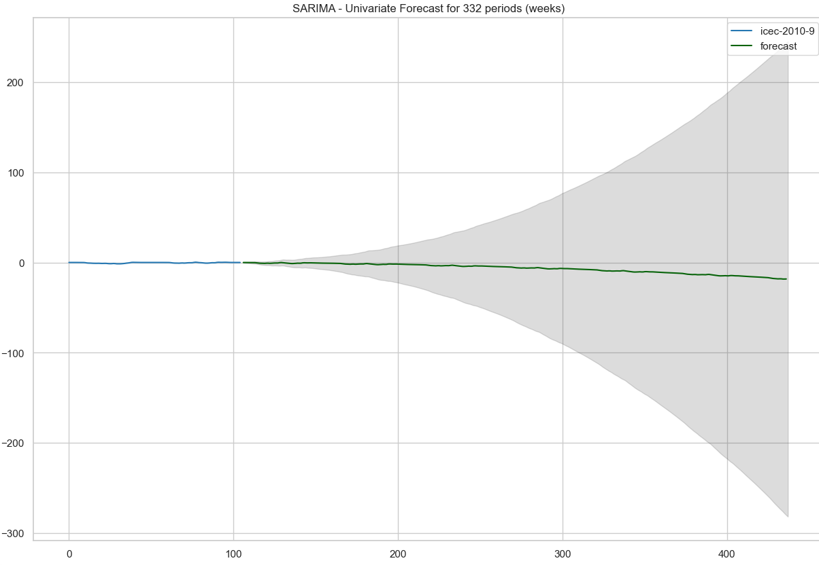
Not so confident on sea ice concentration
Notes:
Several models select this feature... note the low confidence in the future on actual value

Slide 16
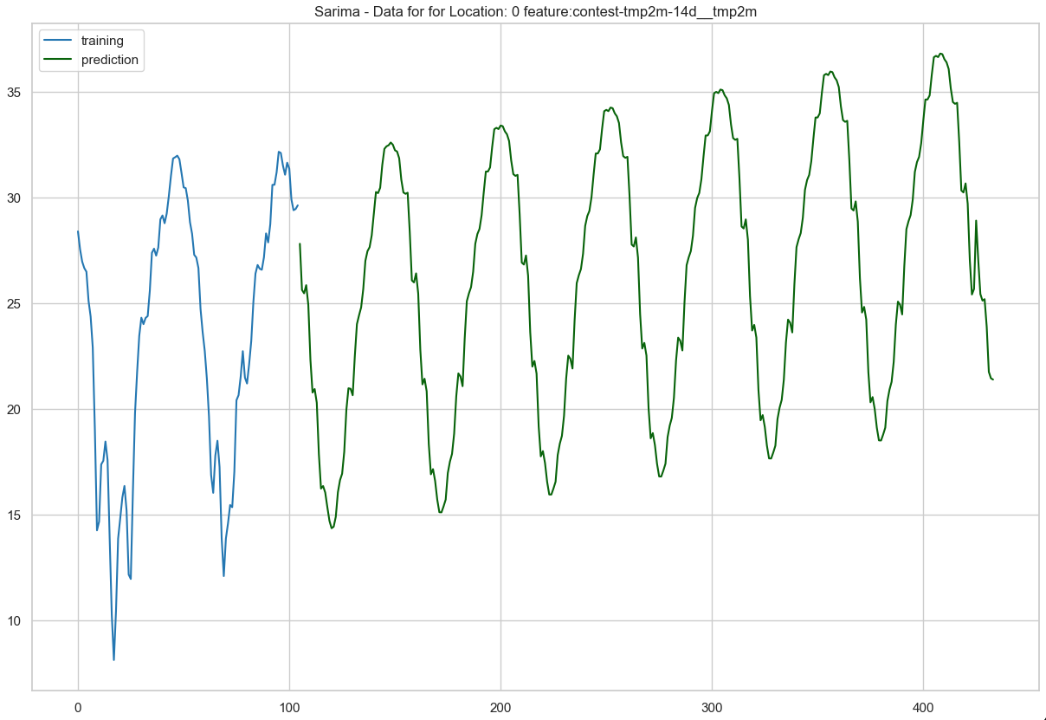
Prediction for Location 0
Notes:
The prediction is adjusted to account for exogenous features... this example did not try to realign with the week shifting

Slide 17
Process Flow
Test SarimaX with Feature List
Refine Feature List
Train SarimaX Model
Predict Feature Data
Train Feature Models
Predict Results
Hope for the Best
Landed on weekly model (m=52)
Training / Predicting occurred on each of the 514 Locations
Model used to select features used for SarimaX training and prediction per location
Combination of features and model orders almost infinite
Should have instantiated a better pipeline for iterations

Slide 18
SarimaX – Take Aways
Use auto_arima and your own grid search with caution
Model is invalid with BIC of:
-inf or Nan
Nearly identical models should be tried (vs best score only)
Add a check for reasonable prediction
Issues with exogenous variables on auto_arima
Exogenous variables are valuable
Sarima = 13.7
Typical SarimaX = 2.9 to 3.8
Miracles = 1.33 / 1.28

Slide 19

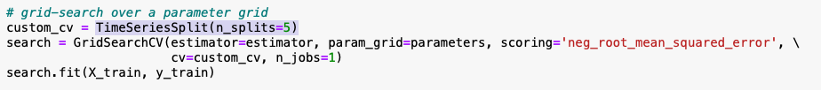
Best practices we didn’t practice ;)
Using a too many features which were highly correlated with each other (Cat Boost)
Leaving data “in time order” when doing train-test splits (for tree-based algorithms)
Some of us did better than others recording the hyperparameters for the runs ;o)

Slide 20
Destination – Rank 22/697 Top 3%
T-5 Days…. Best RMSE by approach (individually ranking ~350 – 50 percentile)
SarimaX – 1.284 (predicted highest temperatures)
CatBoost – 1.135 (predicted lowest temperatures)
XGB – 1.412
Ensemble Model – weighted average for values from above
45 / 35 / 20
Final Score / Ranking
0.727 (Public - data provided during the contest duration = 50% of data)
0.718 (Private – final scoring)

