Slide 1



Approaching Text Summarization using ML and DNN
RAIT-ACM STTP
25 May 2020

Slide 2

About Me
Mayank Kumar Jha
Data Scientist | Kaggle Competition Expert
Experience Across
Machine Learning, Deep Learning,
Data Ops, Cloud, Algorithms, Optimization
‹#›

Slide 3
Things to cover
Introduction to Text Summarization
Various approaches
Propose possible solutions
Create a basic solution
Code Walkthrough
Query session

Slide 4
What is Text Summarization?

Slide 5
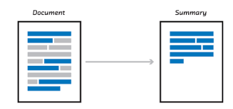
What is Text Summarization?
ref: https://medium.com/@ondenyi.eric/extractive-text-summarization-techniques-with-sumy-3d3b127a0a32

Slide 6
What is Text Summarization?
Text summarization is the process of shortening a set of data computationally, to create a subset (a summary) that represents the most important or relevant information within the original content.^{wikipedia}
Text summarization is the technique for generating a concise and precise summary of voluminous texts while focusing on the sections that convey useful information, and without losing the overall meaning.^{floydhub}
ref: https://medium.com/@ondenyi.eric/extractive-text-summarization-techniques-with-sumy-3d3b127a0a32

Slide 7
Various approaches for text summarization?
Extractive Summarization
Abstractive Summarization

Slide 8
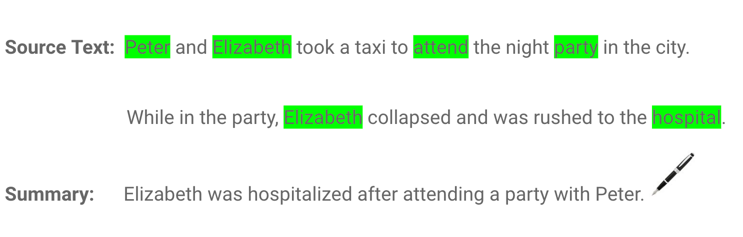
Various approaches for text summarization?
Extractive Summarization
Abstractive Summarization
ref: https://blog.floydhub.com/gentle-introduction-to-text-summarization-in-machine-learning/

Slide 9
Various approaches for text summarization?
Extractive Summarization
Extractive summarization means
identifying important sections
(paragraphs or sentences or
even words) of the text
and selecting (copy paste) them
producing a subset of the text
from the original text.
Abstractive Summarization
Abstractive summarization is the
technique of generating a summary
of a text from its main ideas, not by
copying verbatim most salient
sentences from text.
ref: https://blog.floydhub.com/gentle-introduction-to-text-summarization-in-machine-learning/

Slide 10
Approaching Extractive Summarization?

Slide 11
Approaching Extractive Summarization?
One approach could be to create a semantic representation of sentences.

Slide 12
Approaching Extractive Summarization?
One approach could be to create a semantic representation of sentences.
Following can be used to create a semantic representation for texts:
Count-based techniques like CountVectorizer, Tf-Idf Vectorizer

Slide 13
Approaching Extractive Summarization?
What is TF-IDF Vectorizer:

Slide 14
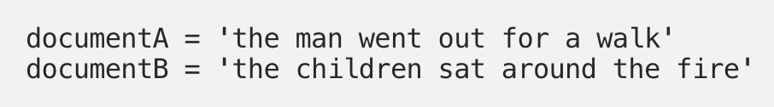
Approaching Extractive Summarization?
What is TF-IDF Vectorizer:

Slide 15
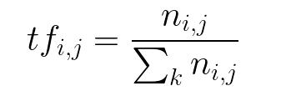
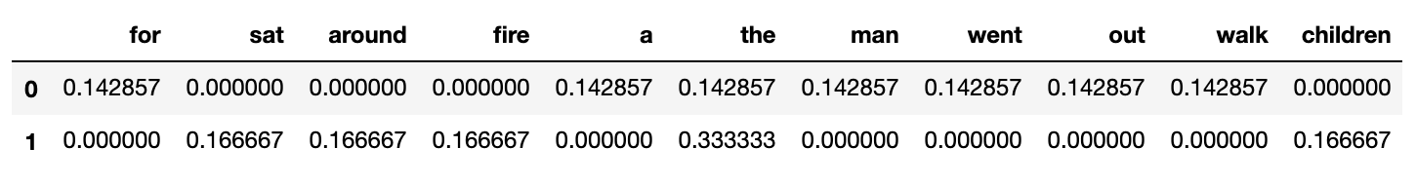
Approaching Extractive Summarization?
What is TF-IDF Vectorizer:
Count vectorization

Slide 16
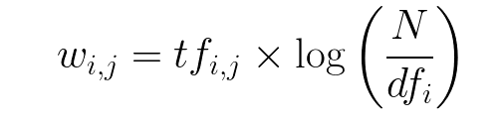
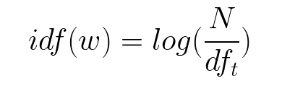
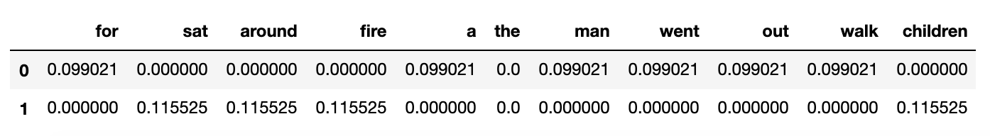
Approaching Extractive Summarization?
What is TF-IDF Vectorizer:
TF-IDF
Count vectorization
Inverse Document Frequency (IDF)

Slide 17
Approaching Extractive Summarization?
One approach could be to create a semantic representation of sentences.
Following can be used to create a semantic representation for texts:
Count-based techniques like CountVectorizer, Tf-Idf Vectorizer

Slide 18
Approaching Extractive Summarization?
One approach could be to create a semantic representation of sentences.
Following can be used to create a semantic representation for texts:
Count-based techniques like CountVectorizer, Tf-Idf Vectorizer
Pretrained word embeddings based techniques like Word2Vec

Slide 19
Approaching Extractive Summarization?
What is Word2Vec embedding:

Slide 20
Approaching Extractive Summarization?
What is Word2Vec embedding:
Embedding is something like key-value pair.

Slide 21
Approaching Extractive Summarization?
What is Word2Vec embedding:
Embedding is something like key-value pair.
For each word in our vocabulary, there will be a learned numerical representation for it.

Slide 22
Approaching Extractive Summarization?
What is Word2Vec embedding:
Embedding is something like key-value pair.
For each word in our vocabulary, there will be a learned numerical representation for it.
To handle unknown words, we will treat each of them as OOV (Out of vocabulary) words and will use the learned OOV representation.

Slide 23
Approaching Extractive Summarization?
What is Word2Vec embedding:
Embedding is something like key-value pair.
For each word in our vocabulary, there will be a learned numerical representation for it.
To handle unknown words, we will treat each of them as OOV (Out of vocabulary) words and will use the learned OOV representation.
Word2vec can utilize either of two model architectures to produce a distributed representation of words: continuous bag-of-words (CBOW) or continuous skip-gram.[wikipedia]

Slide 24
Approaching Extractive Summarization?
What is Word2Vec embedding:
Embedding is something like key-value pair.
For each word in our vocabulary, there will be a learned numerical representation for it.
To handle unknown words, we will treat each of them as OOV (Out of vocabulary) words and will use the learned OOV representation.
Word2vec can utilize either of two model architectures to produce a distributed representation of words: continuous bag-of-words (CBOW) or continuous skip-gram.[wikipedia]
Both of these techniques learn weights which act as word vector representations.

Slide 25
Approaching Extractive Summarization?
What is CBOW:

Slide 26
Approaching Extractive Summarization?
What is CBOW:
CBOW stands for continuous bag-of-words architecture:
Task is to predicts the current word from a window of surrounding context words.[wikipedia]
The order of context words does not influence prediction (bag-of-words assumption).[wikipedia]

Slide 27
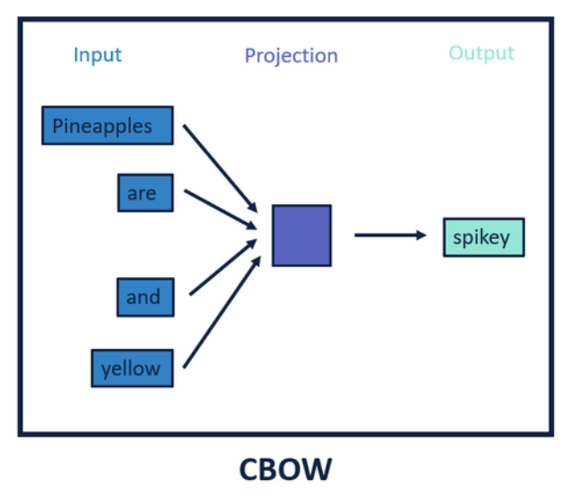
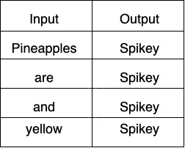
Approaching Extractive Summarization?
What is CBOW:
CBOW stands for continuous bag-of-words architecture:
Task is to predicts the current word from a window of surrounding context words.[wikipedia]
The order of context words does not influence prediction (bag-of-words assumption).[wikipedia]
CBOW
ref: https://community.alteryx.com/t5/Data-Science-Blog/Word2vec-for-the-Alteryx-Community/ba-p/305285

Slide 28
Approaching Extractive Summarization?
What is SKIP-GRAM:

Slide 29
Approaching Extractive Summarization?
What is SKIP-GRAM:
Continuous skip-gram architecture:
Task is to use the current word to predict the surrounding window of context words. [wikipedia]
The skip-gram architecture weighs nearby context words more heavily than more distant context words.[wikipedia]
According to the authors' note, CBOW is faster while skip-gram is slower but does a better job for infrequent words.[wikipedia]

Slide 30
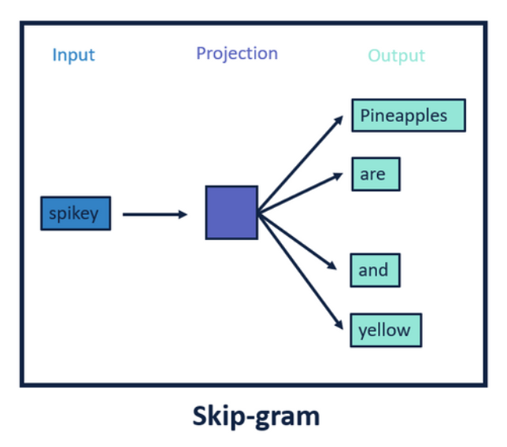
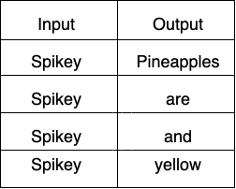
Approaching Extractive Summarization?
What is SKIP-GRAM:
Continuous skip-gram architecture:
Task is to use the current word to predict the surrounding window of context words. [wikipedia]
The skip-gram architecture weighs nearby context words more heavily than more distant context words.[wikipedia]
According to the authors' note, CBOW is faster while skip-gram is slower but does a better job for infrequent words.[wikipedia]
Skip-gram
ref: https://community.alteryx.com/t5/Data-Science-Blog/Word2vec-for-the-Alteryx-Community/ba-p/305285

Slide 31
Approaching Extractive Summarization?
Using Word2Vec Embedding

Slide 32
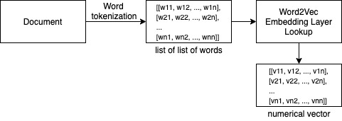
Approaching Extractive Summarization?
Using Word2Vec Embedding
Flow would be something like below one:
Using Word2Vec to convert text data to numerical semantic vector

Slide 33
Approaching Extractive Summarization?
One approach could be to create a semantic representation of sentences.
Following can be used to create a semantic representation for texts:
Count-based techniques like CountVectorizer, Tf-Idf Vectorizer
Pretrained word embeddings based techniques like Word2Vec, Glove, fastText

Slide 34
Approaching Extractive Summarization?
One approach could be to create a semantic representation of sentences.
Following can be used to create a semantic representation for texts:
Count-based techniques like CountVectorizer, Tf-Idf Vectorizer
Pretrained word embeddings based techniques like Word2Vec, Glove, fastText
Pretrained SOTA transformers like BERT (or its variants) to better capture context as well.

Slide 35
Approaching Extractive Summarization?
What is BERT:

Slide 36
Approaching Extractive Summarization?
What is BERT:
BERT stands for Bi-directional Encoder Representation from Transformers.
It is designed to pre-train deep bidirectional representations from unlabeled text by jointly conditioning on both left and right context.
BERT is pre-trained on two NLP tasks:
Masked Language Modeling
Next Sentence Prediction

Slide 37
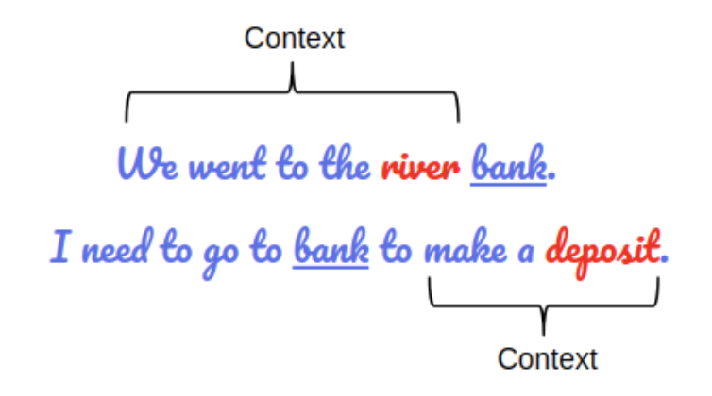
Approaching Extractive Summarization?
What is BERT:
BERT stands for Bi-directional Encoder Representation from Transformers.
It has two variants mainly:
BERT Base: 12 layers (transformer blocks), 12 attention heads, and 110 million parameters
BERT Large: 24 layers (transformer blocks), 16 attention heads and, 340 million parameters
BERT is pre-trained on two NLP tasks:
Masked Language Modeling
Next Sentence Prediction
ref: https://www.analyticsvidhya.com/blog/2019/09/demystifying-bert-groundbreaking-nlp-framework/

Slide 38
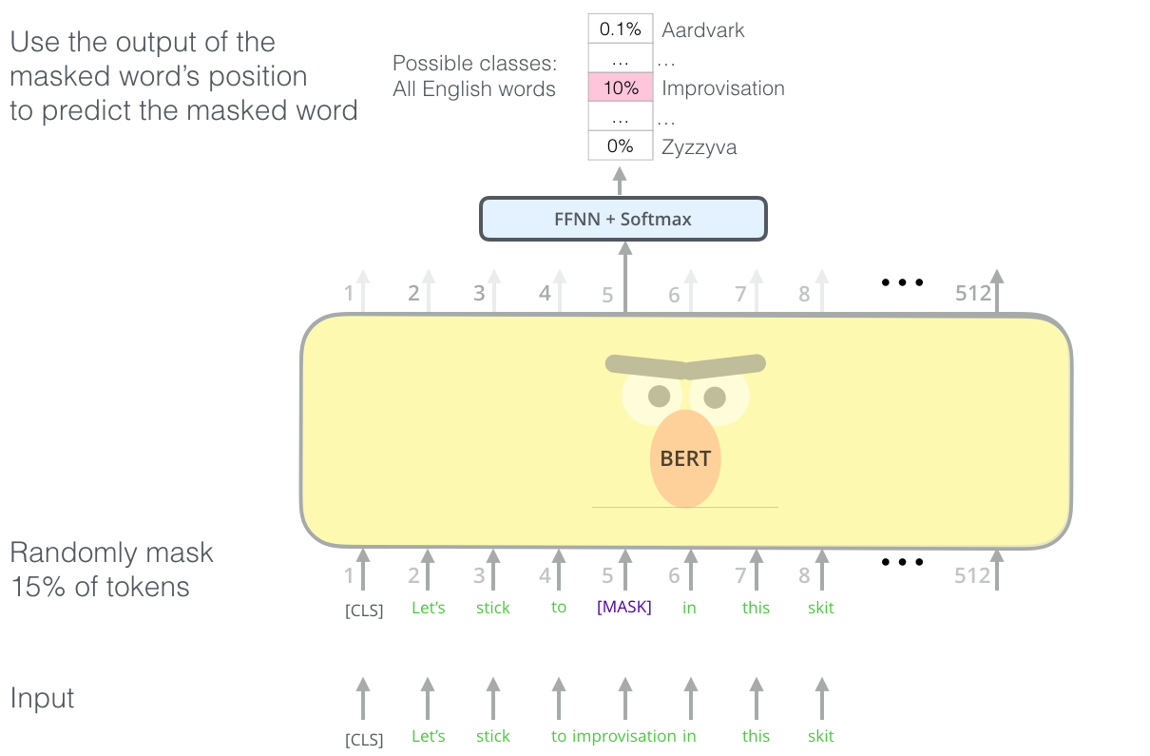
Approaching Extractive Summarization?
What is Masked Language Modeling:
BERT's clever language modeling task masks 15% of words in the input and asks the model to predict the missing word
ref: http://jalammar.github.io/illustrated-bert/

Slide 39
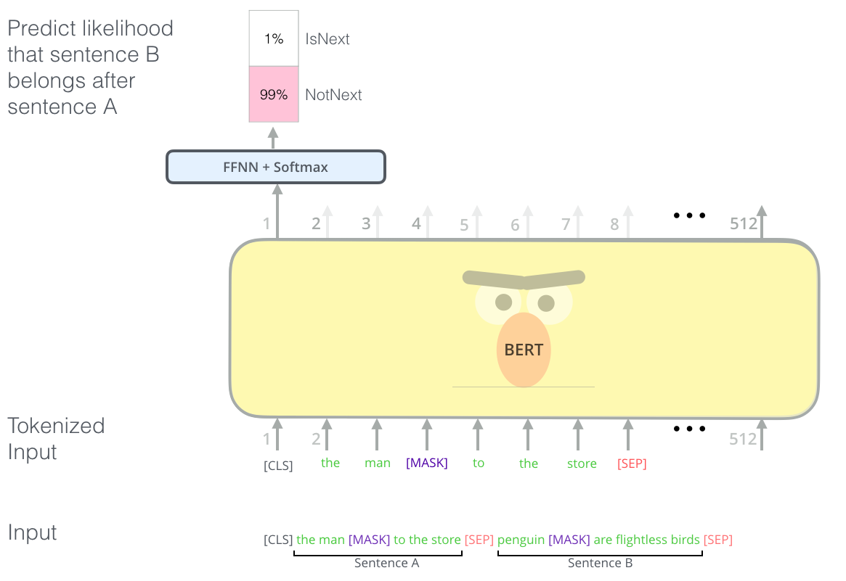
Approaching Extractive Summarization?
What is Next Sentence Prediction:
The second task BERT is pre-trained on is a two-sentence classification task. The tokenization is oversimplified in this graphic as BERT actually uses WordPieces as tokens rather than words --- so some words are broken down into smaller chunks.
ref: http://jalammar.github.io/illustrated-bert/

Slide 40
Approaching Extractive Summarization?
Using BERT for feature extraction

Slide 41
Approaching Extractive Summarization?
Using BERT for feature extraction
Feed the text to BERT Wordpiece Tokenizer

Slide 42
Approaching Extractive Summarization?
Using BERT for feature extraction
Feed the text to BERT Wordpiece Tokenizer
BERT tokenizer will split the sentence as well as words incase needed to match vocabulary.

Slide 43
Approaching Extractive Summarization?
Using BERT for feature extraction
Feed the text to BERT Wordpiece Tokenizer
BERT tokenizer will split the sentence as well as words incase needed to match vocabulary.
Words are splitted on the basis of their probability of occurrences in that context which gives BERT advantages to handle contraction as well as spelling errors

Slide 44
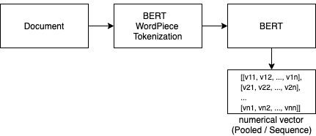
Approaching Extractive Summarization?
Using BERT for feature extraction
Feed the text to BERT Wordpiece Tokenizer
BERT tokenizer will split the sentence as well as words incase needed to match vocabulary.
Words are splitted on the basis of their probability of occurrences in that context which gives BERT advantages to handle contraction as well as spelling errors
Flow would be something like below one:
Using BERT to convert text data to numerical vector

Slide 45
Approaching Extractive Summarization?
One approach could be to create a semantic representation of sentences.
Following can be used to create a semantic representation for texts:
Count-based techniques like CountVectorizer, Tf-Idf Vectorizer
Pretrained word embeddings based techniques like Word2Vec, Glove, fastText
Pretrained SOTA transformers like BERT (or its variants) to better capture context as well.

Slide 46
Approaching Extractive Summarization?
One approach could be to create a semantic representation of sentences.
Following can be used to create a semantic representation for texts:
Count-based techniques like CountVectorizer, Tf-Idf Vectorizer
Pretrained word embeddings based techniques like Word2Vec, Glove, fastText
Pretrained SOTA transformers like BERT (or its variants) to better capture context as well.
Train your own (quite cumbersome :( )

Slide 47
Approaching Extractive Summarization?
One approach could be to create a semantic representation of sentences.
Following can be used to create a semantic representation for texts:
Count-based techniques like CountVectorizer, Tf-Idf Vectorizer
Pretrained word embeddings based techniques like Word2Vec, Glove, fastText
Pretrained SOTA transformers like BERT (or its variants) to better capture context as well.
Train your own (quite cumbersome :( )
Now comparison can be done between each sentences as they are no more a sequence of characters and words but a numerical vector now.

Slide 48
Approaching Extractive Summarization?
One approach could be to create a semantic representation of sentences.
Following can be used to create a semantic representation for texts:
Count-based techniques like CountVectorizer, Tf-Idf Vectorizer
Pretrained word embeddings based techniques like Word2Vec, Glove, fastText
Pretrained SOTA transformers like BERT (or its variants) to better capture context as well.
Train your own (quite cumbersome :( )
Now comparison can be done between each sentences as they are no more a sequence of characters and words but a numerical vector now.
Use the comparisons to score each sentences and pick the top scored ones as your
summary.

Slide 49
Approaching Extractive Summarization?
One approach could be to create a semantic representation of sentences.
Following can be used to create a semantic representation for texts:
Count-based techniques like CountVectorizer, Tf-Idf Vectorizer
Pretrained word embeddings based techniques like Word2Vec, Glove, fastText
Pretrained SOTA transformers like BERT (or its variants) to better capture context as well.
Train your own (quite cumbersome :( )
Now comparison can be done between each sentences as they are no more a sequence of characters and words but a numerical vector now.
Use the comparisons to score each sentences and pick the top scored ones as your
summary.
Scoring technique needs to be intelligent enough to properly evaluate what are the
information content of a sentence and thus score it accordingly.

Slide 50
Approaching Extractive Summarization?
Let’s build our basic Solution

Slide 51
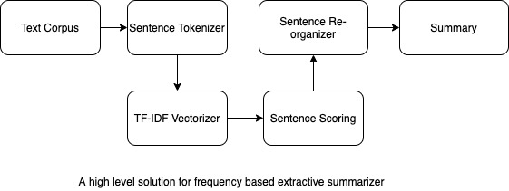
Approaching Extractive Summarization?

Slide 52
Approaching Extractive Summarization?
Sentence scoring using TF-IDF:

Slide 53
Approaching Extractive Summarization?
Sentence scoring using TF-IDF:
TF-IDF

Slide 54
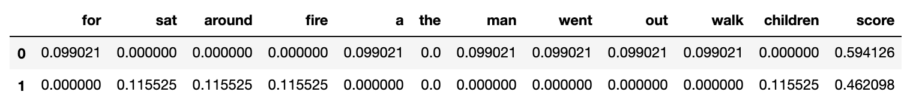
Approaching Extractive Summarization?
Sentence scoring using TF-IDF:
TF-IDF
Adding TF-IDF weights to score each sentence

Slide 55
Approaching Extractive Summarization?

Slide 56
Approaching Extractive Summarization?
What is Sentence Reorganizer:
Text : Stop Words are words which do not contain important significance to be used in Search Queries. Usually, these words are filtered out from search queries because they return a vast amount of unnecessary information. Each programming language will give its own list of stop words to use.

Slide 57
Approaching Extractive Summarization?
What is Sentence Reorganizer:
Text : Stop Words are words which do not contain important significance to be used in Search Queries. Usually, these words are filtered out from search queries because they return a vast amount of unnecessary information. Each programming language will give its own list of stop words to use.
Sentence Order Indexing : { “Stop Words are words which do not contain important significance to be used in Search Queries”: 0,
“Usually, these words are filtered out from search queries because they return a vast amount of unnecessary information”: 1 ,
“Each programming language will give its own list of stop words to use”: 2 }

Slide 58
Approaching Extractive Summarization?
What is Sentence Reorganizer:
Sentence Order Indexing : { “Stop Words are words which do not contain important significance to be used in Search Queries”: 0,
“Usually, these words are filtered out from search queries because they return a vast amount of unnecessary information”: 1 ,
“Each programming language will give its own list of stop words to use”: 2 }
Scored Sentences : { “Each programming language will give its own list of stop words to use”: 1.32 ,
“Stop Words are words which do not contain important significance to be used in Search Queries”: 0.79,
“Usually, these words are filtered out from search queries because they return a vast amount of unnecessary information”: 0.32 }
Result : Stop Words are words which do not contain important significance to be used in Search Queries. Each programming language will give its own list of stop words to use.

Slide 59

Let’s be practical…….
Fire up your Notebooks

Slide 60
Any Questions ?

Slide 61
Thank You

