Slide 1


CS 174A
Discussion-Week 7
2/14/2020

Slide 2
Collision Detection

Slide 3
Collision Detection
Basic idea: We perform collision detection by computing whether one primitive intersects another.
One way is to compare all the triangles in the scene
This is certainly not ideal since it is very computationally expensive
We also don’t care about collision of unrelated triangles
If we cleverly stick to object that we need to compare, comparing triangles still requires a lot of comparisons
Say we have 10 objects, each comprised of 100 triangles. This requires several thousands of comparisons
Can we come up with a smarter way ?

Slide 4
Collision Detection
We can define some standard object representation, a.k.a bounding volume, to check for collisions
A sphere can be considered as the simplest bounding volume.
Certainly not an exact representation, but it provides a cheap way of checking for collision
If a collision is detected, a more through check can be done (e.i. We spend the resources where needed)

Slide 5
Object Representations
Axis Aligned Bounding Box (AABB)
The Simplest and fastest intersection test
How to check whether point in AABB:
Simply along each axes, check if each coordinate falls in the range
function isPointInsideAABB(point, box) {
return (point.x >= box.minX && point.x <= box.maxX) &&
(point.y >= box.minY && point.y <= box.maxY) &&
(point.z >= box.minZ && point.z <= box.maxZ); }

Slide 6
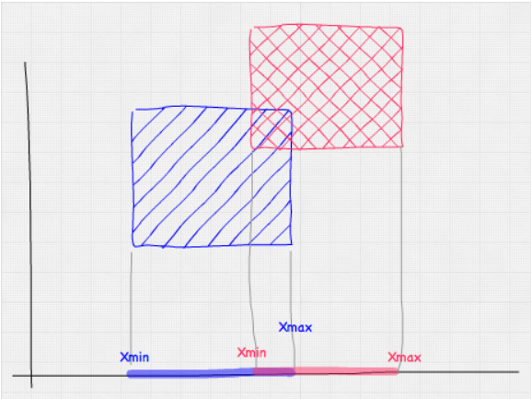
Object Representations
Axis Aligned Bounding Box (AABB)
Checking for interesting is as simple as checking, in each axis, whether there’s an overlap between the ranges
function intersect(a, b) {
return (a.minX <= b.maxX && a.maxX >=b.minX)&&
(a.minY <= b.maxY && a.maxY >= b.minY) &&
(a.minZ <= b.maxZ && a.maxZ >= b.minZ); }

Slide 7
Object Representations
Bounding Sphere
A bit more complicated than AABB but doable
Advantage: it is rotation invariant
Disadvantage: it can encapsulate spherical objects
How to check whether point in Sphere:
function isPointInsideSphere(point, sphere) {
var distance = Math.sqrt((point.x - sphere.x) * (point.x -sphere.x) +
(point.y - sphere.y) * (point.y - sphere.y) +
(point.z - sphere.z) * (point.z - sphere.z));
return distance < sphere.radius; }

Slide 8
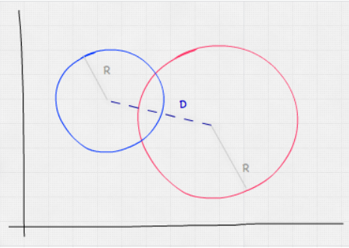
Object Representations
Bounding sphere collision check
function intersect(sphere, other) {
var distance = Math.sqrt((sphere.x - other.x) * (sphere.x - other.x) +
(sphere.y - other.y) * (sphere.y - other.y) +
(sphere.z - other.z) * (sphere.z - other.z));
return distance < (sphere.radius + other.radius); }

Slide 9
Texture Mapping

Slide 10
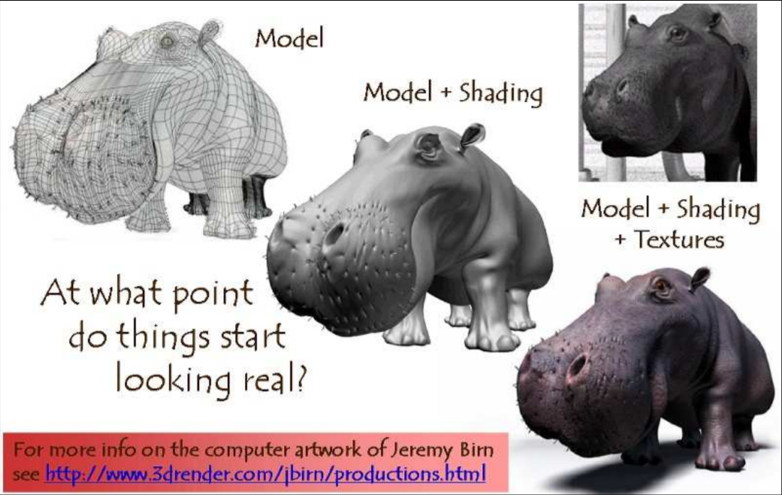
Texture Mapping
There are small surface details on real objects that need to be taken into account for better realism.

Slide 11
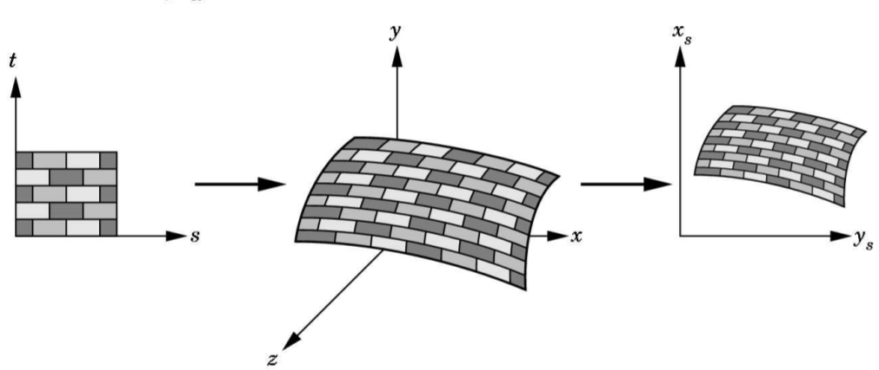
Texture Mapping
To take these into account apply texture to our images to make the surfaces realistic
We can scan textures from real world or paint them
Store the texture as a 2D image
We map the texture to object space and then screen space

Slide 12
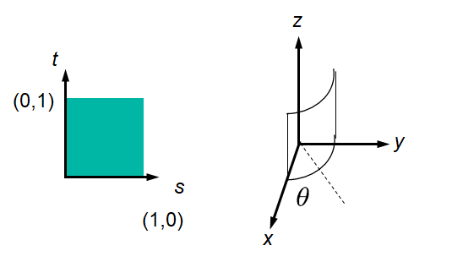
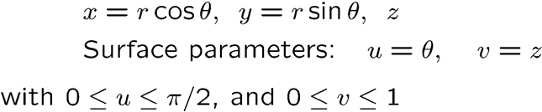
Texture Mapping
A practical approach is to do the screen to texture transformation (so that we don’t have to deal with pixel coverage issues)
Some texture to object transformations
Square to cylinder

Slide 13
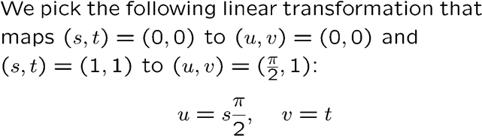
Texture Mapping
A practical approach is to do the screen to texture transformation (so that we don’t have to deal with pixel coverage issues)
Some texture to object transformations
Square to cylinder

Slide 14
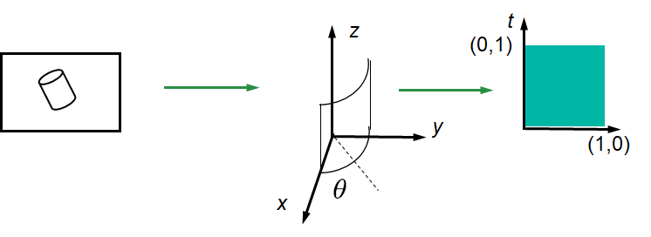
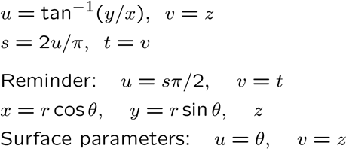
Texture Mapping
A practical approach is to do the screen to texture transformation (so that we don’t have to deal with pixel coverage issues)
From screen to texture:
Inverse the transform (s_x,s_y) to get the world (x,y,z)
With (x,y,z):

Slide 15
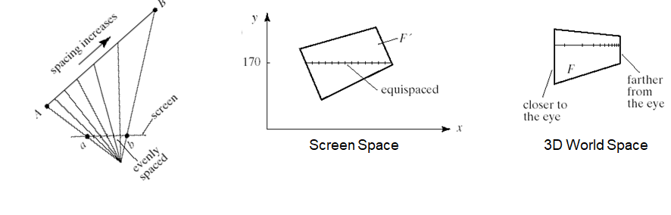
Rendering the Texture
Intuitively speaking, only vertices are sent down to the graphics pipeline so we need to interpolate the texture coordinates
This is done by a scanline in screen space
It is had its own issues such as perspective foreshortening (why ?)

Slide 16
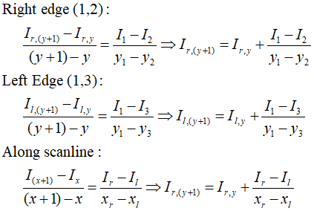
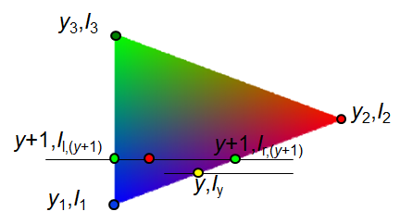
Rendering the Texture
How do we correctly figure out the texture coordinates ?
Interpolate along the scanline
Perform perspective division after interpolation

Slide 17
Multiple Choice
Which of the following is correct ?
Textures are applied in the vertex processing stage of the graphics pipeline
Texture coordinates are typically assigned at vertices and interpolated to the interior of a triangle
Bump mapping can correct the distortion problems that occurred when applying a wood image map to a 3D object
Only b and c
a , b and c

Slide 18
Multiple Choice
Texture coordinates are typically assigned at vertices and interpolated to the interior of a triangle.
True
False

Slide 19
Project

Slide 20
Project Rules
Don’t use Three.js
Don’t use any external application for generating matrix transformations
You may use external applications for generating 3D object files
Cite any code which is not your own (stackoverflow etc)

Slide 21
Tiny-Graphics Examples
Lots of free code in the following repo: https://github.com/encyclopedia-of-code/tiny-graphics-js
For making shapes:
Grid_Patch
Surface_Of_Revolution
copy_onto_graphics_card() method
See demo Surface_Of_Revolution

Slide 22
Tiny-Graphics Examples
For motion:
For each moving object, we need to store:
Model Matrix
Give the model transform matrix a "velocity" and track it over time
Need to split it up into angular and linear components so you can scale angular speed
Check out the inertia demo
Collision:
Use AABB or bounding sphere ( appropriately) for checking the collision between your objects and create a more realistic looking scene
You may want to incorporate some very simple physics (e.g. corresponding forces on each object) for simulating collision

Slide 23
Tiny-Graphics Examples
Scene timing ideas:
Use if statements for switching scenes
Keep multiple copies of the animation_time variable with different offsets subtracted from it.
Name the copies like "time since (scene #17) started"
If it’s negative, the scene shouldn’t start yet, so skip those lines for this frame
If it's positive, you know to proceed with the lines of code that animate that scene
If it’s too positive, it’s past the scene’s end time, so manually overwrite it to some negative number, making the scene go away again

Slide 24
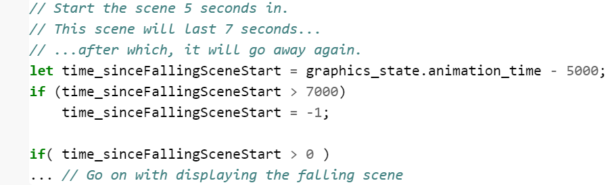
Tiny-Graphics Examples
Scene timing ideas:
Use if statements for switching scenes
Keep multiple copies of the animation_time variable with different offsets subtracted from it.

Slide 25
Tiny-Graphics Examples
If your program is interactive:
May want less of a time-dependent scene system -- and more of a finite state machine (FSM)
Conditionals in your display() function would consult the state before proceeding with any drawing code sections.
Certain key inputs will change your state variable to a different enum value, causing those if's to act differently.
Multiple offset copies of your time variable will again be needed to track how long each animation has been going on for, so you can change state once it's done.

Slide 26
Tiny-Graphics Examples
What are some advanced features ?
Raytracing
Shadowing
Mirroring
Collision detection
Scene graphs
Physics-based simulation
What can’t be considered as advanced features ?
Matrix transformations
Lighting
Textures

Slide 27
Thank you!

