Slide 1


CS 174A
Discussion-Week 9
3/6/2020

Slide 2
Curves

Slide 3
Curves
Can you identify Bezier curves and B-splines in the following?

Slide 4

Bezier Curves
Bezier curves allow for smooth splines with incredible flexibility via control points that determine the shape of graph between different poses.

Slide 5
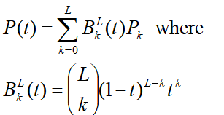
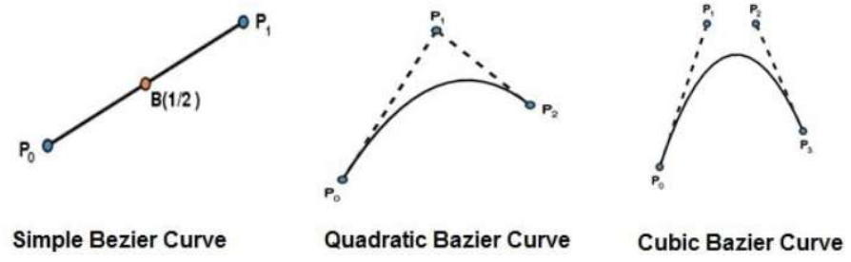
Bezier Curves
A Bezier curve is a parametric curve which employs Bernstein polynomials as basis and can be formally defined according to

Slide 6
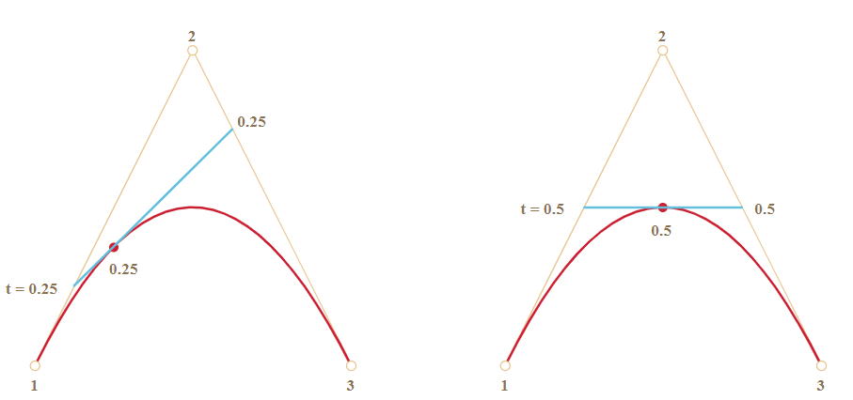
Bezier Curves
How do you even a Bezier curve ? Let’s discuss… (De Casteljau algorithm)
https://javascript.info/bezier-curve

Slide 7
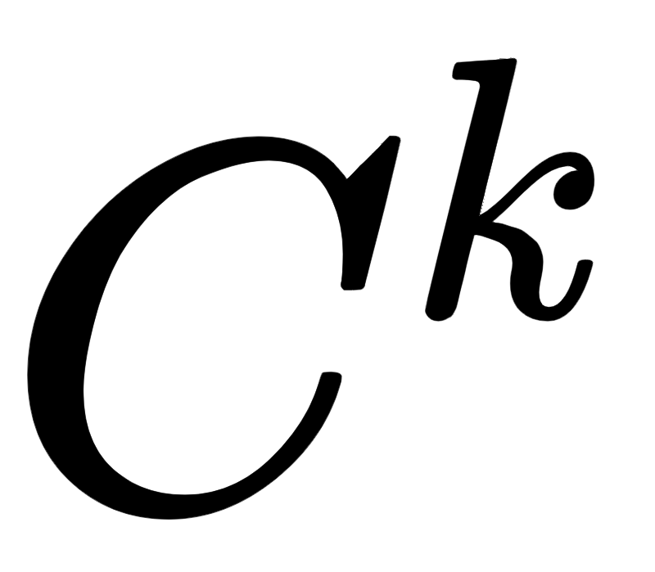

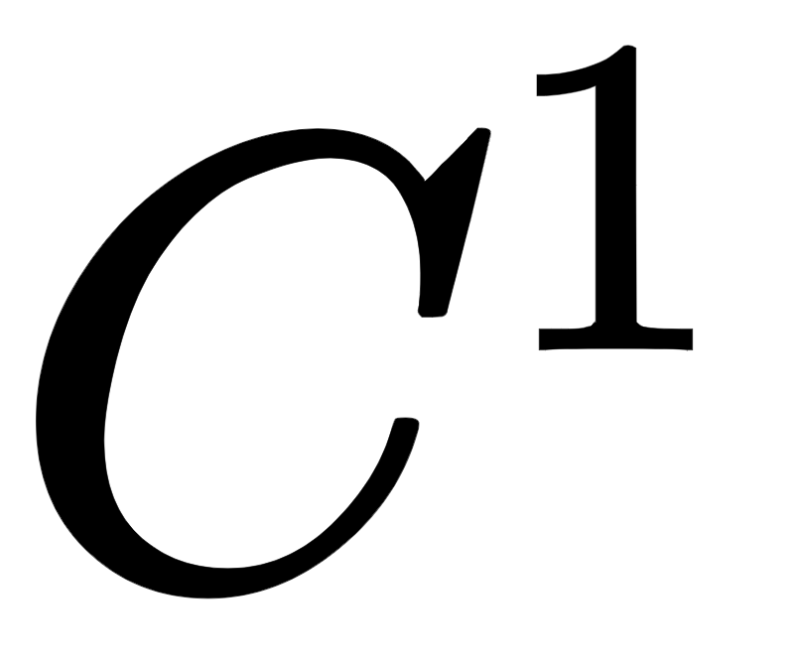
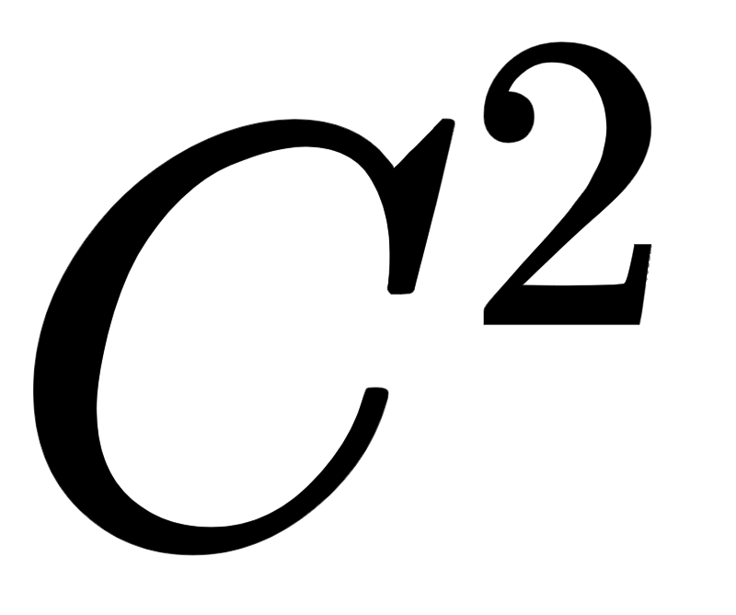
Continuity of Curves
Here the notion of parametric continuity implies that:
Each coordinate function of the curve is differentiable k times.
And each is continuous through the kth derivative.
Hermite has guaranteed continuity.
Catmull-Rom has guaranteed continuity.
B-spline has guaranteed continuity.

Slide 8
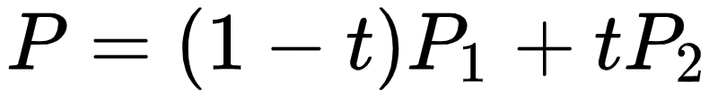
Bezier Curves
Let’s talk about math. Here, P1,P2 and P3 represents the coordinates of the desired control points.
For a 2-point curve:
For a 3-point curve:
For 4 control points:
https://javascript.info/bezier-curve

Slide 9
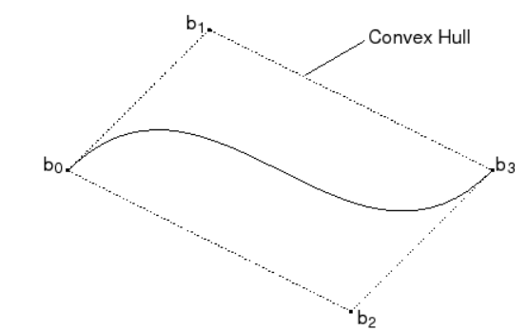
Properties of Bezier Curves
Degree of Bezier curve = number of control points-1.
A curve is always inside the convex hull of control points.
points don’t have to be on the curve , except for the first and last curve
This convex hull property for a Bezier curve enables the polynomial smoothly follows the control points ( This is important !)

Slide 10
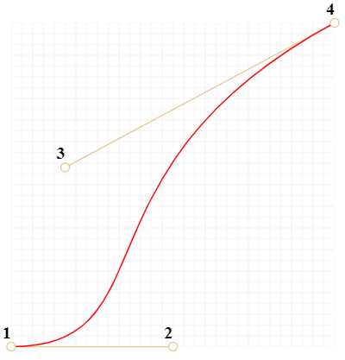
Properties of Bezier Curves
They are invariant under an affine transformation.
Bezier curves exhibit global control means moving a control point alters the shape of the whole curve.
Bezier curves are always tangent to the first and last edges of control polyline.

Slide 11
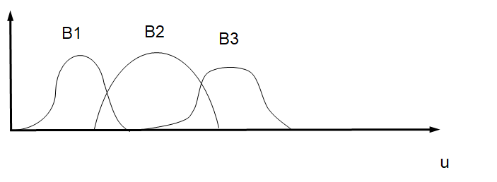
Disadvantages of Bezier Curves
The number of control points fixes the order of the resulting polynomial which defines the curve.
For large number of control points, it is computationally expensive.
The value of the blending function is non-zero for all parameter values over the entire curve.
Local control over the segments of curve is not possible.

Slide 12
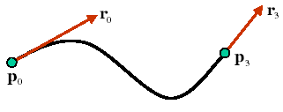
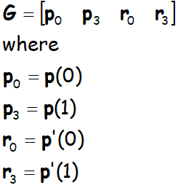
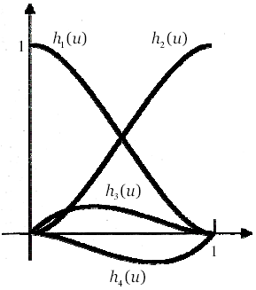
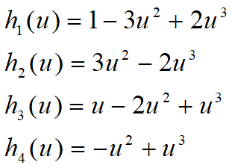
Hermite
In Hermite splines, every blending function is cubic.
Hermite has guaranteed continuity.
We need 4 geometric constraints.

Slide 13
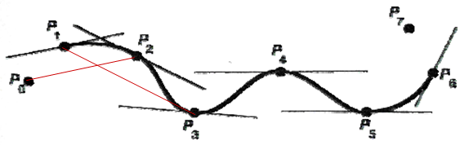
Catmull-Rom
In Catmull-Rom, every blending function is cubic and the tangent at each point is calculated using the previous and next point on the spline.
Catmull-Rom has guaranteed continuity.
Define tangents r_{i} = s (p_{i+1} – p_{i-1})

Slide 14
B-Splines
B-splines curve allow more flexibility and local control for creating complex shapes.

Slide 15


B-Splines
An order k B-spline curve is defined by joining several pieces of polynomials of degree k-1 according to
Here P_i are control points.
N_i,k are normalized B-spline blending functions (k>1):
Base:

Slide 16
Properties of B-Splines
No invariance under perspective transformation
C2 continuous
The sum of the B-spline basis functions for any parameter value is 1.
Each basis function is positive or zero for all parameter values.
The degree of B-spline polynomial is independent on the number of vertices of defining polygon.
B-spline allows the local control over the curve surface because each vertex affects the shape of a curve only over a range of parameter values where its associated basis function is nonzero.
The curve line within the convex hull of its defining polygon.

Slide 17


Multiple Choice Questions
Under what condition can we expect a continuity for two joined cubic Bezier curves, given points p0, p1, p2, p3 and q0, q1, q2, q3 ? (note that the order of points in each segment is from left to right as written in the above.)
Hint:
p3 − p2 = q1 − q0
p3 − p2 = q3 − q2
p3 − p0 = q1 − q0
p3 − p0 = q3 − q0

Slide 18
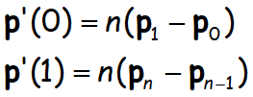
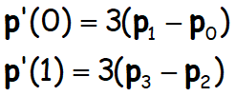
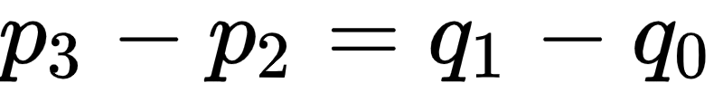
Multiple Choice Questions
Under what condition can we expect a continuity for two joined cubic Bezier curves, given points p0, p1, p2, p3 and q0, q1, q2, q3 ? (note that the order of points in each segment is from left to right as written in the above.)
Hint:
Answer: The derivative at endpoints are:

Slide 19
References & Interesting Resources
https://www.autodesk.com/products/fusion-360/blog/sketch-control-point-splines-faq/
http://web.mit.edu/hyperbook/Patrikalakis-Maekawa-Cho/node16.html#1115
https://en.wikipedia.org/wiki/Convex_hull
https://javascript.info/bezier-curve
https://www.tutorialspoint.com/computer_graphics/computer_graphics_curves.htm
https://pages.mtu.edu/~shene/COURSES/cs3621/NOTES/spline/Bezier/bezier-der.html

Slide 20
Thank you!

