Slide 1
String
String is a sequence of characters. In java, objects of String are immutable which means a constant and cannot be changed once created.
There are 2 ways to create a String in Java:
String literal:
String s = “aha trainings”;
Using new keyword:
String s = new String(“aha trainings”);

Slide 2
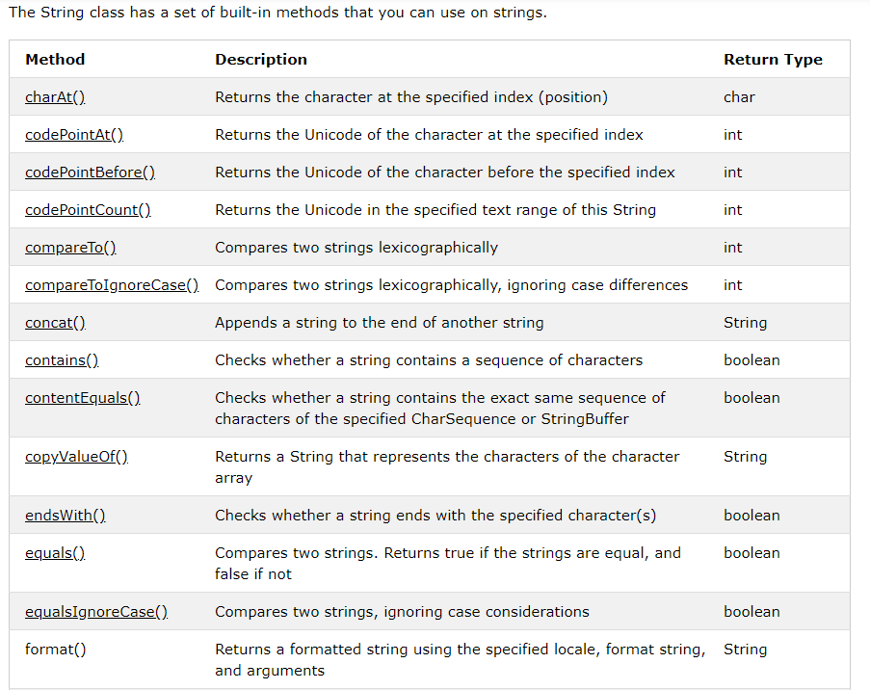

Slide 3
Access Specifiers
In Java, methods and data members of a class/interface can have one of the following four access specifiers. The access specifiers are listed according to their restrictiveness order.
1) private (accessible within the class where defined) 2) default or package private (when no access specifier is specified) 3) protected 4) public (accessible from any class)
But, the classes and interfaces themselves can have only two access specifiers when declared outside any other class. 1) public 2) default (when no access specifier is specified)

Slide 4
Java - What is OOP?
OOP stands for Object-Oriented Programming.
Provides a paradigm to simplifies the development and maintenance of a Software. Here are the main concepts of OOPS:
Object-oriented programming has several advantages:
OOP is faster and easier to execute
OOP provides a clear structure for the programs
OOP helps to keep the Java code easier to maintain, modify and debug
OOP makes it possible to create reusable components with less code and shorter development time

Slide 5
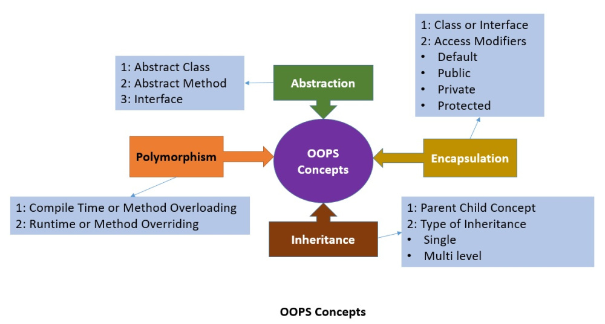

Slide 6
Abstraction
Abstraction is the concept of hiding the internal details and describing things in simple terms. For example, a method that adds two integers. The internal processing of the method is hidden from the outer world. There are many ways to achieve abstraction in object-oriented programming's, such as encapsulation and inheritance.

Slide 7
Encapsulation
Encapsulation is the technique used to implement abstraction in object-oriented programming. Encapsulation is used for access restriction to class members and methods.
Access modifier keywords are used for encapsulation in object oriented programming. For example, encapsulation in java is achieved using private, protected and public keywords

Slide 8
Polymorphism
Polymorphism is the concept where an object behaves differently in different situations. There are two types of polymorphism – compile time polymorphism and runtime polymorphism.
Compile-time polymorphism is achieved by method overloading.

Slide 9
Method Overloading(Compile Time Polymorphism)
public class Circle {
public void draw(){
System.out.println(“Circles draw”);
}
public void draw(int diameter)
{
System.out.println(“Circles draw with diameter”+diameter);
}
}

Slide 10
Method Overriding (Runtime Polymorphism)
Runtime polymorphism is implemented when we have an “IS-A” relationship between objects. This is also called a method overriding because the subclass has to override the superclass method for runtime polymorphism.
If we are working in terms of the superclass, the actual implementation class is decided at runtime. The compiler is not able to decide which class method will be invoked. This decision is done at runtime, hence the name as runtime polymorphism or dynamic method dispatch.

Slide 11
Inheritance
Inheritance is the object-oriented programming concept where an object is based on another object. Inheritance is the mechanism of code reuse. The object that is getting inherited is called the superclass and the object that inherits the superclass is called a subclass.
We use extends keyword in java to implement inheritance.

Slide 12
Below is a simple example of inheritance in java.
class SuperClassA
{
public void foo()
{
System.out.println("SuperClassA");
}
}
class SubClassB extends SuperClassA
{
public void bar(){
System.out.println("SubClassB");
}
}
public class Test {
public static void main(String args[]){
SubClassB a = new SubClassB();
a.foo();
a.bar();
}
}

