Slide 1
Selenium
Selenium is collection of tools and libraries that enable and support the automation of web browsers.
Selenium is a popular open-source test automation tool.
Selenium controls web browsers.
It allows users to simulate common activities performed by end-users; entering text into fields, selecting drop-down values and checking boxes, and clicking links in documents. It also provides many other controls such as mouse movement, arbitrary JavaScript execution, and much more.

Slide 2
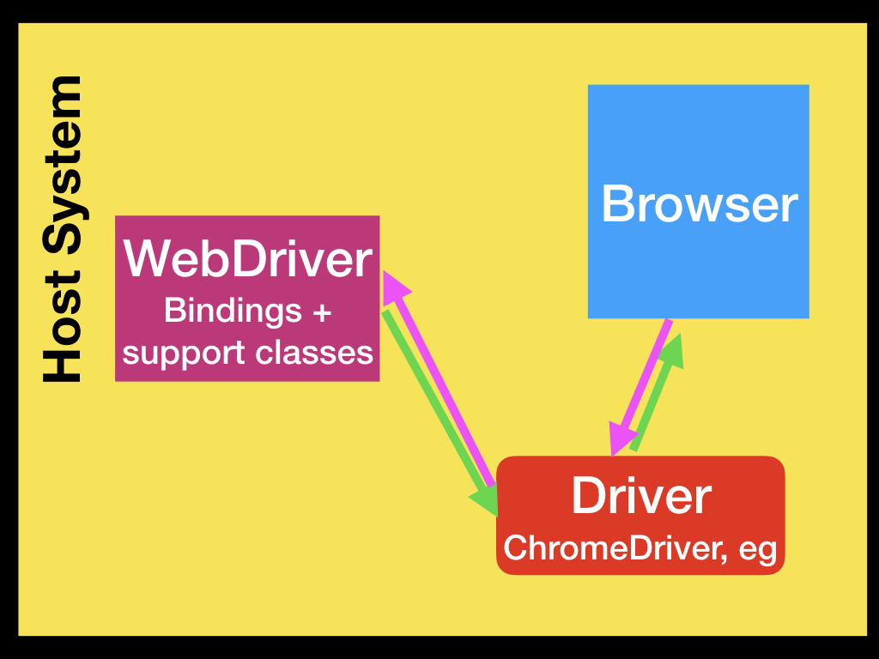
Selenium WebDriver
If you want to create robust, browser-based regression automation suites and tests, scale and distribute scripts across many environments, then you want to use Selenium WebDriver, a collection of language specific bindings to drive a browser - the way it is meant to be driven.

Slide 3
Terminology
API: Application Programming Interface. This is the set of “commands” you use to manipulate WebDriver.
Library: Code which contains the APIs and the code necessary to implement them. For eg: Jar files for Java
Driver: Responsible for controlling the browser. Eg: Selenium WebDriver
Framework: An additional library used as a support for WebDriver suites. These frameworks may be test frameworks such as Junit, Cucumber and NUnit.

Slide 4
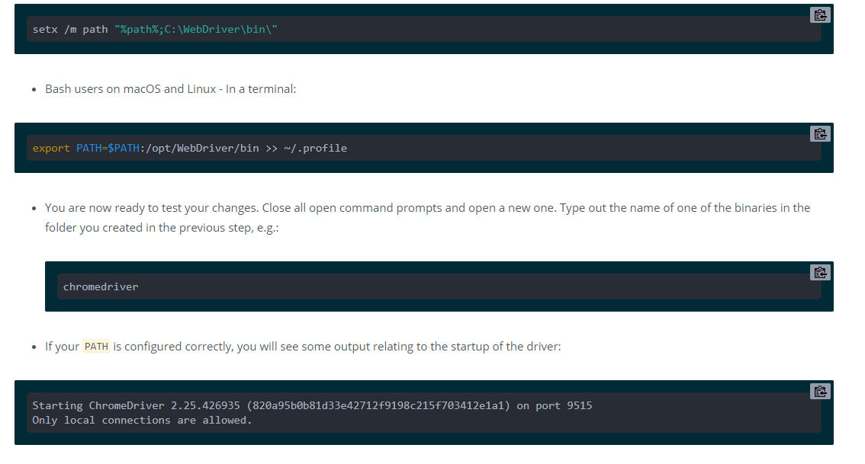
Driver Setup
Selenium supports all major browsers on the market such as Chrome, Firefox, Internet Explorer, Opera, and Safari
Download Chrome drivers here https://chromedriver.chromium.org/downloads
Adding Executables to your PATH

Slide 5
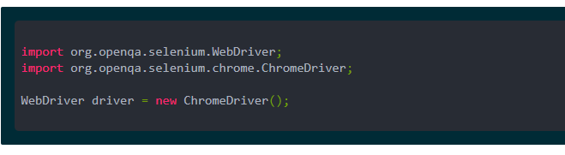
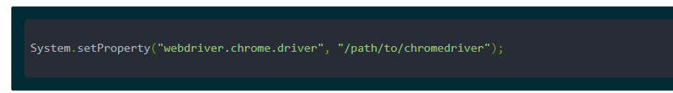
When chromedriver is available on your path, you should be able to execute the chromedriver executable from any directory.
To instantiate a Chrome session, you can do the following:

Slide 6
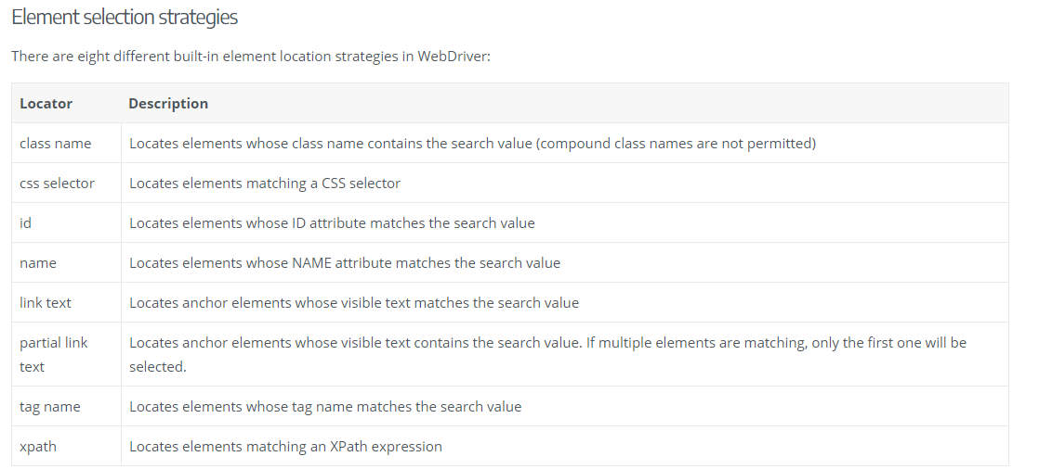
Locating Elements

Slide 7
Web element
WebElement represents a DOM element.
WebDriver API provides built-in methods to find the WebElements which are based on different properties like ID, Name, Class, XPath, CSS Selectors, link Text, etc.
Find Element:
It is used to find an element and returns a first matching single WebElement reference, that can be used for future element actions
// Get search box element from webElement ‘a' using Find Element
WebElement searchBox = driver.findElement(By.name(“a”));
//Find Elements returns the list of elements
List<WebElement> elements = driver.findElements(By.tagName("p"));

