Slide 1
Propagator Type Inferencer
Katherine Fang, Drew Haven,
Casey McNamara

Slide 2
Overview
Added ability to keep track of types to evaluator from pset 3
User never explicitly declares types – inferencer figures them out
Propagators compute types based on constraints imposed by the syntax of the user’s program

Slide 3
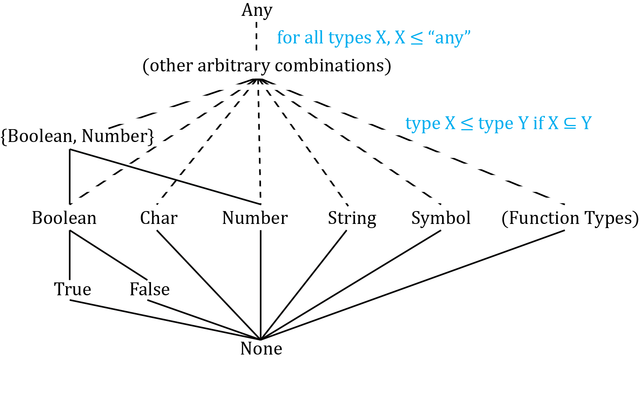
Type Lattice

Slide 4
Type Cells
Normal case: cell holds type interval directly
Procedure: cell holds
(input-cells . output-cell)
type interval: like a numerical interval,
but the ≤ relation is based on the type lattice.

Slide 5
Evaluator Changes: Environment
Normal environment:
#((x y z) (1 2 #f) parent-env)
Our environment:
#((x y z) (1 2 #f)
(x-type-cell y-type-cell z-type-cell)
parent-env)
These are propagator cells holding type intervals.

Slide 6
Evaluator Changes: type-extract
New special form
(defhandler eval
(lambda (expression environment)
(let ((cell (type-eval
(type-expr expression)
environment)))
(run)
(content cell)))
type-extract? any?)

Slide 7
type-eval
Takes an expression and environment
Returns a propagator cell
Holds the type of the output of the expression
Is hooked up to other type cells via constraints
(type-eval '(+ 3 4) environment)
> type cell constrained ≤ the return type of +

Slide 8
type-apply
2 kinds of procedures
Primitive procedures
Compound procedures (starting as unbuilt-procedures)
Type-apply
Builds procedure type
Constrains input types, returns output type

Slide 9
Demo

